Slide 1


Kickapoo tribe In Kansas brownfields/ tribal response Drone Program
Craig wahwahsuck

Slide 2

Drone pilot ground school
The Recreational UAS Safety Test (TRUST) Completion Certificate
FAA Part 107 compliance required for tribal program work on Reservation land
Surveying and mapping
Brownfields site/ open dumps
Aerial photos and video
Built-in safety protocols
Flight range and battery life

Slide 3
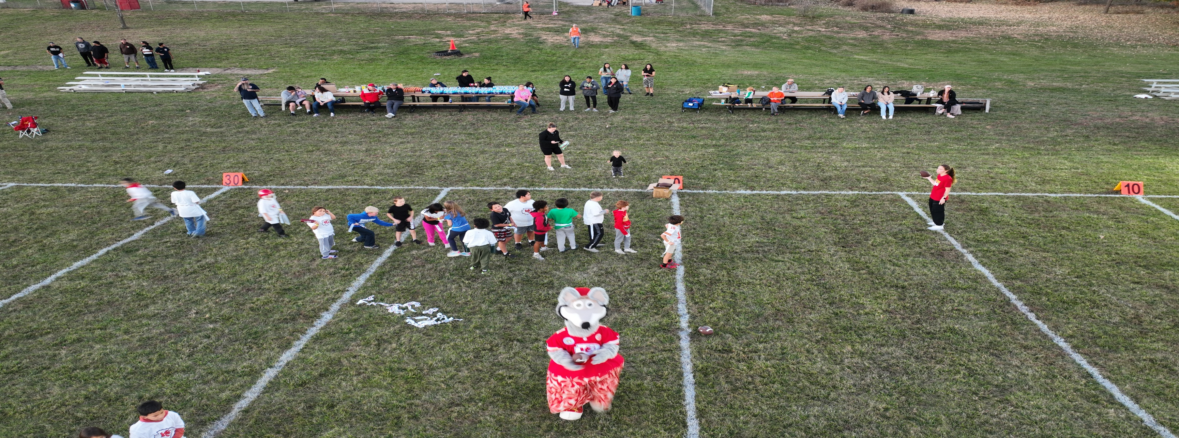
Drone can be used for all Tribal needs

Slide 4
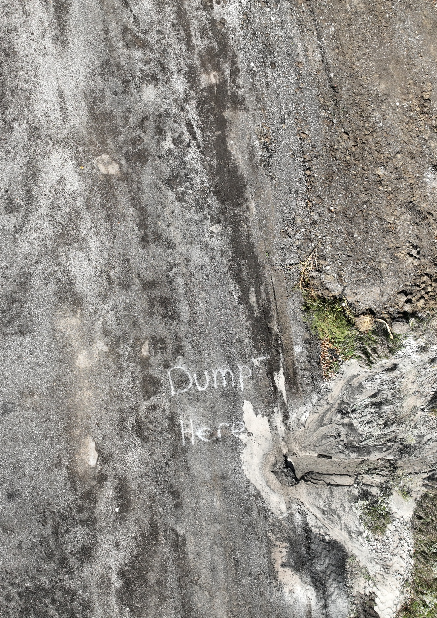
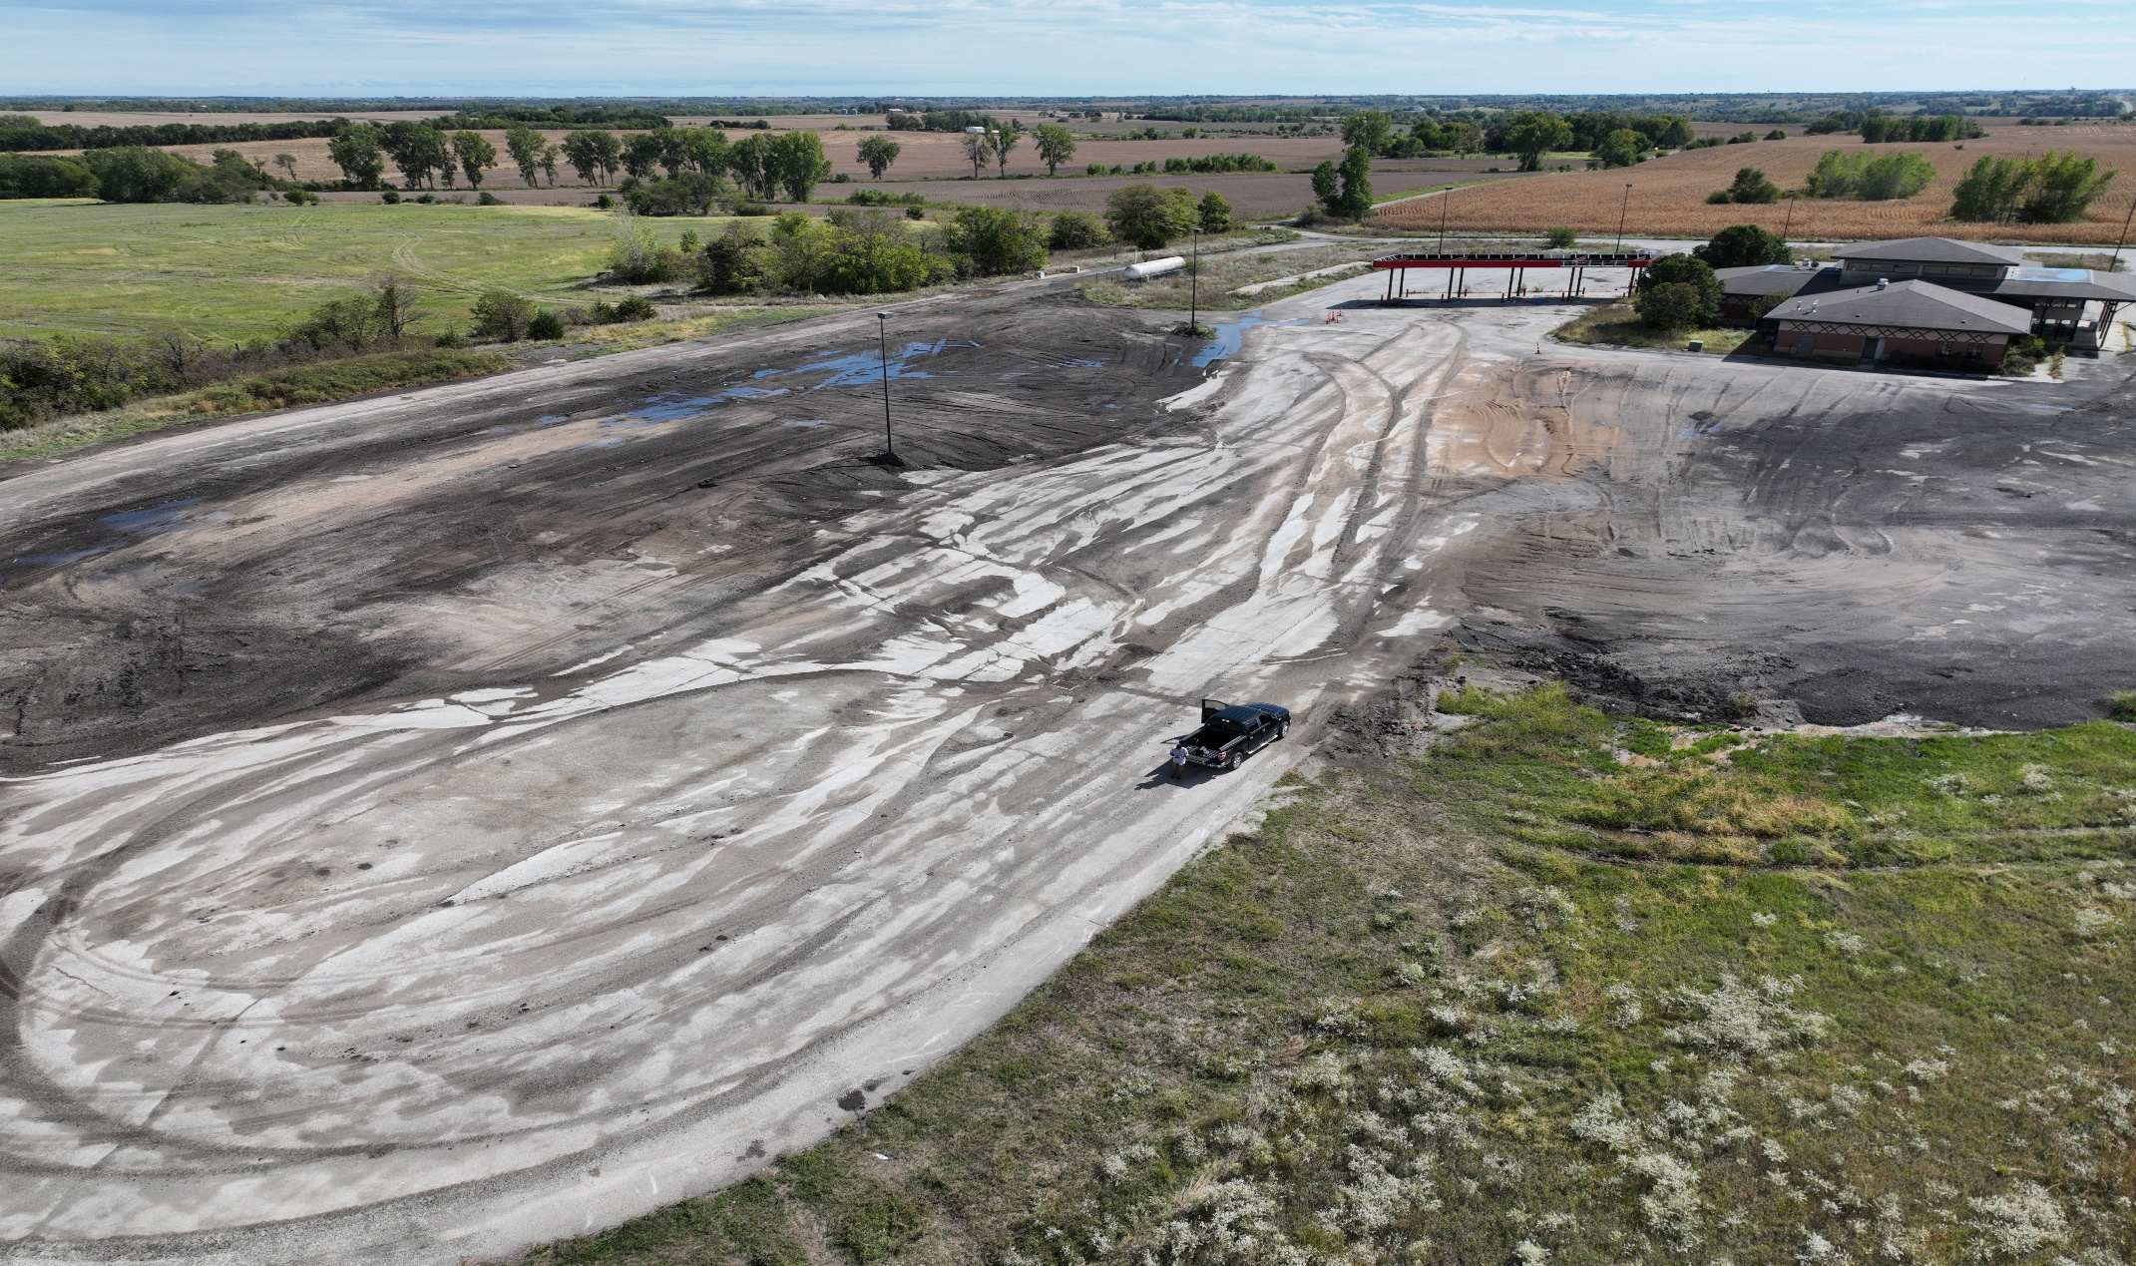
Drone imagery supports Brownfields documentation, site review, and project planning.

Slide 5
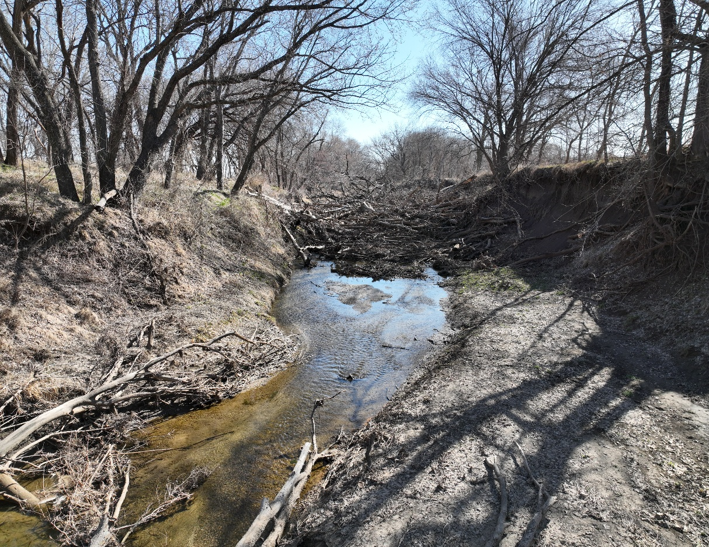
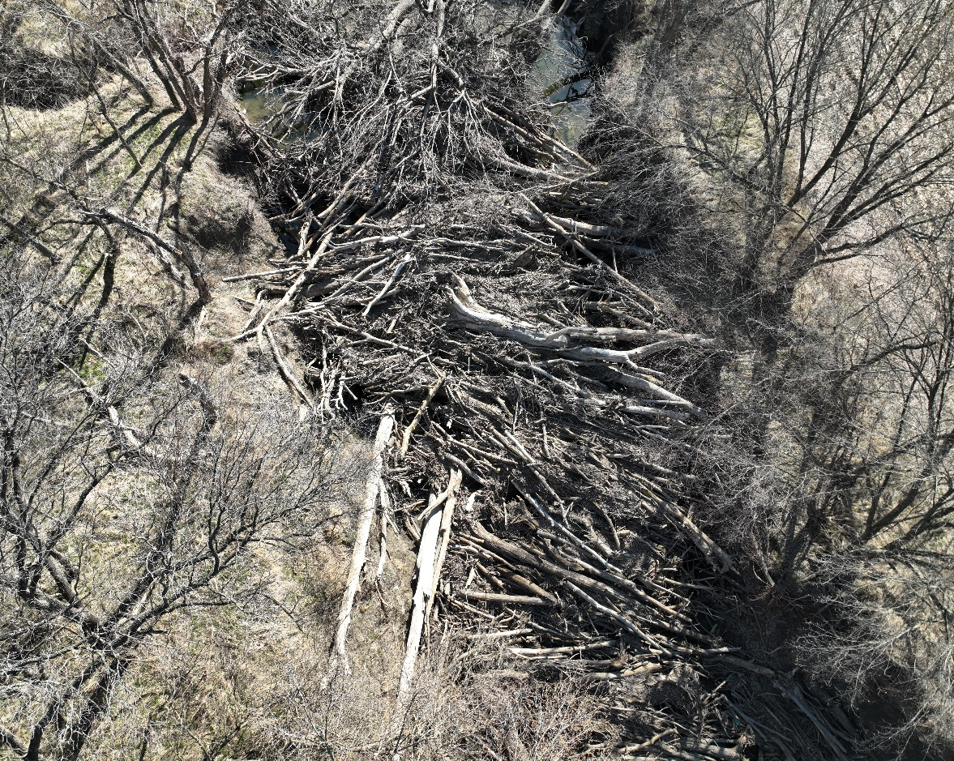
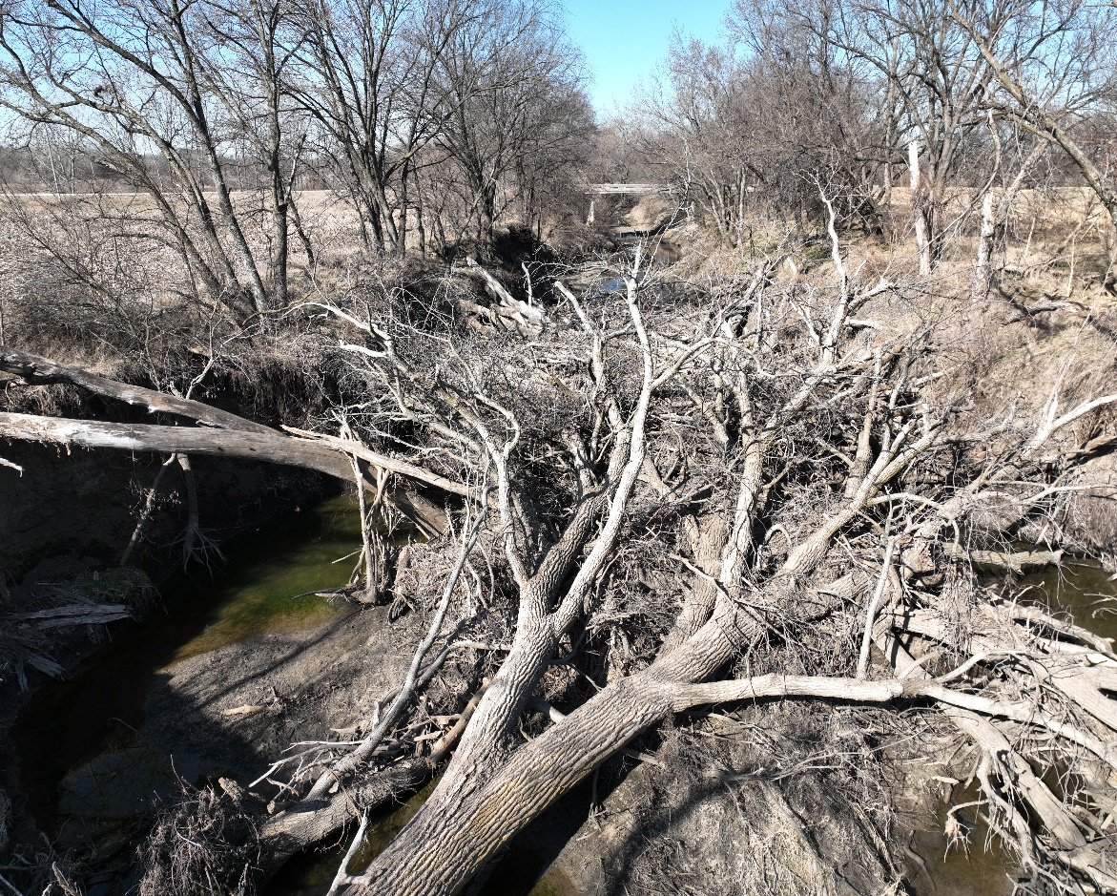
Trees block creek that runs to the tribe’s main water source.
Drone under the trees
Above the trees
More IMAGES around and under the trees

Slide 6
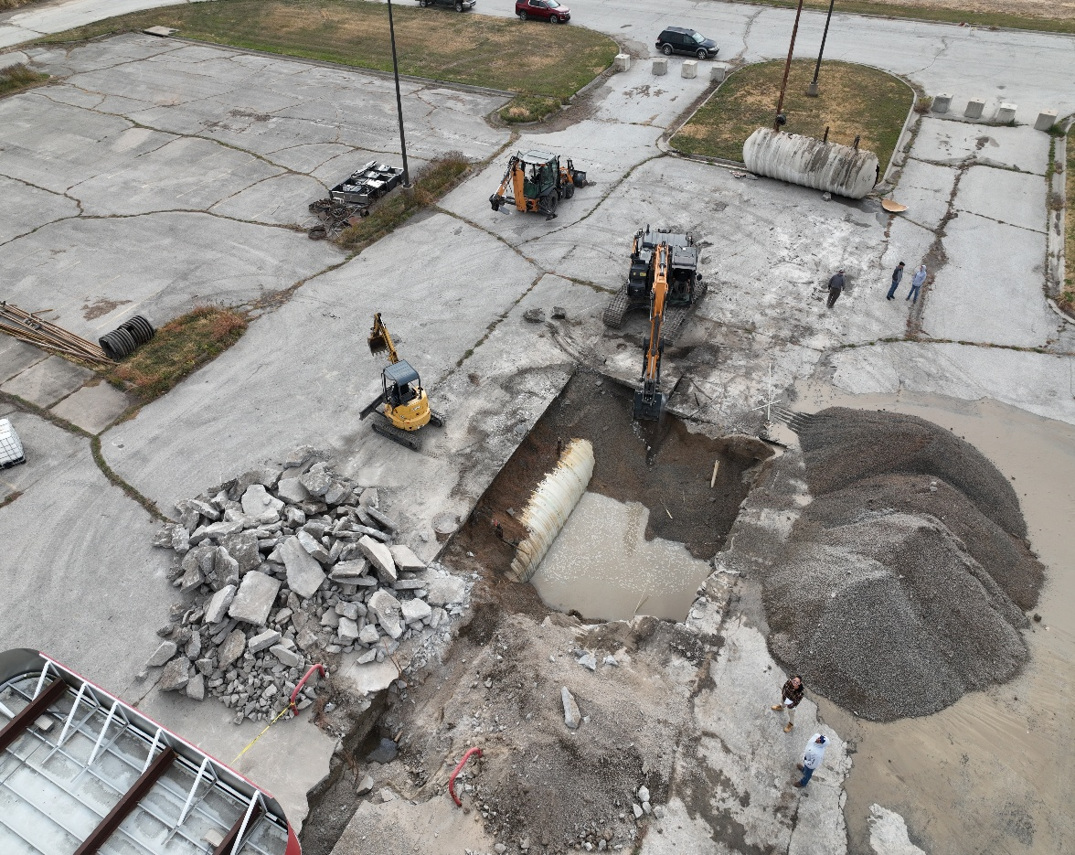
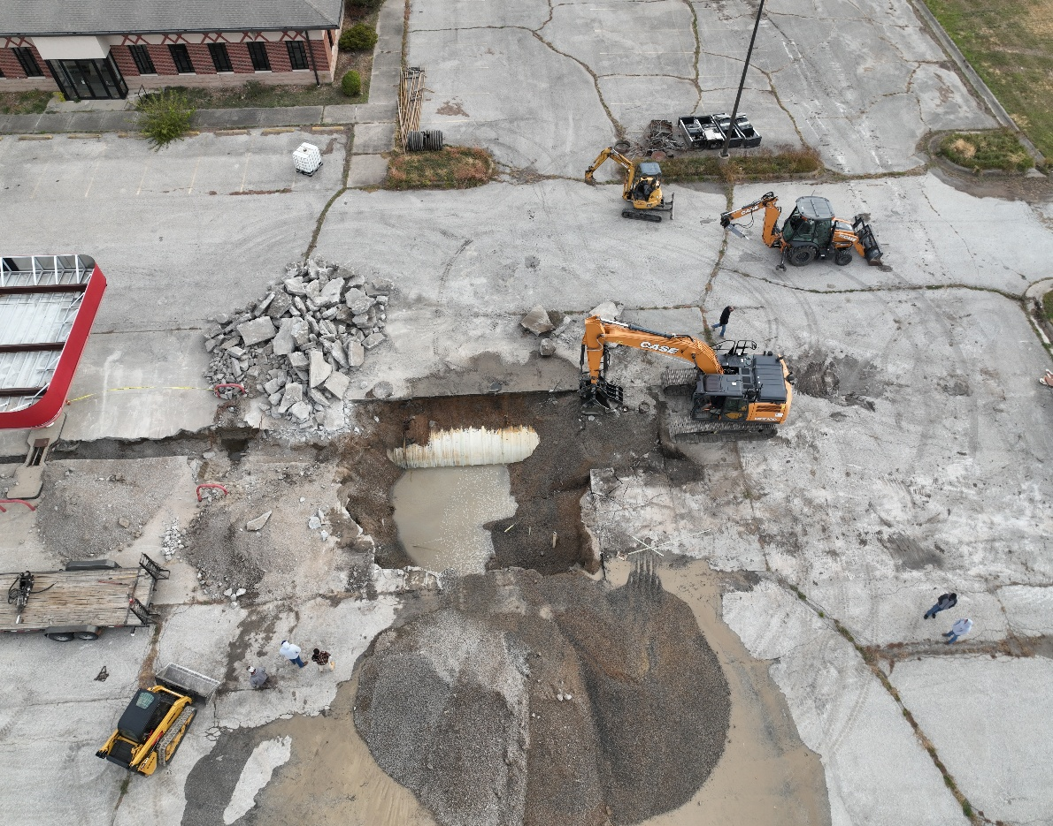
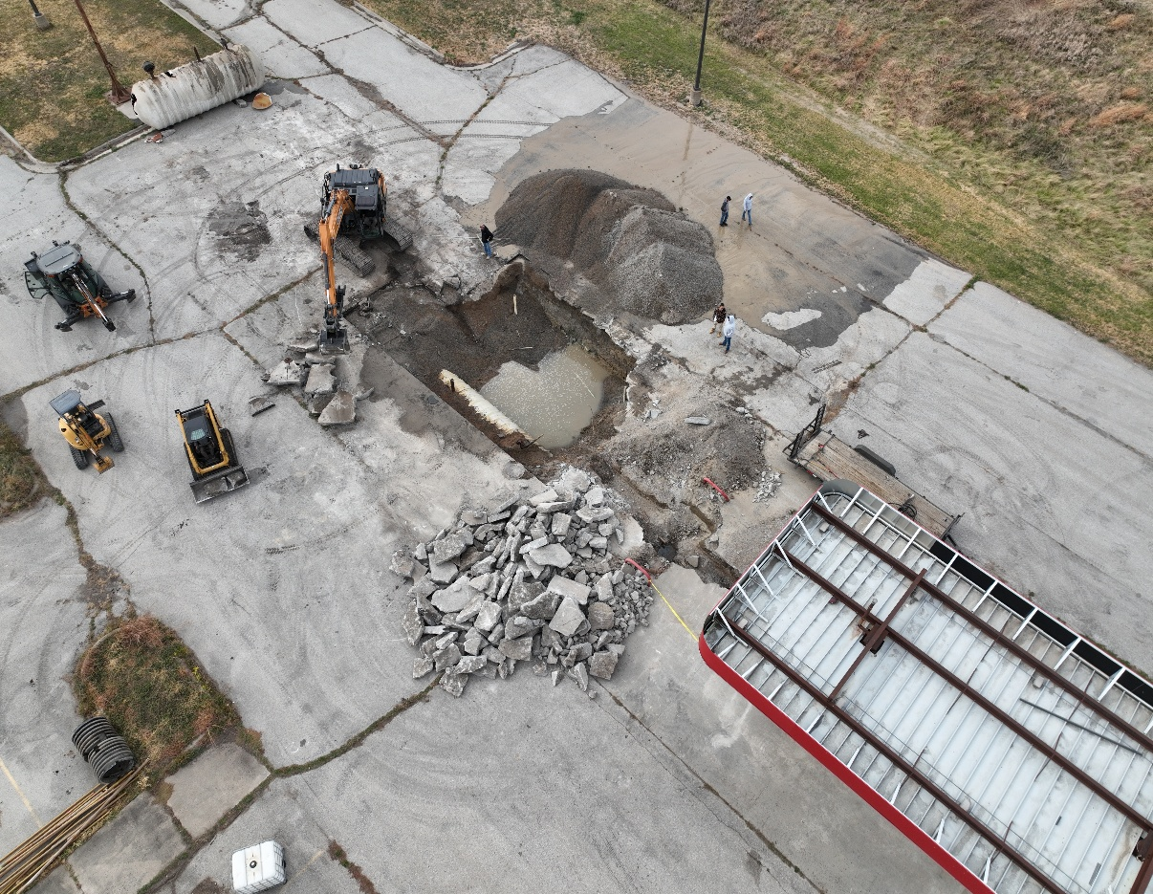
Underground Storage Tank Removal
8,000 gal tanks
15,000 gal tanks
groundwater concerns

Slide 7
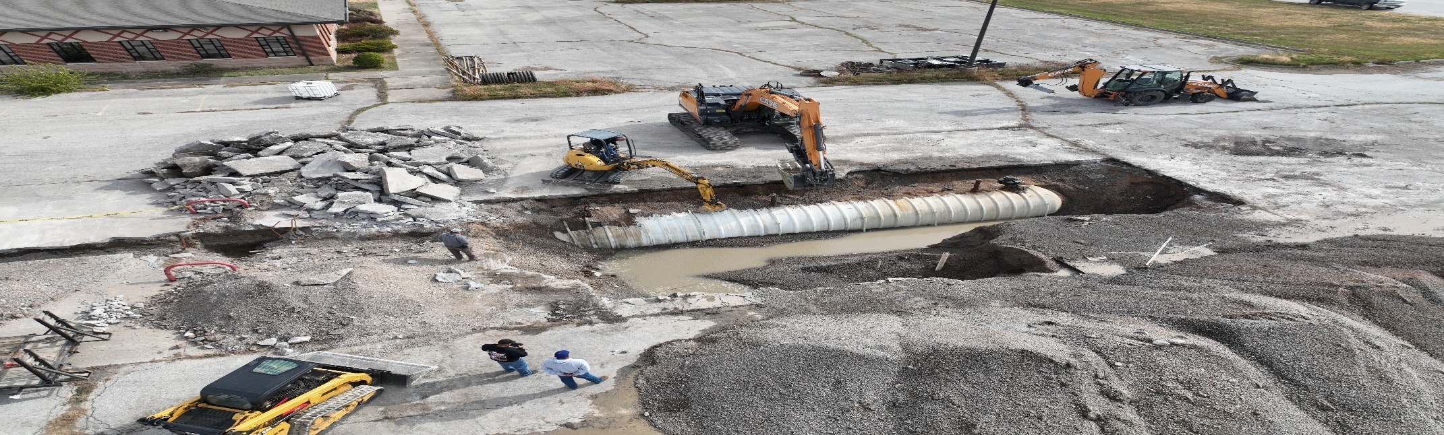
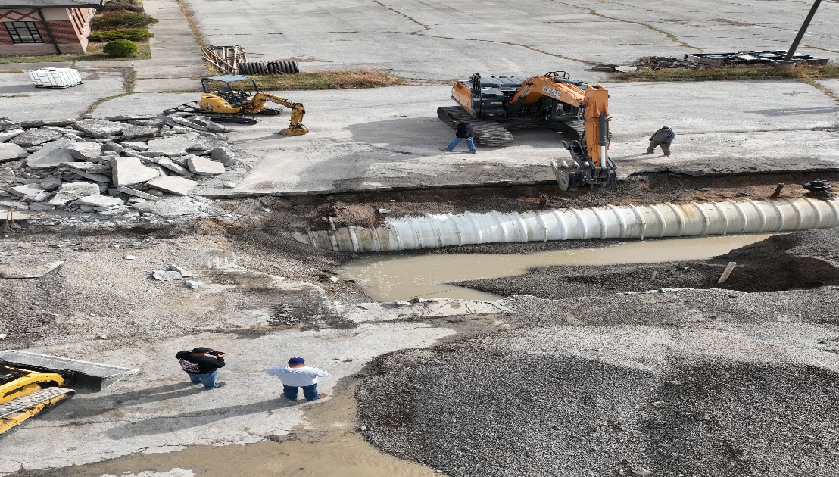
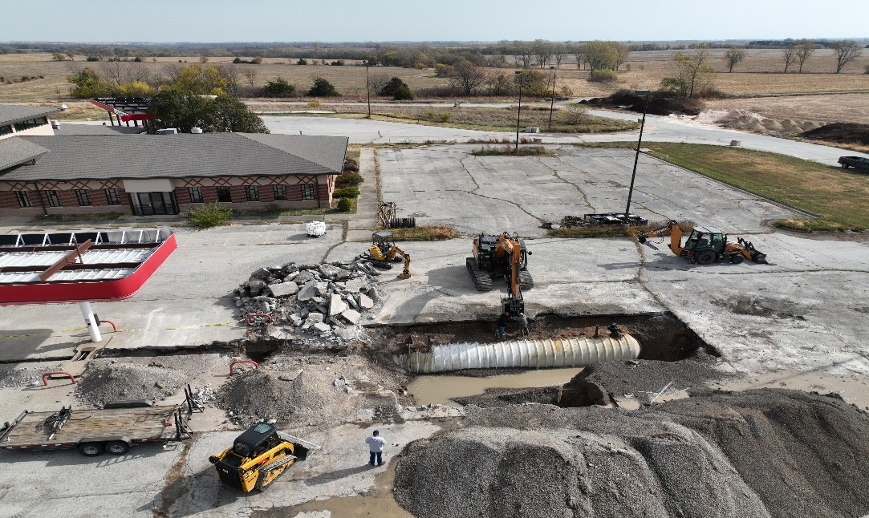
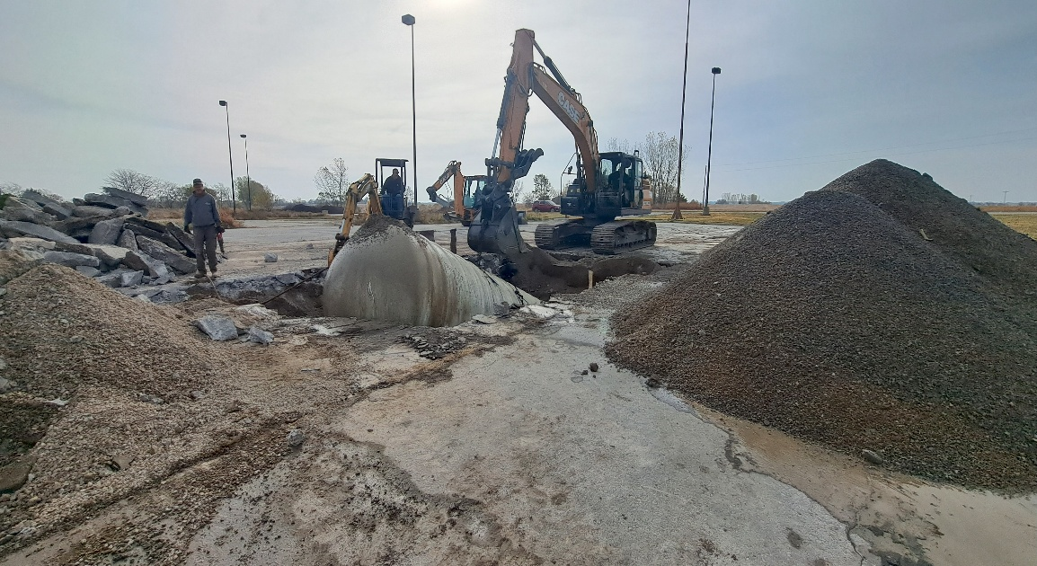
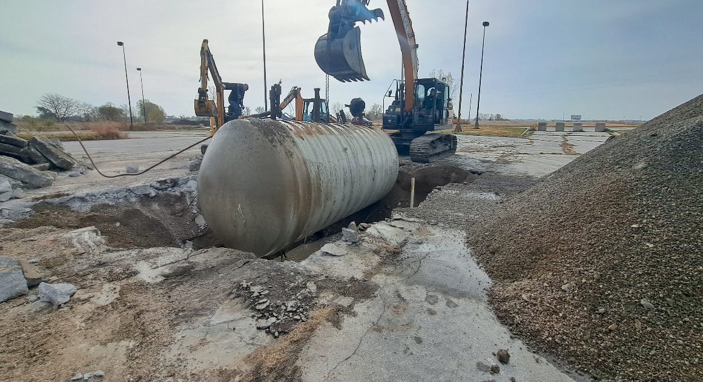
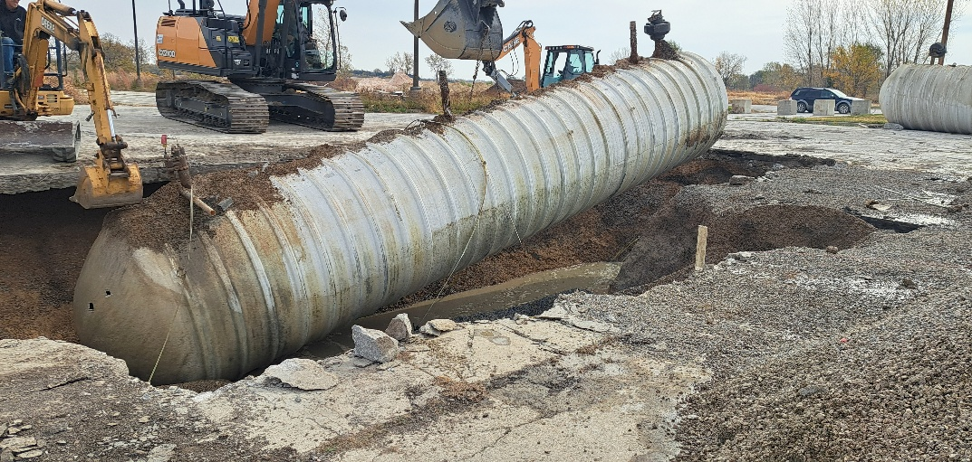
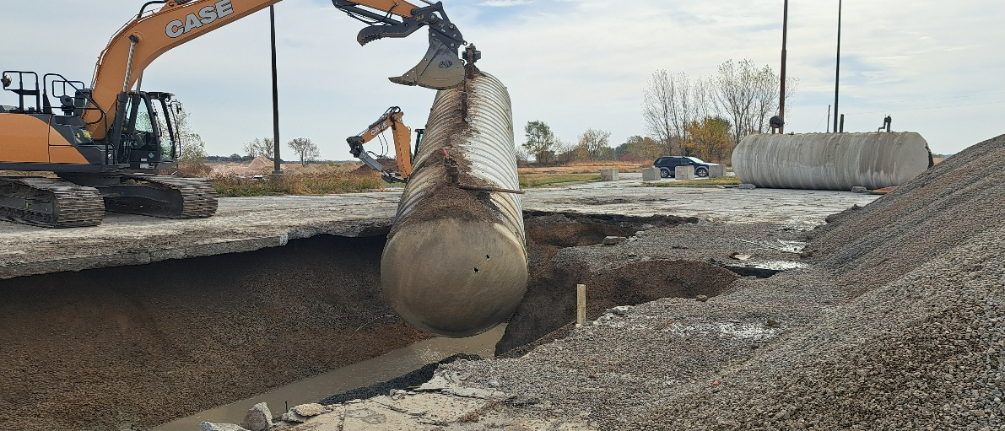
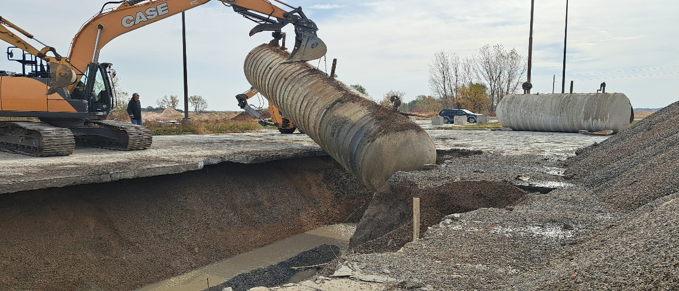
More pic of UST tanks being removed.

Slide 8
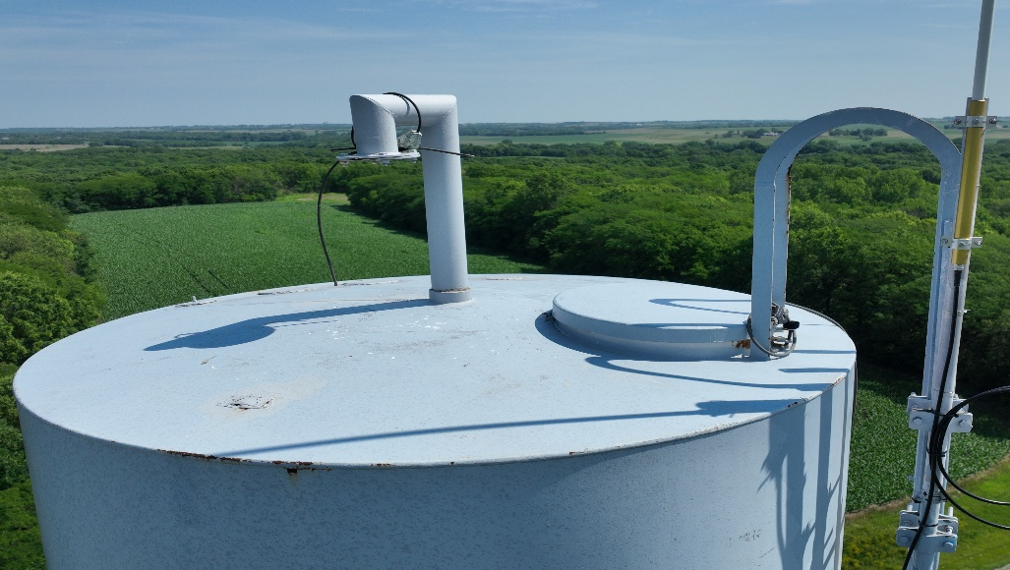
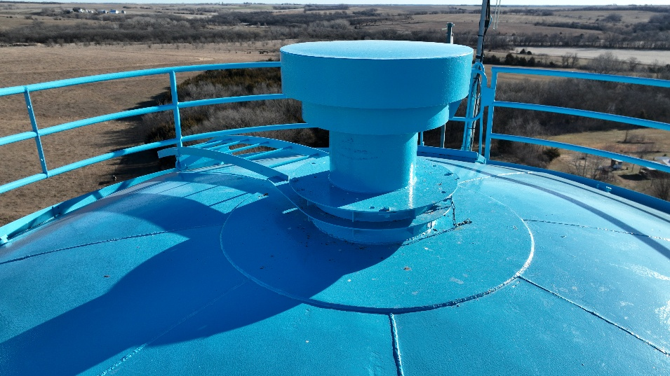
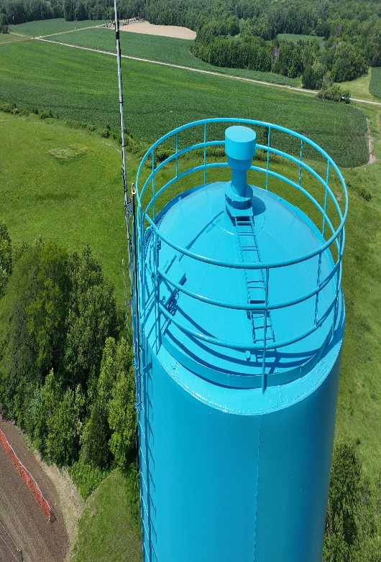
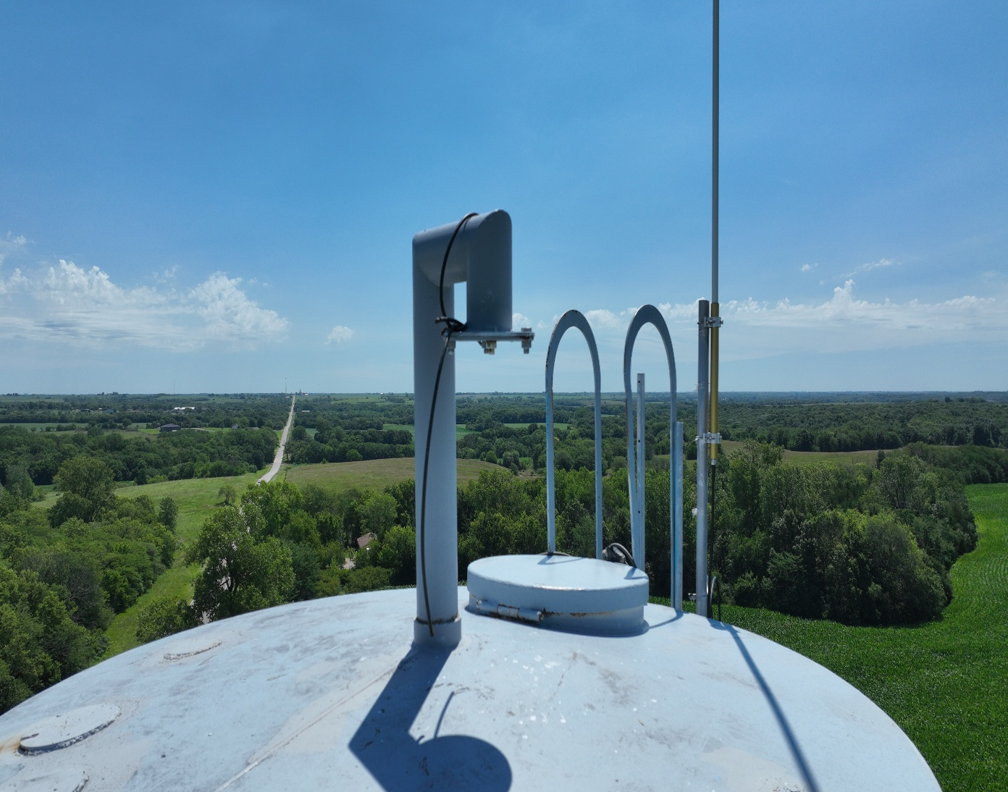
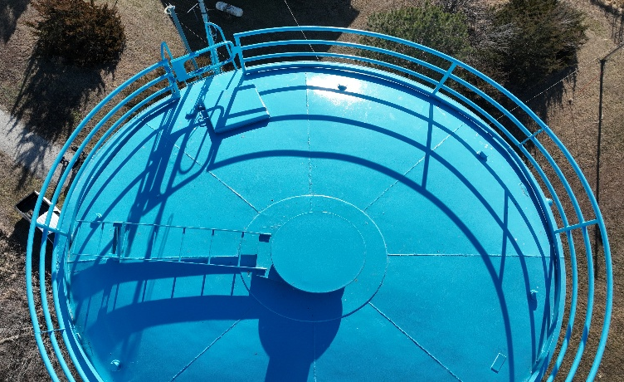
EPA Region 7 requested documentation of water tower vent conditions

Slide 9
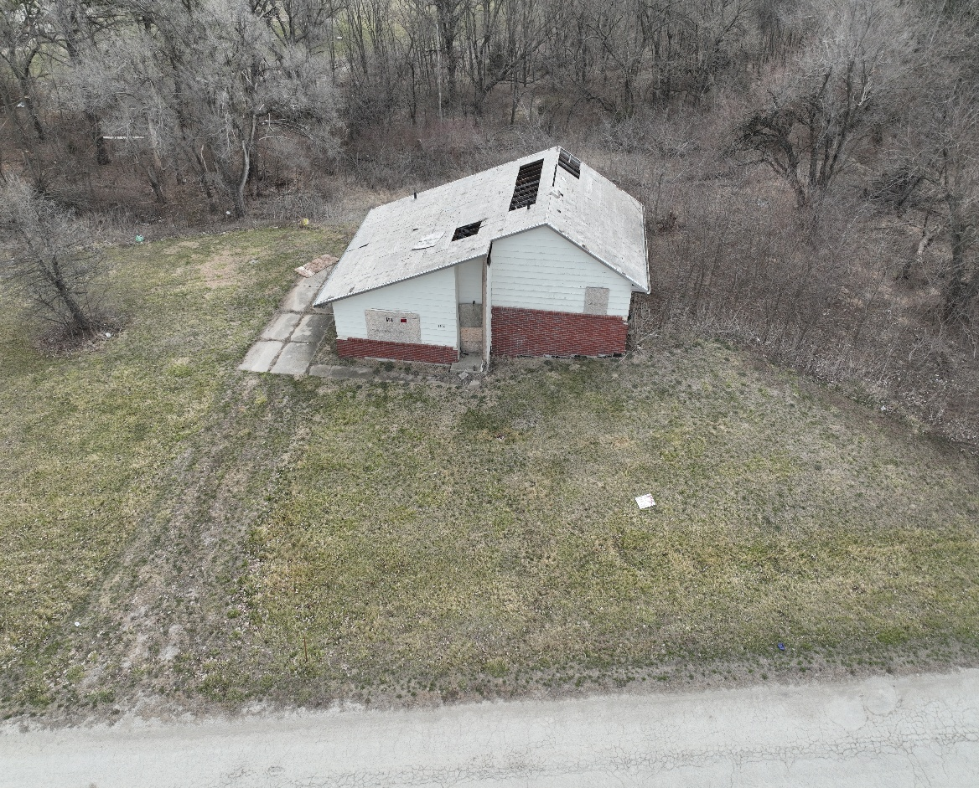
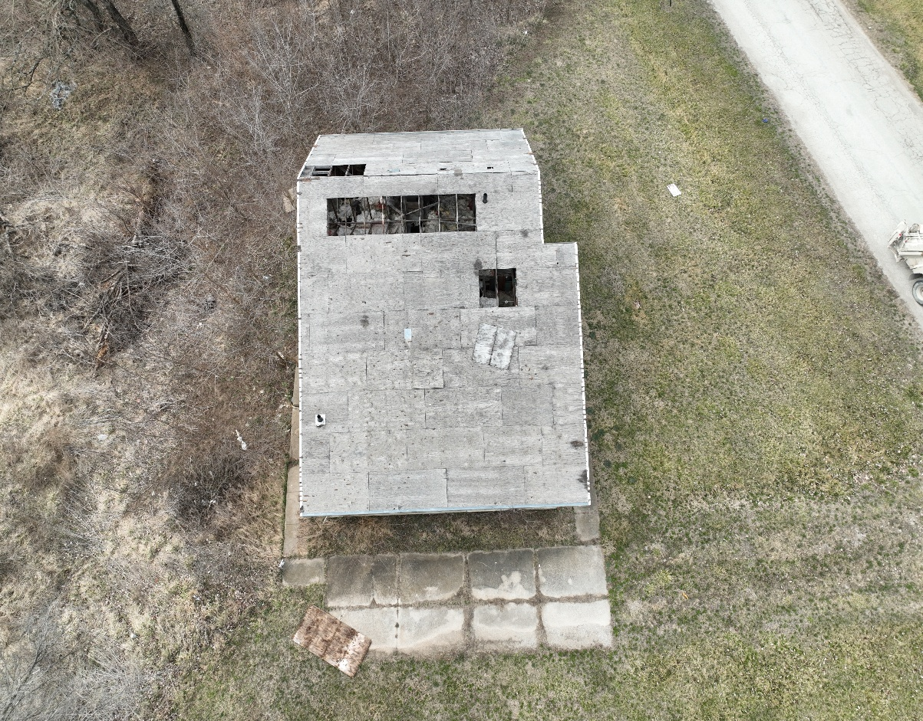
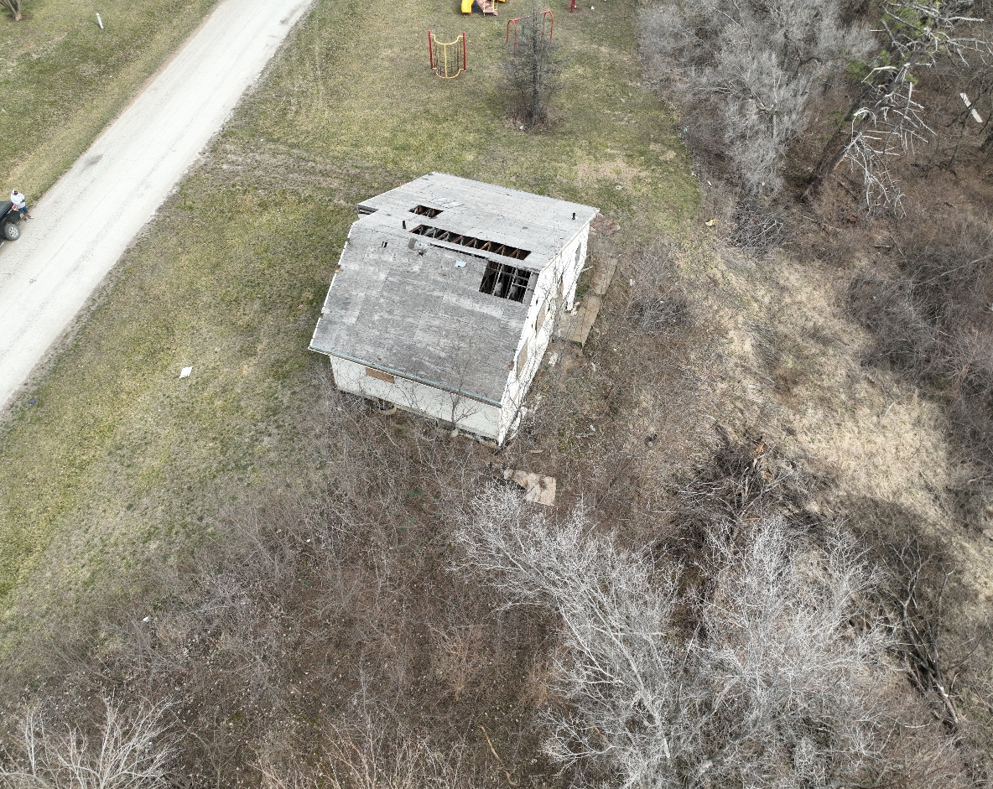
Former Brownfields site. Phase I/II assessments identified asbestos-containing material.

Slide 10
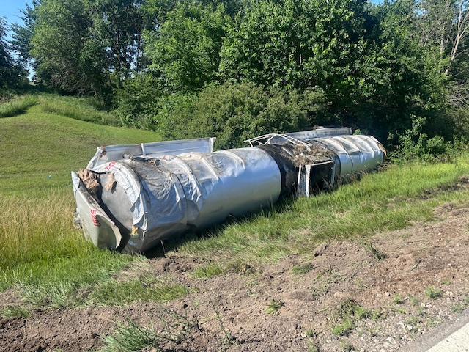
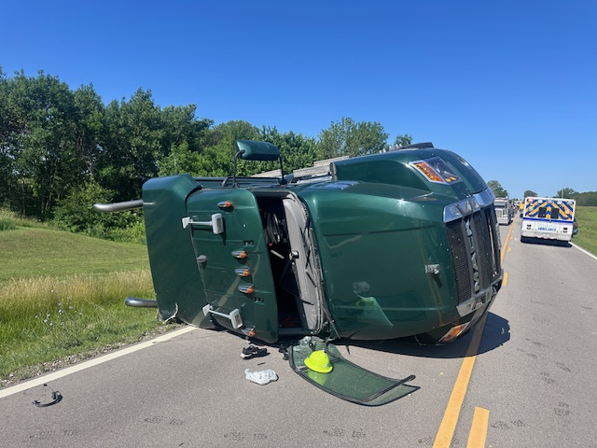
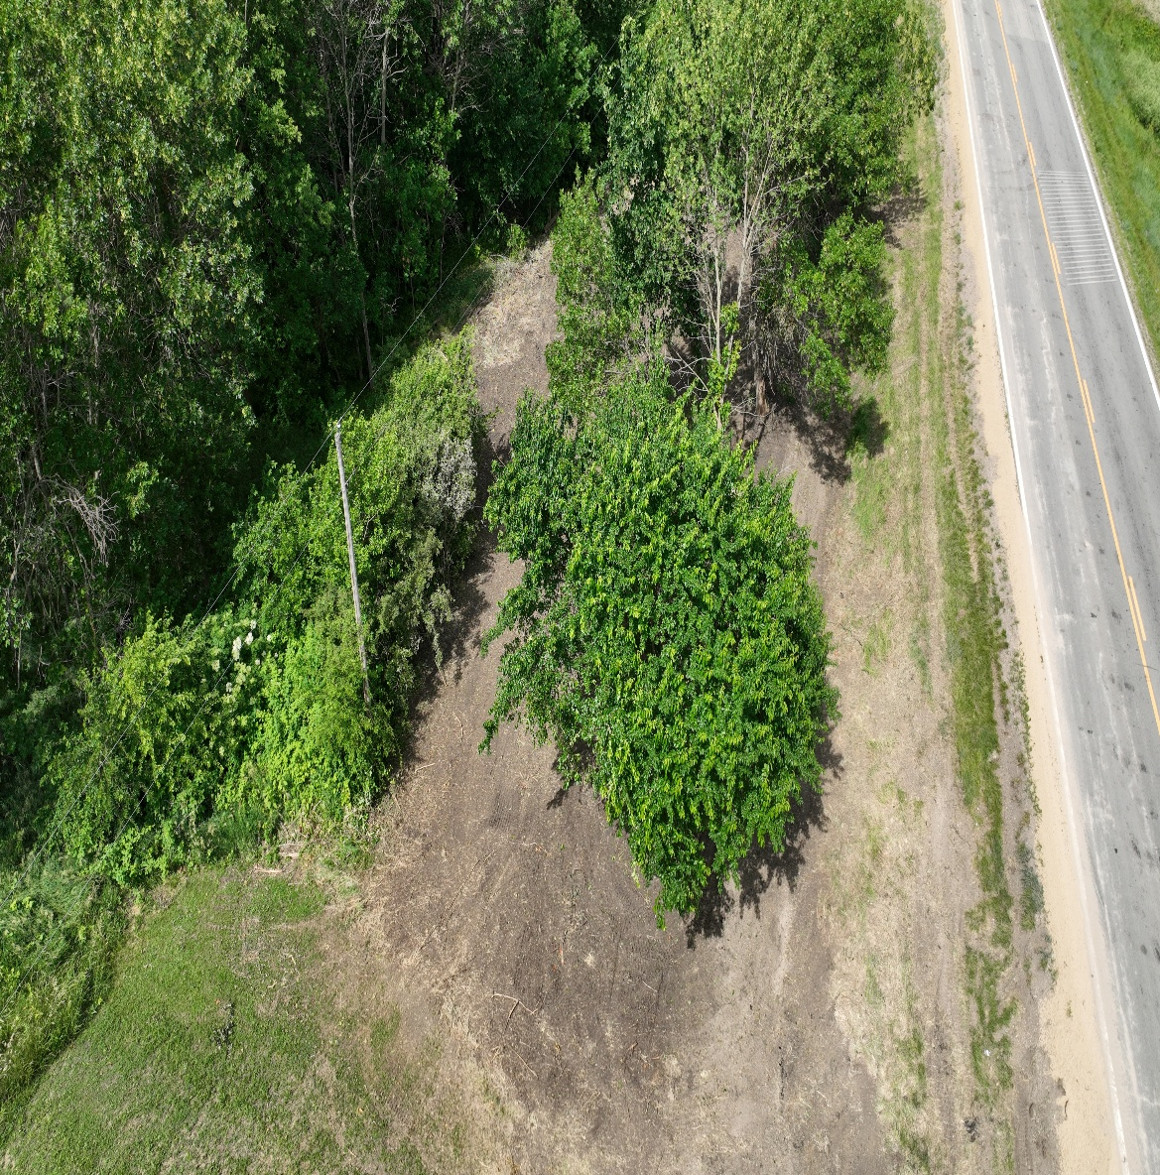
Oil tank spill response and post-cleanup documentation

Slide 11


Questions?
Kickapoo Tribe in Kansas
Brownfields/Tribal Response Program

