Slide 1



EPA Multipurpose Grant
Choctaw Nation Brownfields Program
The Story of Old Talihina Indian Hospital

Slide 2
Brief Brownfields Timeline for the Site
Date | Steps
2018 | Identified
2019 | 1st Assessment Grant Attempt
2020 | Phase I ESA, LBP Inspections, and Soil Sampling
2021 | Medical Dump investigations
2022 | Began preparing for Multipurpose
2023 | Awarded Multipurpose Grant
Notes:
A Phase II Environmental Site Assessment could not be completed unless the building was declared safe to enter. In order to perform a Phase II, a structural engineering study needed to be completed. The structural engineering assessment could not be completed due to debris covering the floors, doorways, and exits.
The debris removal began September 9th and was completed October 31st. Debris removal funding was provided by supplemental brownfields funding.

Slide 3
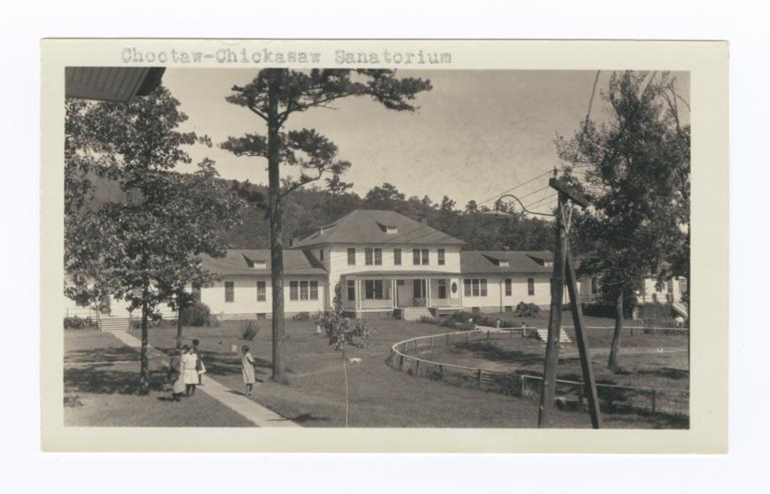
Hopa(n)ki oh chash...Site History
57 acres, located West of Talihina, OK
1913-1917: Carter Hospital-Office of Indian Affairs
1917-1938: Choctaw and Chickasaw Sanatorium
  Treatment of tubercular Choctaw/Chickasaw tribal members
1938-1999: Choctaw-Chickasaw Hospital, renamed the Talihina Indian Hospital around 1940. By 1963 transitioned to a full hospital run by Public Health Services and Indian Health Services.
Notes:
A Phase II Environmental Site Assessment could not be completed unless the building was declared safe to enter. In order to perform a Phase II, a structural engineering study needed to be completed. The structural engineering assessment could not be completed due to debris covering the floors, doorways, and exits.
The debris removal began September 9th and was completed October 31st. Debris removal funding was provided by supplemental brownfields funding.

Slide 4
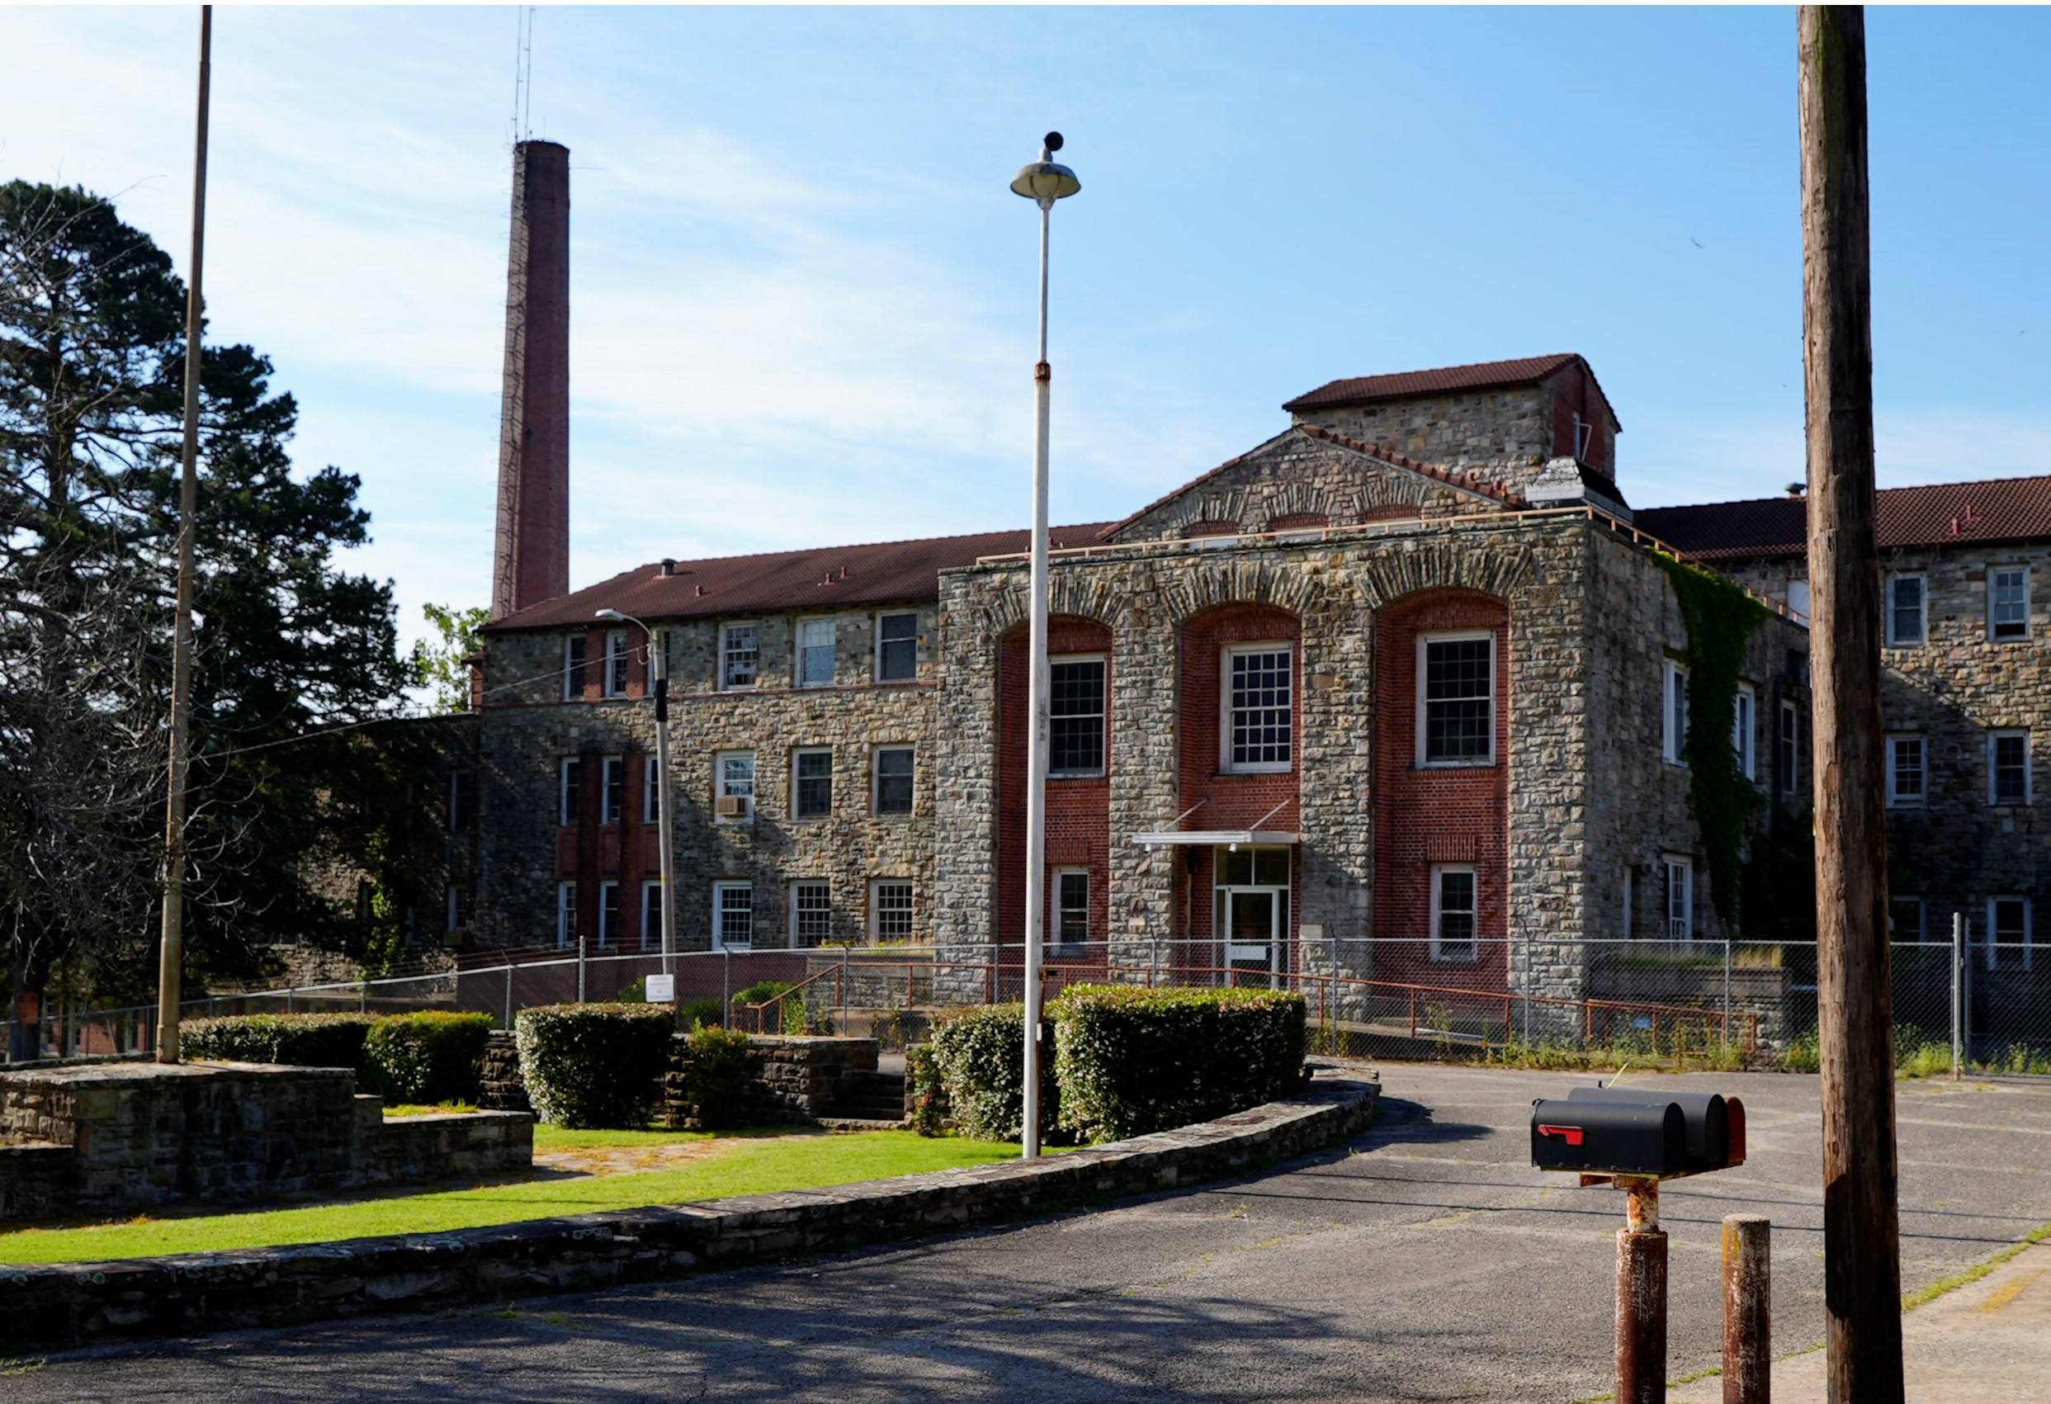
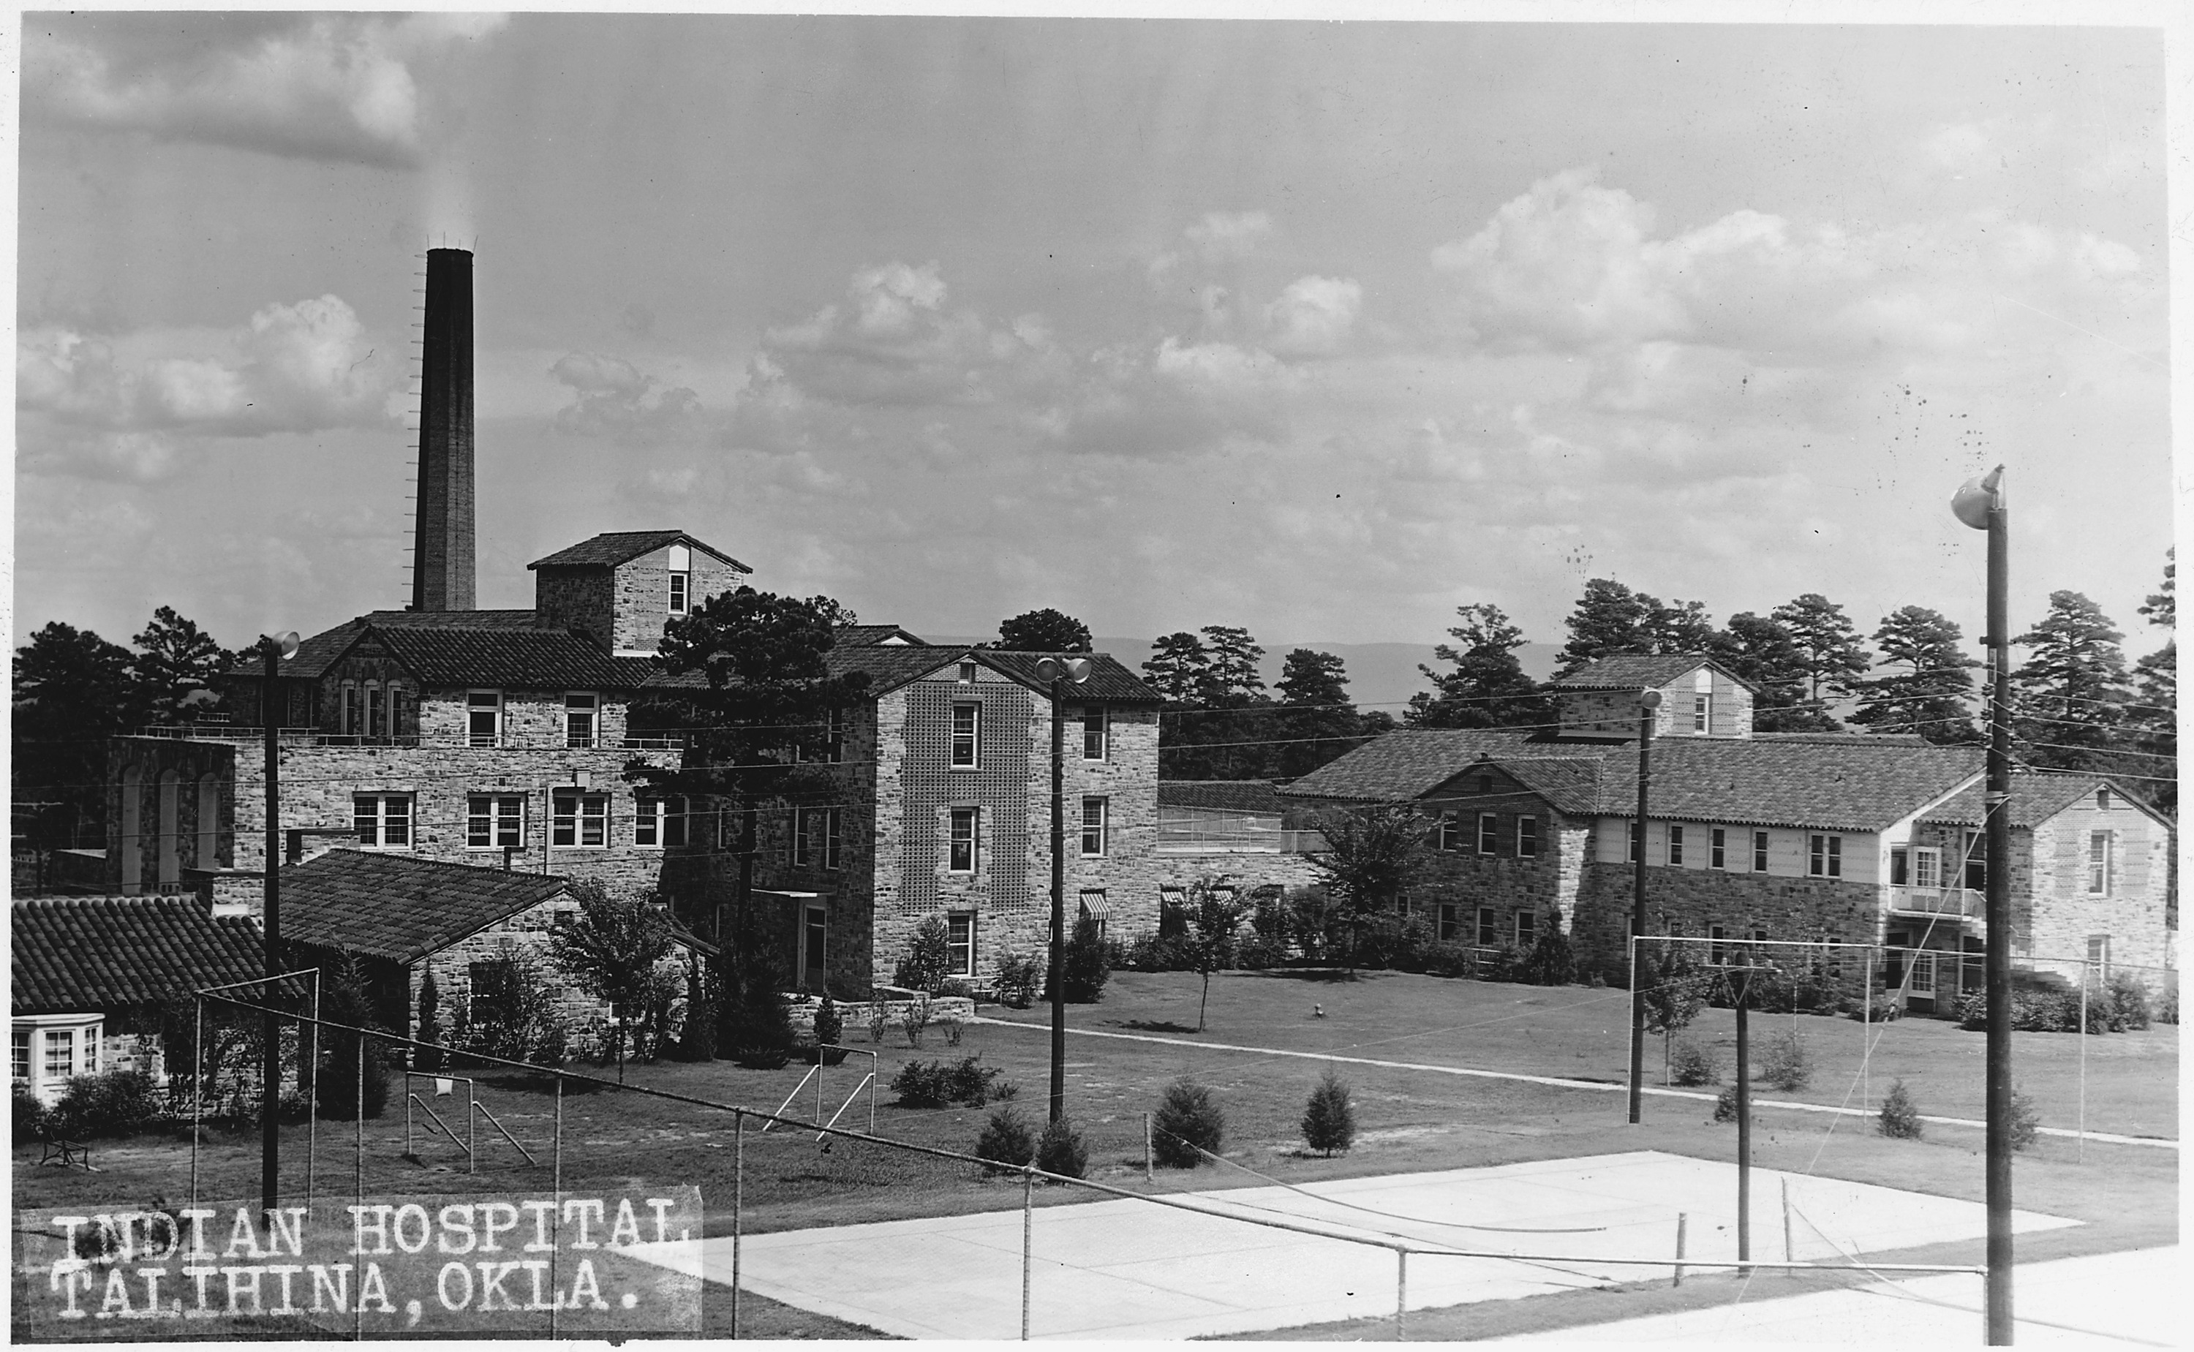
Building History
57 acres, located West of Talihina, OK
1913-1917: Carter Hospital-Office of Indian Affairs
1917-1938: Choctaw and Chickasaw Sanatorium
  Treatment of tubercular Choctaw/Chickasaw tribal members
1938-1999: Choctaw-Chickasaw Hospital, renamed the Talihina Indian Hospital around 1940. By 1963 transitioned to a full hospital run by Public Health Services and Indian Health Services.
Notes:
A Phase II Environmental Site Assessment could not be completed unless the building was declared safe to enter. In order to perform a Phase II, a structural engineering study needed to be completed. The structural engineering assessment could not be completed due to debris covering the floors, doorways, and exits.
The debris removal began September 9th and was completed October 31st. Debris removal funding was provided by supplemental brownfields funding.

Slide 5
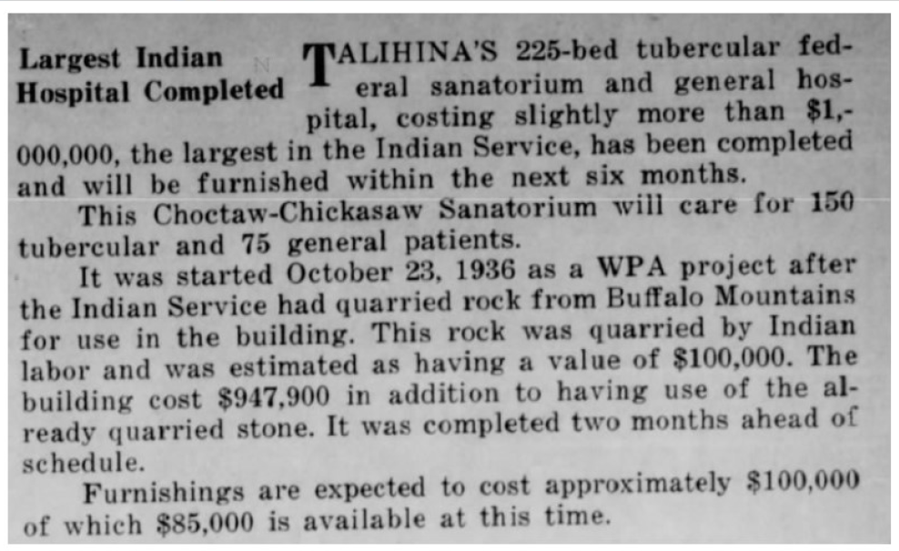

Slide 6
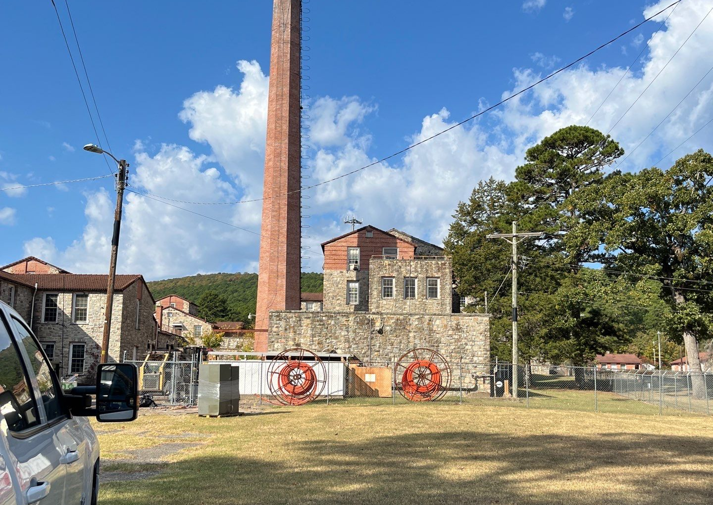
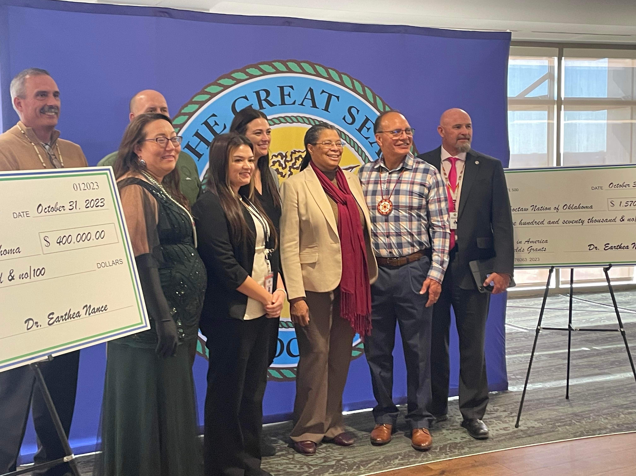
EPA Multipurpose Grant
In 2023 CNO Brownfields was awarded the competitive EPA Multipurpose grant for Old Talihina Indian Hospital Building 201. (picture)
Grant Tasks:
  Assessments within Building 201 and the surrounding grounds
  Develop and Conduct Community Engagement
  Develop and Implement Cleanup Plans
  Reuse and Revitalization Plan Development
Notes:
CNO Brownfields was one of the tribal brownfield programs selected to receive the competitive Multipurpose grant for the Old Talihina Indian Hospital Building 201. As of March 2025, We have completed a Phase I ESA, a debris removal, and a structural engineering assessment using grant funding totaling $179,410.

Slide 7

Project Schedule:
Establish and coordinate the Choctaw Nation Brownfields Multipurpose Grant Project Involvement Team
Debris Removal
Structural Engineering Assessment
Phase II Environmental Site Assessment
Completed October 31st, 2024
Completed February 27th, 2025
Completed January 19, 2026
Assessment for Brownfields Cleanup Alternatives
Submit Cleanup Plan or ABCA to EPA project officer for review and public comment
Remediation of any hazardous material
$500,000
Reuse and Revitalization Plans
Estimated Completion: End of May 2026
Estimated Completion: End of June 2026
Estimated Completion: End of October 2026
Estimated Completion: End of October 2027
Notes:
The project schedule had an adjustment between establishing the Project Involvement Team and the Structural Engineering Assessment. A debris removal had to be conducted for a structural engineering assessment to be completed. As of today, the debris removal is completed, the structural engineering assessment is completed, and CNO Brownfields next step is the start of the Phase II Environmental Site Assessment.

Slide 8
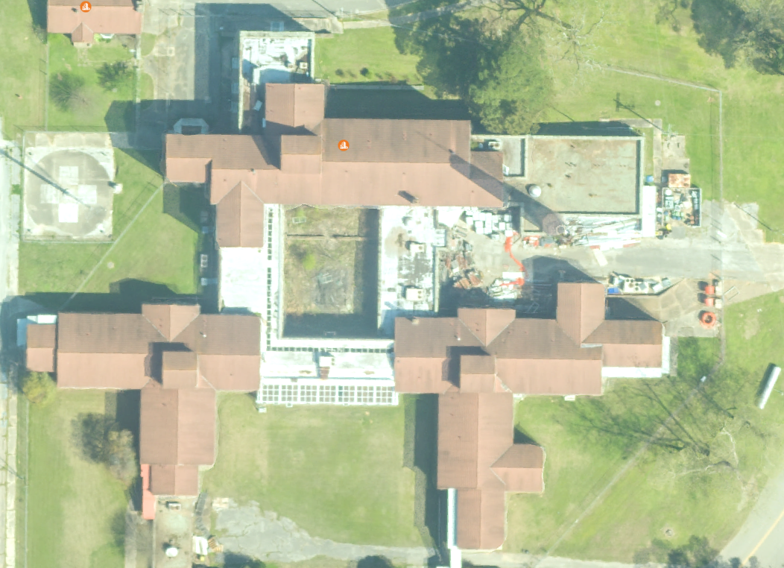
Building Orientation
94,000+ square feet
CNO Health and Fixed Assets were consulted and no items in the building could be kept due to possible contamination.
Four floors and the basement were cleared under the debris removal.
North
Boiler Room
West
East
South
Notes:
A Phase II Environmental Site Assessment could not be completed unless the building was declared safe to enter. In order to perform a Phase II, a structural engineering study needed to be completed. The structural engineering assessment could not be completed due to debris covering the floors, doorways, and exits.
The debris removal began September 9th and was completed October 31st. Debris removal funding was provided by supplemental brownfields funding.

Slide 9
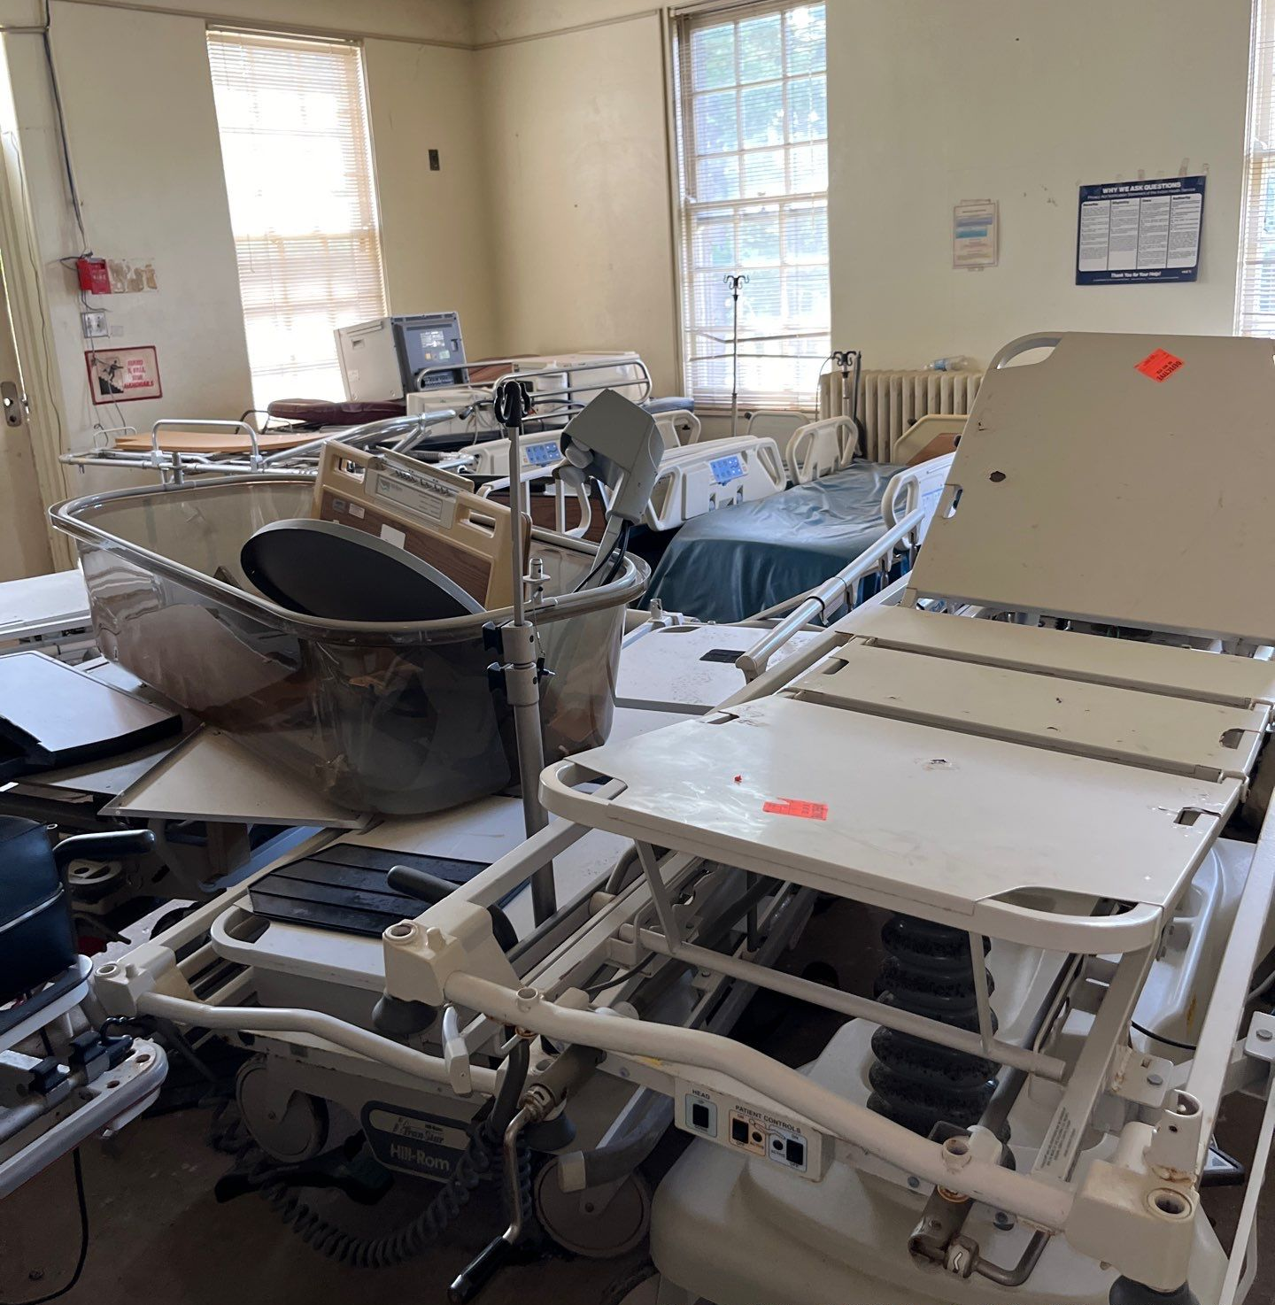
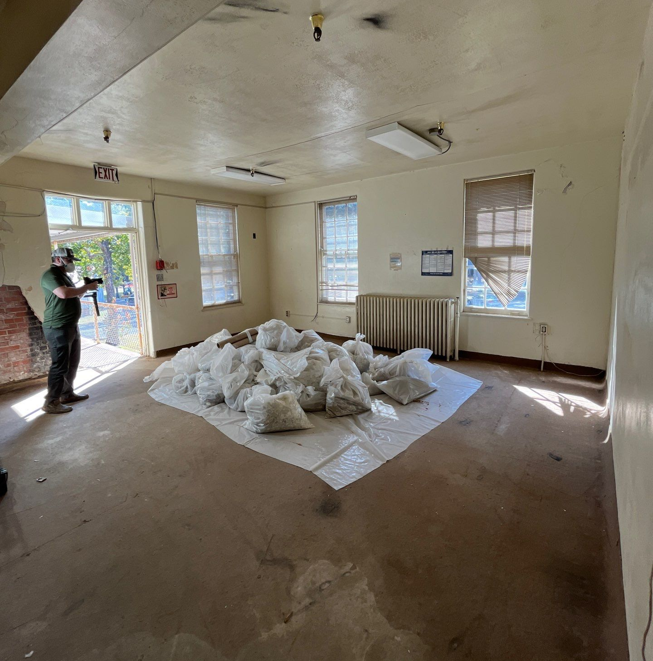
Before & After
Notes:
This is the southeast corner of the building on the second floor.

Slide 10
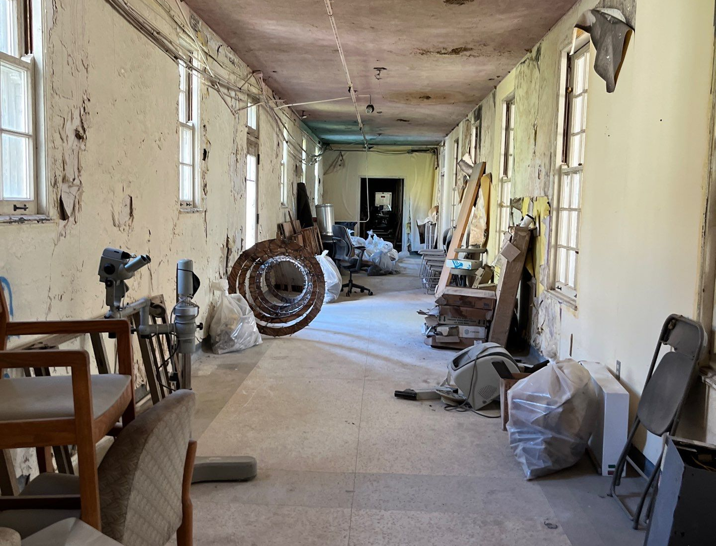
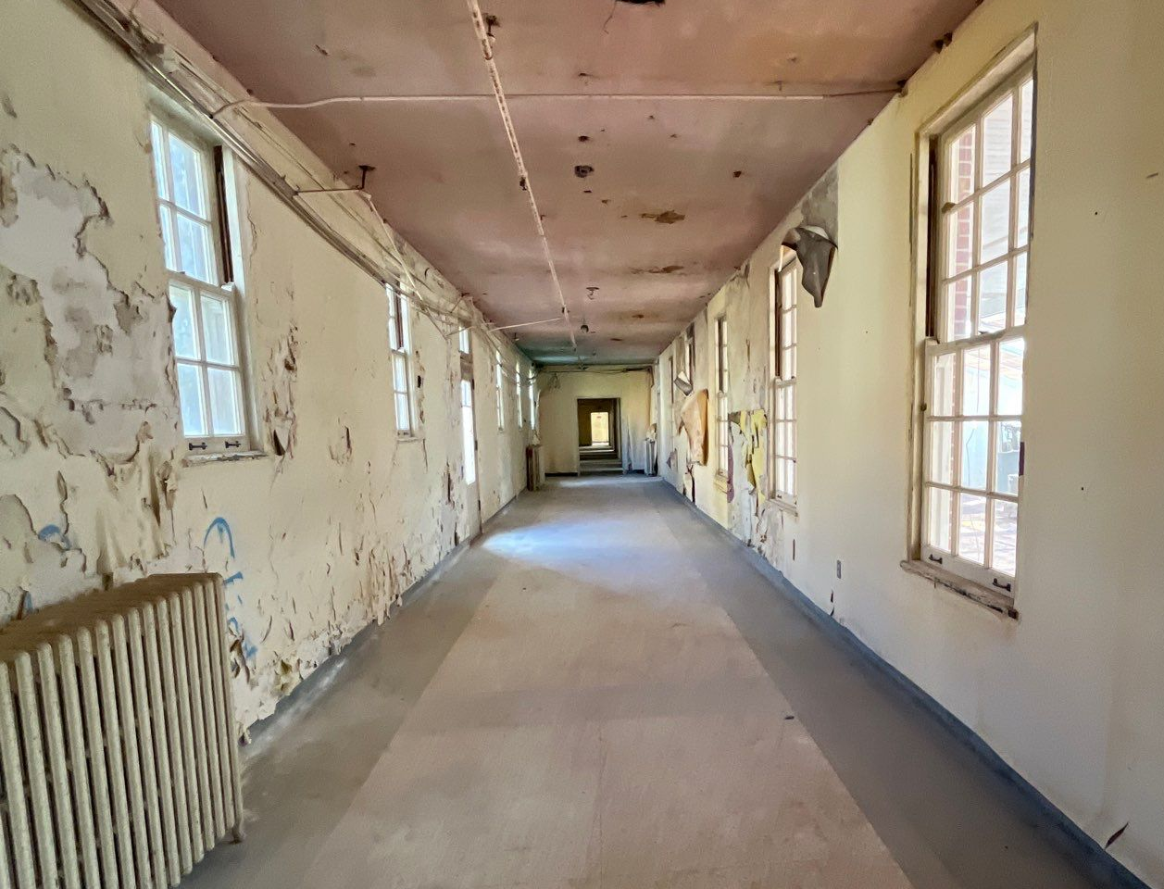
Before & After
Notes:
This is a south-central hallway on the second floor.

Slide 11
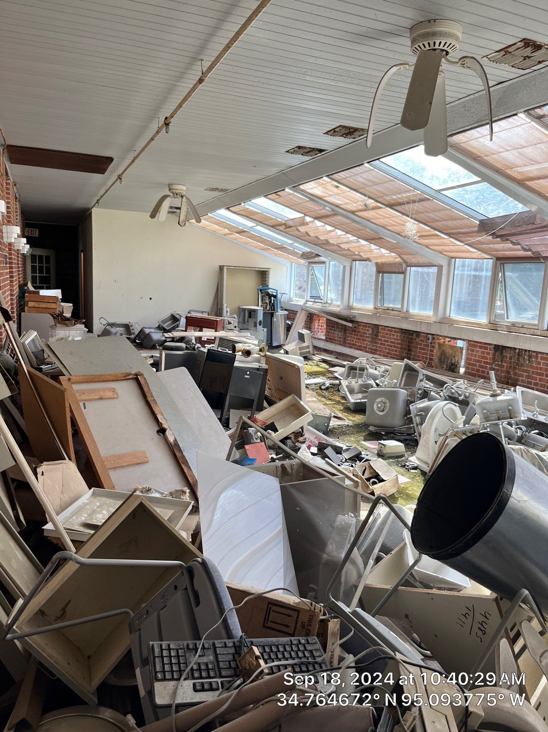
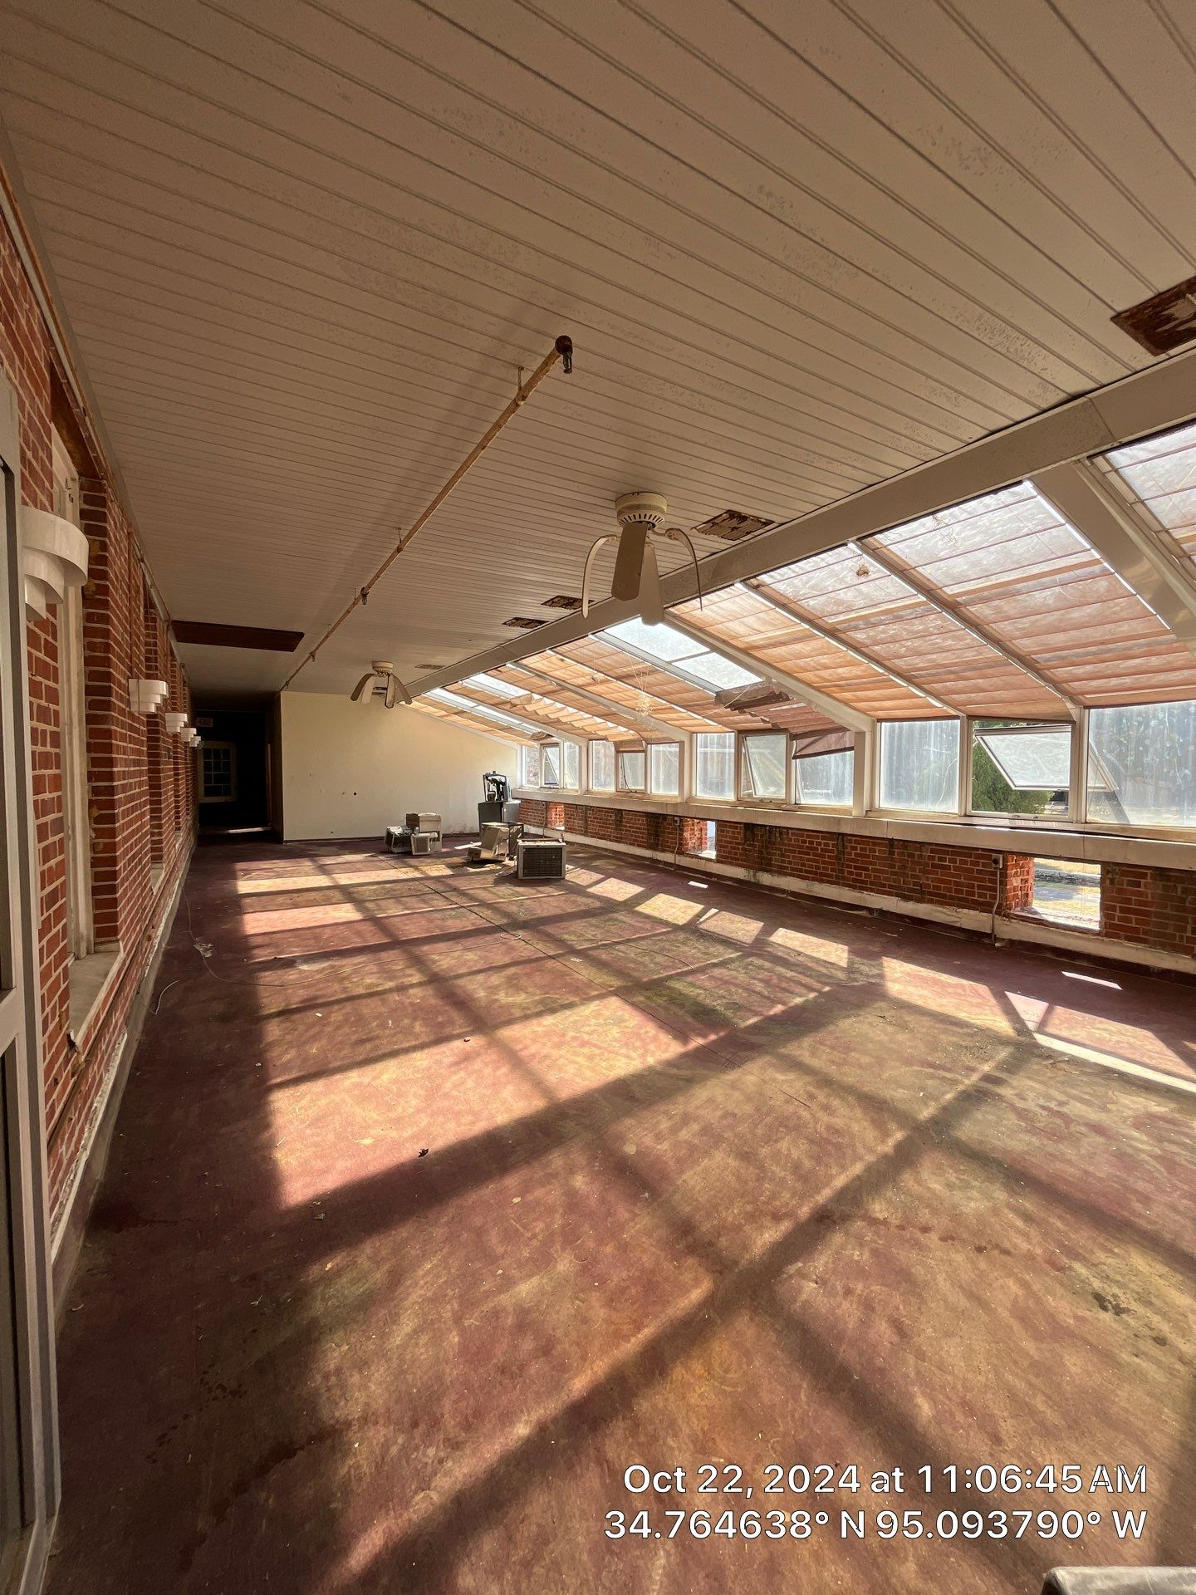
Before & After
Notes:
This is the sunroom located on the south-central side of the second floor.

Slide 12
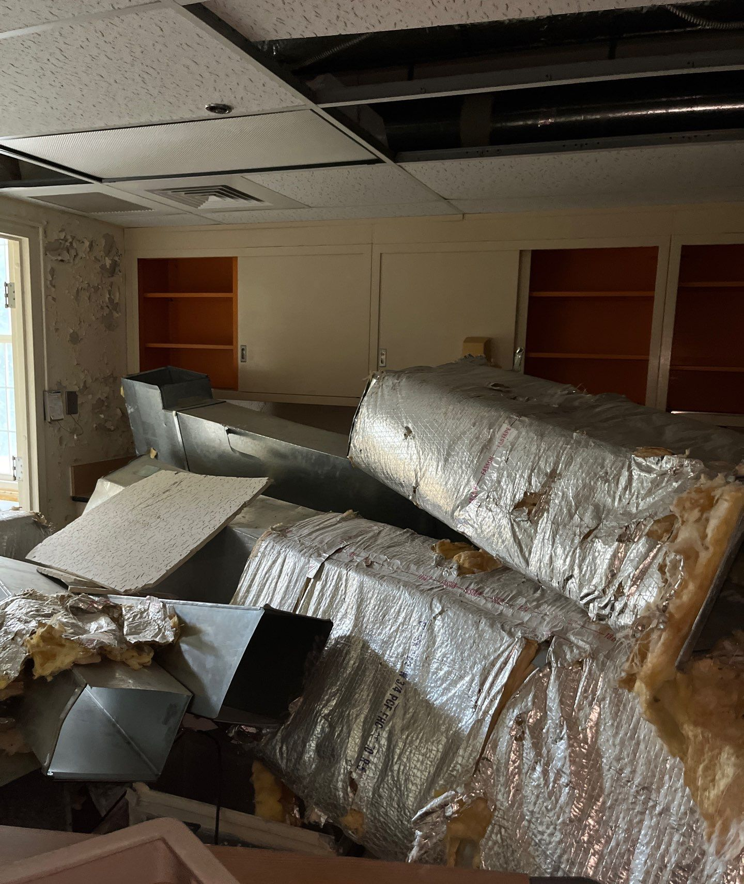
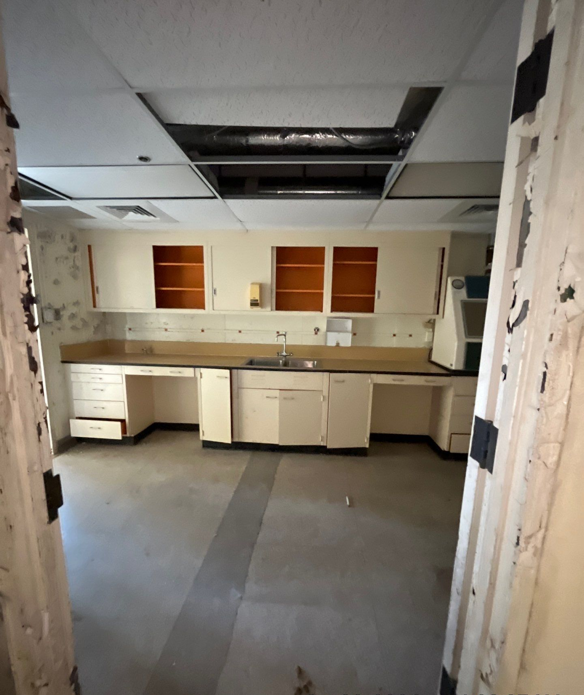
Before & After
Notes:
This is a southwest room on the second floor.

Slide 13
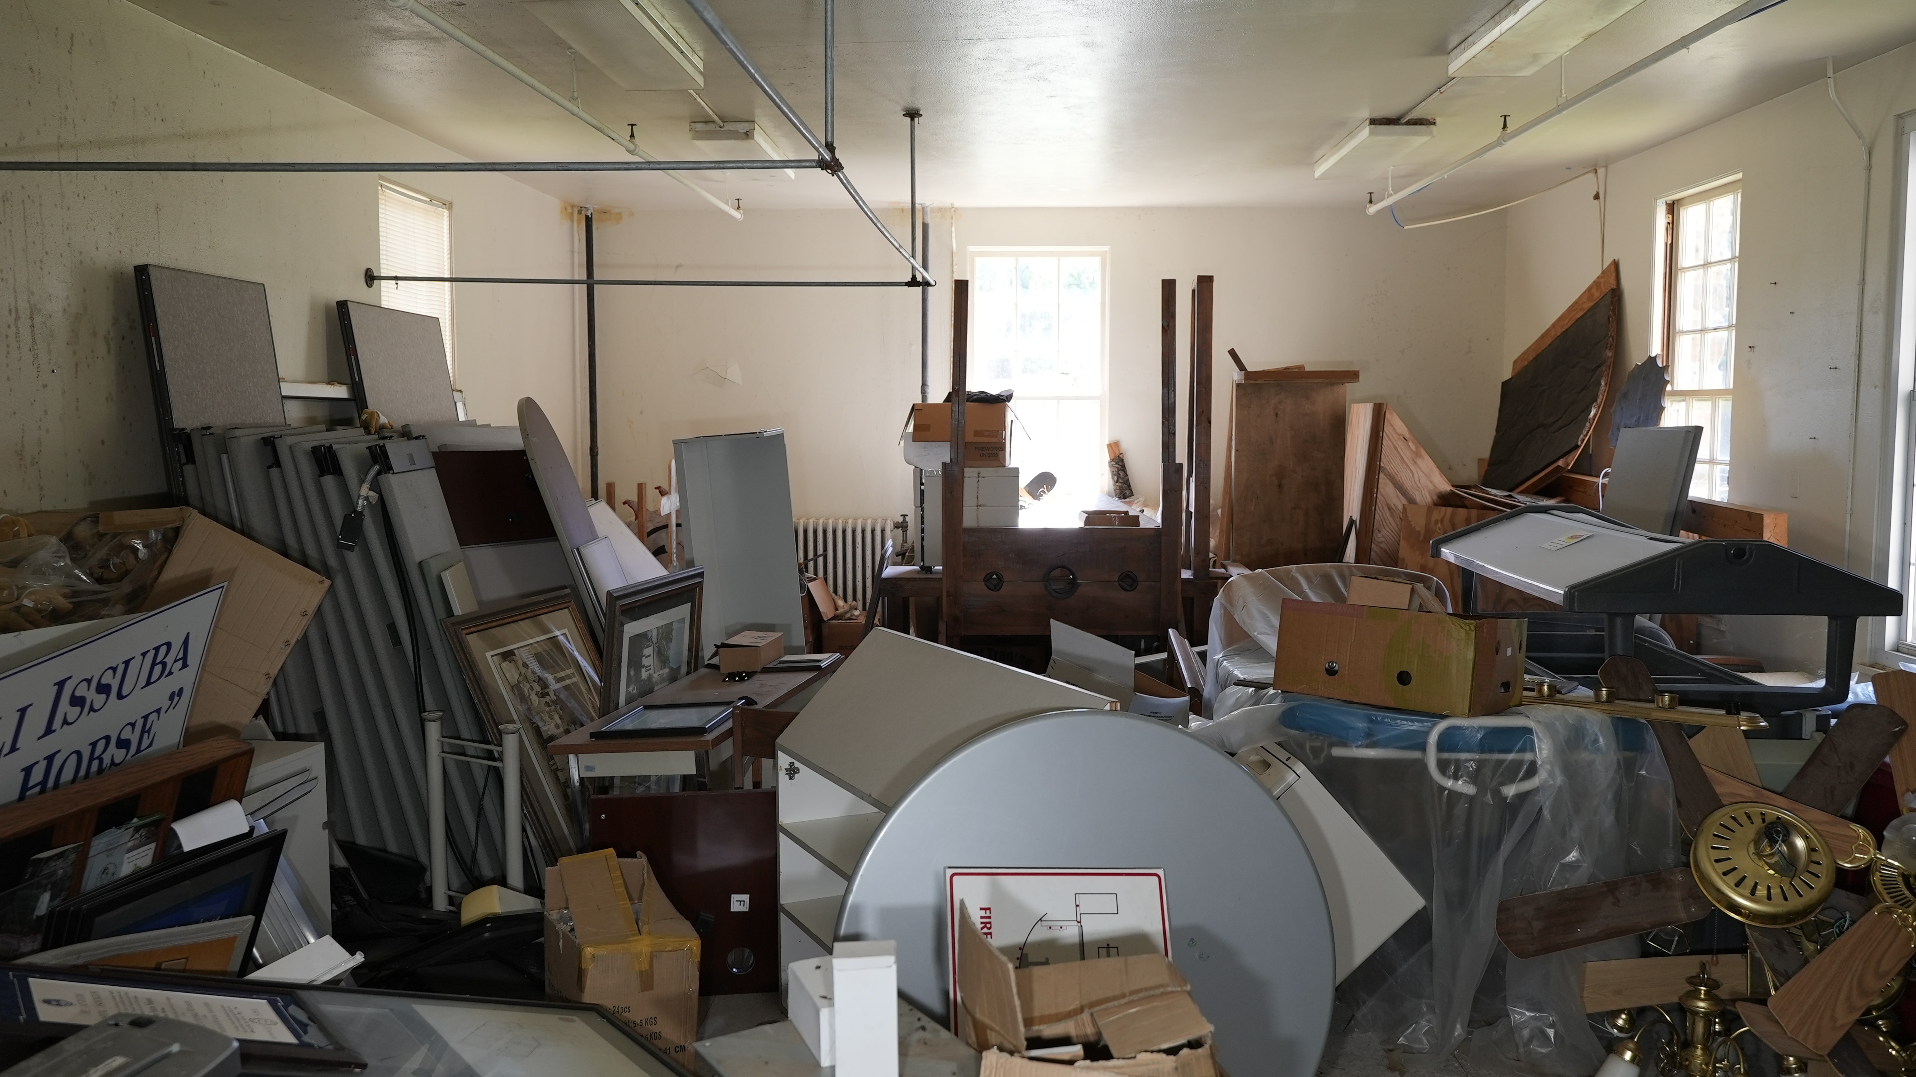
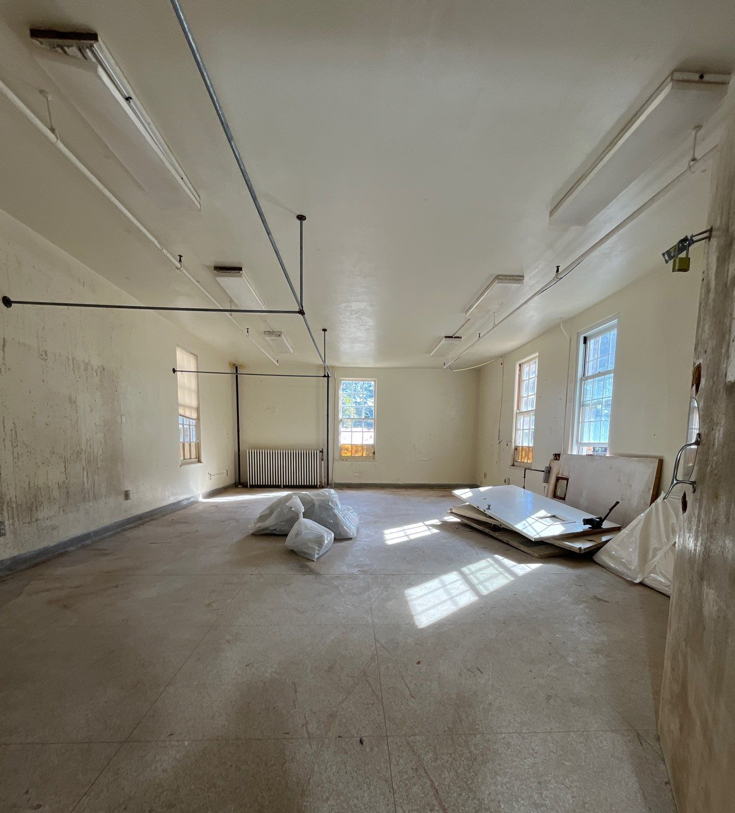
Notes:
Southeast room on first floor.

Slide 14
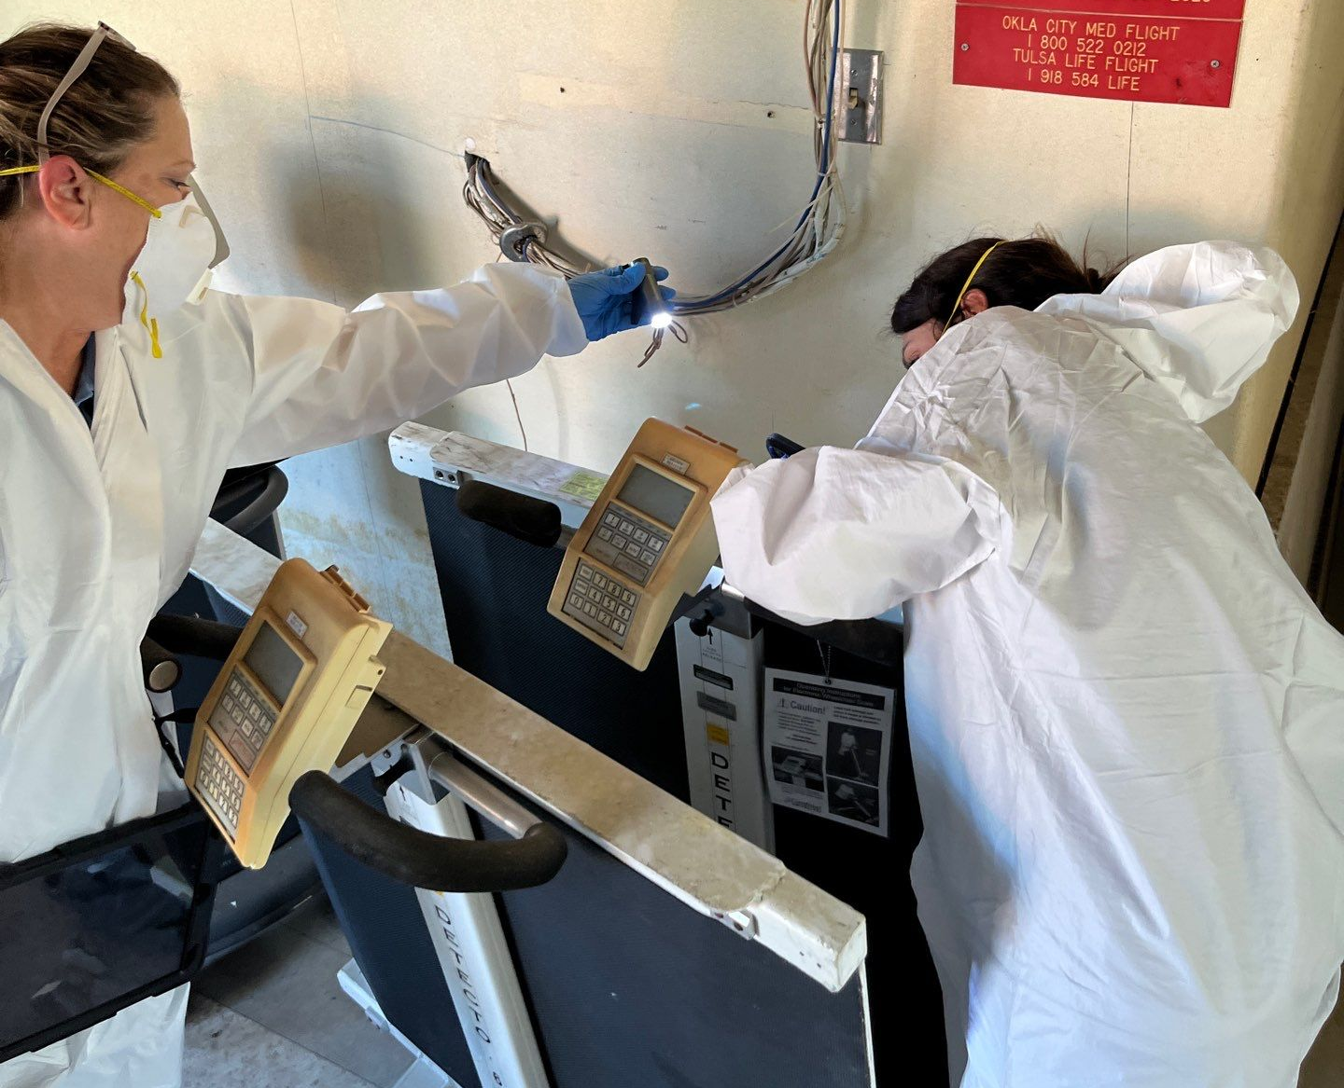
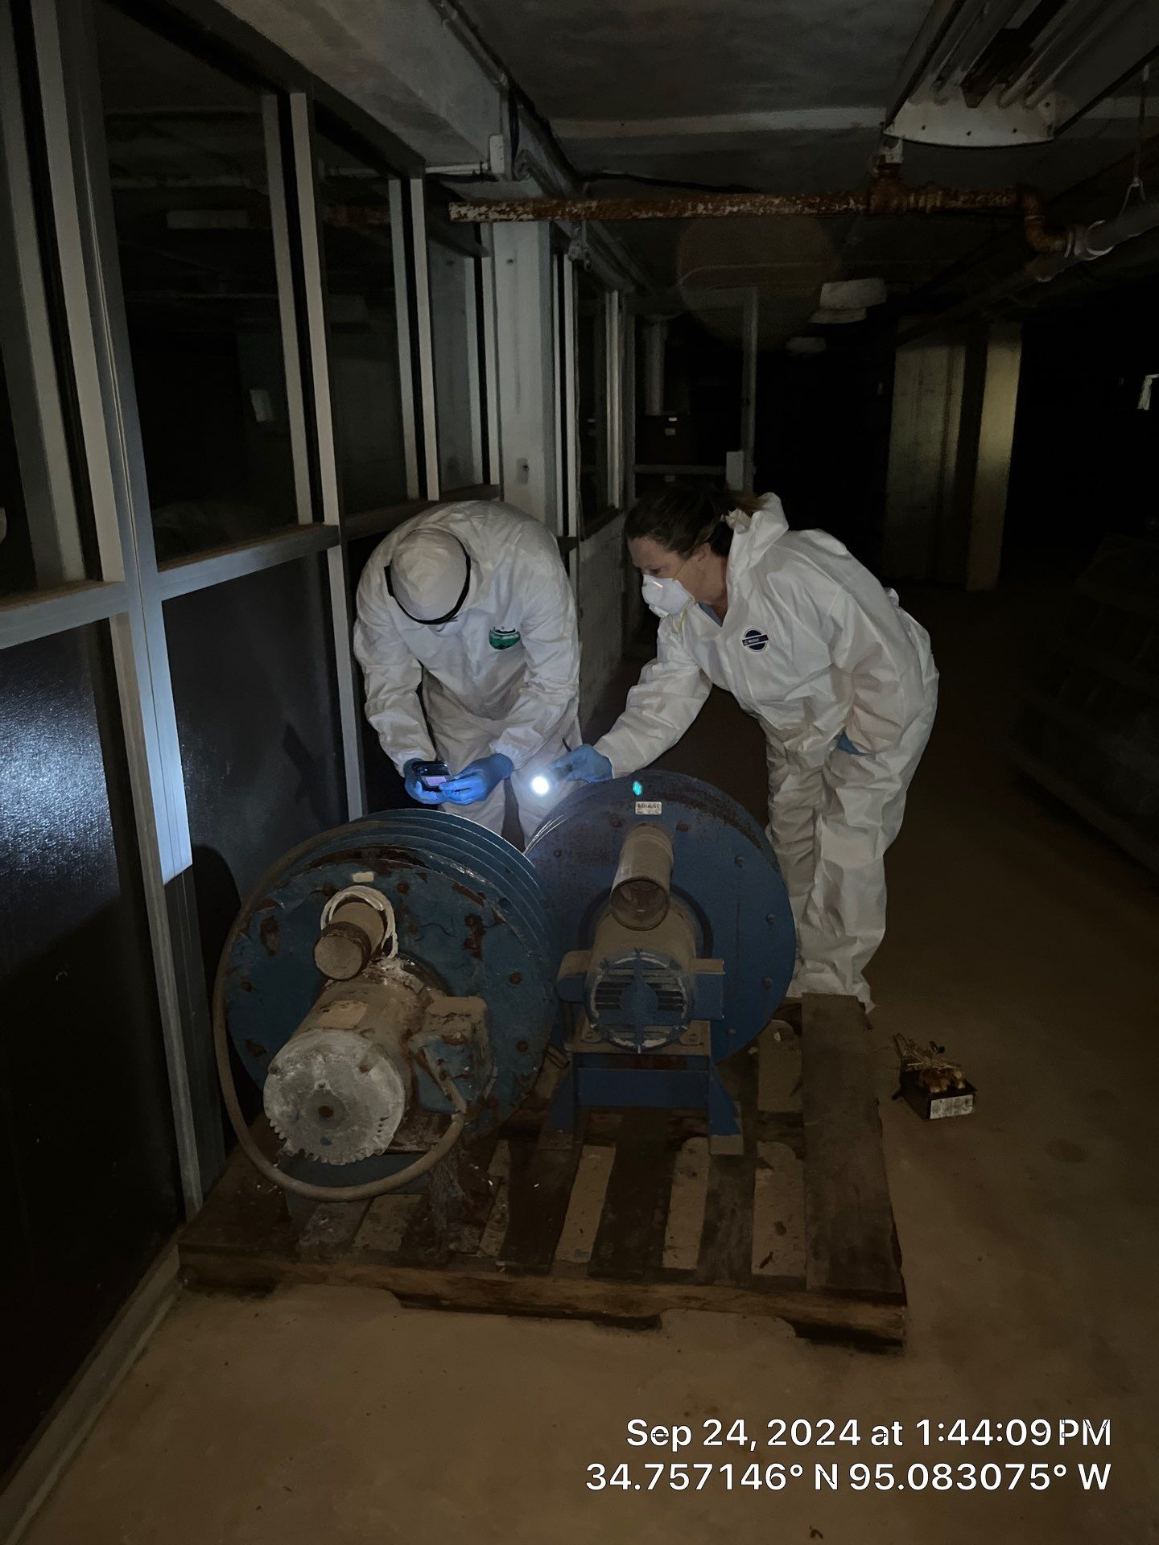
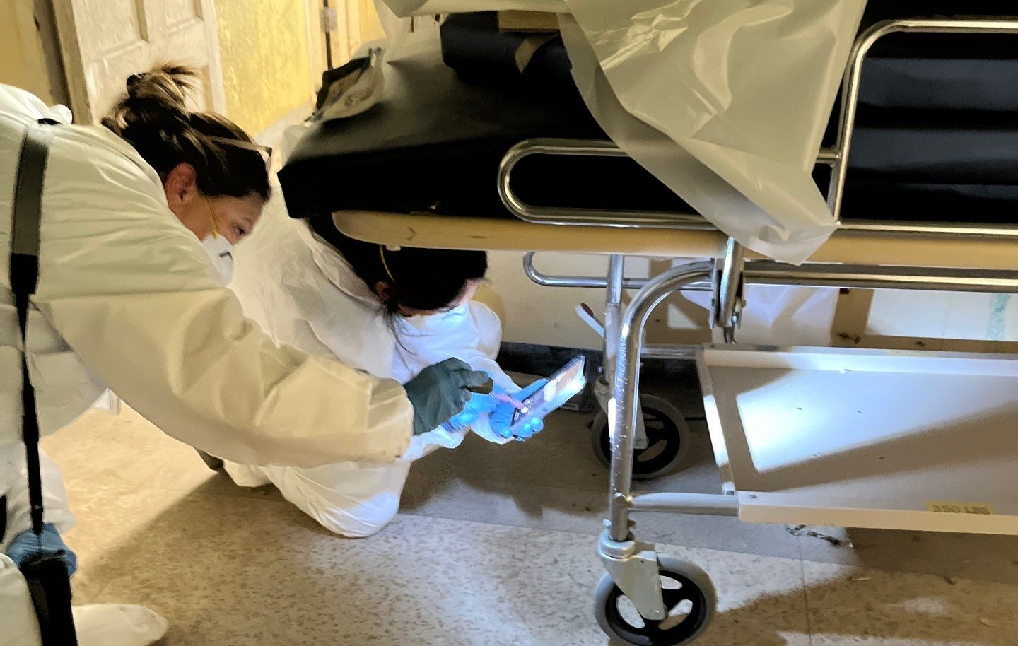
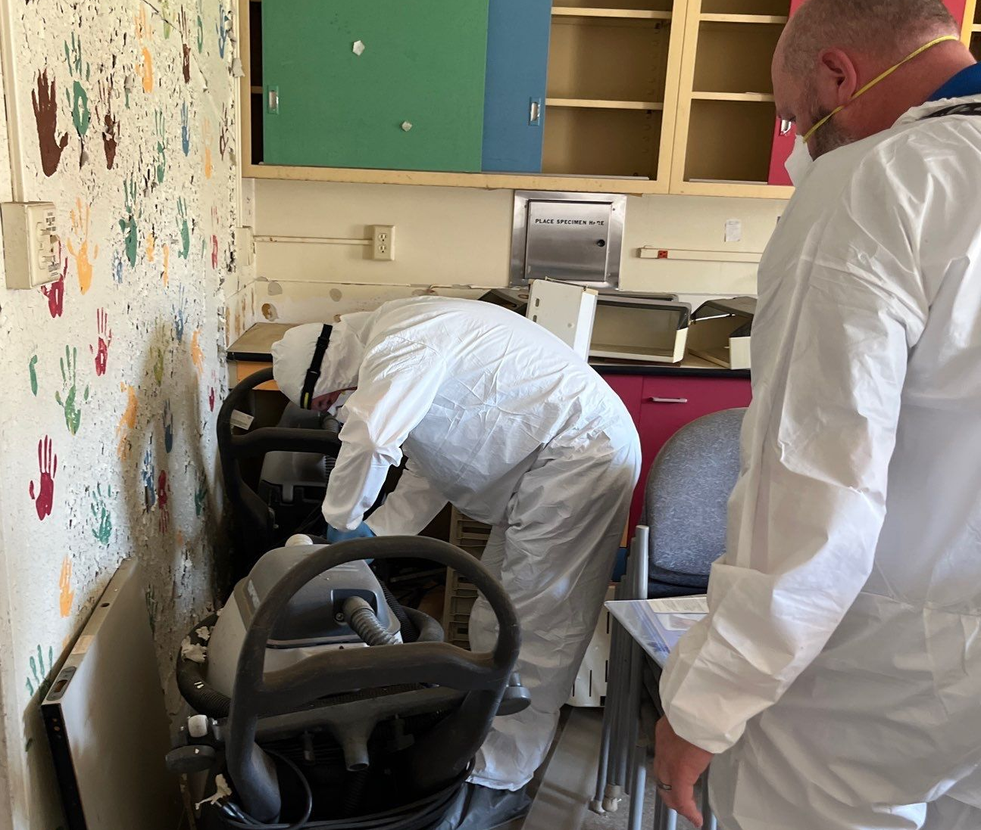
Fixed Assets on Site
September 24th, 2024, the CNO fixed assets team traveled to the OTIH to conduct inventory. Every item containing an inventory number was photographed for CNO Fixed Asset records.
Notes:
CNO Brownfields and CNO Fixed Assets collaborated on this project by taking inventory of all IHS and CNHSA item numbers throughout Building 201.

Slide 15
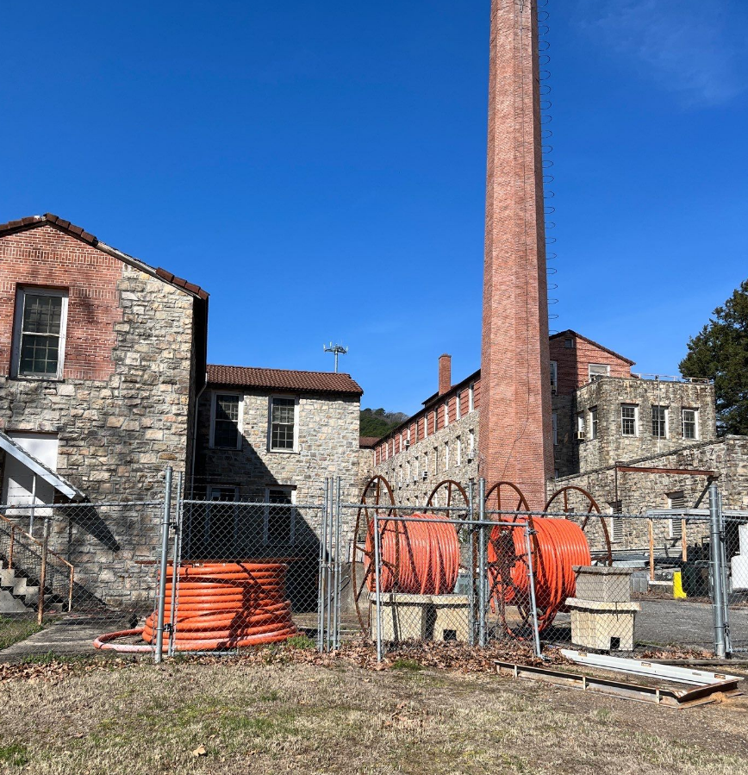
Structural Engineering Report
Repair priorities:
  Addressing the roof, with temporary repairs or a roof replacement.
  Repair and/or replace the broken windows and doors.
  Chimney Stack structural assessment
Notes:
The structural engineering report was completed in February of 2025. The priority repairs in the consultant’s opinion are the roof, windows, and doors which rainwater intrudes in from.

Slide 16
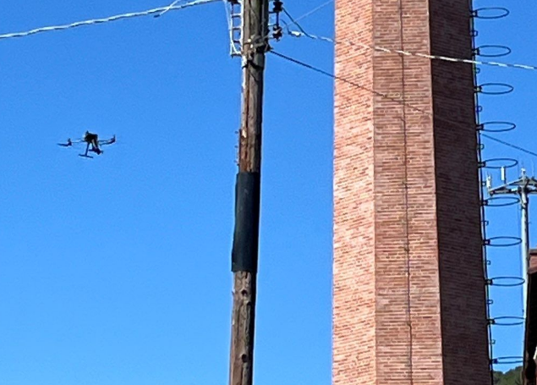
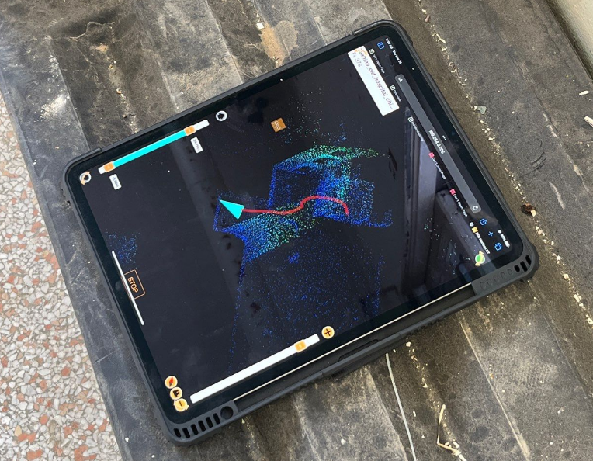
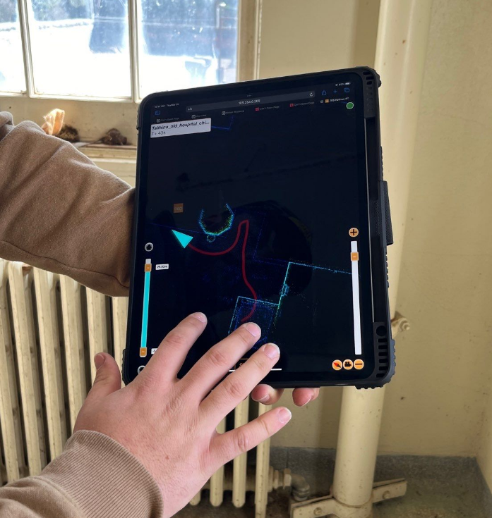
Chimney Scans
Used GeoSLAM point clouds
Report/Scan Conclusions:
  Gave indications that the base is solid, but limited how high we could go
  Inconclusive
Notes:
The structural engineering report was completed in February of 2025. The priority repairs in the consultant’s opinion are the roof, windows, and doors which rainwater intrudes in from.

Slide 17
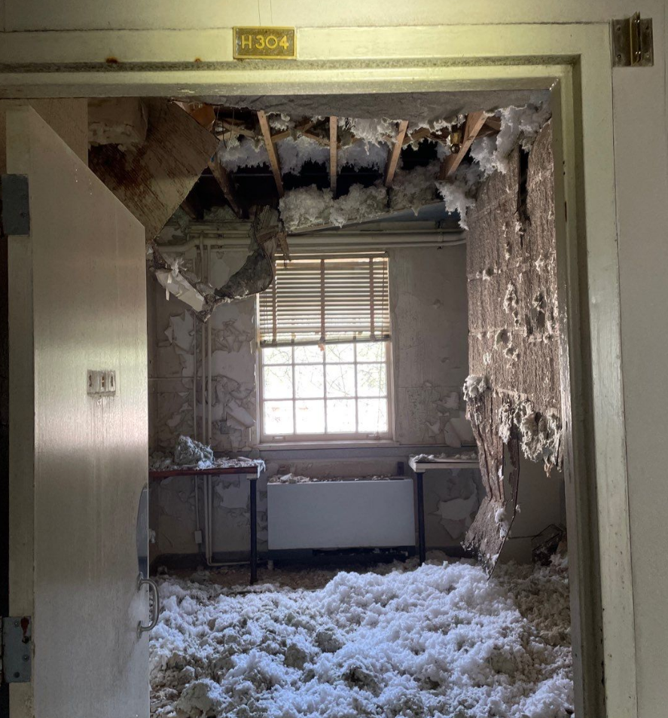
Phase II Site Assessment Results
Soils surrounding 201:
  ORO, DRO, and GRO found in soils
  Benzene (VOCs) in soils
  Benzene and other VOCs in groundwater
Asbestos/LBP Inspections
  Friable asbestos found in interstitial areas, areas prior abatements could not reach.
    (Photo) These areas are now exposed.
  Lead-based paint in poor condition throughout
Notes:
The structural engineering report was completed in February of 2025. The priority repairs in the consultant’s opinion are the roof, windows, and doors which rainwater intrudes in from.

Slide 18
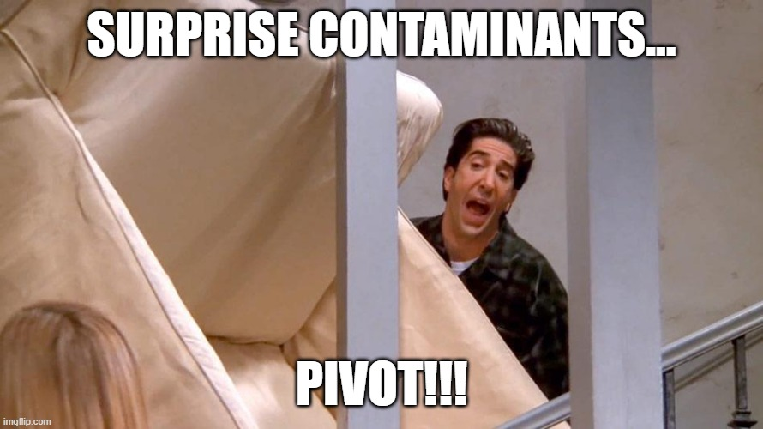
Conclusions and Pivot Approach
Separate out soils/groundwater to be addressed with FY25/26 BIL funding
  Previously aligned for OTIH
  Conceptual Site Model investigation would not align with timeline of Multipurpose completion date of Sept. 2027
Move forward with asbestos and lead-based paint abatements in building.
Notes:
This is the chimney located in the boiler room, on the northeast side of the building.

Slide 19

PIT Re-engagement
Community Outreach through Historic Preservation community meetings and collection of stories
  Collecting stories of community experiences at or of the Old Hospital-still in planning stages
  Both virtual and in-person avenues
Constant struggle to keep Senior Leadership engaged
  Next meeting will be in July/August after abatement.
Notes:
This is the chimney located in the boiler room, on the northeast side of the building.

Slide 20
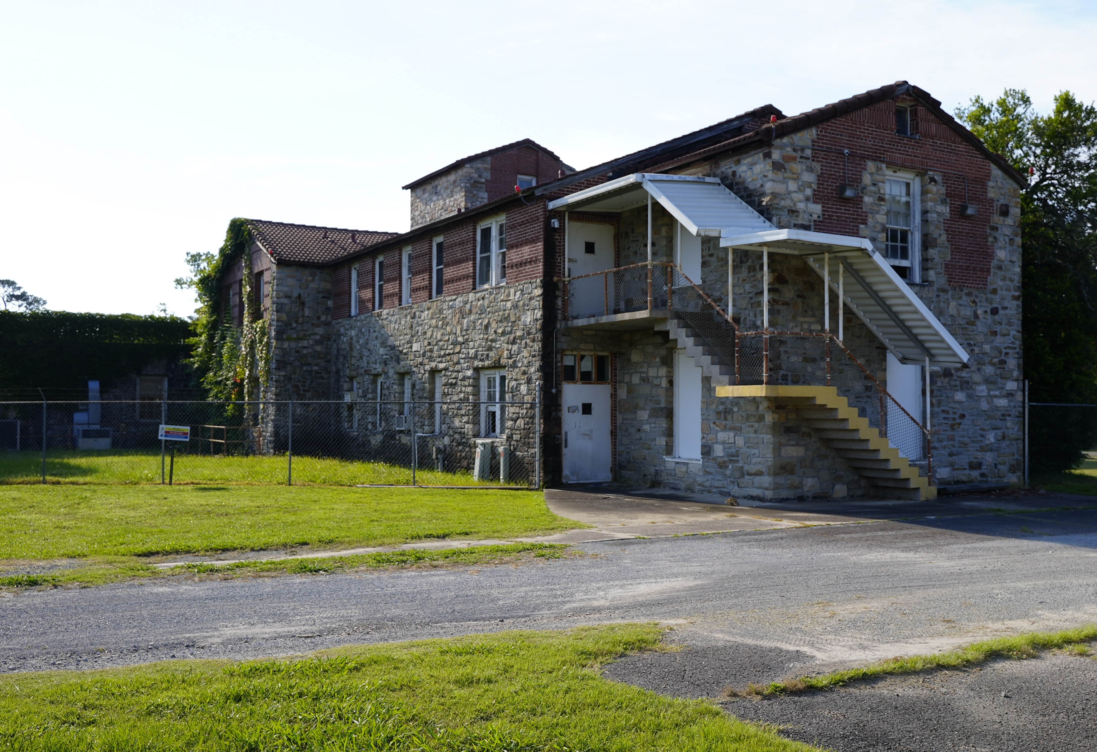
Next steps
Abbreviated ABCA process completion-
  Abbreviated ABCA process to move quickly to abatement. (ABCA required by 104(k).)
Asbestos and Lead-Based Paint abatement within 201
Site Reuse Assessment for overall campus
Supplemental Phase II Sampling in soil and groundwater below and around 201
  TPH, VOCs, ORO, DRO, GRO
Notes:
The remaining next steps are to complete a Phase II ESA, where a consultant will sample the building for contamination. The consultant will write a Phase II report detailing where any contamination is located within Building 201. Once the Phase II is completed CNO Brownfields will continue the brownfields process and conduct an ABCA report. The ABCA will give us an environmental professional’s opinion on the options to remediate the contamination within Building 201.

Slide 21
Site reuse plan includes input from the Project Involvement Team members:
Teresa Jackson- SEO Tribal Services
Daron Sharp- Executive Director Risk Management
Todd Hallmark- Executive Director Health Services
Jay Johnson- Executive Director of Construction
Rolene Schliesman- Architectual Historian
Tye Baker- Senior Director Environmental Protection Service
Halann Elliott- Senior Director Performance Analytics
Ian Thompson- Tribal Historic Preservation Officer
Lakesha Hawkins- Environmental Specialist
Notes:
Two meetings with the project involvement team stakeholders has taken place – one in 2023, and one in 2024. Our stakeholders include CNO Historic Preservation, Economic Development, Risk Management, Construction, Grants, Health Services, and Environmental Assessment. These meetings are used to update stakeholders on project tasks and objectives. The next project involvement team meeting will occur after the Phase II ESA is completed.

Slide 22
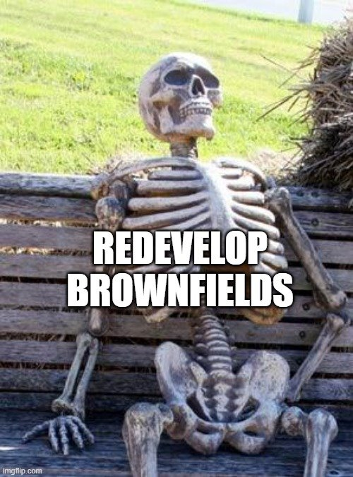
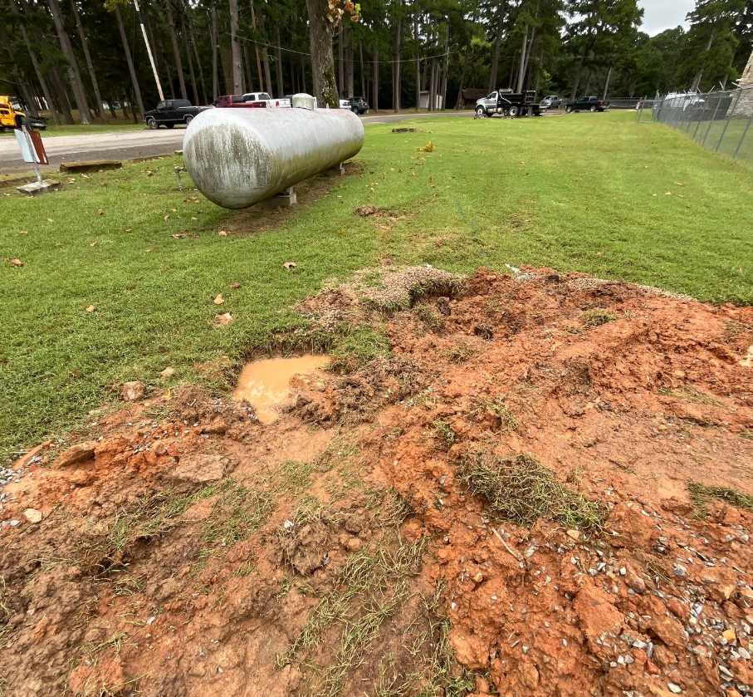
Lessons Learned:
Nothing will be as simple as it seems
Things will go WRONG!
Break up large sites into individual sites by building or area of concern.
MAKE A PLAN prior to the grant!
  You may need it sooner than expected.
Keeping a committee engaged on a single complicated project is HARD!
Need more than just site sampling and cleanups for redevelopment!
Notes:
The remaining next steps are to complete a Phase II ESA, where a consultant will sample the building for contamination. The consultant will write a Phase II report detailing where any contamination is located within Building 201. Once the Phase II is completed CNO Brownfields will continue the brownfields process and conduct an ABCA report. The ABCA will give us an environmental professional’s opinion on the options to remediate the contamination within Building 201.

Slide 23

Yakoke Fehna!
Questions?

