Slide 1
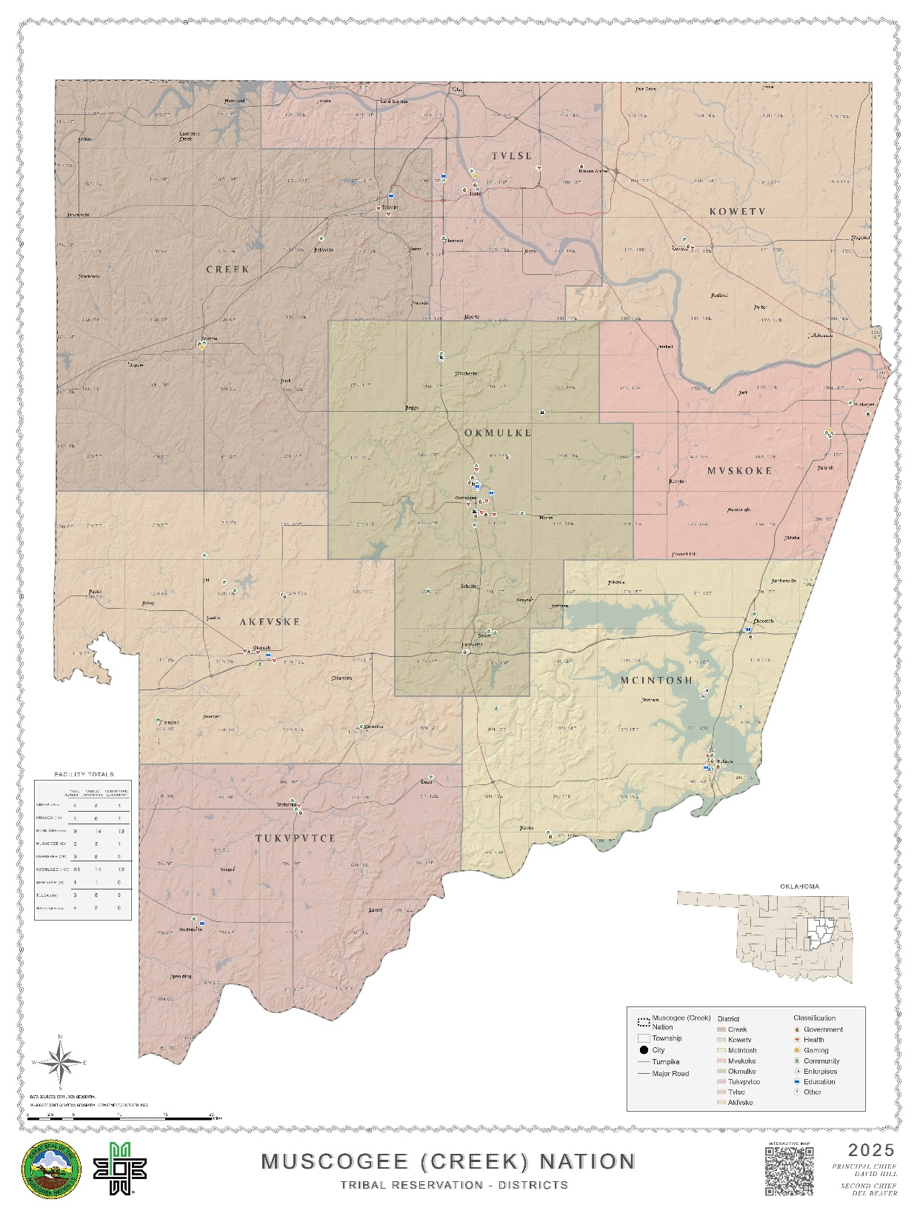
Muscogee (Creek) Nation
Brownfields Data Management
11 County Tribal Reservation
Okmulgee, Oklahoma
Frank Harjo
Muscogee (Creek) Nation
05.05.26

Slide 2
Tribal Data Management
Data Sovereignty and Ownership
CARE principles for Indigenous Data Governance
Collective Benefit = Data ecosystems shall be designed and function in ways that enable Indigenous Peoples to derive benefit from the data
Authority to Control = Indigenous Peoples have the right to govern their own data and their authority to control such data respected
Responsibility = Those working with Indigenous data have a responsibility to share how that data are used to support Indigenous Peoples self-determination and collective benefit
Ethics = Data governance must minimize potential harm, maximize benefits, and ensure data does not portray indigenous peoples, cultures, or knowledge in a deficit light
Each Tribe is unique and has their own rules/regulation for governing their data

Slide 3
PROJECT AND RECORDS MANAGEMENT (RecMan)
Custom Project Management (Workflows) ➔ ArcGIS Tools ➔ Logical Docs Database Archive/Storage
Broader Project Management collaboration and notification among MCN staff
Develop custom MCN project workflow templates as needed (Tribal/Federal Funds?)
Allows each department to work independently and to record MCN Land/Facility documents to a central database (Logical Docs)
Workflows determine who needs to be involved in the tasks and the completion of individual steps

Slide 4
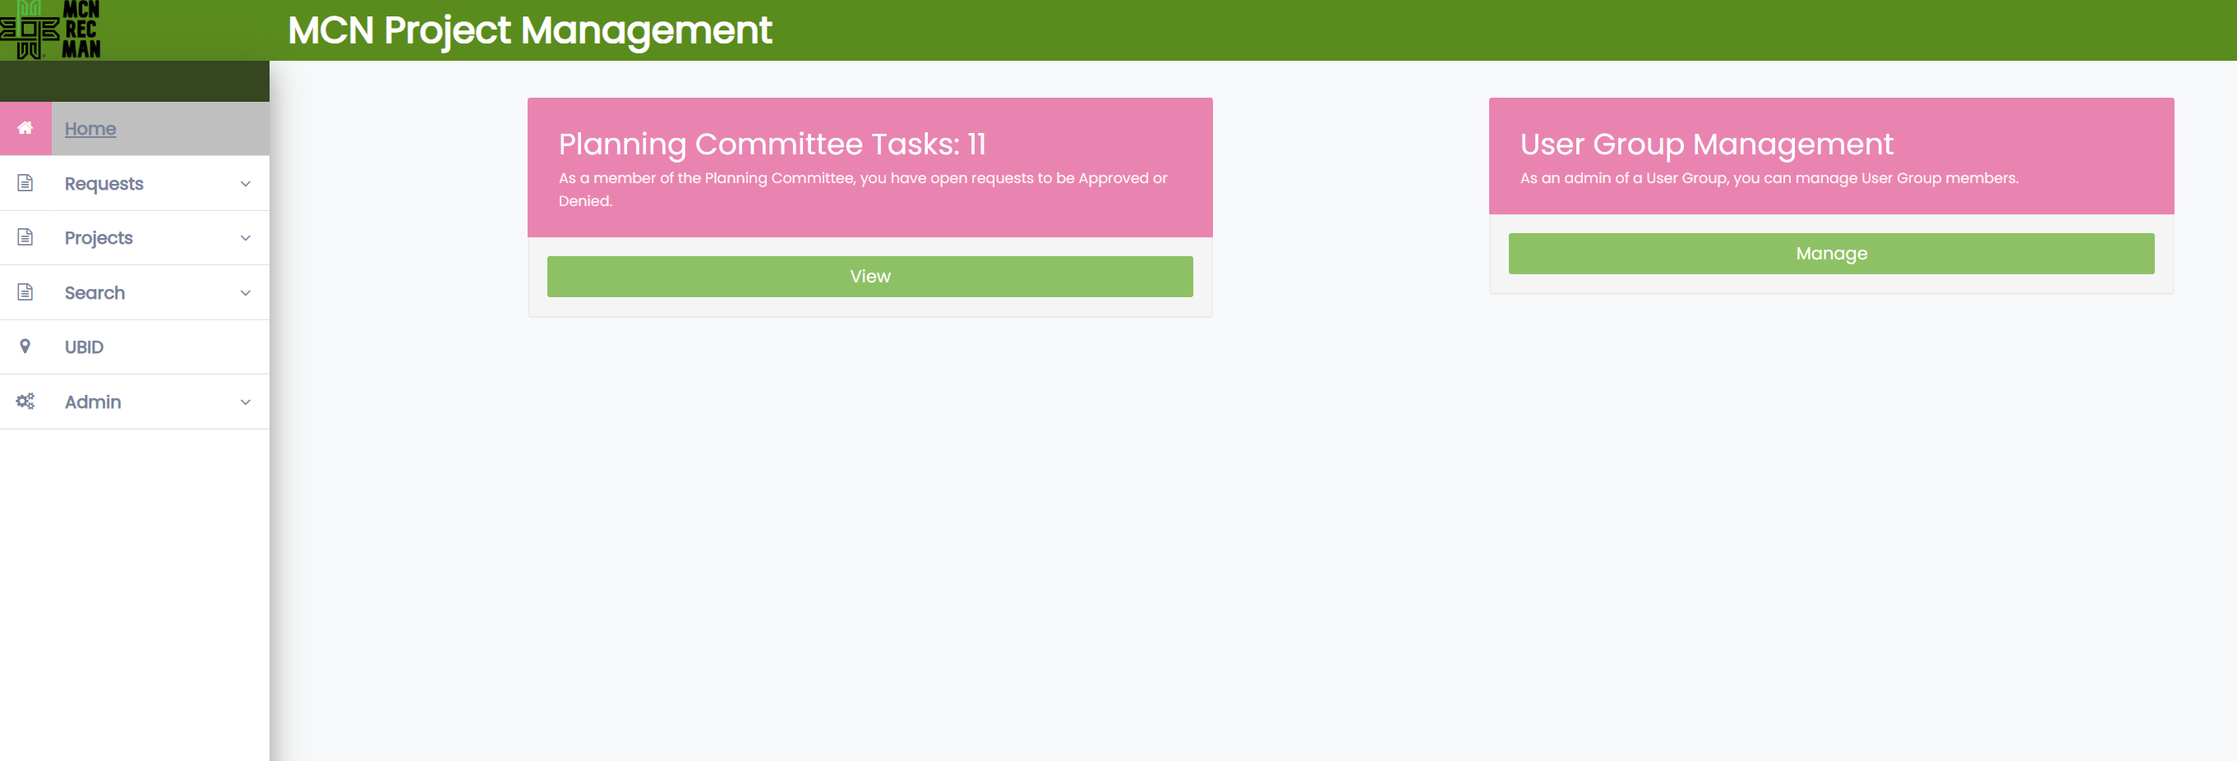
MCN Brownfields Project Management
Requires key data inputs for effective data and document management
Miranda Stiles, Database Analyst/Programmer

Slide 5
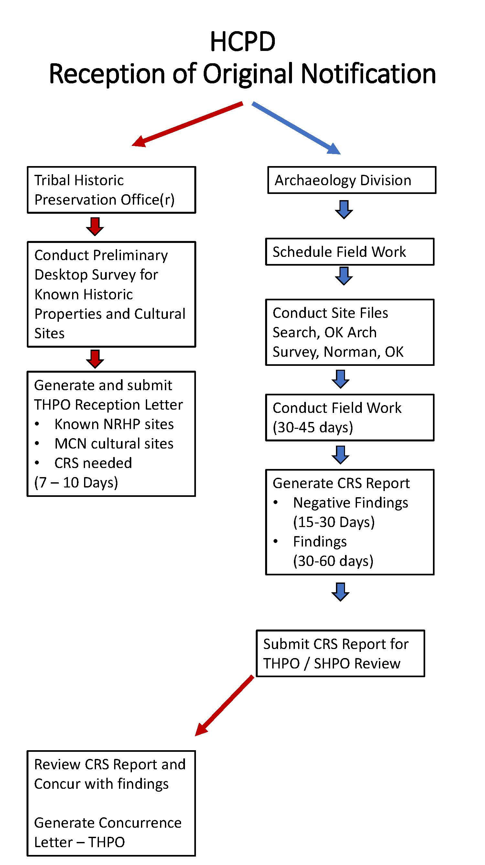
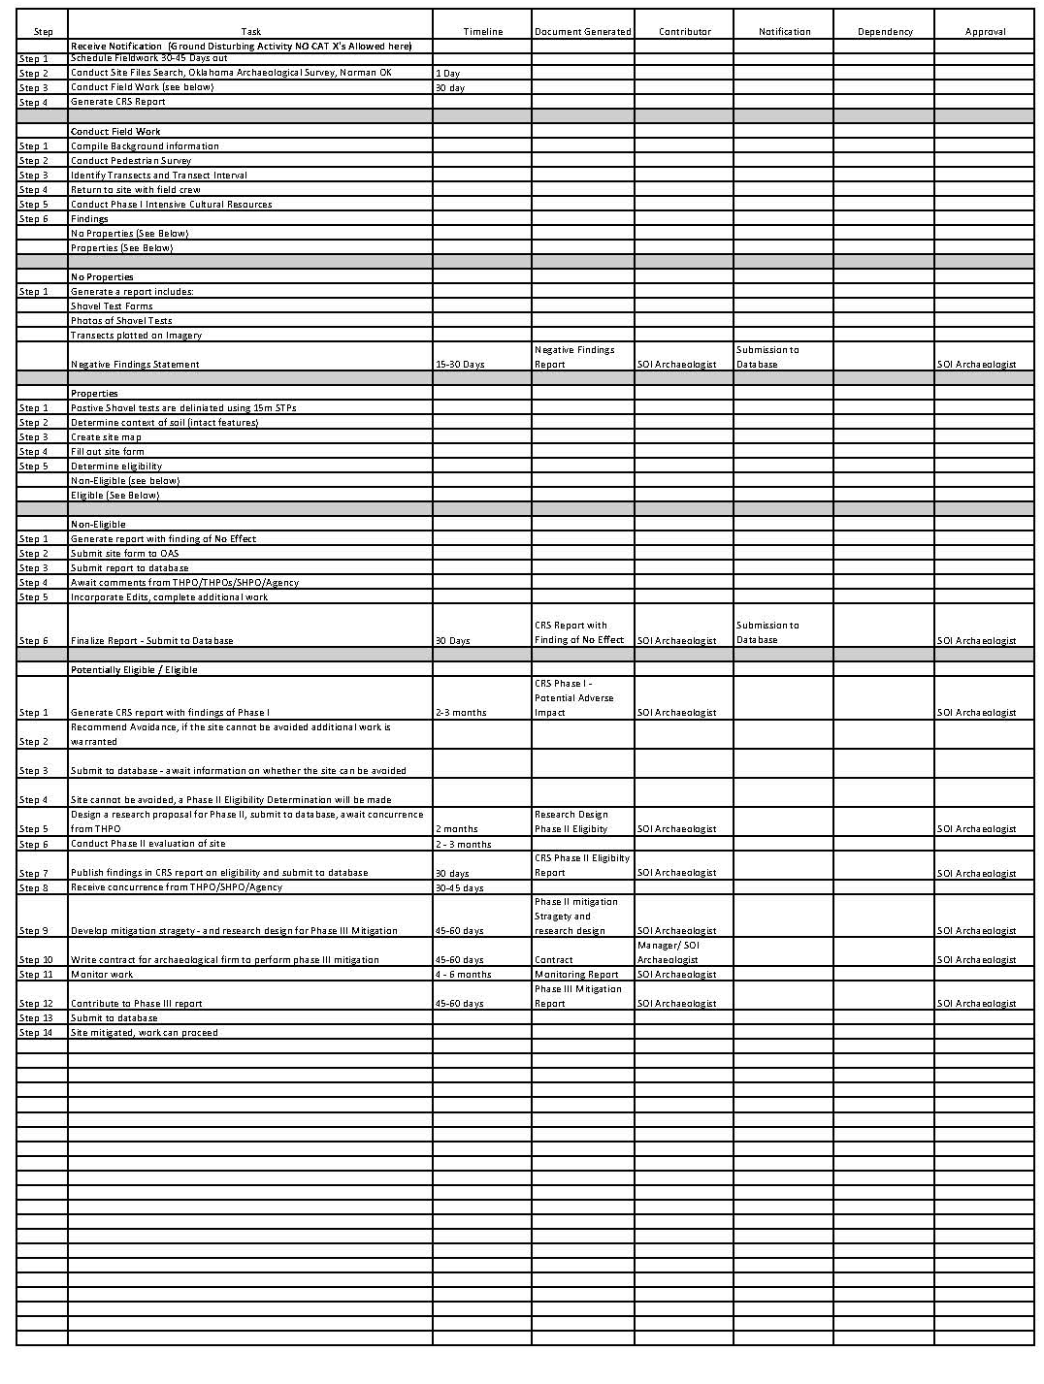
Example Workflows

Slide 6
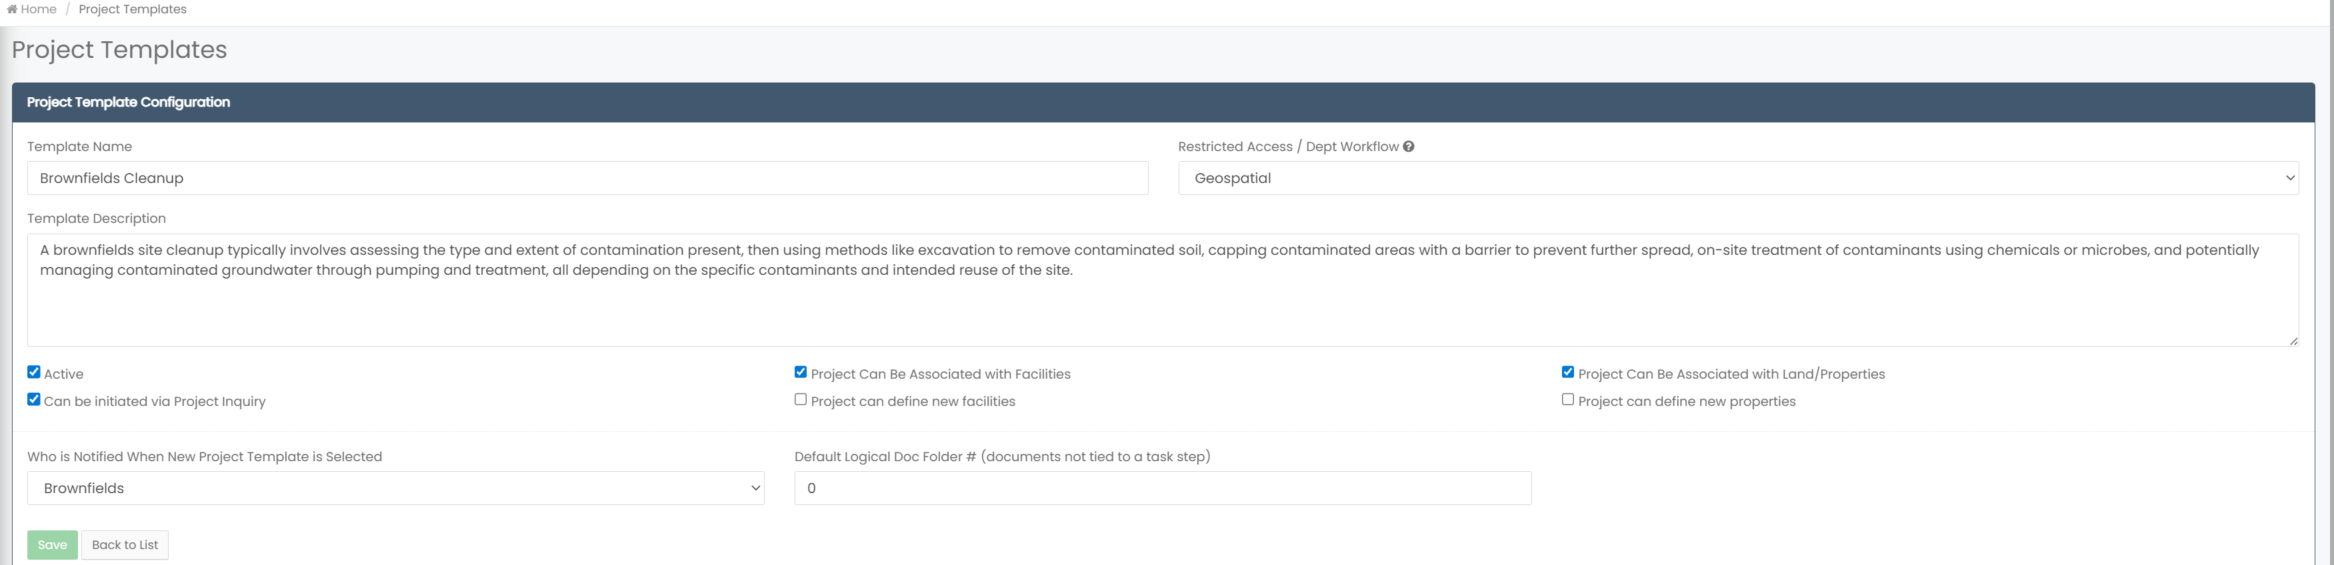
Brownfields Cleanup Workflow Description
Requires key data inputs for effective data and document management

Slide 7
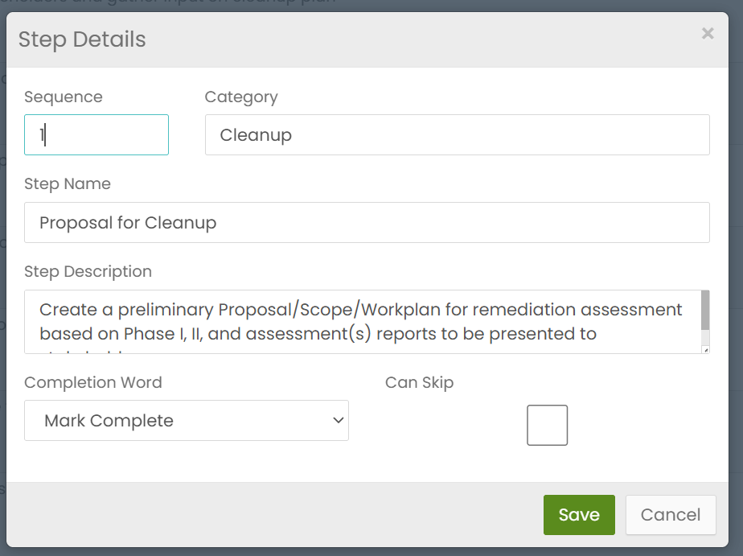
Brownfields Workflow Step Description
Capture required data specific to this workflow step
Maintains consistency and accuracy across all steps

Slide 8
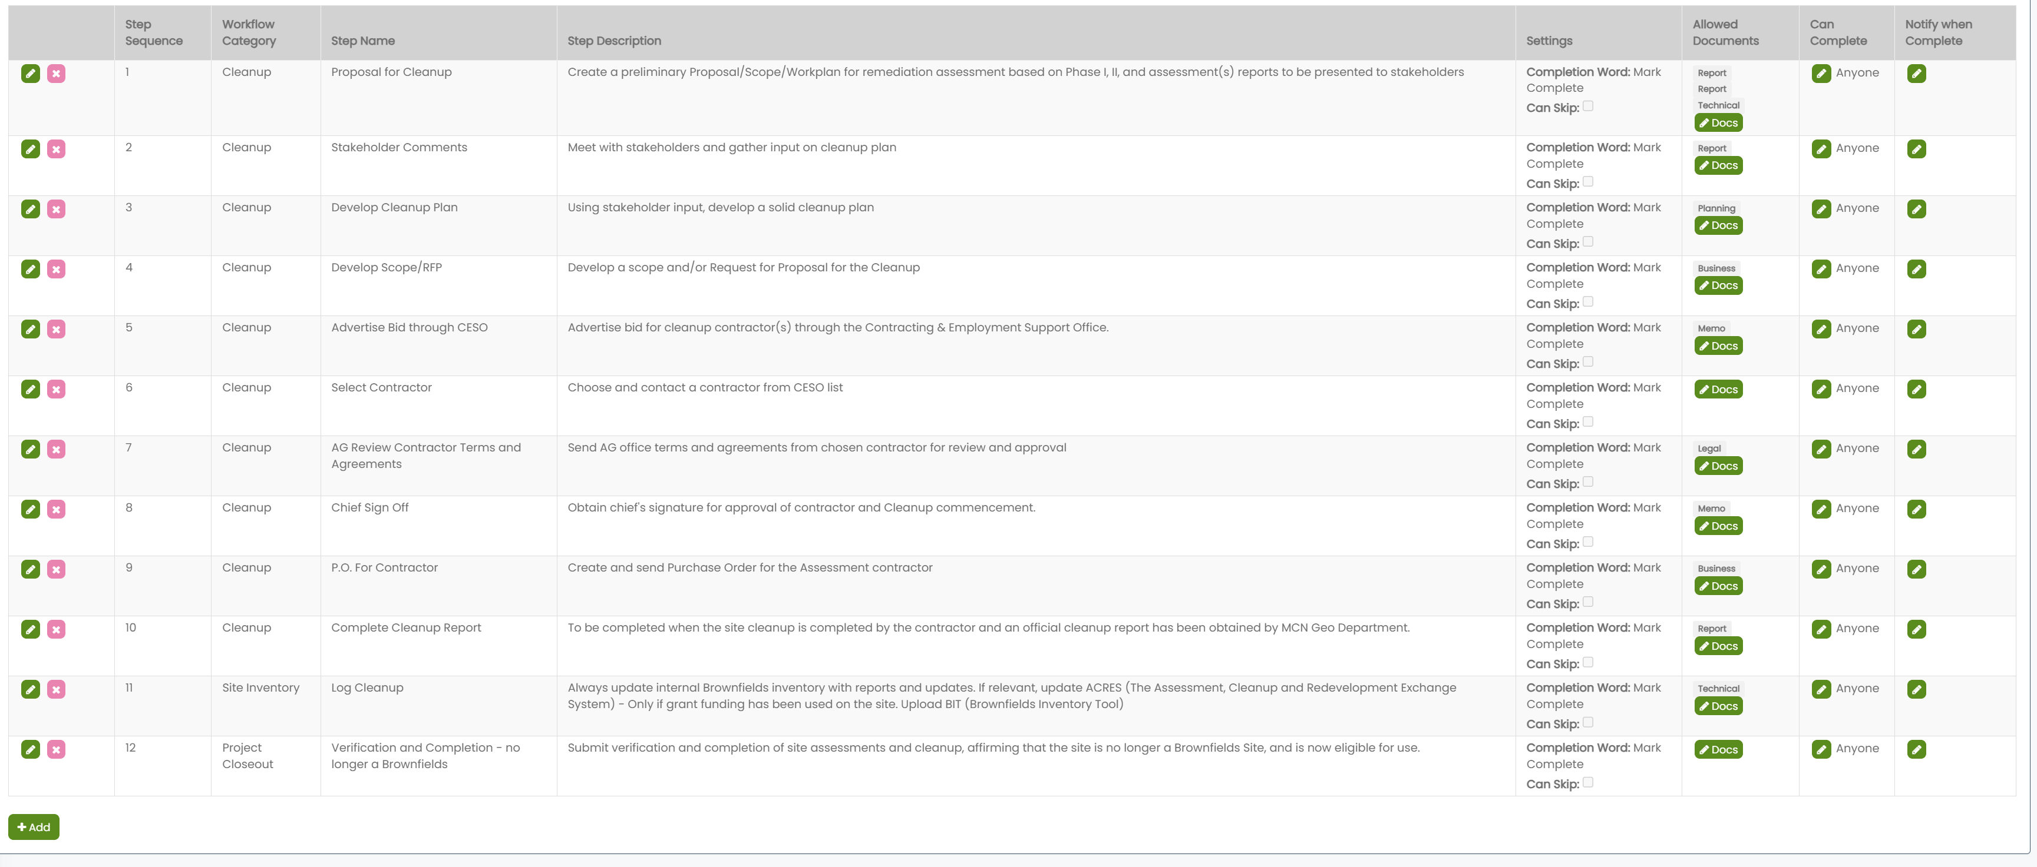
Brownfields Cleanup Workflow Steps
Centralize documents, data, and communication
Integrate with existing tools and systems
Maintain a clear audit trail for transparency

Slide 9
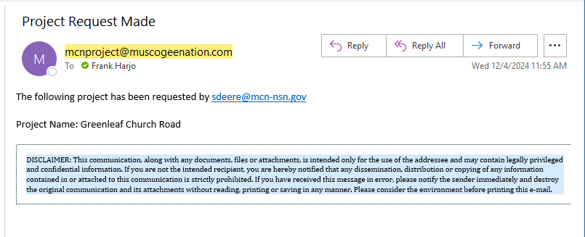
Project Request Notification/Steps
Receive email from mcnproject@muscogeenation.com once form is submitted
  Project Request Made in subject line
  Email registered
  Project Name

Slide 10
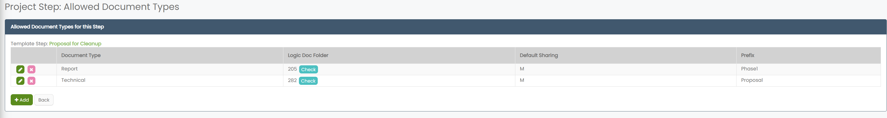
Allowed Documents Per Workflow Step
Each document type is assigned a folder number aligns with the backend system

Slide 11
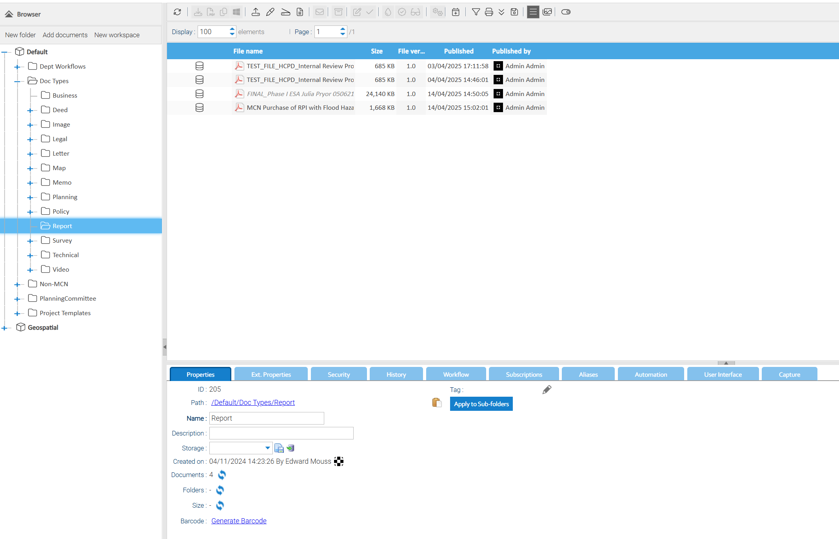
Document Management System:
Logical Docs

Slide 12
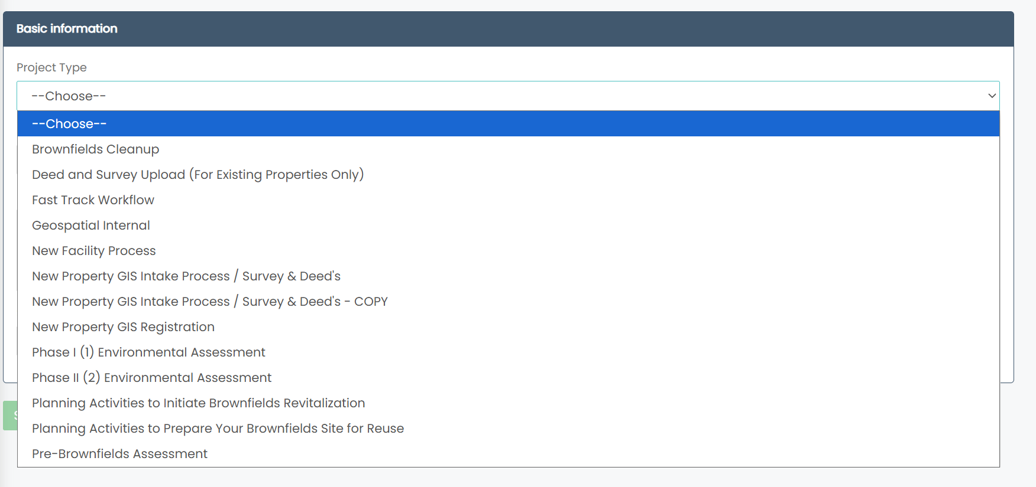
How Do Users Initiate the Workflow?
User group permissions control access to Brownfields workflows in the dropdown menu

Slide 13
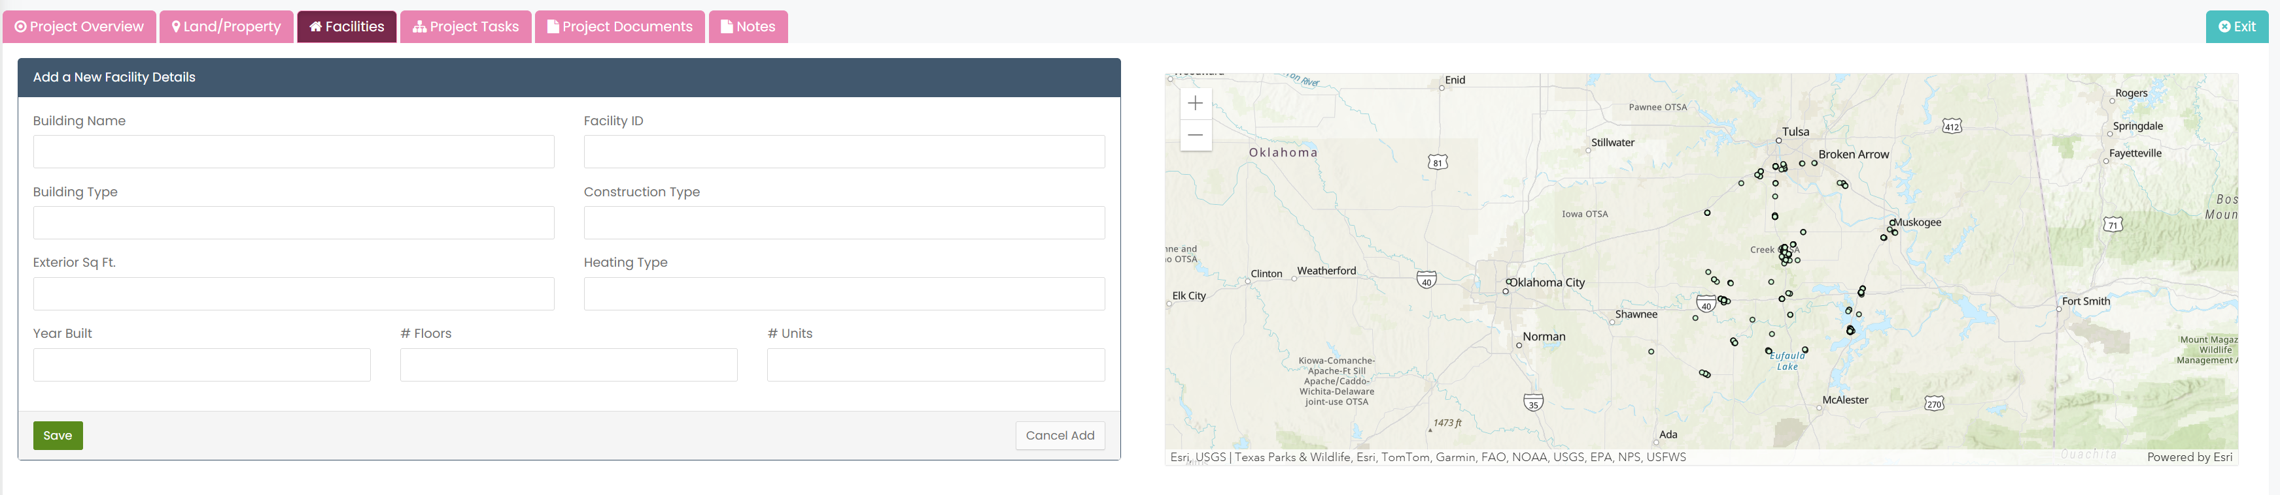
Facility Details
Facility Details

Slide 14
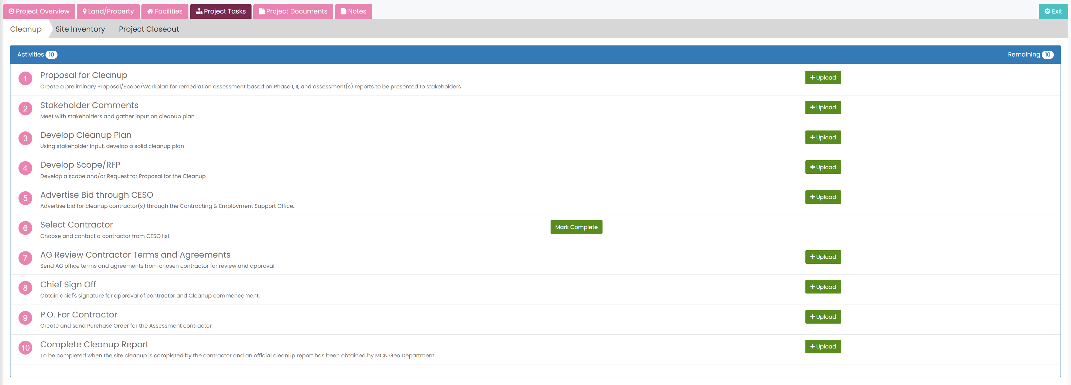
Managing User Tasks
User group permissions control access to Brownfields workflows in the dropdown menu

Slide 15
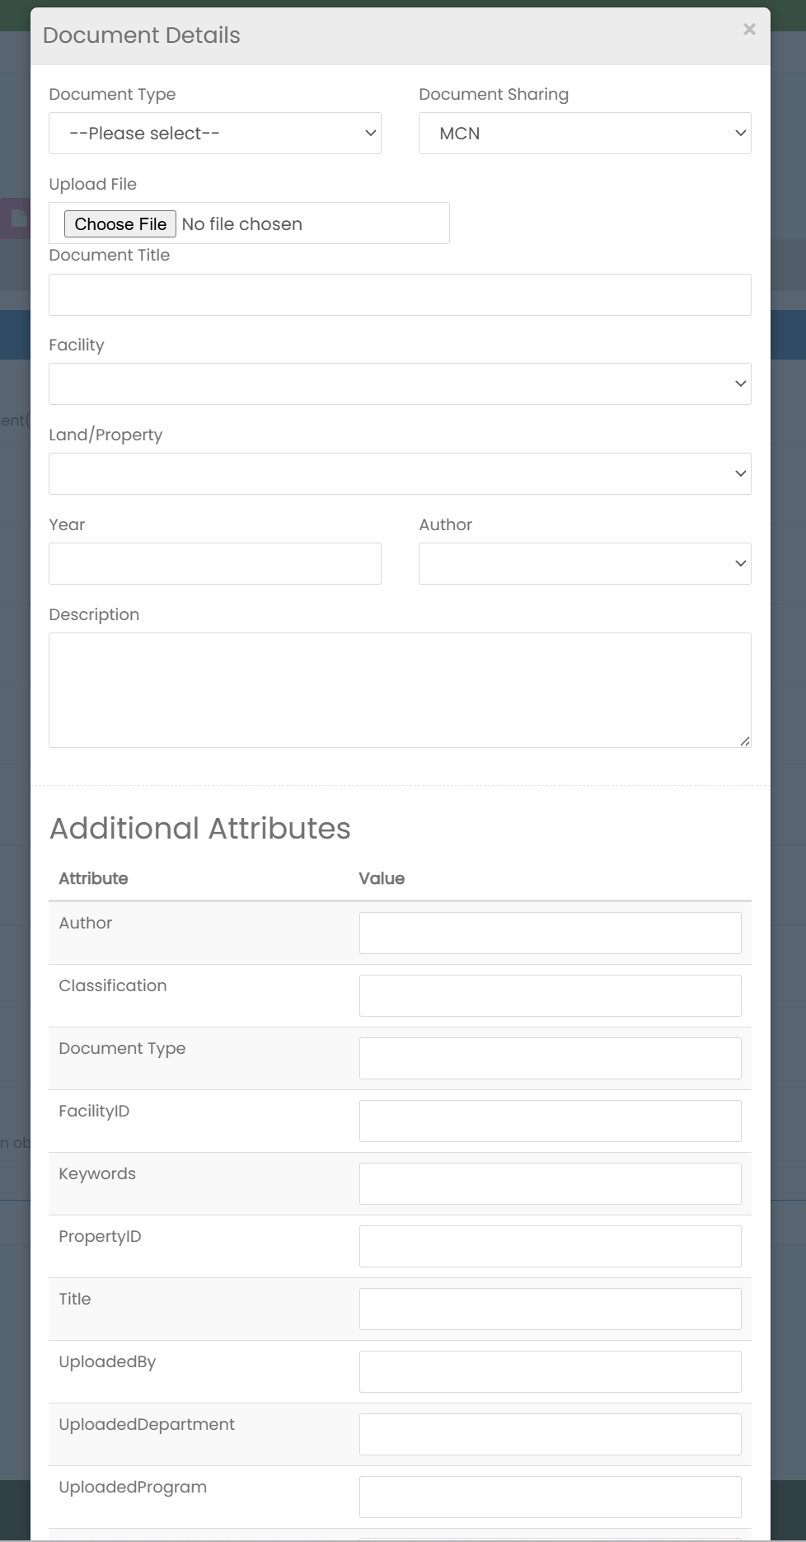
Document Attributes

Slide 16
Managing User Tasks
Shows documents needed at each stage of the workflow
Review process and rollback possibility if inaccurate

Slide 17
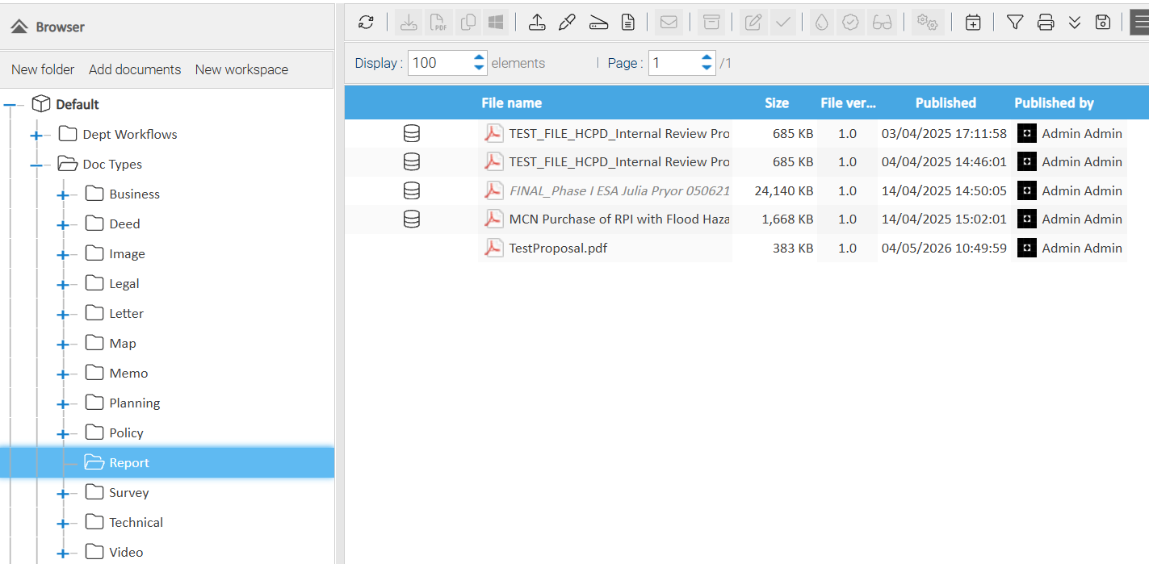
Backend Management

Slide 18
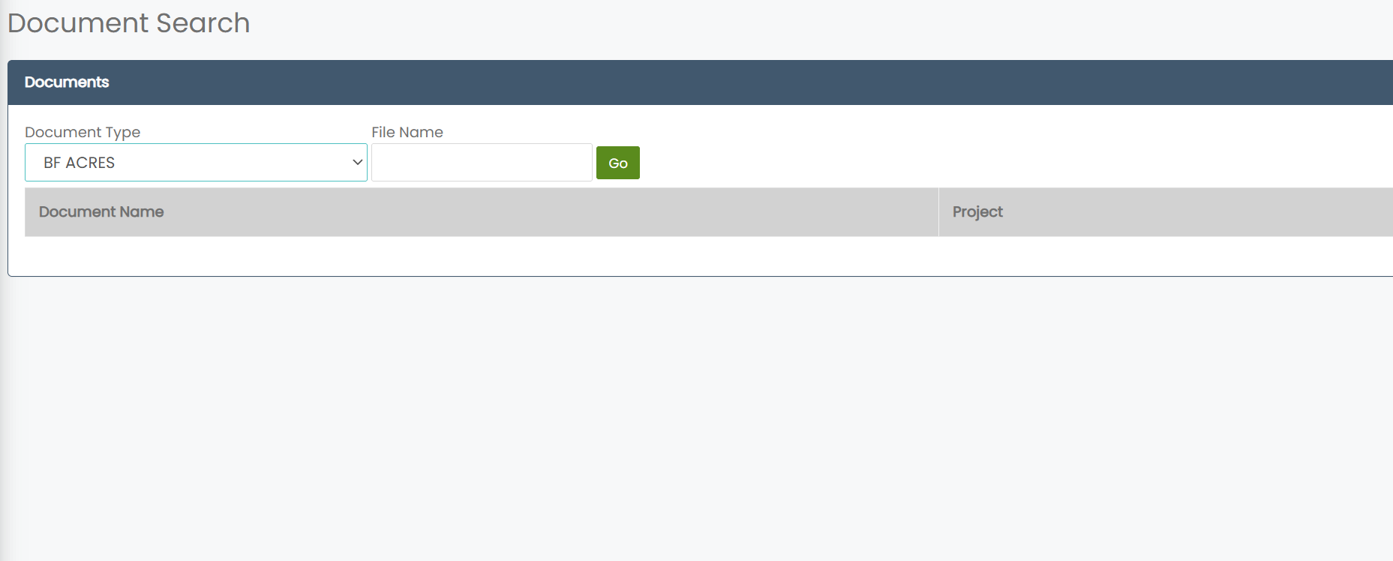
Document Search Function
Search by document type with prefix
Search by file name

Slide 19
Case Study #2
Visual Data Analysis

Slide 20
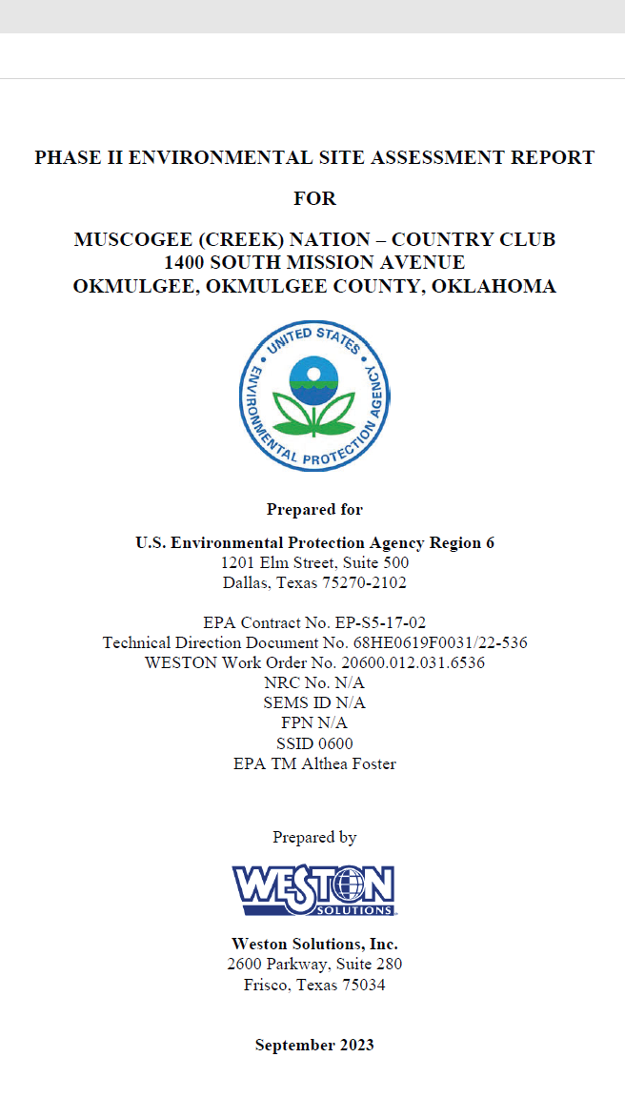
Phase 2 Report:
COUNTRY CLUB SITE
Audrey Southwick – GIS Coordinator
8,301 Page Report
Multi-story historical building

Slide 22
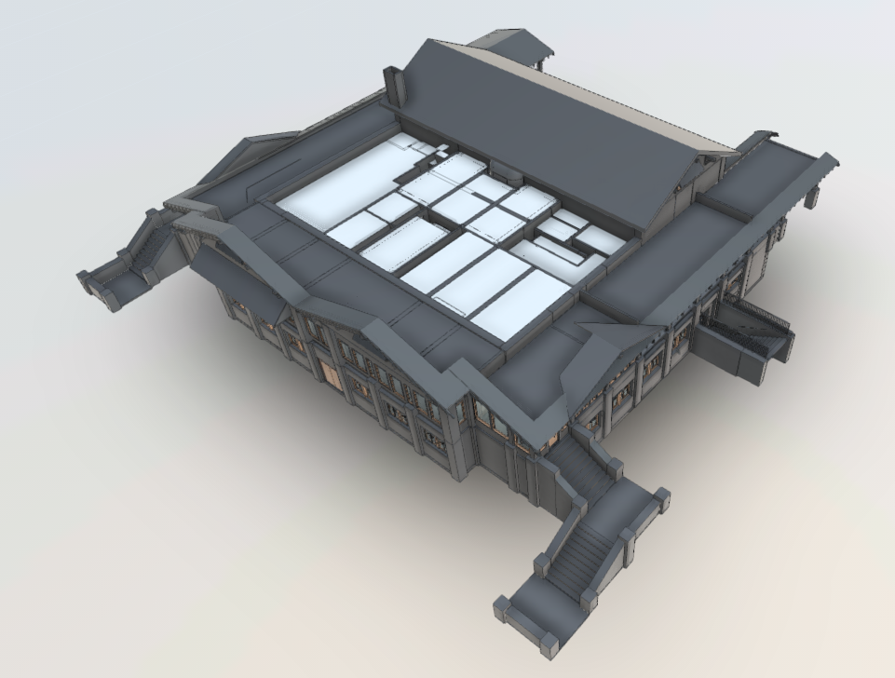
ArcGIS Indoors for Brownfields
MCN Country Club – Contaminate Mapping
Project Goals:
Utilize Esri’s ArcGIS Indoors platform to
create floor aware datasets.
Synthesize information from a PDF report to
an interactive application.
Analyze data to find high priority areas for cleanup.

Slide 23
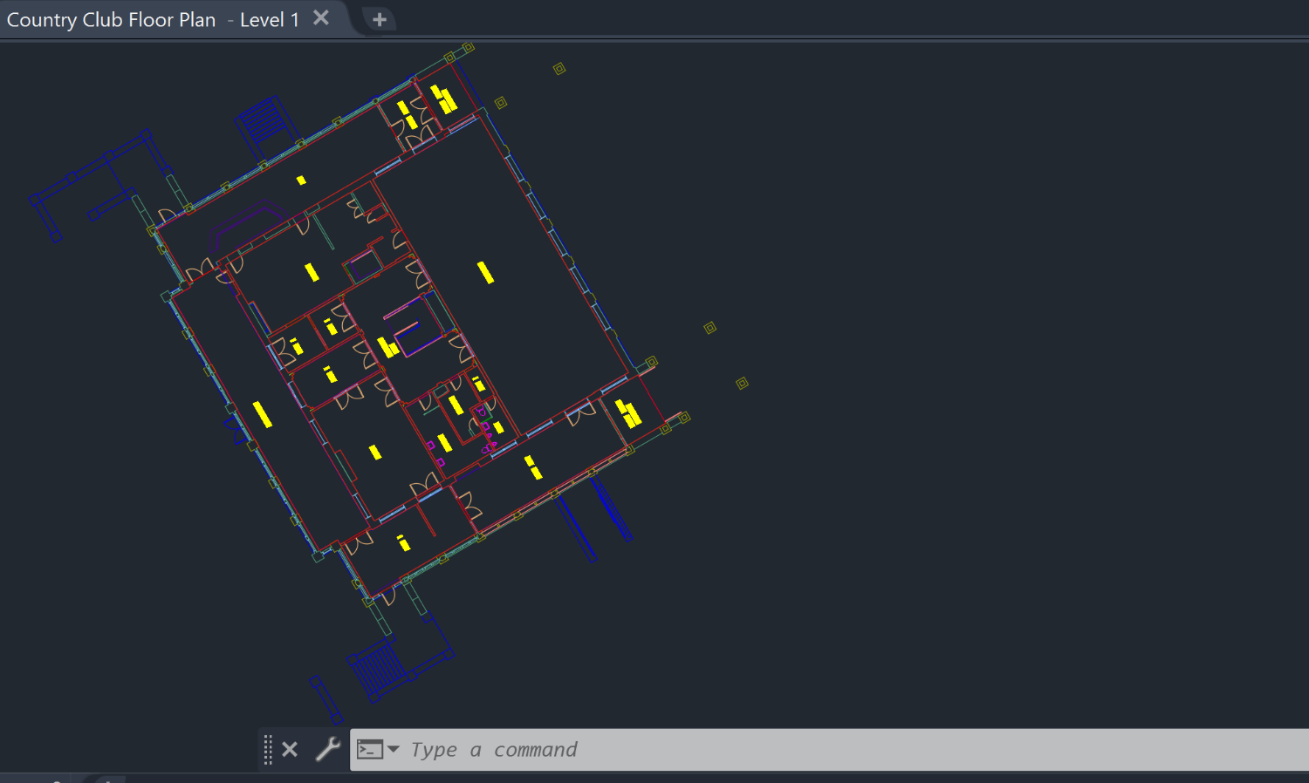
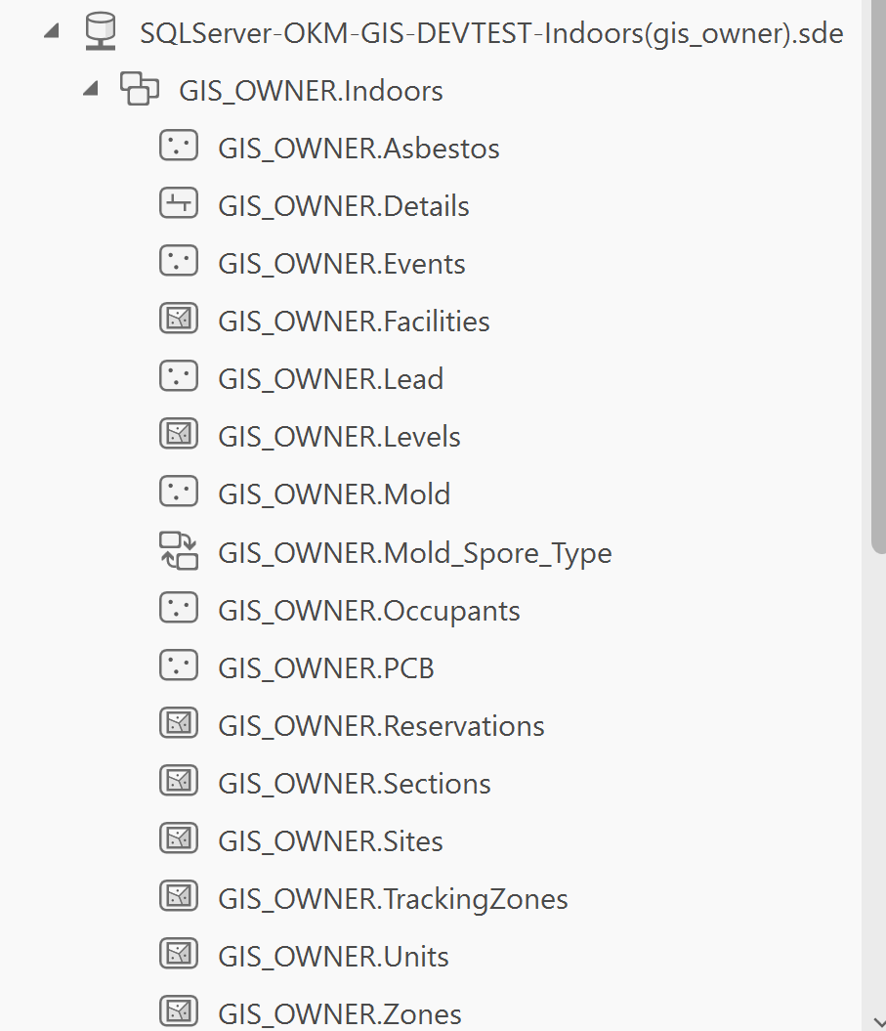
AutoCAD Floorplan to Esri mapping software
Contracted out a full building scan
and AutoCAD file creation.
A ready to use file was created using
ArcGIS for AutoCAD extension to ensure
Esri database requirements for text and geometry.
Created an Indoors dataset through ArcGIS Pro Enterprise Geodatabase.
Imported georeferenced AutoCAD file.
All AutoCAD layers were sorted into Units, Levels, Details, & Facilities feature classes.

Slide 24
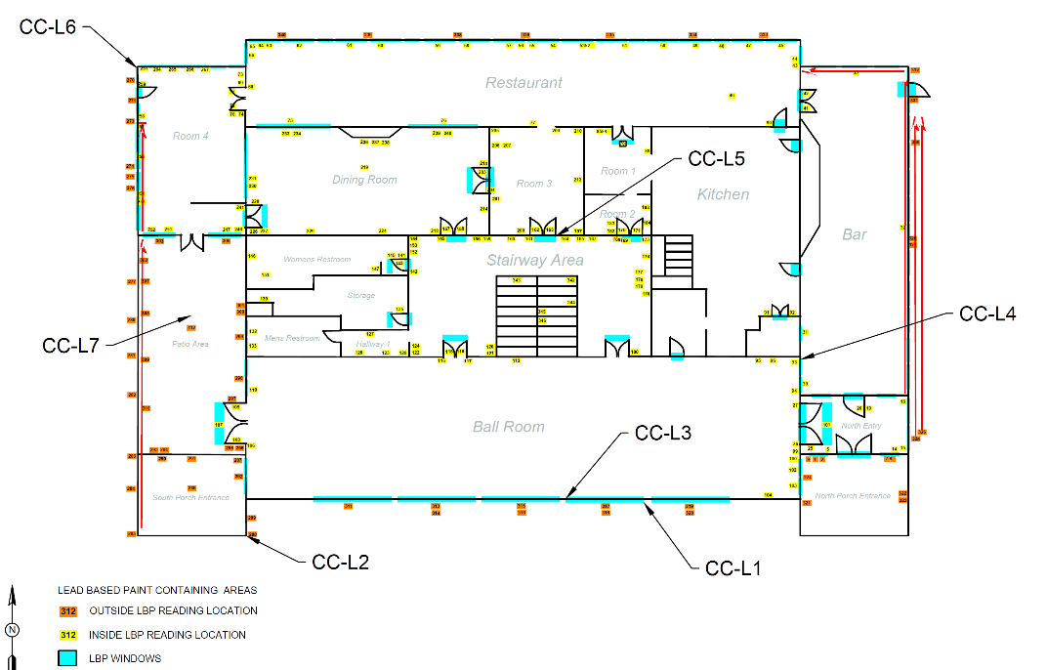
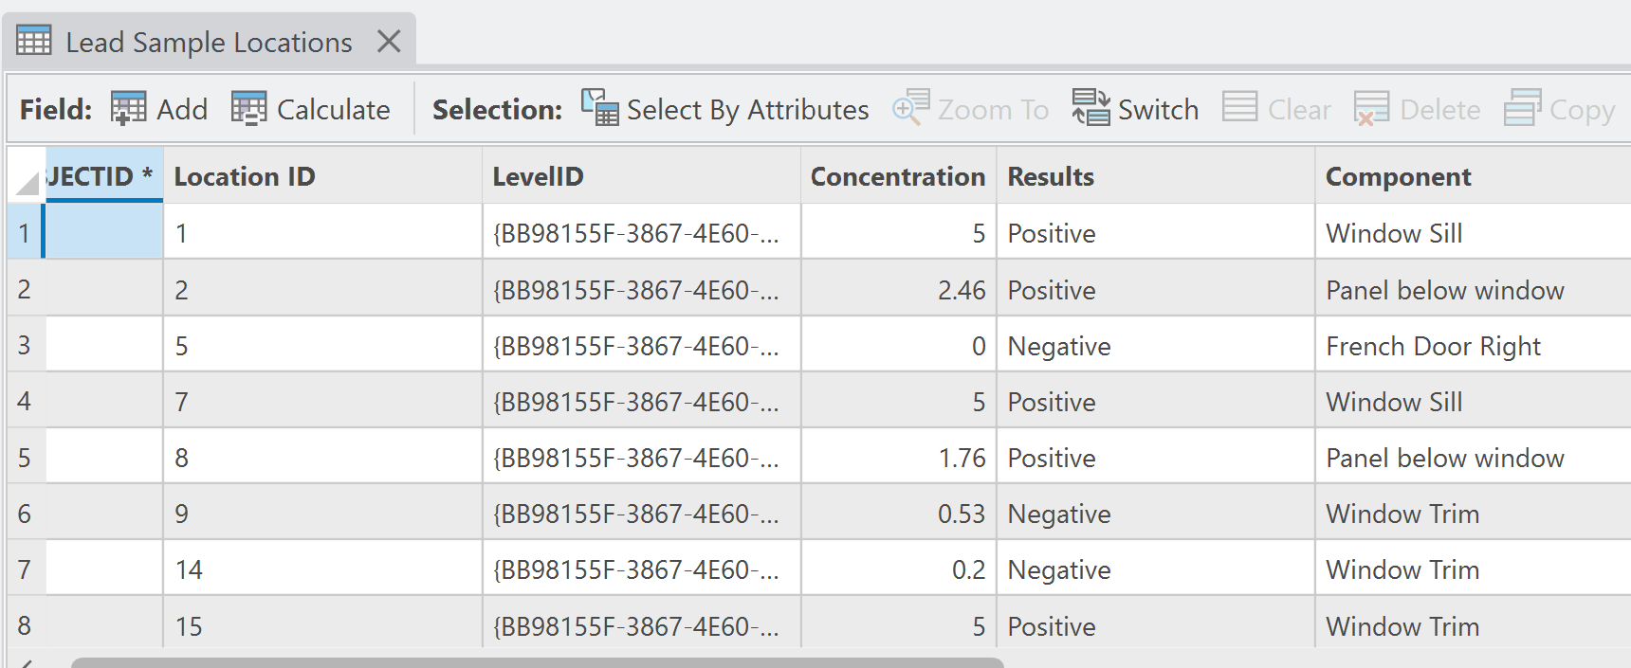
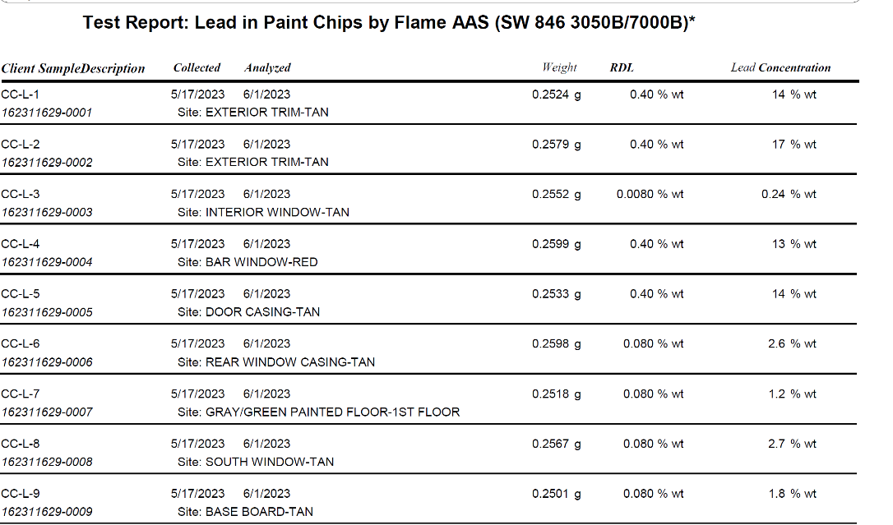
ArcGIS Indoors extension in ArcGIS Pro
Created new feature layers for each type of contamination:
lead, asbestos, mold, PCB.
Assigned level ID to the contaminates to create floor aware layers.
Entered all results from the Phase II report.

Slide 25
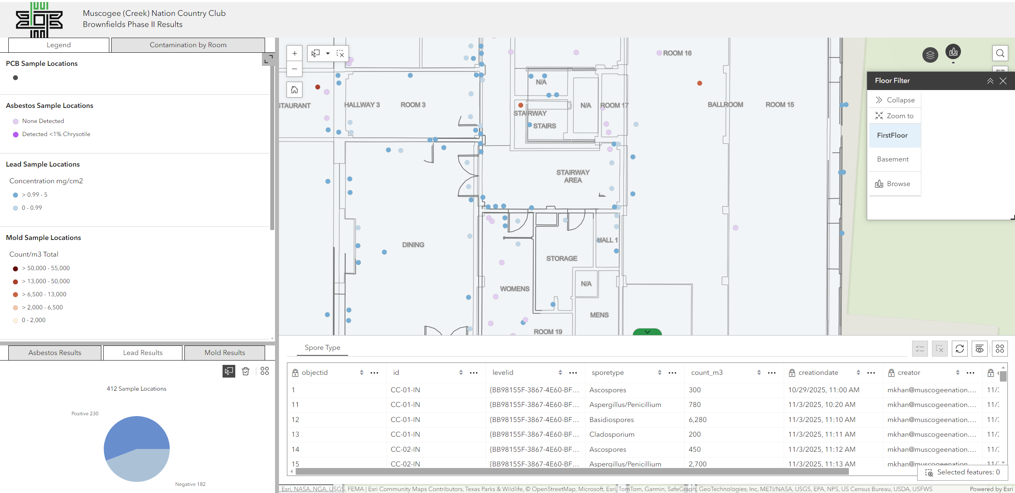
web application through Enterprise Portal
Published map to Enterprise Portal.
Leveraged Experience Builder in Enterprise Portal.
Charts display overall sample results.
Spore Type linked to mold results through a related table.

Slide 26
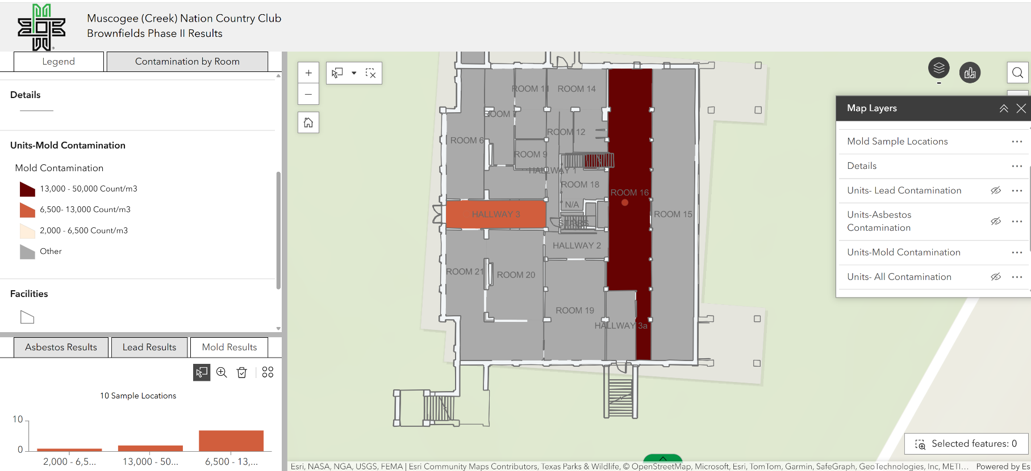
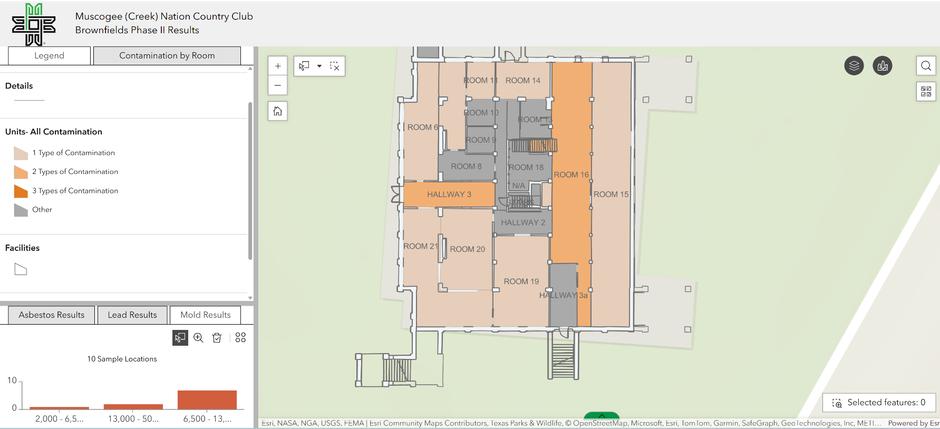
New unit layers color coded to display
contamination present per room.

Slide 27
Case Study #3
All-In-One Field System
Collaborating with KSU TAB for continued development
Notes:
Open Dump application is one of 3 applications built using EPA Exchange Network funding. We consolidated the applications into a portal that will also serve as a framework for environmental data management. This has been a collaborative partnership with tribes in Oklahoma that each tenet maintains their own data and users. First, thing we do is log into the system or if we are new, register for a log in.

Slide 28
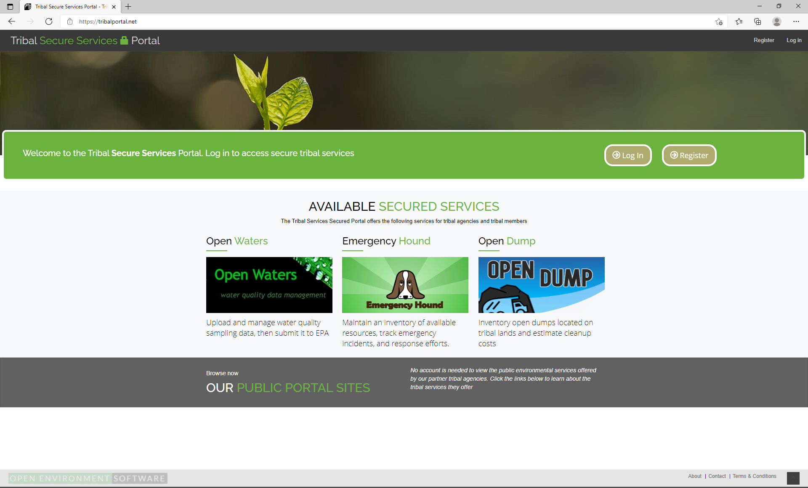
Notes:
Open Dump application is one of 3 applications built using EPA Exchange Network funding. We consolidated the applications into a portal that will also serve as a framework for environmental data management. This has been a collaborative partnership with tribes in Oklahoma that each tenet maintains their own data and users. First, thing we do is log into the system or if we are new, register for a log in.

Slide 29
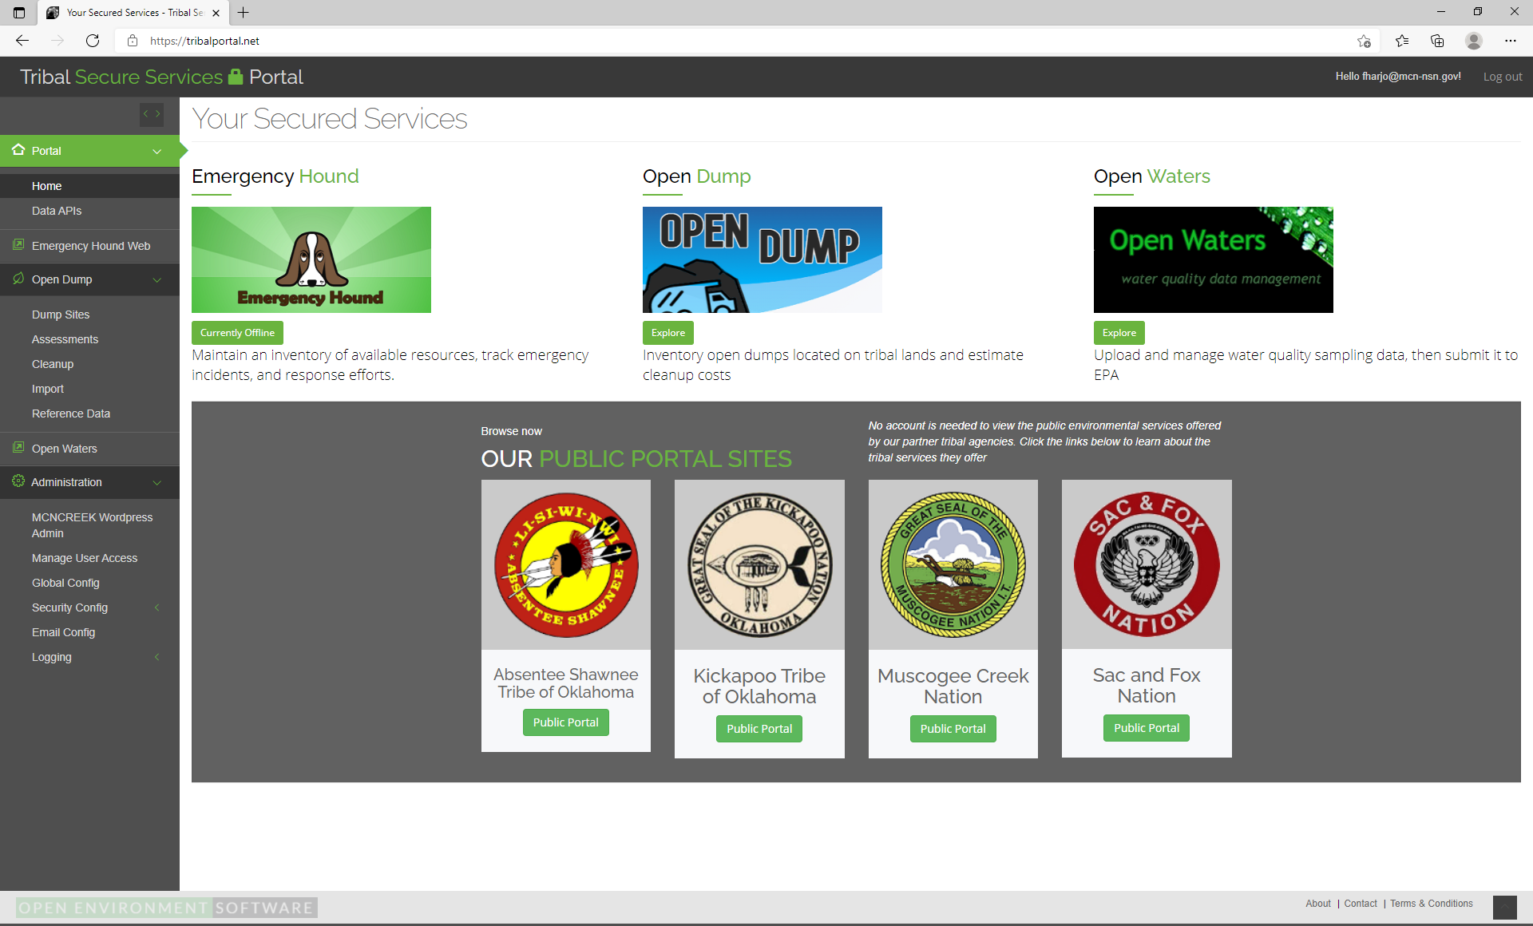
Notes:
Dialog on the left is based on permissions and what you can actually do with one or multiple applications. In this case open dumps, can be an admin, user or viewer. Below is our work with our partners to build out a more robust platform for our tribal partners

Slide 30
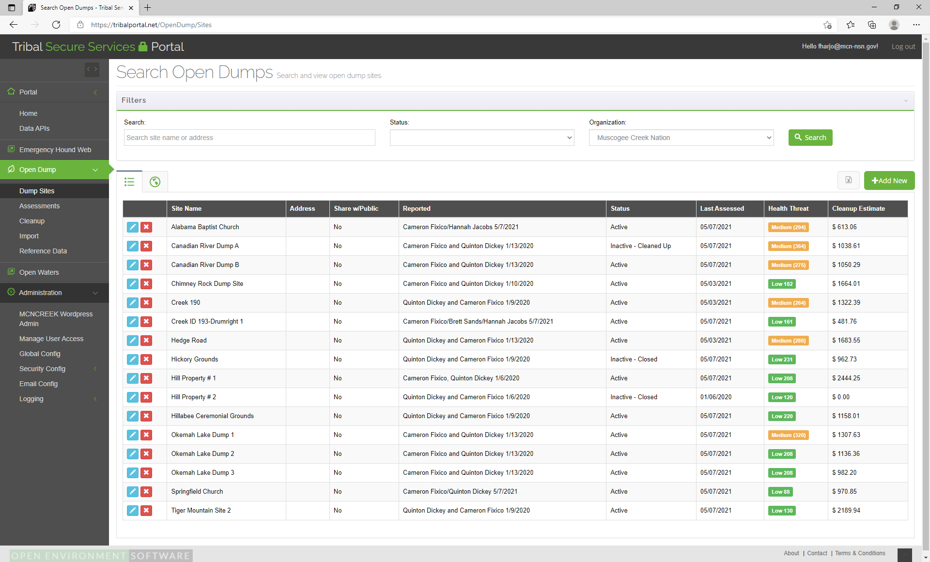
Notes:
The initial dump site dialog

Slide 31
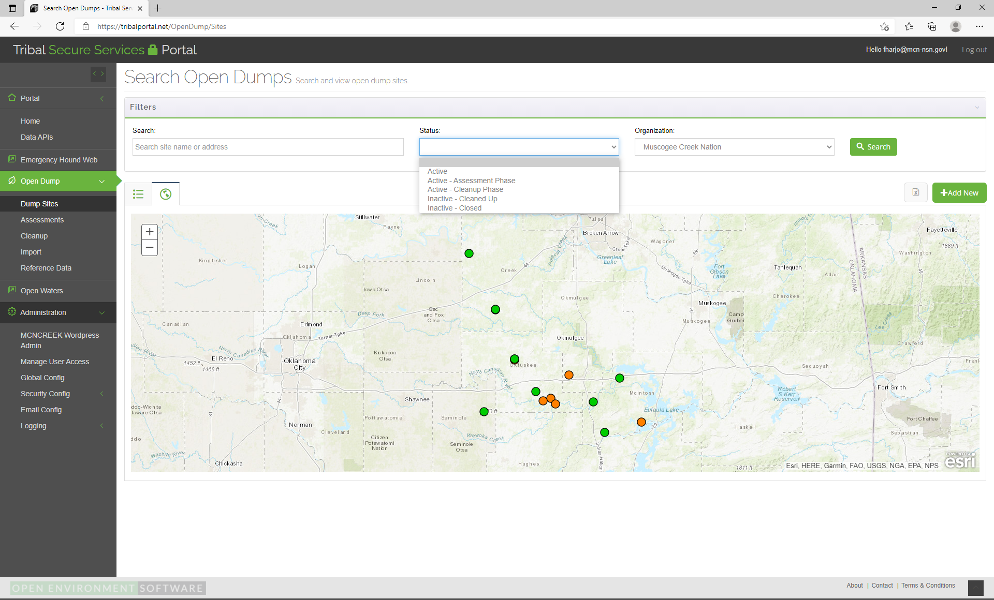

Slide 32
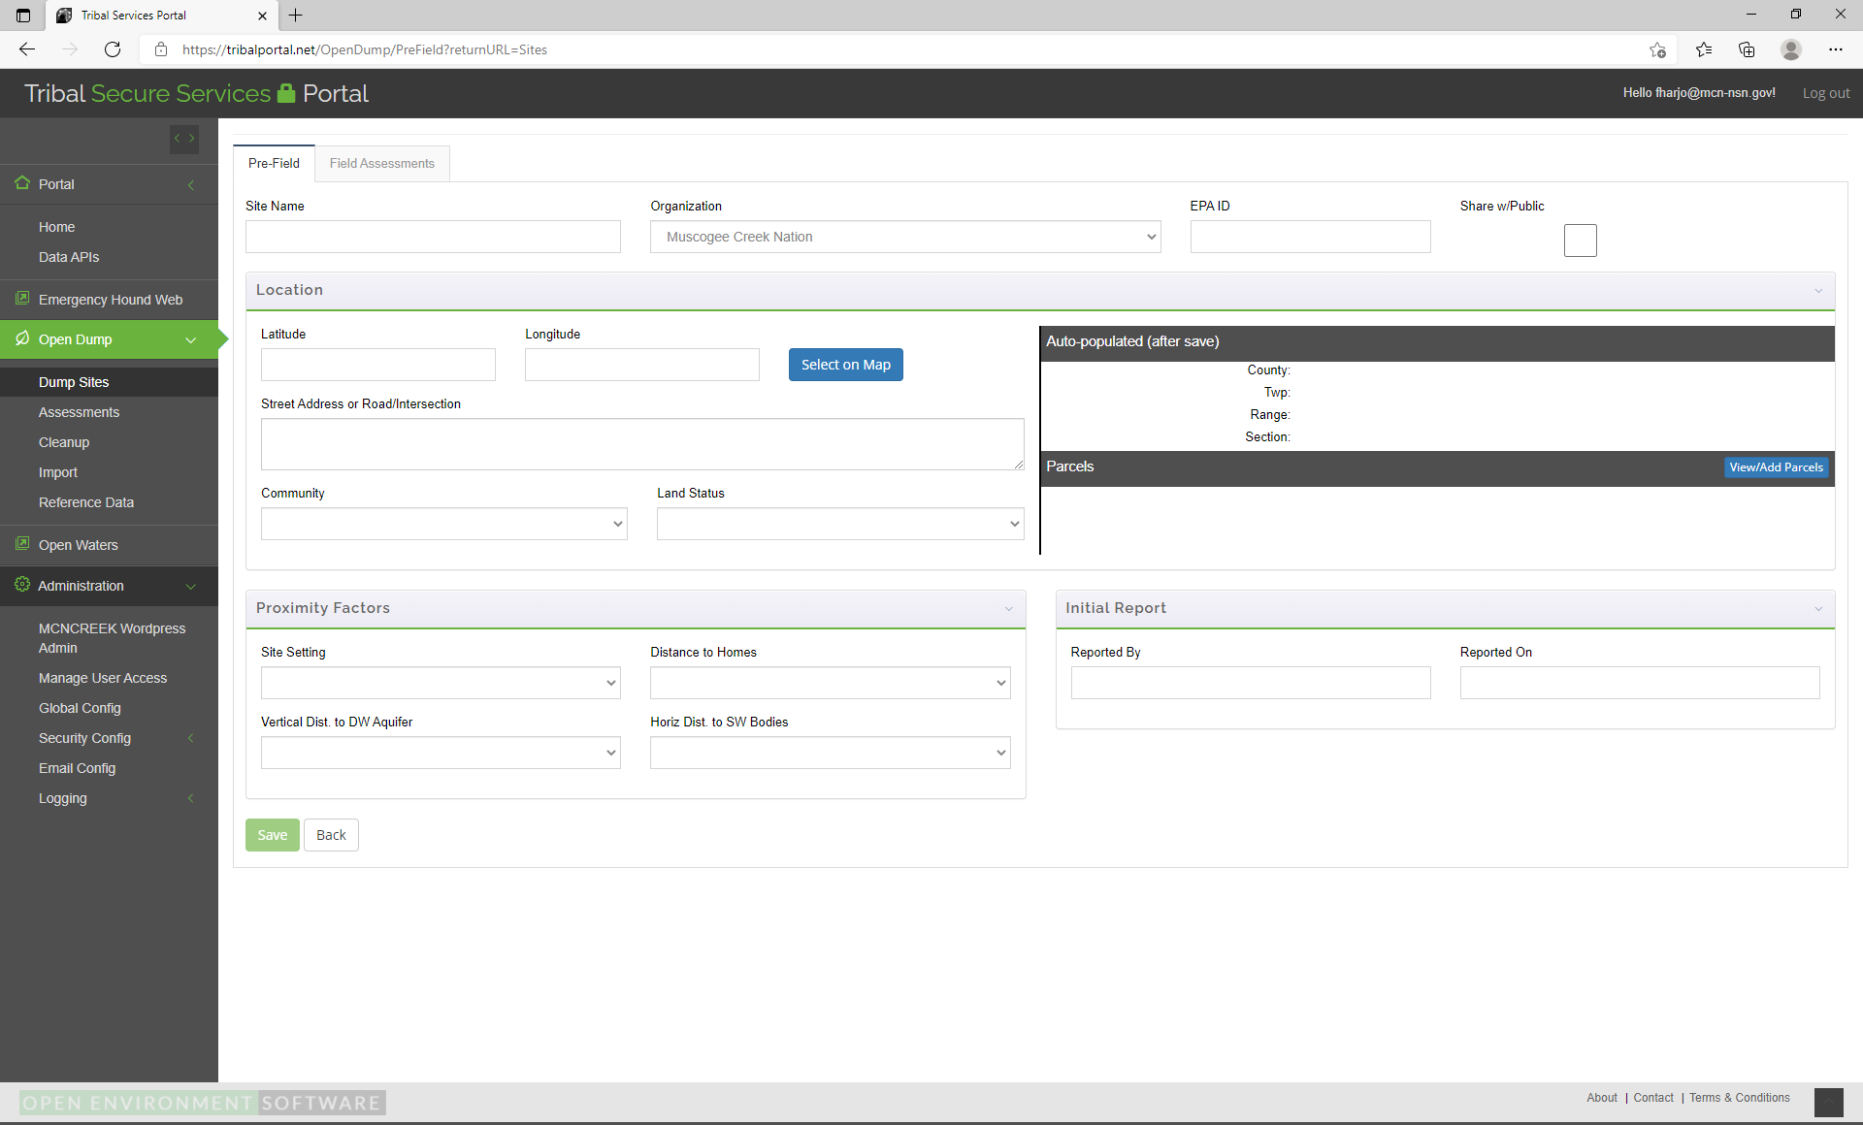
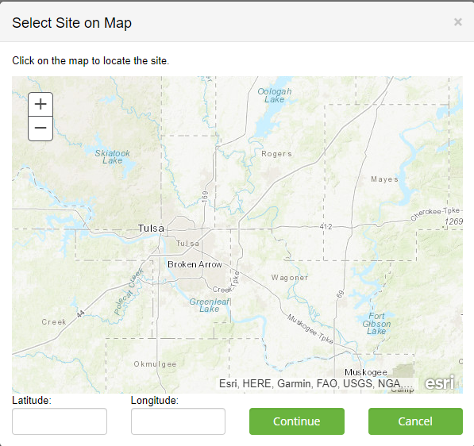
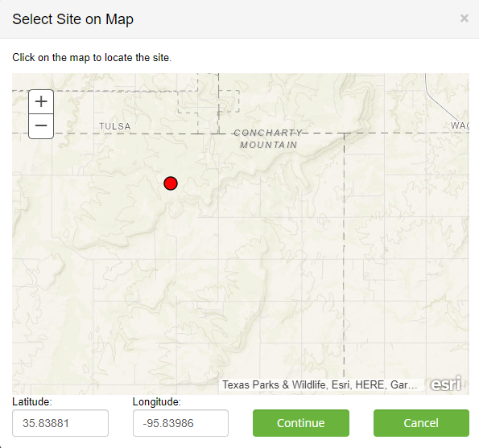

Slide 33
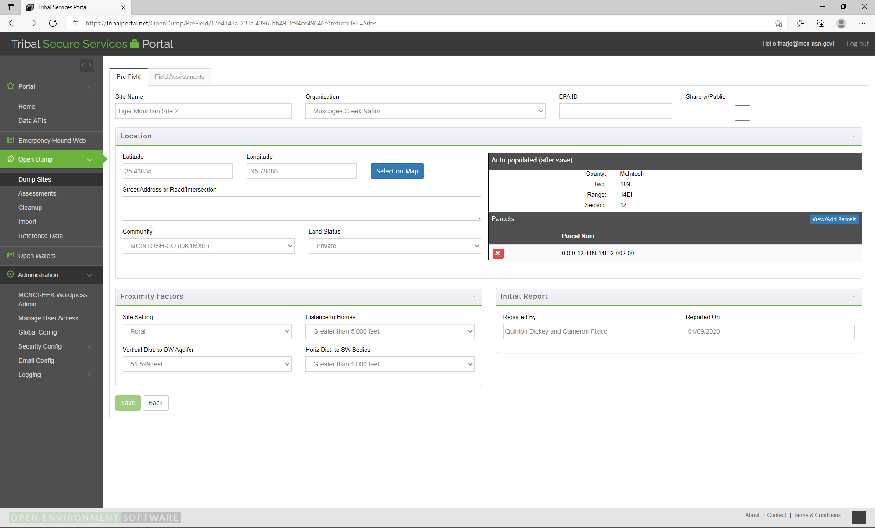

Slide 34
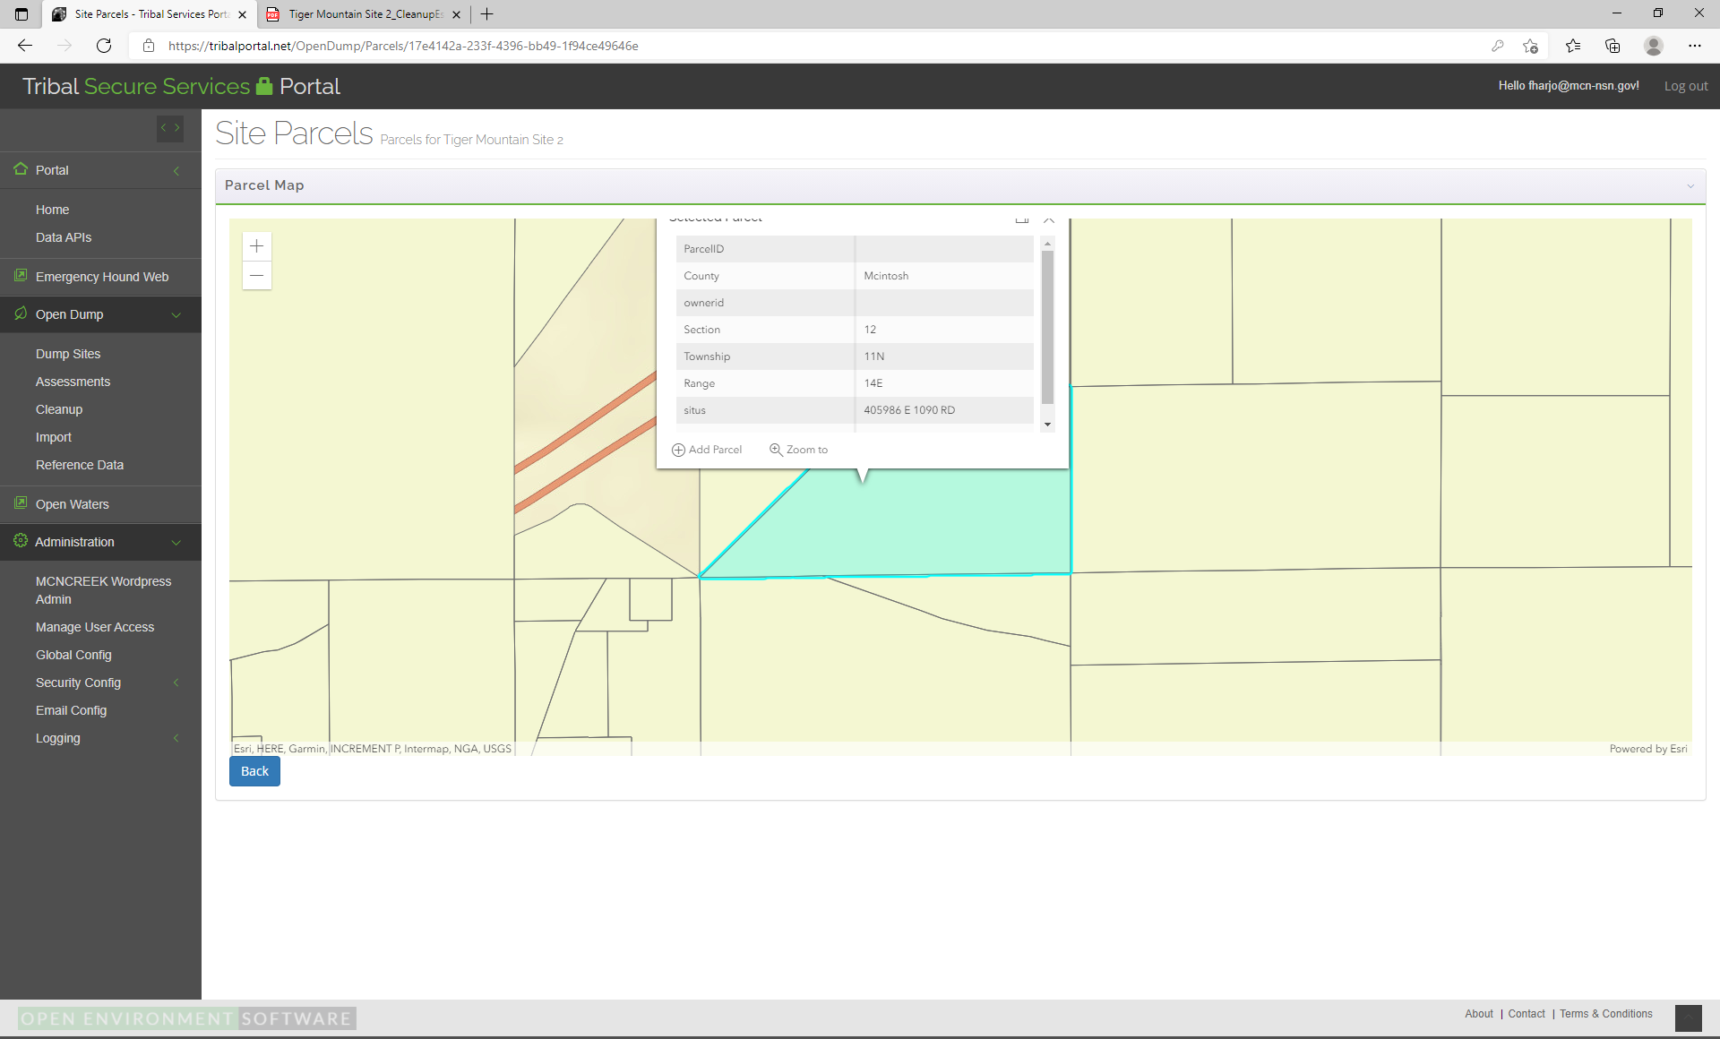

Slide 35
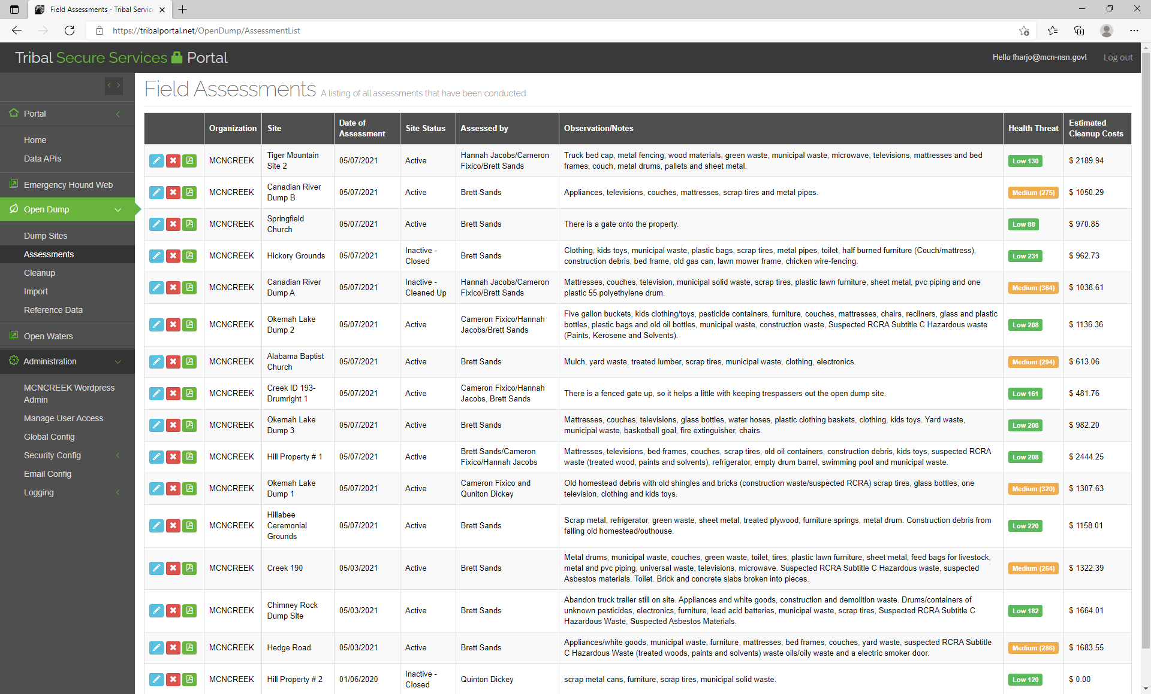

Slide 36
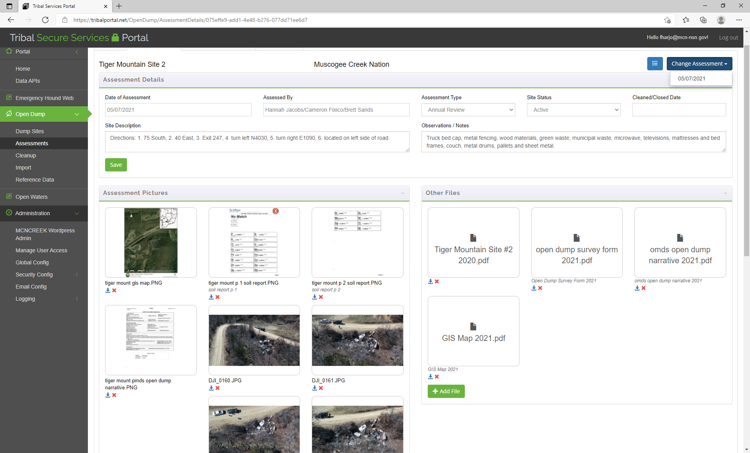
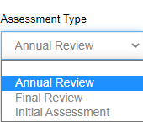

Slide 37
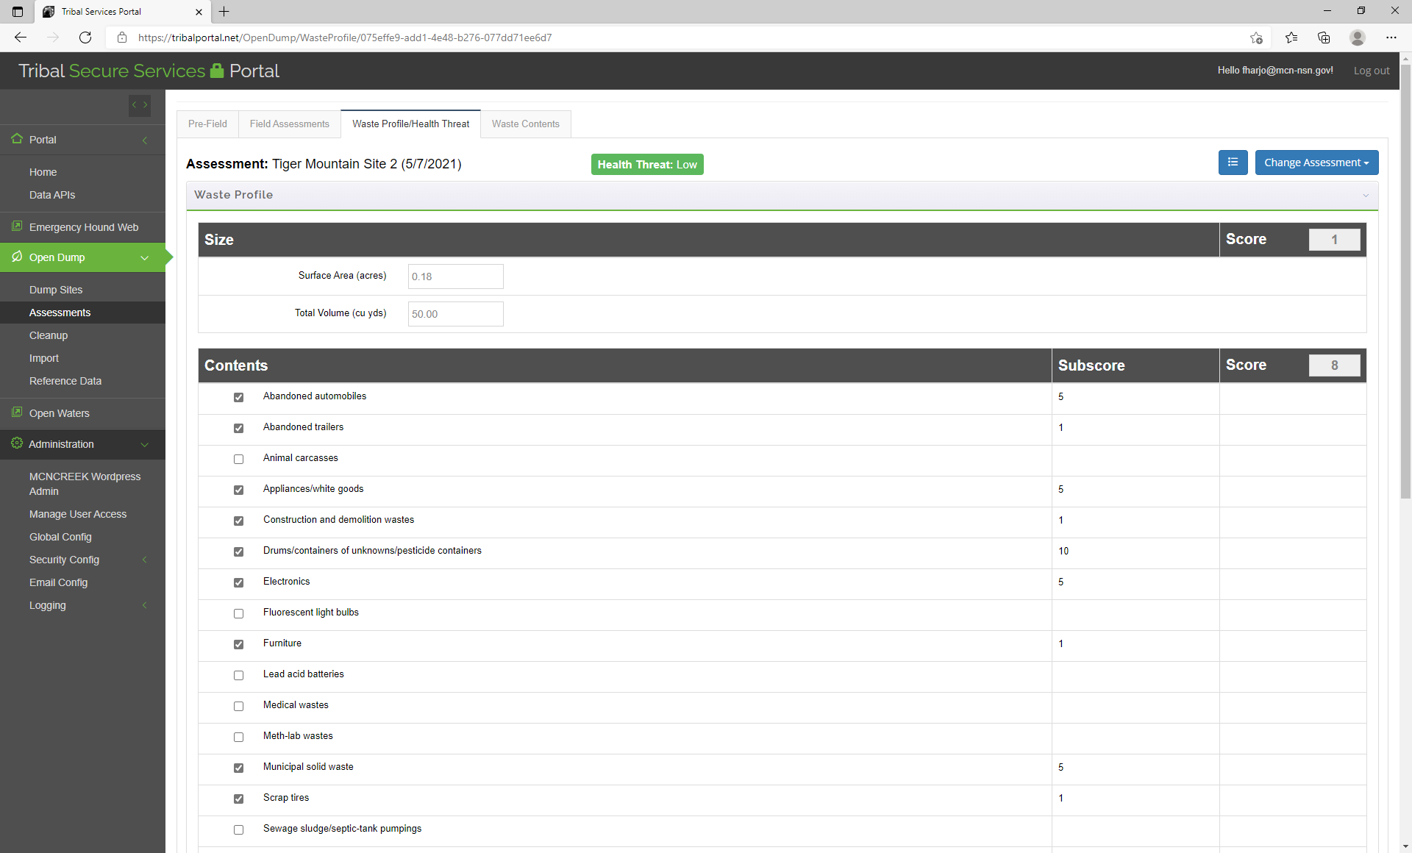

Slide 38
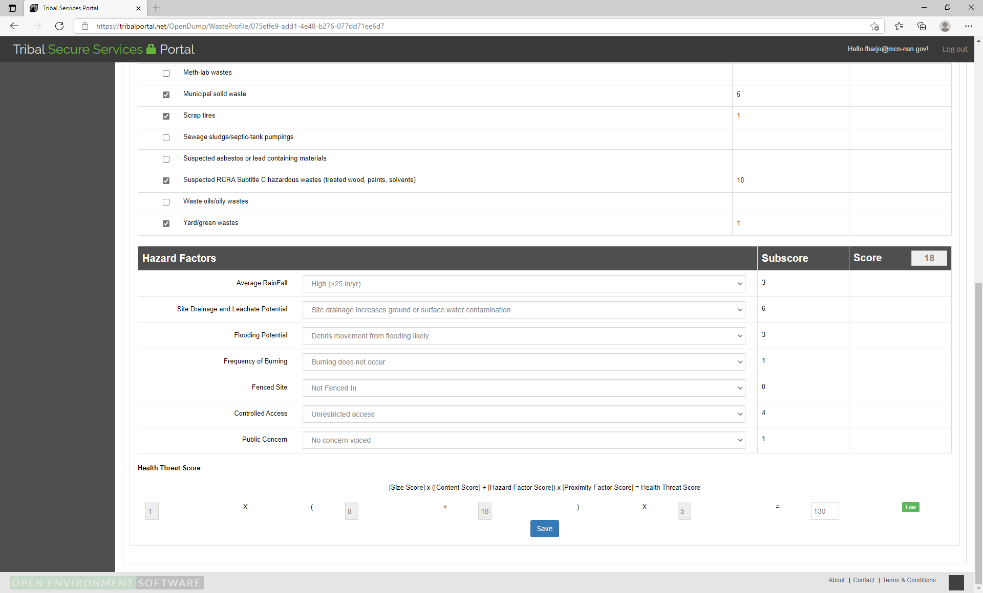

Slide 39
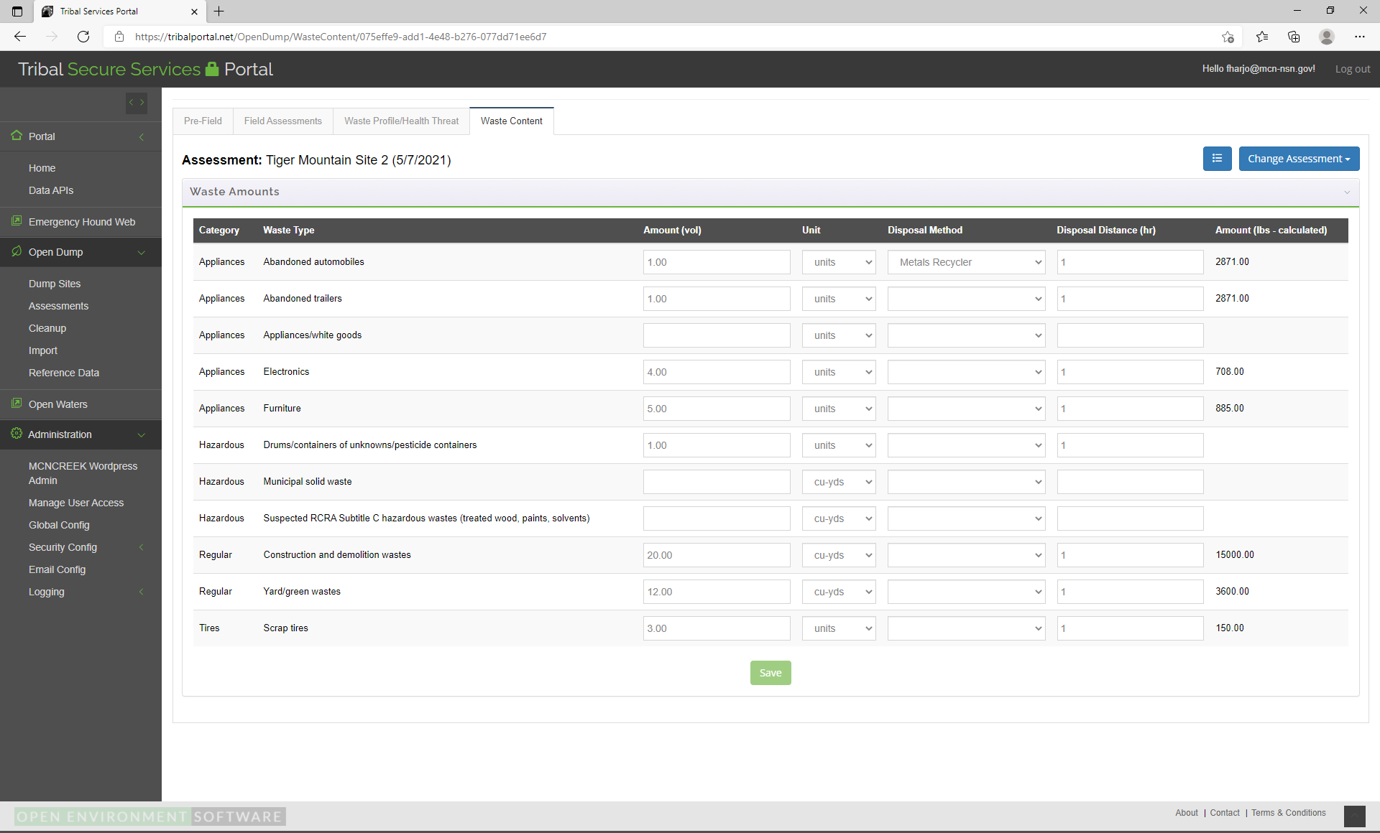

Slide 40


Slide 41
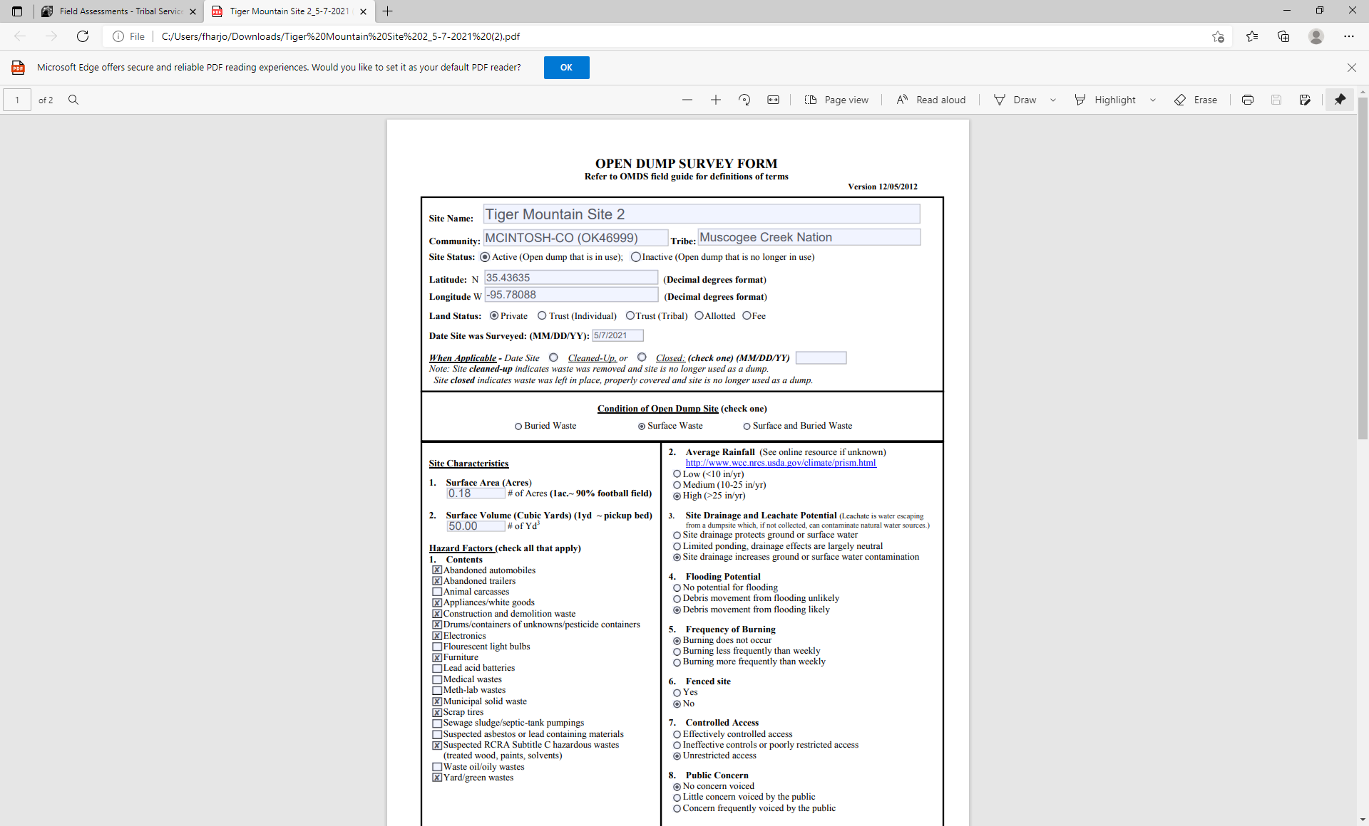

Slide 42
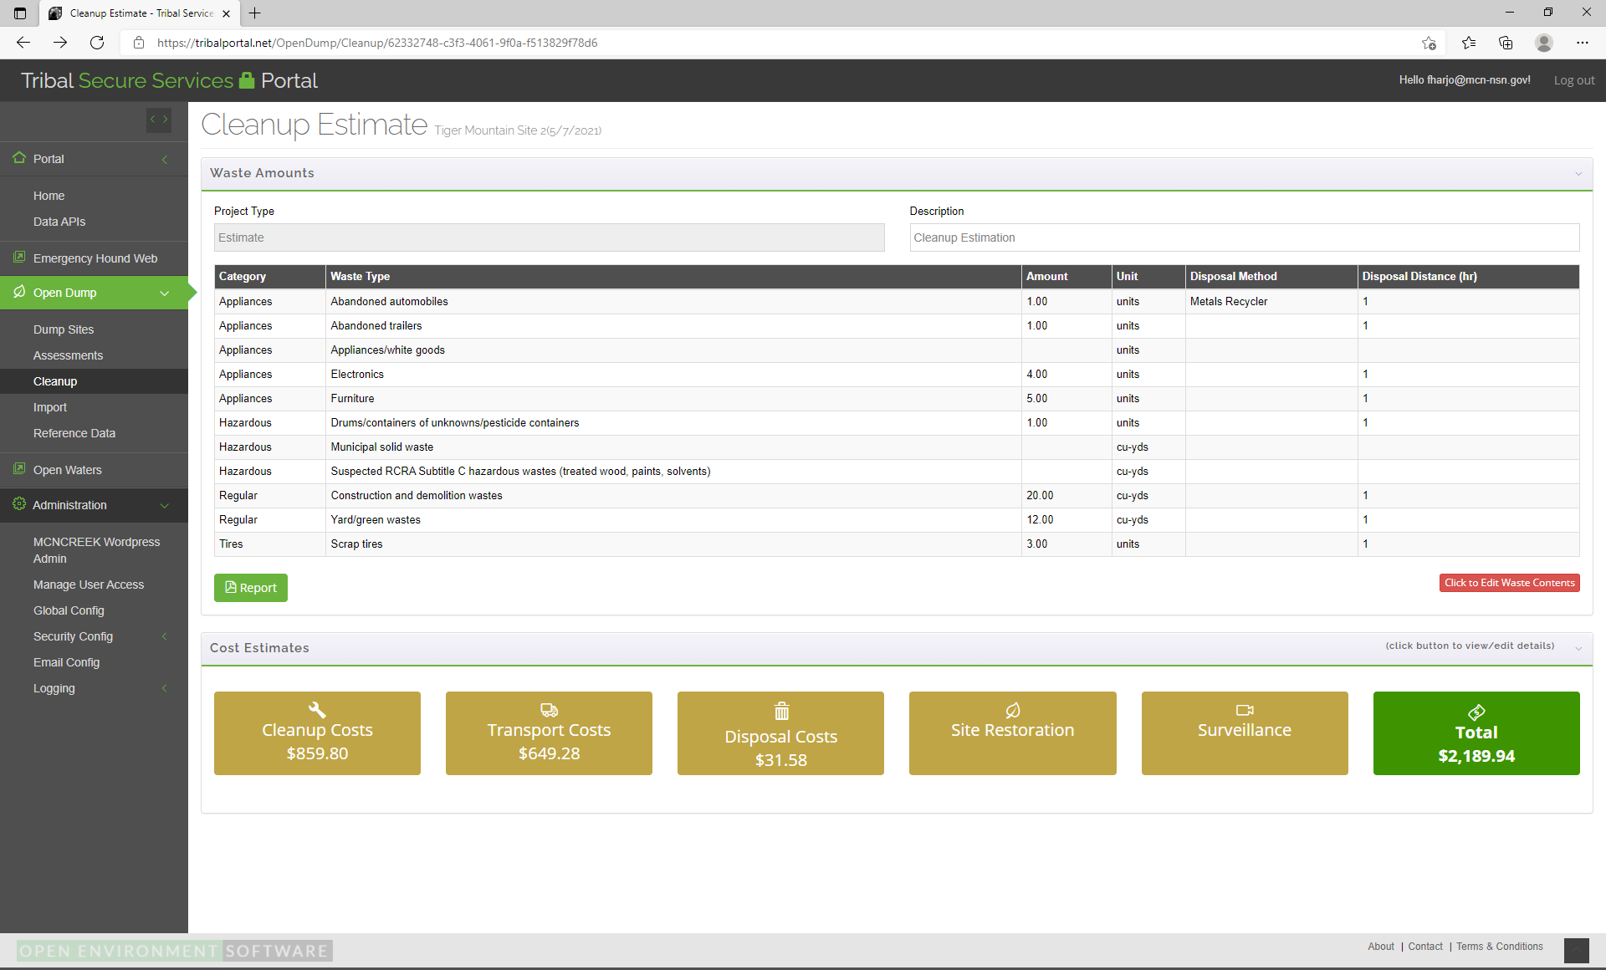

Slide 43
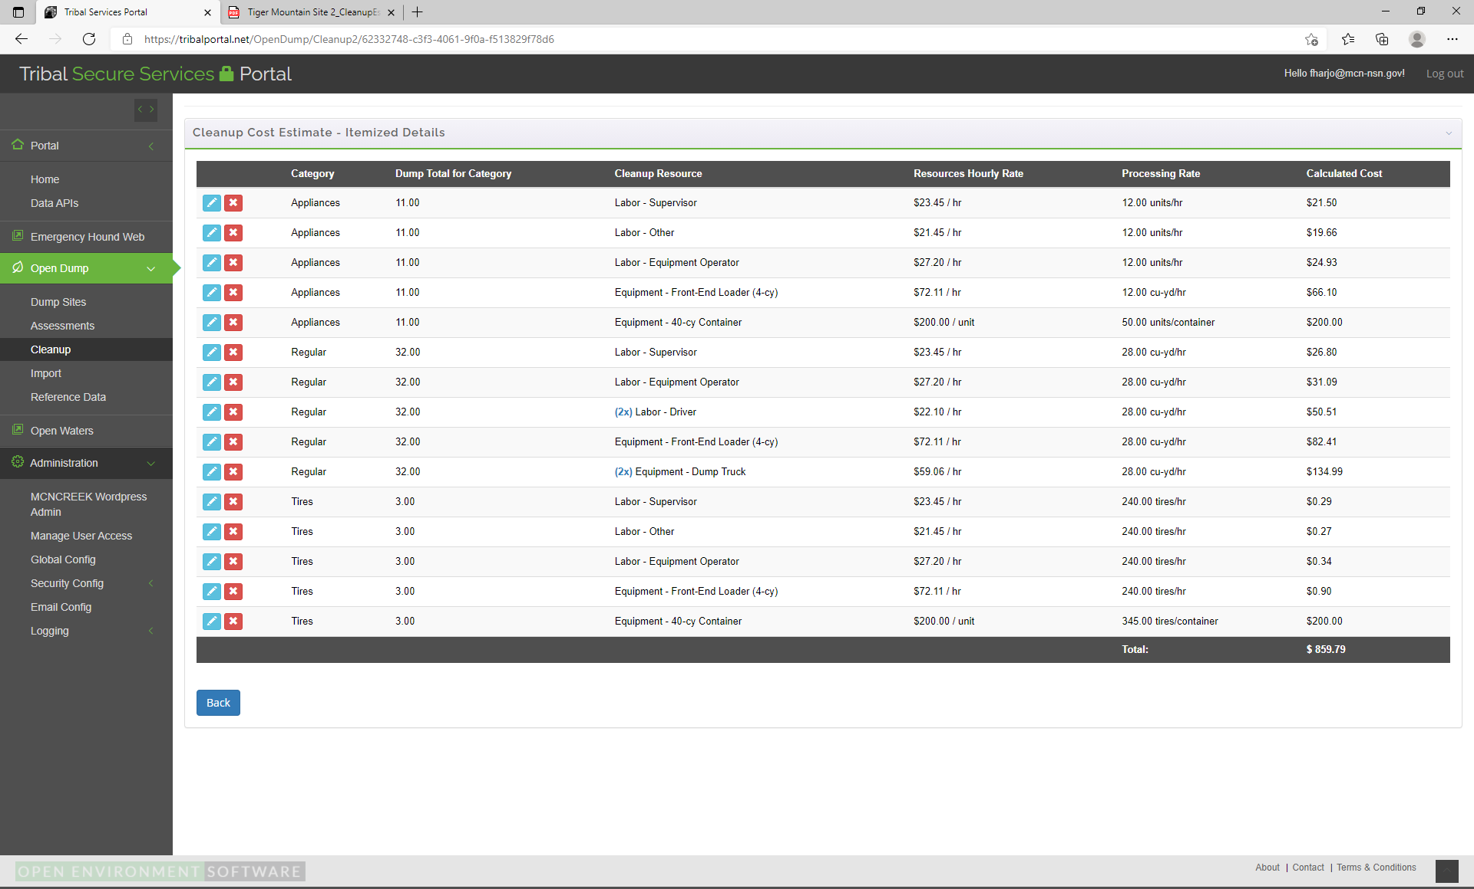

Slide 44
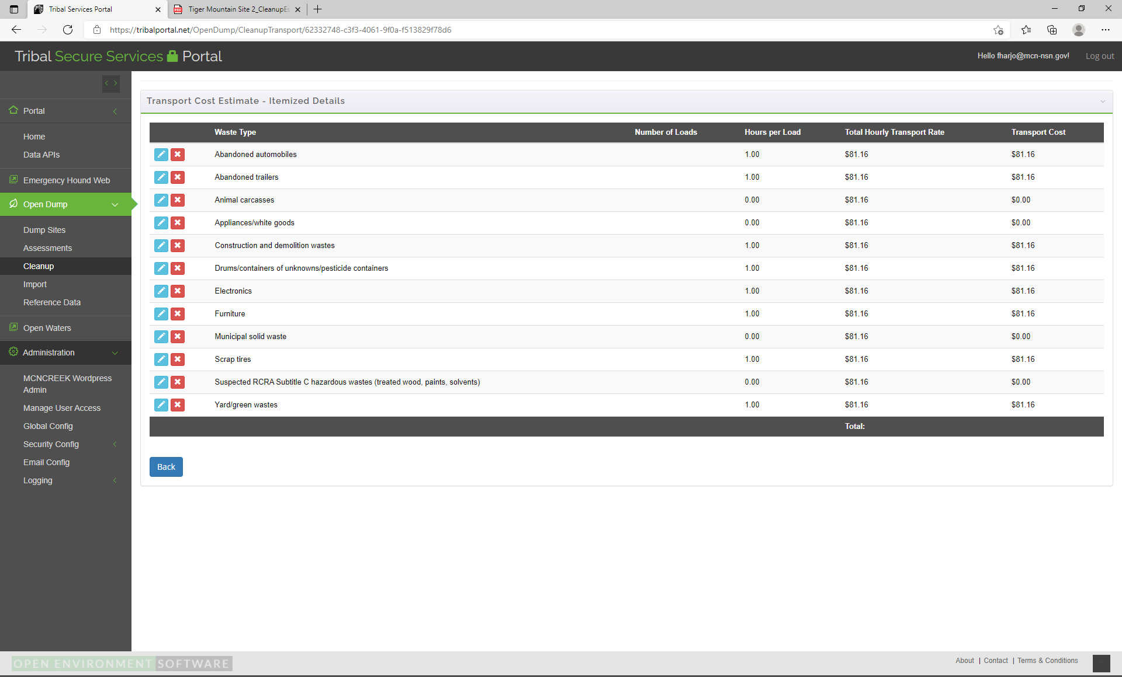

Slide 45
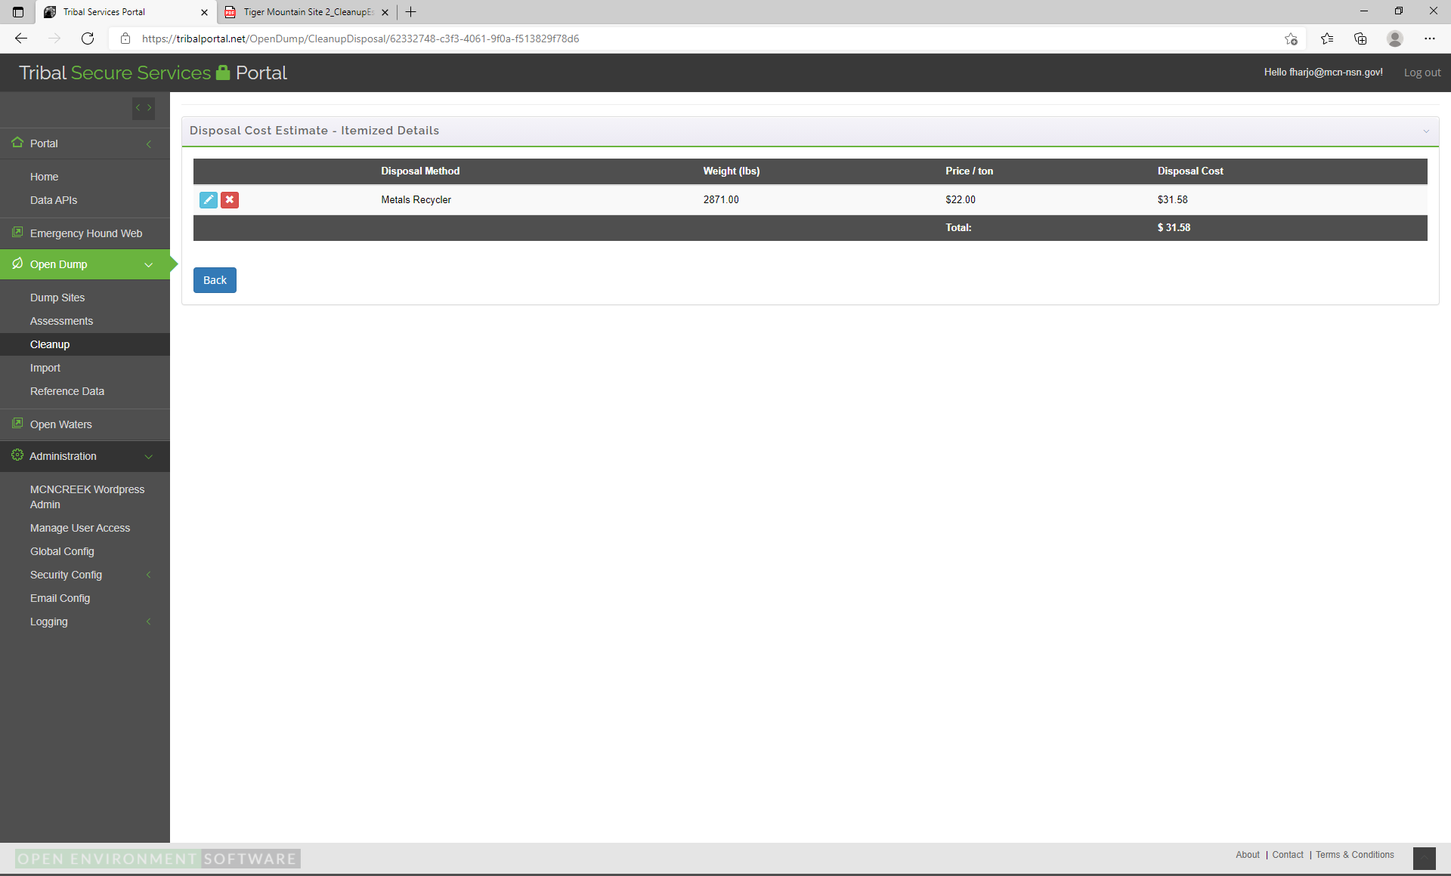

Slide 46
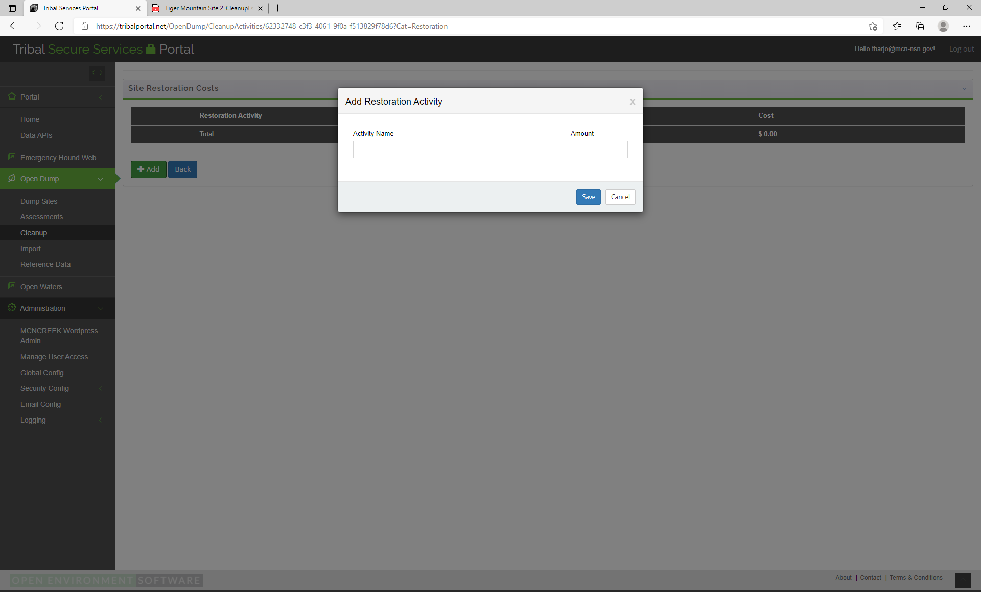

Slide 47


Slide 49
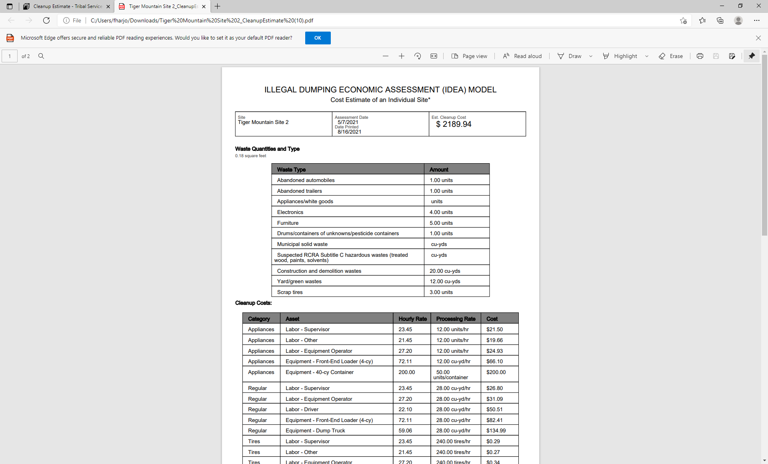

Slide 50
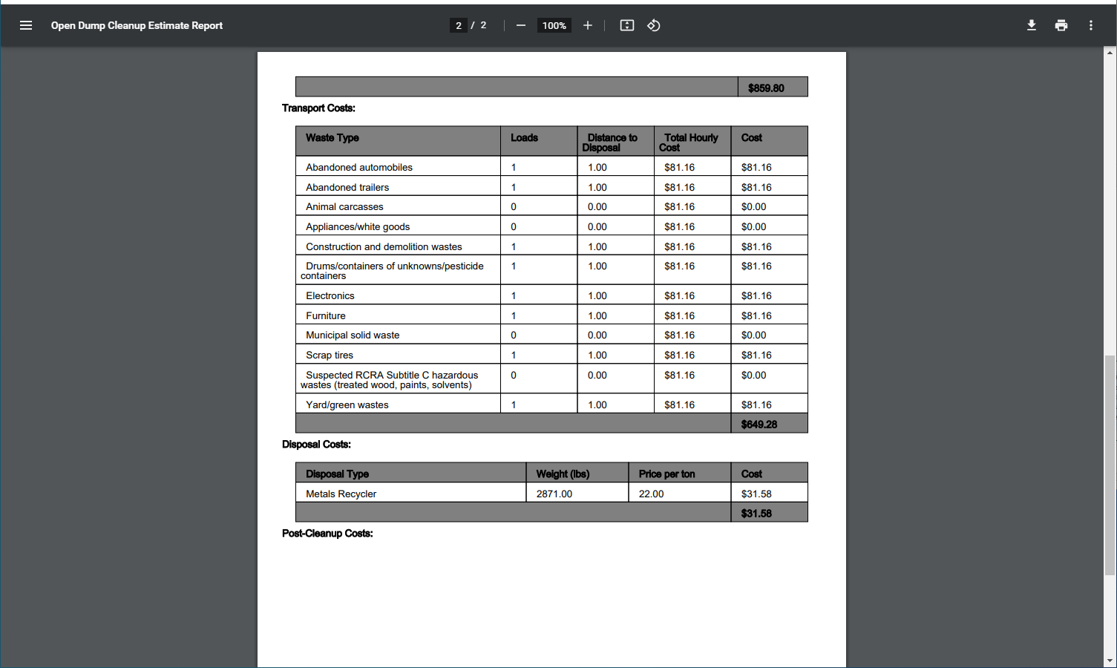

Slide 51
