Slide 1
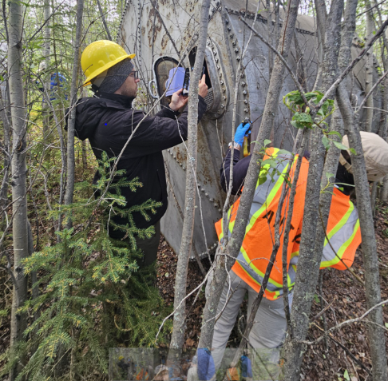
Brownfields in Alaska
Bailey Richards
Alaska Native Tribal Health Consortium
May 7, 2026
Notes:
My name is Bailey Richards and I’m the Program Manager for the Contaminated Sites Program at the Alaska Native Tribal Health Consortium, or ANTHC.
I’ve been working in Tribal contaminated sites and brownfields in Alaska at ANTHC since 2016.
I want to thank the Cherokee Nation for hosting us here this week and inviting us to visit your lands. It’s been really inspiring to see all the work you have done to repurpose contaminated sites to benefit your communities, and it’s given us a lot of ideas to take back home. It’s also a bit of a mental exercise, though, because behind every idea and example we see, there’s a voice in the back of my head going, “okay, how can we make this work in Alaska – CAN we even make this work in Alaska?”.
Today I want to give a broad overview of what brownfields work looks like in Alaska and why it can be very different from what many people experience in other parts of the country.
And just as a warning upfront, I will be getting into some law and policy in this presentation. I promise I’ll try to keep that part as painless as possible.

Slide 2
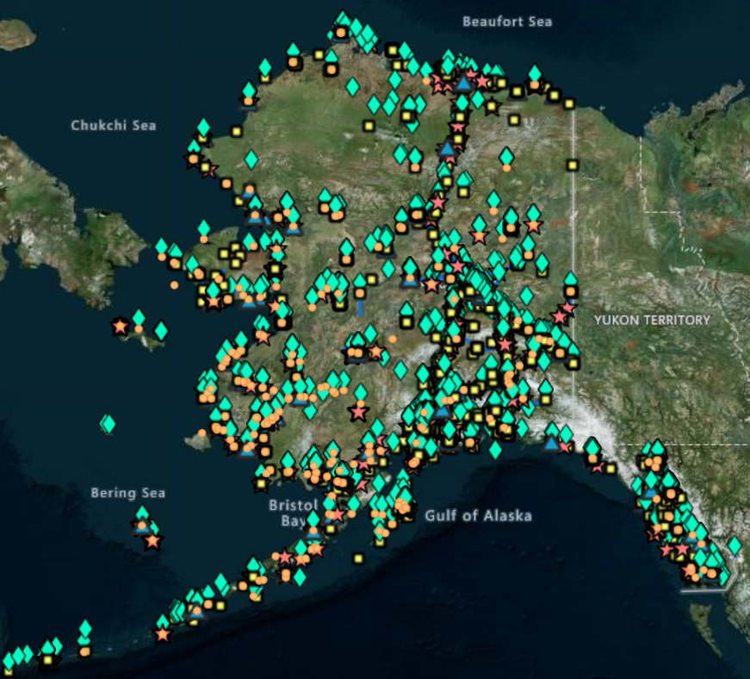

~2,000 Active Sites, and ~6,000 Closed Sites
Military (~760)
Bulk Fuel Storage/Gas Station/Power Generation (~380)
Airport/Airfield (~250)
Maintenance Yard (~170)
Residence (~150)
Source: 2023 SPAR Annual Report
https://dec.alaska.gov/spar/reports/
Notes:
So starting big picture: to give a sense of scale, every dot on this map is a reported contaminated site in Alaska.
There are around:
2,000 active contaminated sites,
and roughly 6,000 closed sites in Alaska. A lot of these sites are tied to infrastructure systems: military installations, bulk fuel storage, airports, maintenance facilities, and residential contamination.

Slide 3
Common Contaminants in Alaska
1,759
75%
152
7%
147
6%
99
4%
81
4%
Petroleum
Volatile Organic Compounds and Semi-Volatile Compounds
Metals
PFAS
Explosives/
Munitions
Source: 2023 SPAR Annual Report
https://dec.alaska.gov/spar/reports/
Notes:
What’s actually in the ground at most of these sites?
Usually when I ask this question, someone immediately guesses petroleum, because it’s Alaska – we’re an oil state – they think it’s basically just bubbling out of the ground.
(1) And they are correct. Not about the bubbling part, but about 75% of active contaminated sites in Alaska do involve petroleum contamination. Usually diesel. That’s not surprising when you think about Alaska’s infrastructure history.
We have: bulk fuel storage facilities in most rural communities, aging tanks that are logistically difficult to replace or maintain, residential home heating oil systems that are prone to failure, power generation infrastructure, and historical spills.
(2, 3, 4, 5) After petroleum, common contaminants include: VOCs, metals, PFAS, and explosives or munitions contamination associated with military sites.
But petroleum is really the dominant contamination story in Alaska.
At first glance, many of these contaminated sites may not seem wildly different from sites elsewhere in the country. But there are a number of realities in Alaska that make this work much more complicated in practice, so let’s talk about those.

Slide 4
Demographics & Infrastructure
Notes:
Starting off, with demographics and infrastructure.

Slide 5
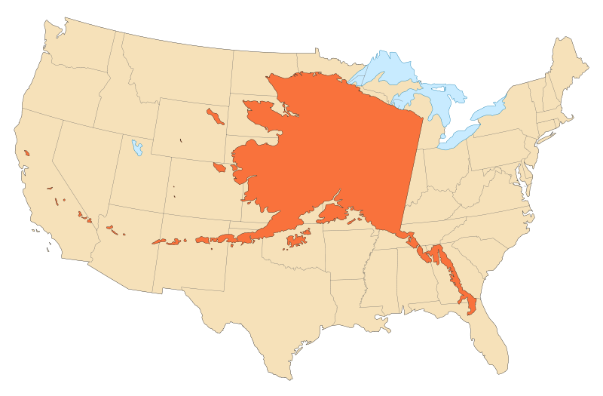
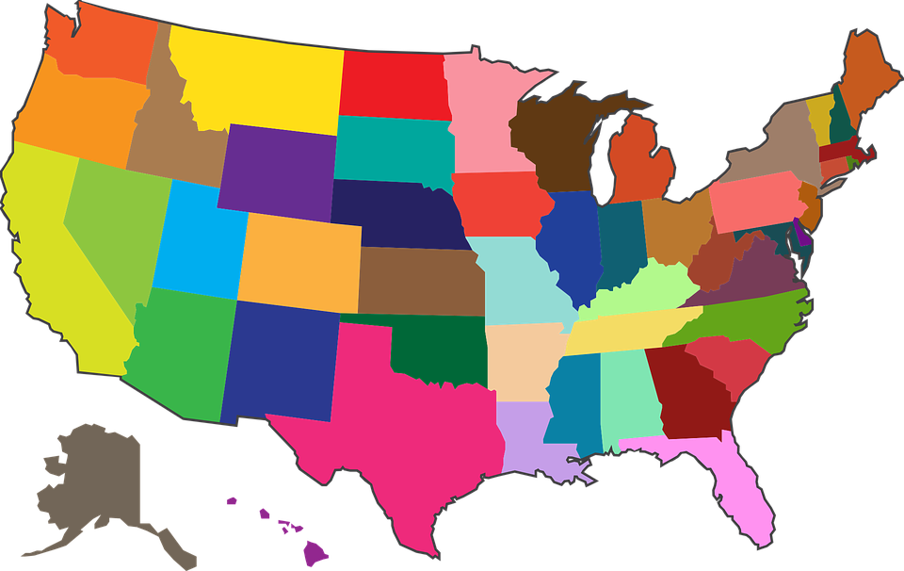
Notes:
First: size.
Usually when people see Alaska on a U.S. map, it looks like this tiny little afterthought tucked down in the corner by Hawaii.
(1) But in reality, this is Alaska at proportional scale compared to the contiguous U.S. states.
And that scale does matter because every environmental project in Alaska is shaped by: distance, logistics, transportation, and mobilization costs.
If you’re trying to move equipment, people, sampling supplies, or contaminated material across a state this large with very limited infrastructure, costs increase quickly.

Slide 6
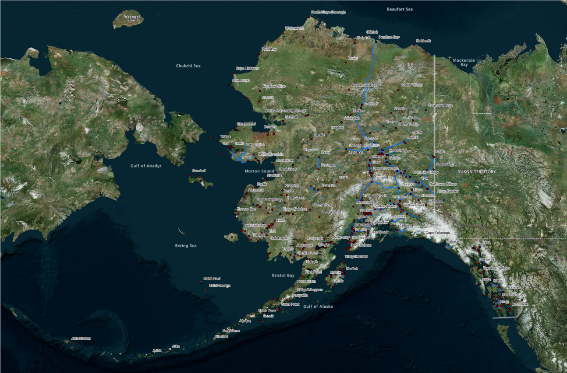
Notes:
About half of Alaska Native people live in smaller rural communities like the ones shown on this map.
And the blue lines are our road system.
So as you can see, most communities in Alaska are not connected to the road system.
Around 86% of communities can only be reached by: plane, boat, snowmachine, or in some cases seasonal ice roads.
Many of these communities have populations under 500 people.
That remoteness affects all parts of our brownfields projects: cleanup costs, disposal options, staffing, equipment transport, emergency response times, redevelopment options, and long-term operations and maintenance.
Even getting a consultant or drill rig to a community can become a major expense. In the Aleutians, some communities are only serviced by barges twice a year – so if you don’t get a critical piece of equipment onto the springtime barge, you may have missed out on doing work until the following year.

Slide 7
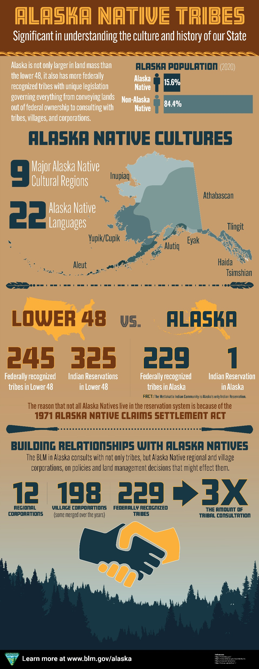
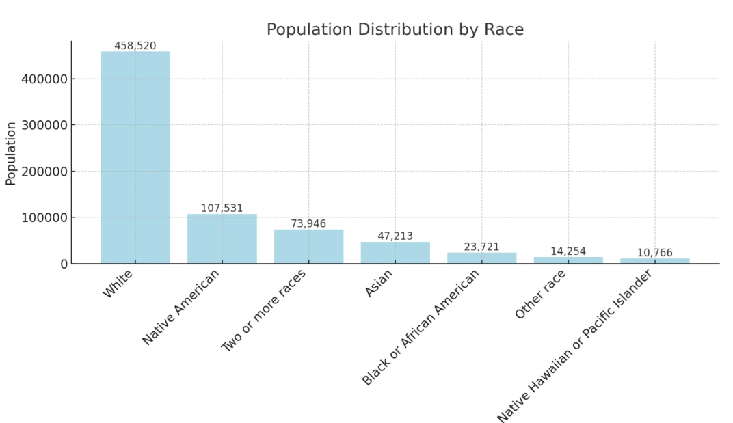
Notes:
Now looking at Alaska through more of a demographic lens.
Alaska has around 740,000 people total.
(1) It also has the highest percentage of American Indian and Alaska Native peoples in the country, at around 16% of our state population, and much higher than that in many rural census areas.
We also have 229 federally recognized Tribes, which is almost 40% of the federally recognized Tribes in the United States.

Slide 8
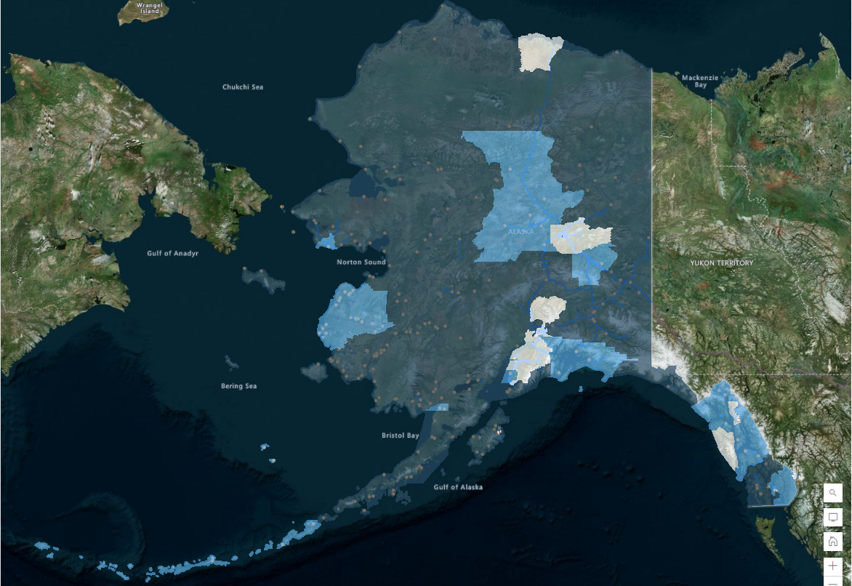
Notes:
This map was originally created under EPA’s Justice40 initiative, which has since been eliminated. But the data is still relevant.
The darker blue areas represent communities that EPA has identified as more disadvantaged. And you can see that a lot of those areas overlap with rural Alaska.
An Alaska economist named Scott Goldsmith created the term “remote rural economy” to describe the economic structure in many of these regions. And it’s important to understand that this structure is somewhat different than what many people may be used to, because a lot of rural Alaska economies are a mix of: subsistence activities, seasonal work, and cash.
That matters for brownfields work, because while subsistence-based systems are incredibly valuable and resilient, contaminated site work requires cash. Tribes have to pay for assessments, cleanups, engineering, mobilization, demolition, disposal, and redevelopment. So Tribal communities in Alaska are often trying to navigate expensive contaminated site problems with perhaps a more constrained financial capacity.

Slide 9
Capacity
Adminstrative limitations
Few environmental staff
Lack of technical training
High turnover
Notes:
I also want to mention capacity, because we hear all the time from Tribes that this is one of their top barriers to doing contaminated site work.
1. Small Tribal communities are often assumed to have administrative capabilities similar to those in your average American municipality, but in reality, in most cases, a single Tribal administrator manages several roles for the community.
2. There may be one, occasionally two environmental coordinators for the Tribe, who are funded through a small federal grant program. They work on a wide scope of environmental issues in the community, so they are typically not subject matter specialists.
3. It is uncommon for them to have formal training coming into the job in things like soil and water sampling. Training requires money and time, or the Tribal could hire an outside contractor, which will involve more money and time.
4. Due to the pressures of the few paid roles that do exist in rural communities (including local politics), turnover can be quite high in these positions, which leads to frequent loss of knowledge and experience.

Slide 10
Law & Policy
Notes:
I warned you I would be talking about policy. But it is very important, because a lot of the realities of brownfields work in Alaska really do trace back to land status, jurisdiction, and policy decisions, so I want to provide enough context for the challenges Tribes are navigating.

Slide 11
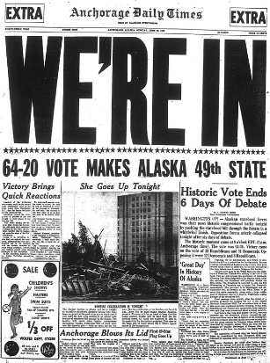
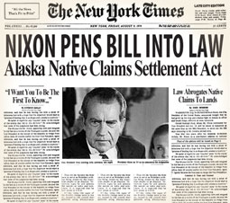
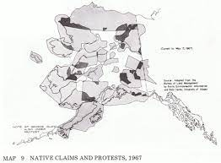

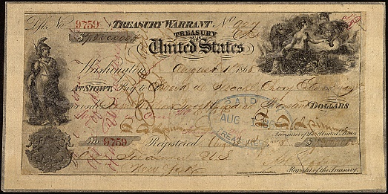
The Alaska Native Claims Settlement Act
1867
1966
1998
Time
Immemorial
1959
1971
Notes:
A key — and often misunderstood — law in Alaska is the Alaska Native Claims Settlement Act, or ANCSA. Alaska is the only state with a law like this.
I’m going to give a very condensed version here because this topic could honestly be an entire conference by itself. Starting off with a very brief timeline of events leading up to ANCSA:
(1) Alaska Native people have lived in Alaska since time immemorial.
(2) The U.S. purchased Alaska from Russia in 1867.
(3) Alaska became a state in 1959.
(4) Conflicts over land selection and Native land claims intensified during the 1960s.
Oil was discovered at Prudhoe Bay. The federal government became highly motivated to resolve land claims so the Trans-Alaska Pipeline could move forward.
(5) Congress passed ANCSA in 1971. I’ll go into more details about what that act actually did in a moment here.
Then in 1998, the U.S. Supreme Court issued the Venetie decision, which held that ANCSA-conveyed lands generally did not qualify as Indian Country.
That decision has major implications for: jurisdiction, environmental regulation, liability, and subsequently, Alaska Tribal brownfields work. And a lot of the legal and policy complexity we deal with today traces back to ANCSA and Venetie.

Slide 12
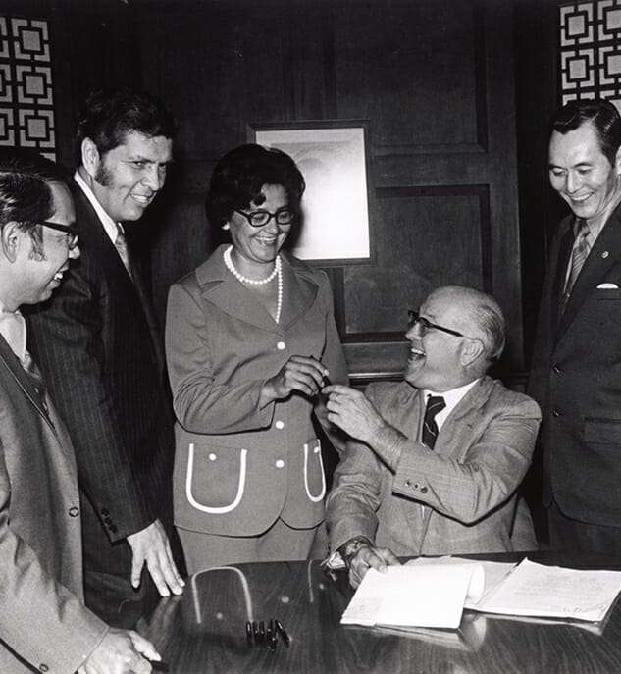
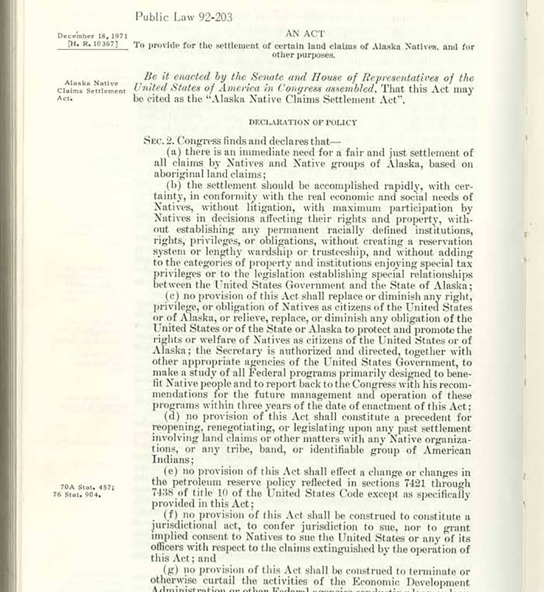
Notes:
So what did ANCSA actually do?
At a very high level, ANCSA was the settlement of Alaska Native land claims.
But it did that in a very unusual way.
First, ANCSA extinguished Aboriginal title to lands in Alaska and eliminated nearly all reservations, except for the Annette Island Reservation in Southeast Alaska.
As compensation, ANCSA conveyed about 44 million acres of land and paid nearly a billion dollars in 1971 dollars — almost 8 billion today.
But the federal government did not transfer that land and compensation directly to Tribes.
Instead, ANCSA created a for-profit corporate structure to receive and manage those lands and funds.

Slide 13
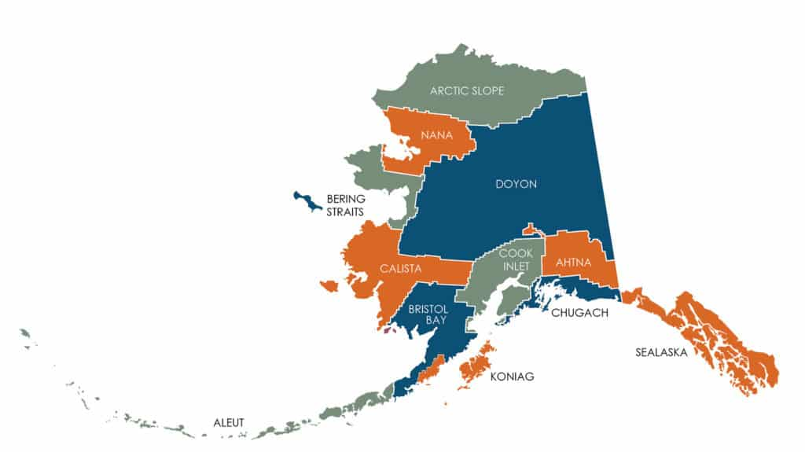
Notes:
ANCSA created two main types of Alaska Native Corporations: Regional Corporations and Village Corporations.
The state was divided into twelve cultural and geographic regions, shown on this map. Each region has a Regional Corporation.
Then many individual communities within those regions also formed Village Corporations.
Both Regional and Village Corporations are for-profit corporations owned by Alaska Native shareholders.
That is a key distinction: Alaska Native Corporations and federally recognized Tribes are not the same legal entities.
But outside Alaska, they are often confused or treated interchangeably.
That confusion matters when we start talking about land ownership, liability, eligibility for brownfield funding, and who has authority to make decisions about a contaminated property.
That structure is also one of the reasons brownfields work in Alaska can get complicated very quickly.
Because when we talk about contaminated lands, we are often dealing with multiple entities: Tribes, Village Corporations, Regional Corporations, and sometimes land that has moved between them over time.
One other important point: the regional boundaries on this map do not mean the Regional Corporation owns all land within that region.
The map shows which Regional Corporation serves that region. It is not a map of continuous land ownership.

Slide 14
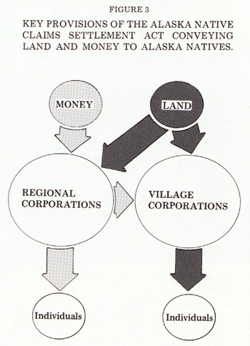
Subsurface Estate
Surface Estate
Notes:
Another thing that complicates contaminated site work in Alaska is how ANCSA land ownership was structured.
In many cases, Village Corporations received surface estate rights of ANCSA-conveyed lands (1).
Regional Corporations often received the subsurface estate rights (2).
So very broadly speaking, Village Corporations may control surface uses (e.g. logging), while Regional Corporations may control subsurface interests (e.g. minerals).
That split estate structure is important because contaminated site work often involves questions about access, cleanup authority, liability, reuse, and long-term land management. Note: there is no statutory definition of where surface estate ends, and subsurface estate begins.
Some ANCSA lands were already contaminated when they were conveyed to corporations.
And in some cases, lands were later transferred again from corporations to Tribes or individuals.
So over time, ownership histories can become complicated.
You can end up with split estates, multiple ownership transfers, overlapping interests, and different legal entities connected to the same property.
That’s part of why contaminated site work in Alaska can become legally and operationally complicated very quickly.

Slide 15
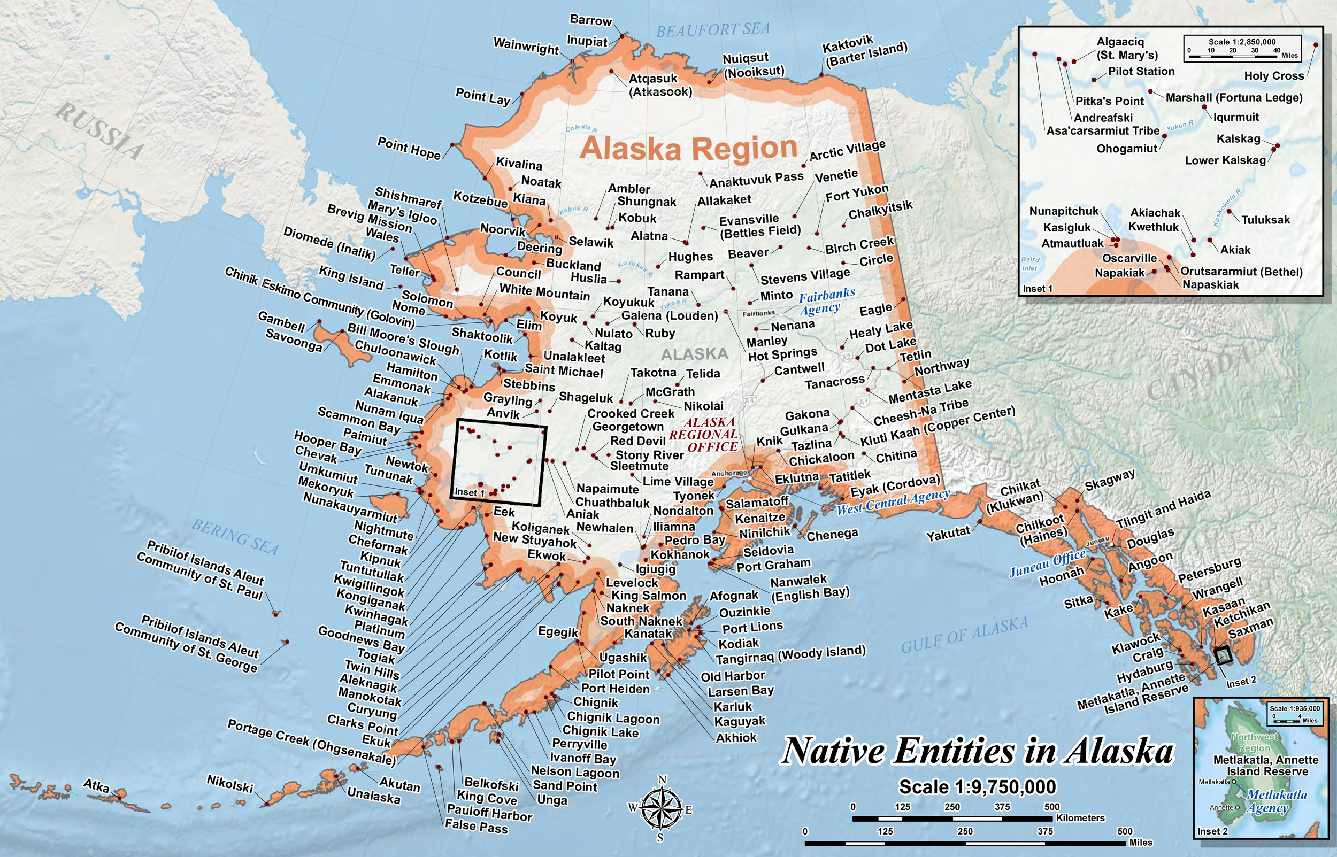
Notes:
Going back to earlier: I mentioned that there is a misperception that Tribes and Alaska Native Corporations are interchangeable entities. They are not. ANCSA did not eliminate Alaska Native Tribes. I’m repeating that because it’s a really important distinction and often misunderstood.
Another common misperceptions is that Alaska Native Tribes don’t own land. As you now know, they absolutely do.
But because of the Venetie decision – which said that ANCSA-conveyed lands generally did not qualify as Indian Country – lands owned by Alaska Tribes or Alaska Native Corporations are generally subject to Alaska State environmental laws and regulations. The Tribes are considered “sovereign without territorial jurisdiction.” They can create Tribal codes that affect their Tribal members’ behavior – e.g. you’re prohibited from dumping here – but when it comes to the land itself, the State decides what the acceptable cleanup levels and methods are. When we do our Phase II assessments, the State has to review everything – our scope of work, sampling plan – if it’s a reported site on their database (saw in first slide) we’re required to send the State the Phase II report and data.
This also means we have a hell of a time fulfilling Elements 2 and 4 – because Tribes don’t have enforcement authority over land. We had an EPA PO in R10 argue that Alaska Tribes shouldn’t be allowed to have TRPs because they don’t have territorial jurisdiction.
So long story short, we have some unique legal and regulatory dynamics that don’t always exist elsewhere.

Slide 16
Federal vs. State Law
CERCLA
Liability: Strict*, joint, several**
Created Brownfield program; notably exempts Alaska Native Tribes from eligibility for 104(k)
“Person” does not include “tribe”
Has liability relief provisions
ANCSA liability relief: reference Alaska Native Corporations and “successors in interest”
Alaska Law
Liability: Strict*, joint, several**
No Brownfield program; no voluntary clean-up program
“Person” includes “any other entity whatsoever”
Has liability relief provisions
ANCSA liability relief: reference Alaska Native Corporations, not “successors in interest”
Notes:
Here’s another example: let’s compare CERCLA against Alaska State environmental law.
As we just established, both systems apply to Tribal lands in Alaska.
(1, 2) Both contain strict, joint, and several liability structures for contaminated sites.
But they don’t line up neatly.
For example:
(3) The EPA Brownfields program was created through CERCLA amendments in 2002.
However, Alaska Native Tribes are explicitly excluded from eligibility for EPA competitive brownfield grants under 104(k).
Alaska Native Corporations are eligible. But again — those are not the same entities.
(4) Meanwhile Alaska does not have: a state-funded brownfield program, or a voluntary cleanup program. So this significantly limits the funding options Alaska Tribes have to address brownfield sites.
Definitions also differ.
(5) Under CERCLA, “person” does not include Tribes.
(6) Under Alaska law, the definition is much broader.
So there are situations where:
the federal government may not treat a Tribe as a potentially responsible party for a brownfield site, but the State of Alaska potentially could.
(7, 8) They both have liability protections for contaminated sites, but those also differ.
(9) Federal liability protections for ANCSA-conveyed contaminated sites reference Alaska Native Corporations and “successors in interest” (which could include Tribes that received land from their corporation).
(10) State law references Alaska Native Corporations but NOT “successors in interest”. So again, while a Tribe could receive liability relief from the federal government for contaminated ANCSA lands they received, they won’t necessarily receive that same protection under State law.
The point here is not that everyone needs to become environmental attorneys.
The point is that navigating these overlapping regulatory systems is a barrier to Tribes doing brownfields work in Alaska.

Slide 17
Status of Tribal Lands into Trust
1978 DOI Solicitor Opinion – no, they can’t
1980 Regulations: “Alaska Exception” – no, they can’t
1993 DOI “Sansonetti” Opinion – no, they can’t
Mid-90’s – Petitions – They should
2001 DOI Solicitor Opinion – maybe they can
Akiachak Native Community v. Jewell (2006) – yes, they can
2014 Regulation Change – yes, they can
2017 DOI Solicitor Opinion – yes, they definitely can
2018 DOI Solicitor Opinion – maybe they can’t
January 2021 DOI Solicitor Opinion – no, they can’t
April 2021 DOI Solicitor Opinion – maybe they can
2022 DOI Solicitor Opinion – yes, they can
Alaska v. Bryan Newland (filed in 2023) – They shouldn’t
2024 Alaska Federal Transition Plan - They shouldn’t
January 2025 EO 14153 – They probably shouldn’t
February 2025 DOI Acting Solicitor Opinion – Maybe they can’t
February 2026 DOI Solicitor Opinion - No they can’t
Notes:
Another issue that has been heavily debated in Alaska is whether Alaska Tribes can place lands into federal trust.
I am not going to walk through every line on this slide because I would like everyone to remain conscious.
But what I hope this illustrates is the instability and uncertainty Alaska Tribes have had to navigate with trust lands.
For decades, federal positions have shifted back and forth repeatedly depending on: administrations, solicitor opinions, litigation, and regulatory interpretation. And this matters because land status affects all kinds of things related to brownfields: jurisdiction, redevelopment options, environmental regulation, and long-term planning.
Most recently, in February 2026, DOI formally revoked all prior opinions supporting trust acquisitions in Alaska and indicated it may pursue codifying that prohibition. So this remains a very active and evolving issue.

Slide 18
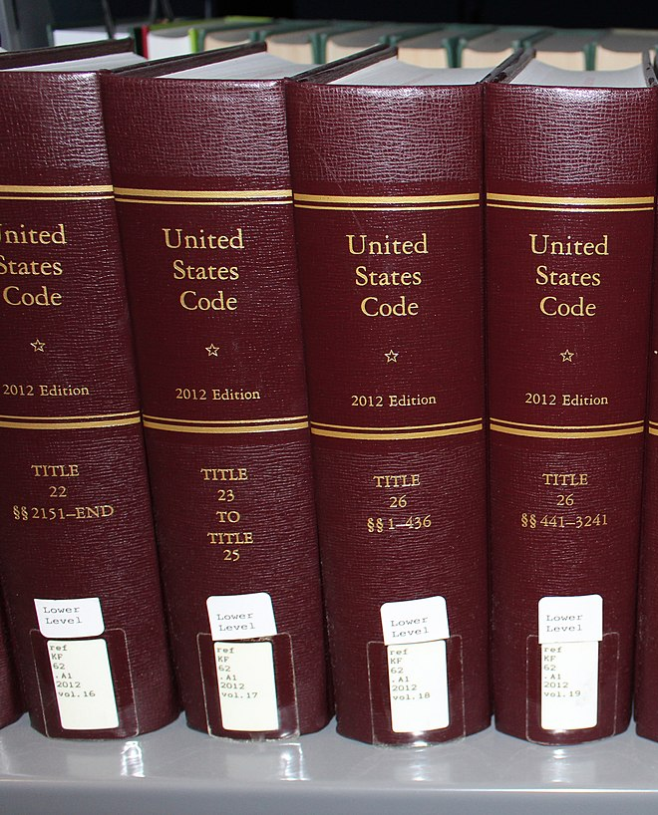
Different federal laws define “Tribe” differently
  42 USC 9601 (CERCLA)
  25 USC 5304 (ISDEAA)
  25 USC 5130 (IRA)
  25 USC 1301 (ICRA)
  25 USC 1903 (ICWA)
  Words Matter
Notes:
I’m also not going to go too deep into the legal rabbit hole here.
(1) But one thing that’s important to understand in Alaska is that different federal laws define “Tribe” differently.
Depending on which law you’re working under, Alaska Native Corporations may or may not be included in that definition.
These definitions affect: eligibility for grants, liability for contamination, redevelopment options, and jurisdiction.
So the very short version here is:
Words matter. The way laws are written matters.
And in Alaska, those distinctions can have real operational consequences for Tribal contaminated site work.

Slide 19
Case Studies
Notes:
So to illustrate some of these challenges in practice, here are a couple of case studies from communities we’ve worked with.

Slide 20
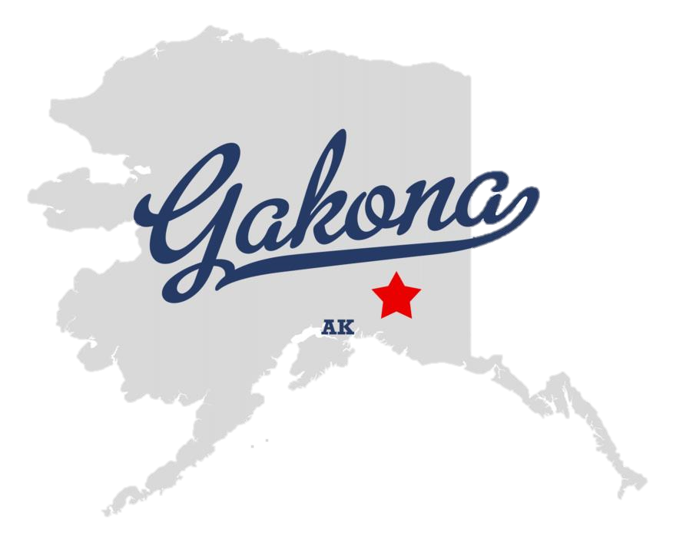

Environmental Cost Case Study: Heinz Salvage Yard (Gakona)
  First assessment:
  $69,944
  Second assessment:
  $110,139.59
  Third assessment (to be completed):
  $58,800 - $126,000
  Estimated Cleanup Cost:
  $571,200 - $1,224,000*
  Total estimated for entire project:
  $810,083.59 - $1,530,083.59
Notes:
As I’ve mentioned, one major barrier in Alaska is simply cost. Here’s an example from the Heinz Salvage Yard site in Gakona. For context, this site was basically a guy’s salvage/dumping yard for all sorts of stuff, like old vehicles, snowmachines, equipment, empty drums, scrap metal, etc. And this site isn’t tiny, but it isn’t huge – the total property size is about 4 acres, with scrap present on part of it.
Just to assess this one site:
the first Phase II assessment cost around $70,000,
the second Phase II cost over $110,000,
and the third Phase II assessment is estimated between about $60,000 and $126,000.
Current cleanup estimates range from roughly: $570,000, to over $1.2 million. So total projected costs are somewhere between: about $810,000, and over $1.5 million.
For the record, Gakona is on the road system. Again, costs become dramatically higher than this for communities off the road system.
These costs create barriers because:
funding caps may not align with actual Alaska costs
This happened on the the Heinz site – projects often require multiple grants over multiple years to complete just one phase – our viable work season is short, the ground is only thawed 3-4 months out of the year
Tribe may not have administrative capacity to manage all of that – often have one IGAP coordinator, sometimes an IGAP assistant, and a Tribal Administrator – and they all wear a ton of hats in the community
and redevelopment economics may not pencil out in the same way they do elsewhere.
We’ve even heard stories of grant proposal reviewers from outside Alaska questioning whether budgets submitted by Alaska Tribes are realistic because the numbers seem so high, they think they’re being inflated, and we’ve heard of Tribes in Alaska getting rejected for grant awards as a result.

Slide 21
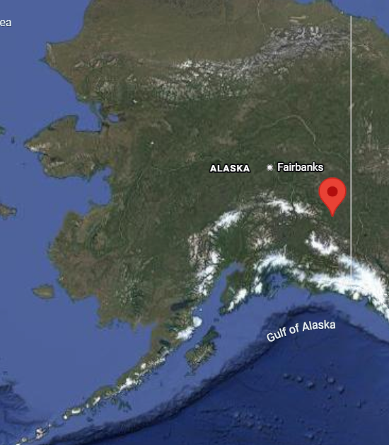
Law & Policy Case Study: Native Village of Tetlin
Notes:
Back to law and policy.
One example is the Native Village of Tetlin.
Tetlin previously had reservation status before ANCSA.
During ANCSA negotiations, Tetlin negotiated unique land transfer arrangements.
And the result created some very unusual ownership structures that continue to affect their brownfield work today.

Slide 22
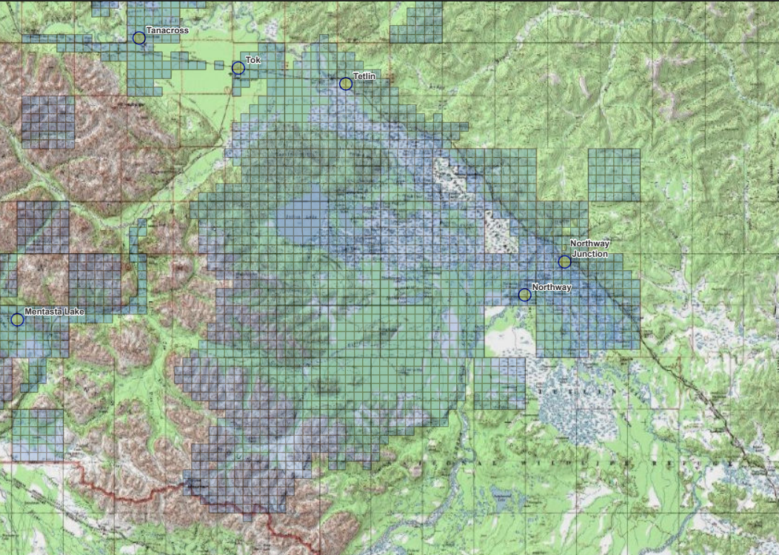












TNC Conveyance and Re-conveyance
*Map boundaries are approximate
Notes:
One of those terms was the federal land transfer. The Village Corporation got over 700,000 acres transferred to it from the federal government in fee simple status instead of split estates with the Regional Corporation like other areas.
After they received the land, the Village Corporation then transferred the majority of that land to the federally recognized tribe.
The blue section is what the Village Corp kept
The yellow section is what the Native Village got. So the Village, a federally recognized tribe in Alaska owns land in fee simple status. If some of the land around their village is contaminated, what barriers to reuse is Tetlin looking at?

Slide 23
Law & Policy Barriers Case Study: Native Village of Tetlin
128(a)
TBA
Reuse funding
104(k)
DBAC
“You could partner w/ your Village Corporation”
“You could partner w/ your Regional Corporation”
Notes:
First, is the challenge with finding funding for a reuse.
For example, there’s not exactly a developer waiting in the wings to develop a mixed use building in Tetlin, AK. So some policies meant to encourage redevelopment like opportunity zones can be of limited impact. Then there are the challenges with accessing funding for Brownfield assessment and cleanup
The 128(a) funding
has traditionally not been enough to fund a capacity building program and address contaminated sites,
and 128(a) is technically not supposed to be used for site specific work on lands owned by the grantee
Because of the 104(k) exclusion of Alaska Tribes,
the Native Village cannot apply for an EPA Competitive grant on their own at all
Instead Tribes in Alaska are often told that they could partner with their Alaska Native Village Corporation
That assumes that that village corporation has the capacity to administer the grant. Not all do.
If the Village Corp is a Potentially Responsible Party, they are not eligible to apply for Brownfield funding and
The Village Corp could refuse to partner because they do not get along with the Tribe
or the Corp could refuse to partner due to liability fears.
They are also told they could partner with their Alaska Native Regional Corporation
All of the above issues with Village Corporations also apply to Regionals, and
Specifically for villages like Tetlin, they are not associated with a Regional Corporation because of how they negotiated ANCSA. Lastly, in Brownfields, the applicant must be the owner for competitive cleanup grants.
If the landowner is the tribe and not the Alaska Native Corporation how would an Alaska Native Corporation apply for a cleanup grant for a property they do not own?
They could technically go for a Targeted Brownfield Assessment (TBA)
but that would only get them through assessment because TBAs don’t do cleanups. Tetlin got a TBA…and then struggled to find resources for cleanup.
They could apply to the State of Alaska DEC Brownfield Assessment and Cleanup services, which they have done. But that has its own challenges.
DEC’s funding is limited
its still competitive within the state.
And with the time limit imposed by the field season because there is snow on the ground for 6+months out of the year, relying on only DEC funding can take a very, very long time.
So this creates situations where communities can spend years trying to piece together even a single pathway toward cleanup and reuse.

Slide 24
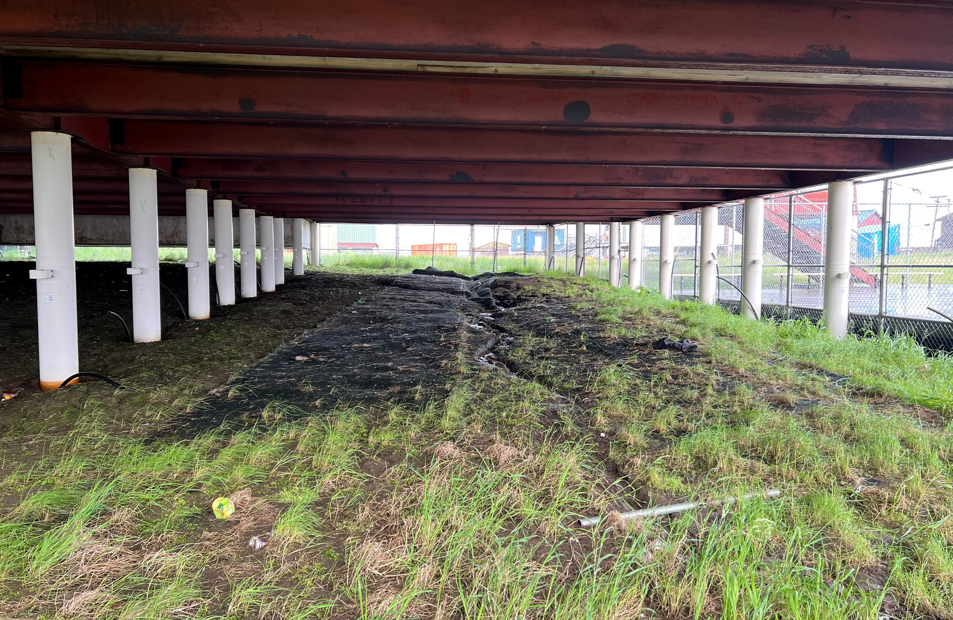
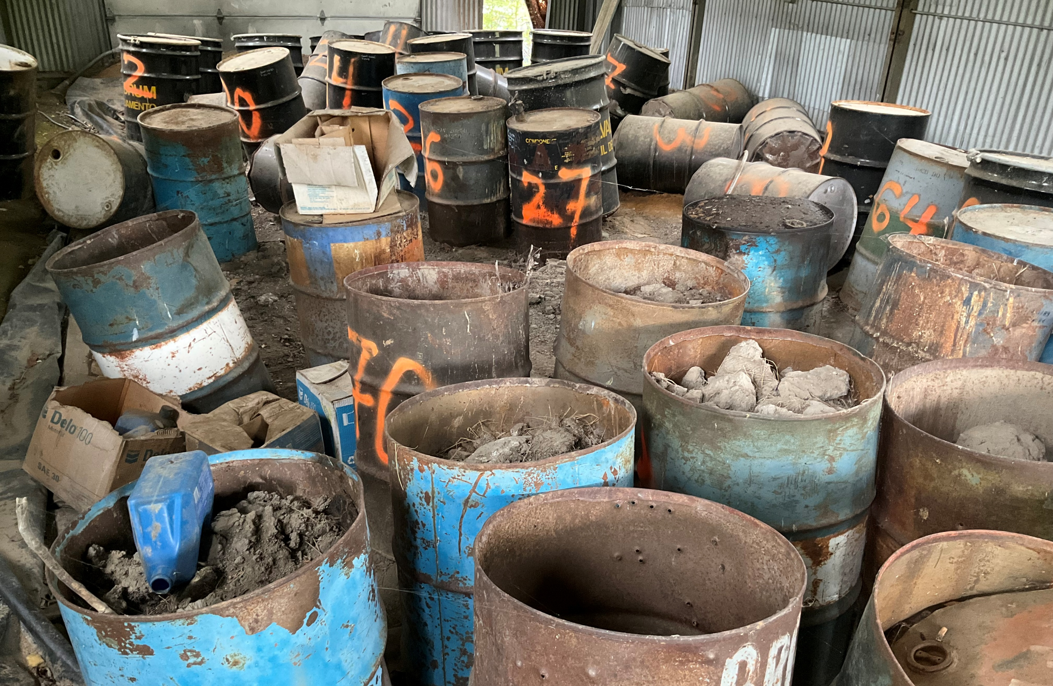
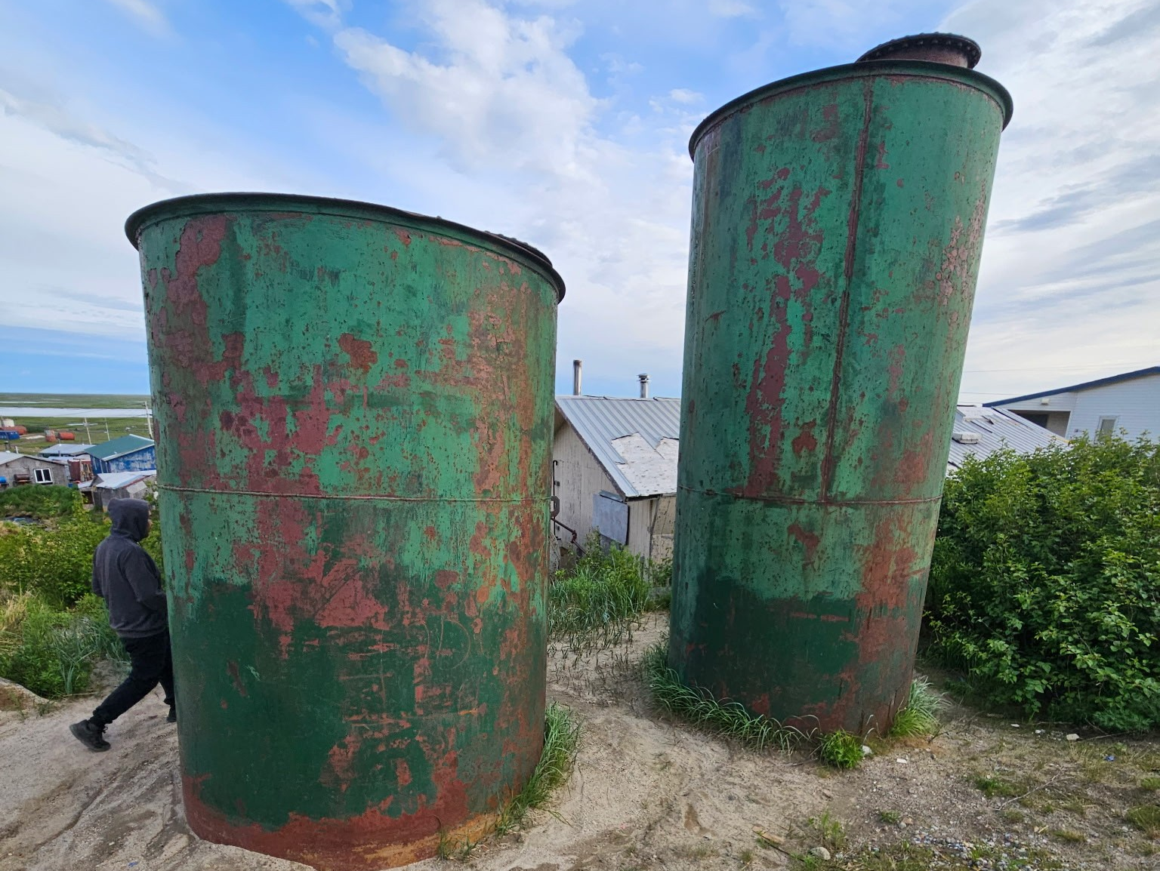
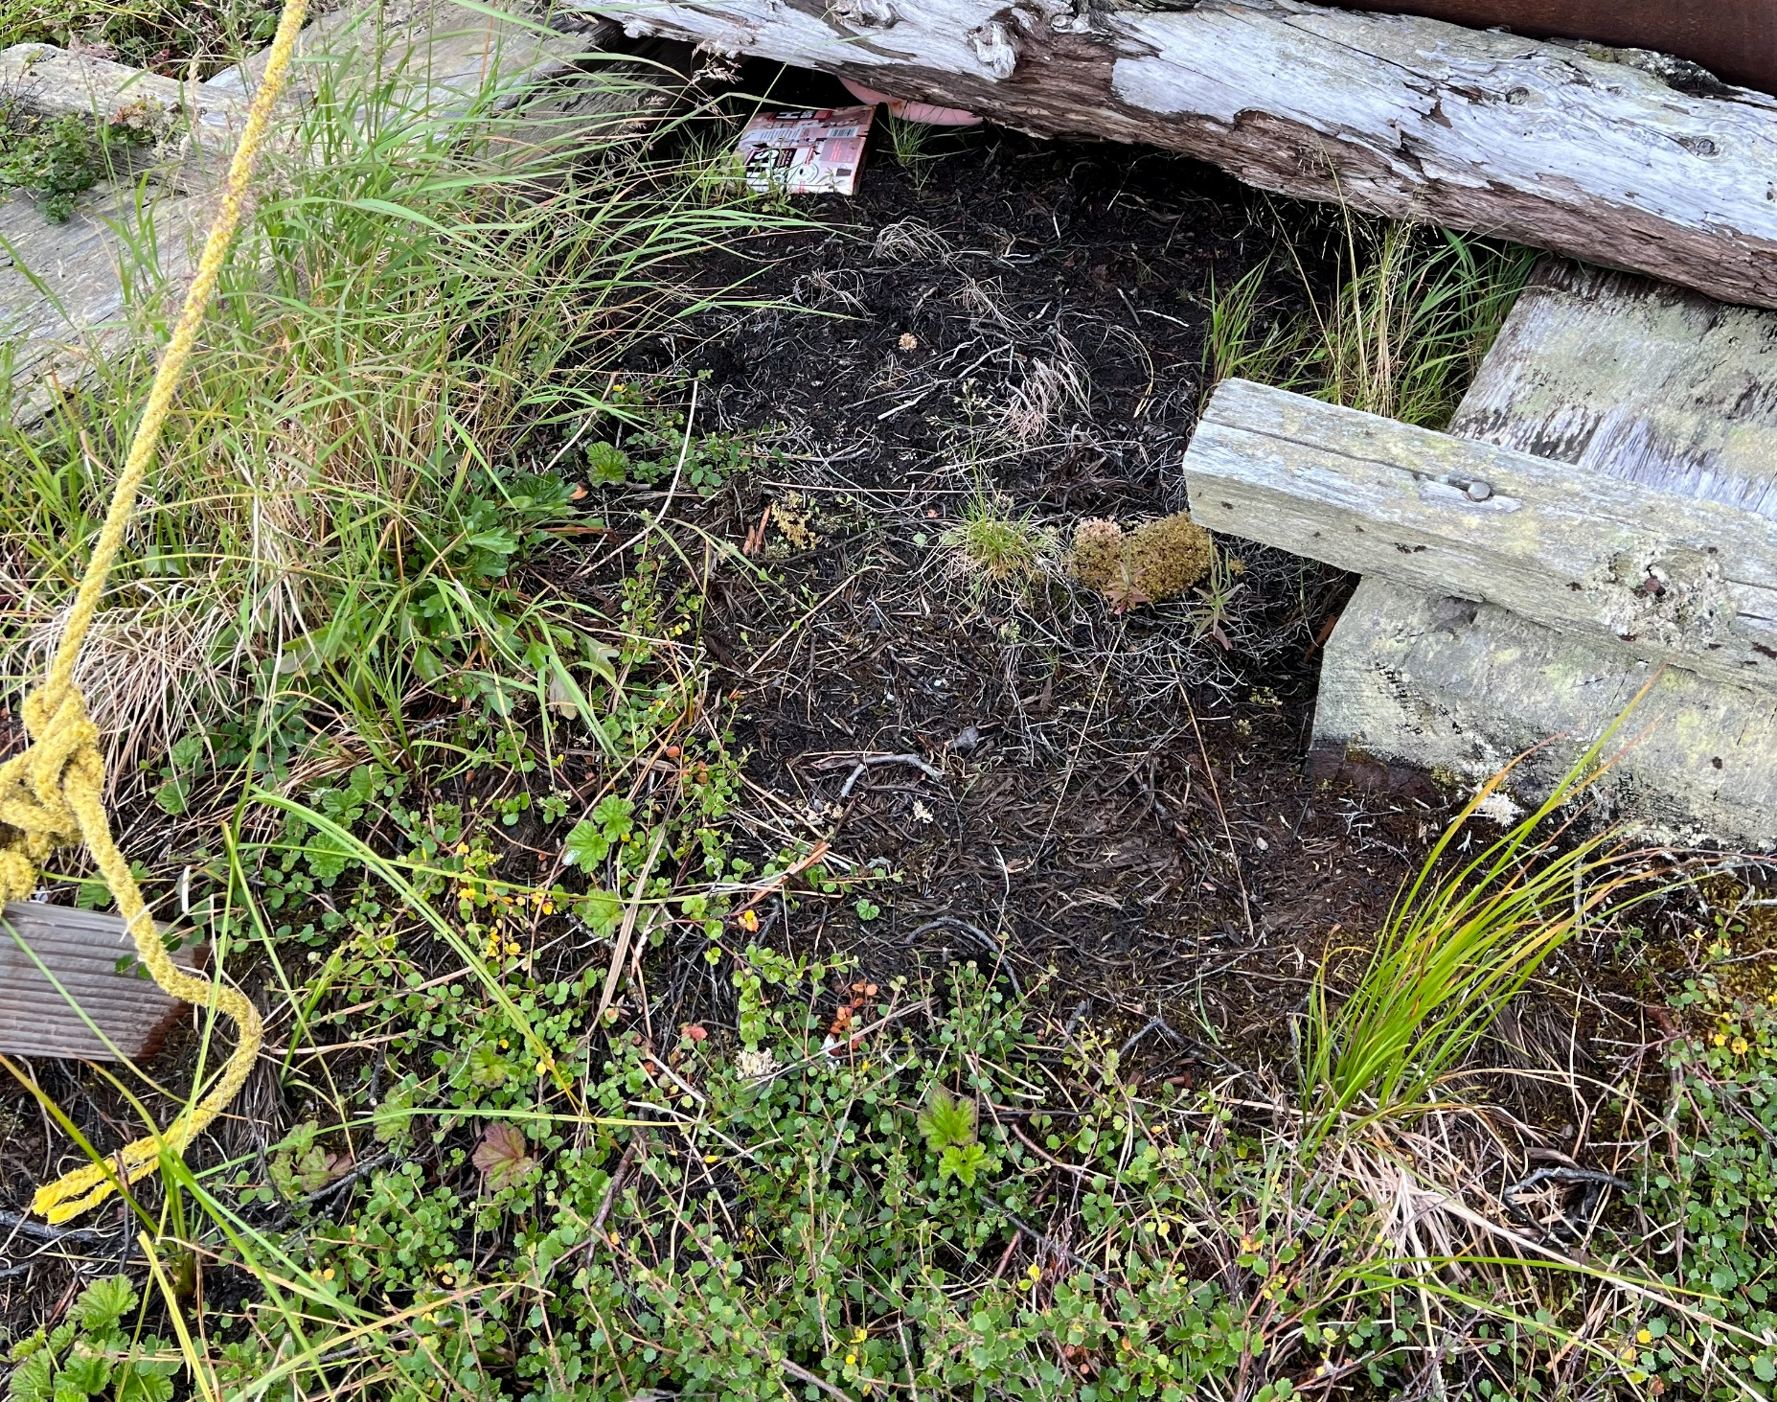
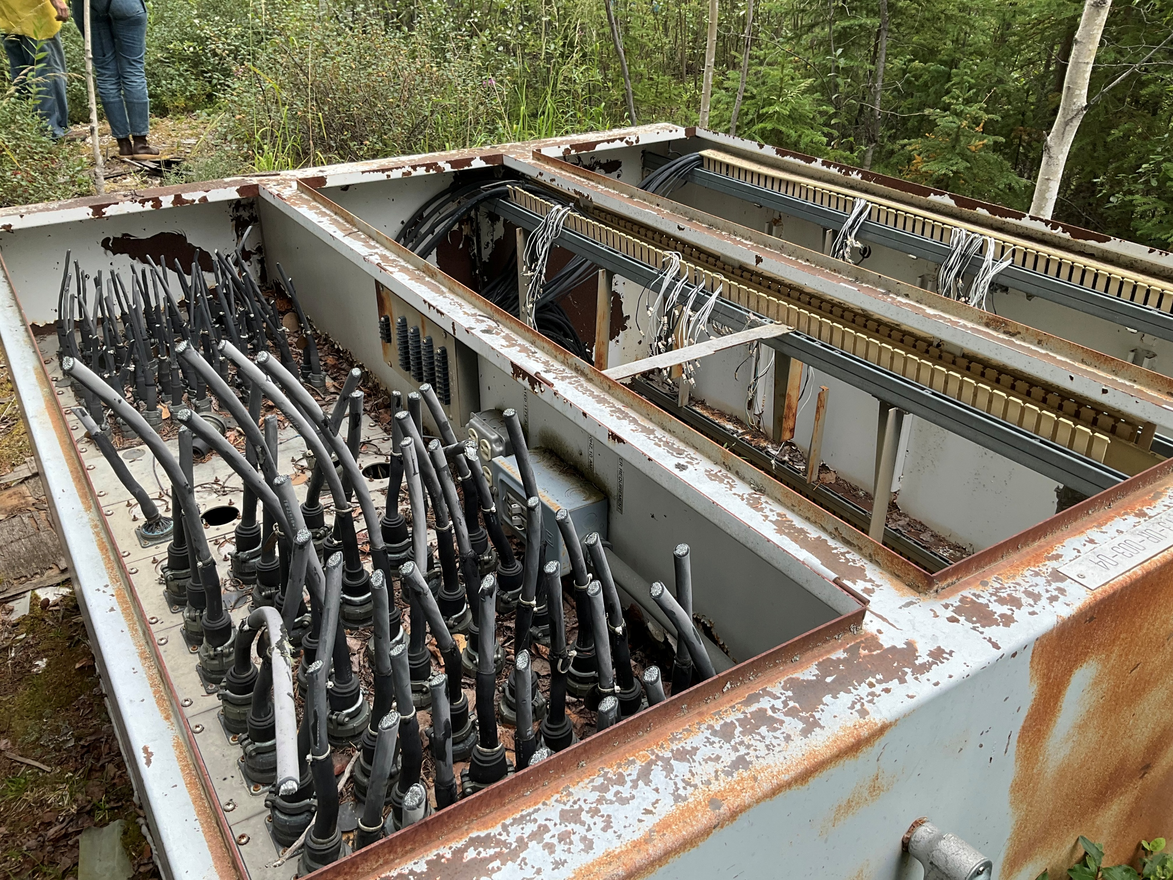
Notes:
So why does all of this matter?
Because these legal, logistical, and funding structures have real consequences for Tribes.
In our experience, EPA Region 10 staff have really tried to work within the systems they have to help Tribes in Alaska.
But the broader system still creates disproportionate burdens for Alaska Tribes.
The result is that some communities remain stuck with contamination for: years, decades, or even generations.
But that would be an extremely depressing ending to this presentation, so I want to spend some time talking about the work Tribes in Alaska ARE doing to move sites toward cleanup, planning, and reuse.

Slide 25
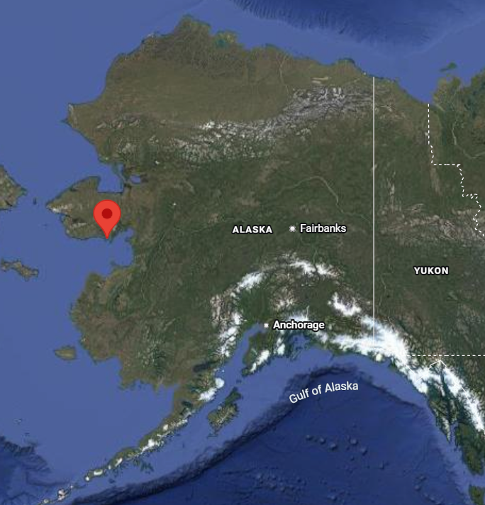
Community Example: Golovin
Notes:
I want to share an example from the community of Golovin. This was a project that the Tribal TAB program supported.

Slide 26
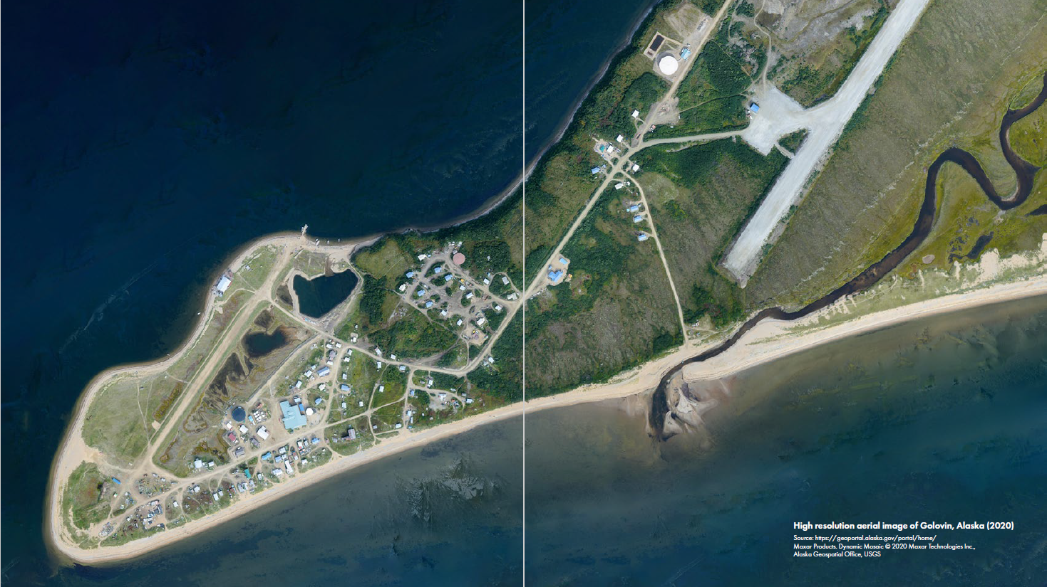
Notes:
Golovin is a community of about 190 people on a narrow spit of land on Norton Sound. There’s water on both sides of the community, and nearly all their critical infrastructure is located in a flood zone.
When Golovin reached out to Tribal TAB for assistance, the community had been concerned for some time about several legacy contaminated sites, but they had identified three sites in the heart of their community that were particularly concerning to them: (1) the former fish processing plant, (2) a former washeteria, and (3) their old landfill site. They had been working closely with their regional TRP, which is a Tribal Health Organization called Kawerak (located in Nome), on these sites, and felt ready to have a community-wide conversation about next steps. We’re close collaborators with the Kawerak team, so Tribal TAB got pulled in to help facilitate that conversation.

Slide 27
Golovin Brownfield Video
Notes:
I’ll talk more about our involvement in a moment, but I wanted to start out by showing this short video. In 2023 a team of Tribal TAB folks, including ANTHC, KSU, and the Indigenous Design and Planning Institute (UNM) visited Golovin, and ANTHC’s videography team documented our visit, focusing in on the fish plant site. It’s pretty short, about five minutes, and it provides some good context and information for Golovin and what they’re dealing with there.

Slide 28
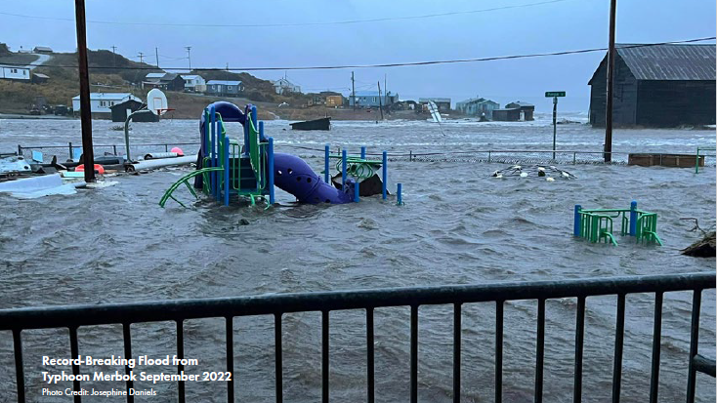
Notes:
As you saw in the video, part of what prompted Golovin to focus on these brownfield sites was the impact of Typhoon Merbok on Golovin in fall of 2022. Merbok brought significant storm surges and flooding to many coastal communities across western Alaska, including Golovin.
When we visited in May 2023, the snow cover was just melting off, so some of the contamination impacts from the storm were revealing themselves. The school playground (in this photo) was fully closed and roped off because without snow cover, it had started smelling so strongly of petroleum from home heating oil tanks and fuel that had been carried there by the floodwaters that it wasn’t safe or usable for the kids to play on.
And for the community, this made contaminated sites feel very immediate and very personal.
The conversation shifted from: “How do we eventually address these sites?” to: “What does long-term community safety and infrastructure planning look like, and how do these sites fit into that plan?”

Slide 29
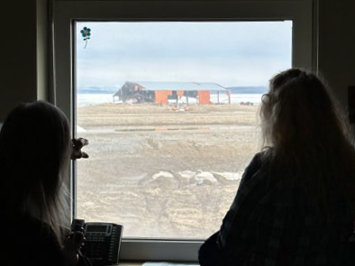
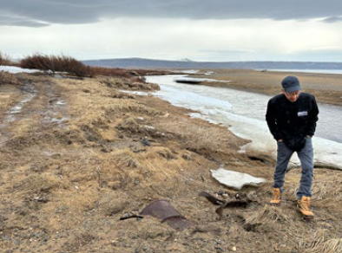
Notes:
To support the community with this conversation, we pulled together a team of partners including Kawerak (Brandie), Tribal TAB folks from KSU, and the Indigenous Design and Planning Institute at University of New Mexico to facilitate a community visioning and planning dialogue in Golovin, focusing around those three sites.
The team spent several days in the community visiting each of the three sites and meeting with residents and Tribal leaders. Our goal with this initial visit was to spend time listening so we could start to understand community priorities.
So there was a lot of discussion around values, hopes, community identity, things people wanted to preserve in the community and at these sites. At the same time, they were really concerned about the contamination present on these sites, the potential for future storms, and other waste sites that might affect safety and future development of the community.

Slide 30

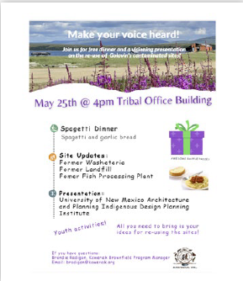
Notes:
Toward the end of our week there, Carol (IGAP Coordinator) called a community-wide meeting where people shared their concerns about the fish plant, washeteria, and old landfill, and how these sites might fit into their future priorities for the community. To get the conversation going, we first asked everyone to talk about what they love about Golovin.

Slide 31
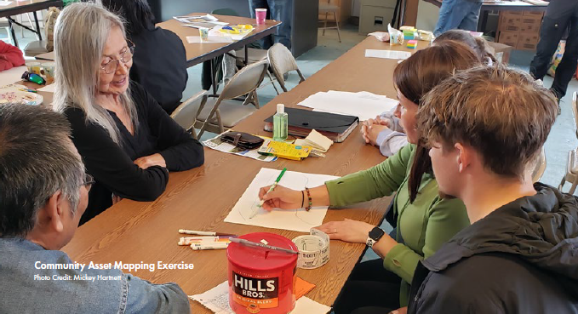
Notes:
The screenshot was a little blurry, but you can see here that people highlighted places they care about deeply: subsistence areas, beaches, family homes, and gathering spaces. We asked them to draw these places on paper, and also draw any areas that they felt might need attention and TLC through further community planning. The kids at the meeting got really into this part, which was awesome.

Slide 32
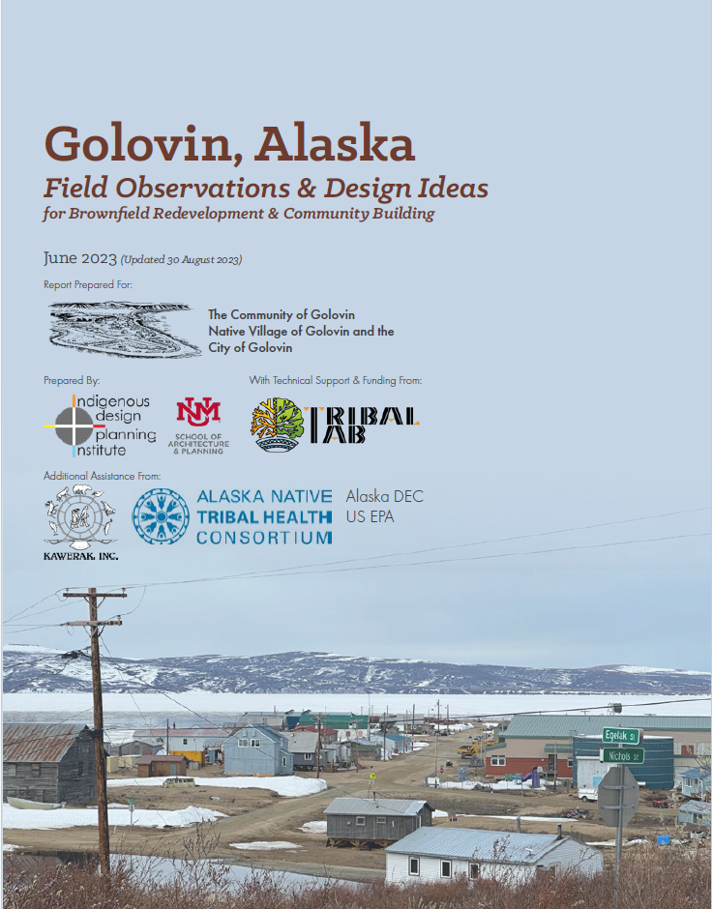
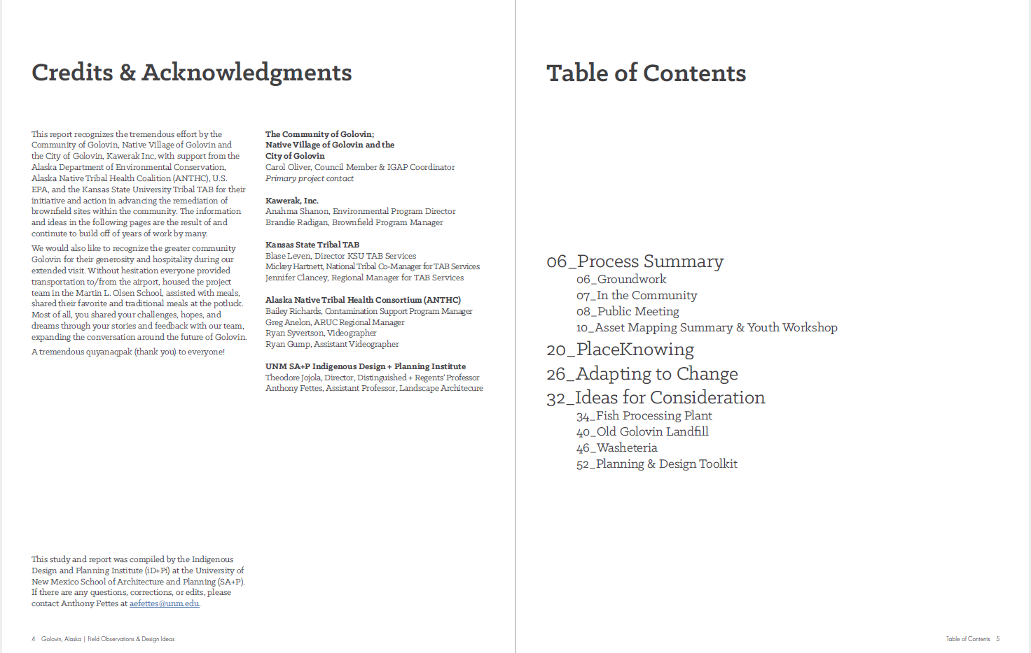
Notes:
The goal of this initial conversation was for the community to start thinking about how these three contaminated sites might support future development and infrastructure needs once those contamination issues are addressed. The outcome of our initial visit was a community planning report, put together by IDPI, that documented the conversation, the community’s priorities, and explored potential future uses for their three focus sites.

Slide 33
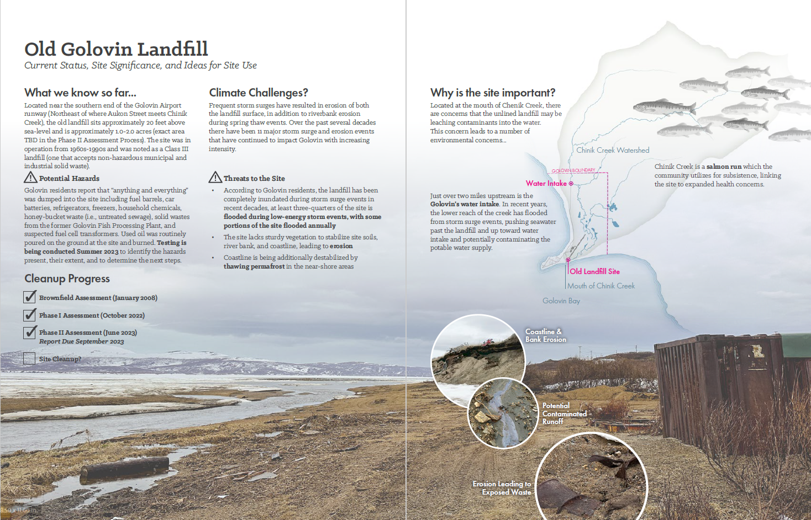
Notes:
The report included redevelopment ideas and planning concepts that could help inform the community’s future infrastructure decisions. Here’s an example from the old landfill site – that’s what it looks like now…

Slide 34
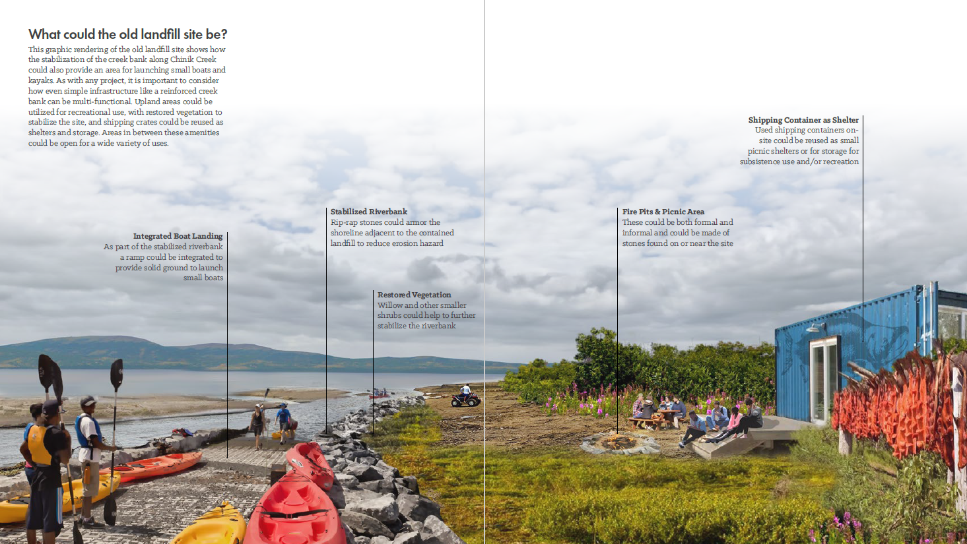
Notes:
…and this is one rendering of what it could look like, based on what the community shared they wanted to see in Golovin in the future. These ideas came directly from what people said they loved about Golovin: subsistence, time with family on the beach, gathering spaces, and the ways of life they want to see supported through future community infrastructure.
(Boat landing, picnic area for the beach, shelter/smoke house)
Obviously when we talk about redevelopment on contaminated sites, we have to remain realistic. Engineering constraints, erosion, contamination type and severity all matter, and not every site can support every type of redevelopment.
But contaminated sites can still become opportunities for communities to think intentionally about future land use, which Golovin is doing exceptionally well.

Slide 35
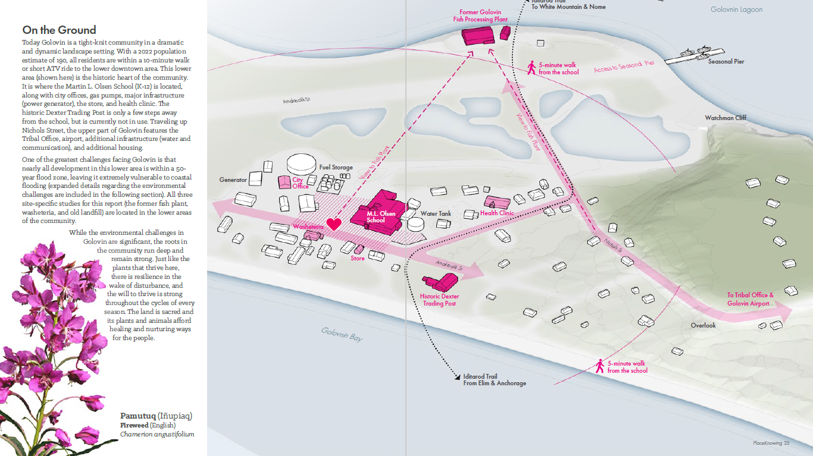
Notes:
These are long-term conversations in Golovin, and they’re still ongoing, but since our visit the Tribe has been using this report, and the renderings IDPI created for each site, to help guide their planning and visioning conversations, to ensure that the Tribe’s priorities and values are centered.
One reason I like the Golovin example is because it reframes brownfield sites from being only liabilities. They can also become opportunities for communities to shape future infrastructure around community values. And that’s especially important in places like Golovin that are already facing challenges like climate impacts, erosion, flooding, and infrastructure transitions.

Slide 36
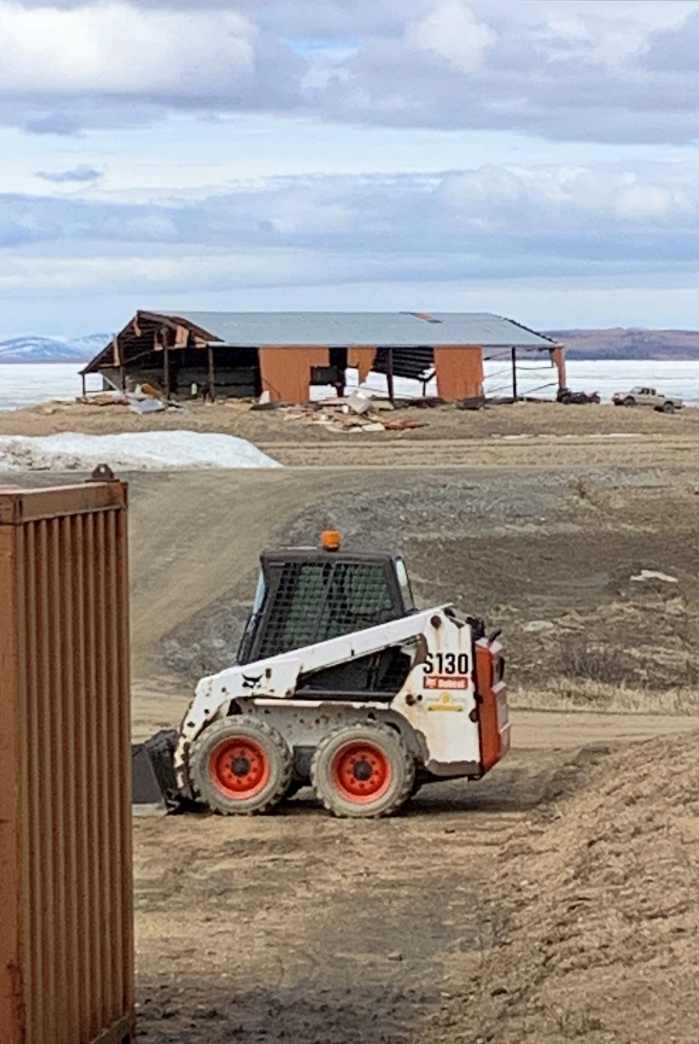

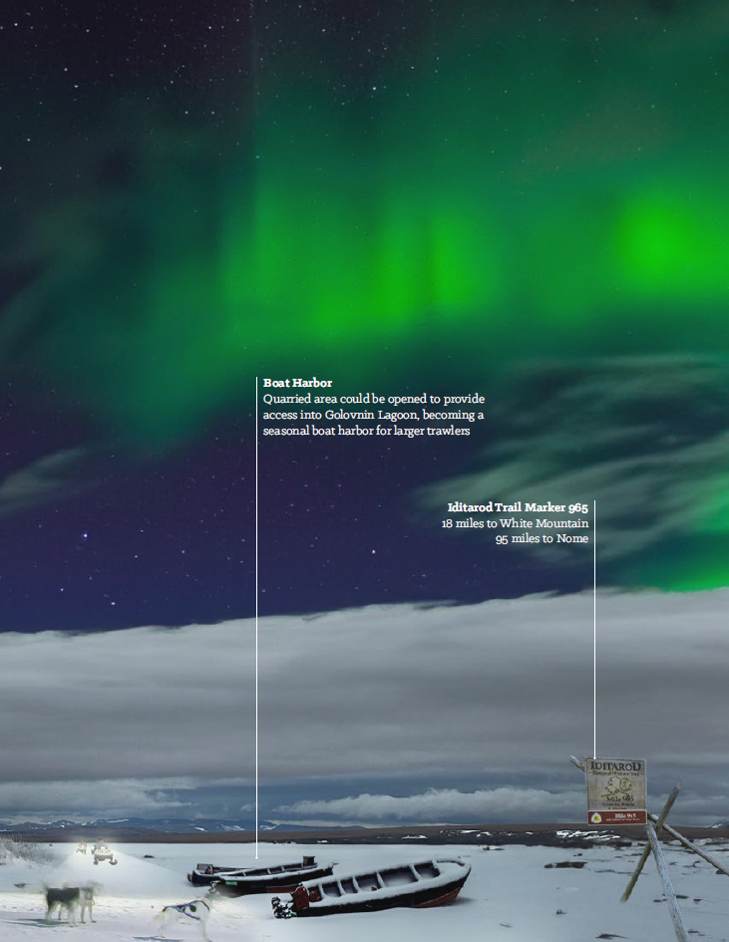
Notes:
As you saw in the video, Kawerak helped the Tribe secure BIA and FEMA funding to demolish the old fish plant building. We happened to be visiting Golovin on the day they started that demolition.
The fish plant building is now gone.
And on the right is part of the community’s vision for what they hope the site could eventually become (Golovin is on the Iditarod trail, so note the sled dogs).
So while these processes can be slow and complicated in Alaska, Tribes ARE making progress on brownfield sites. We just have to jump some different hurdles and remain creative and persistent.

Slide 37
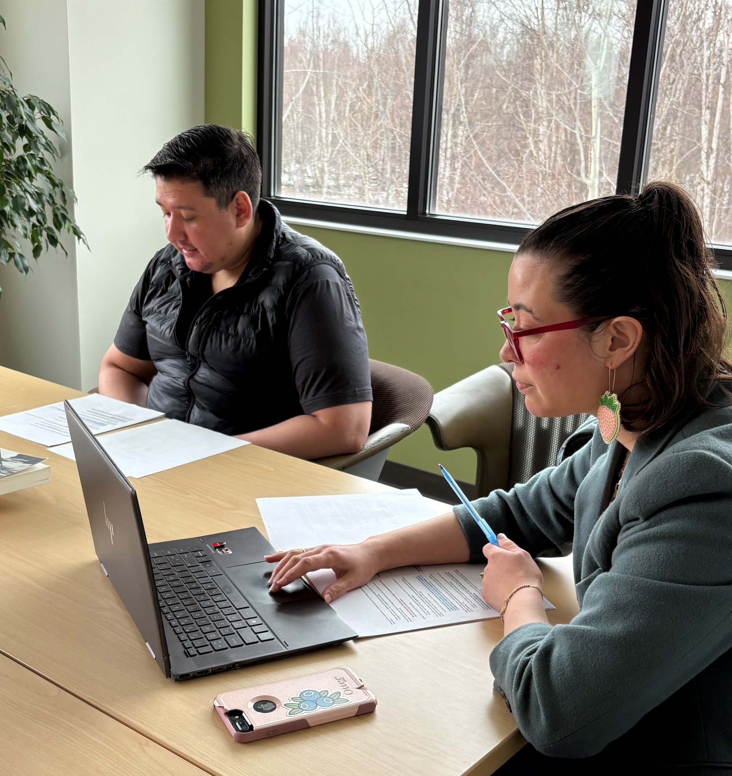
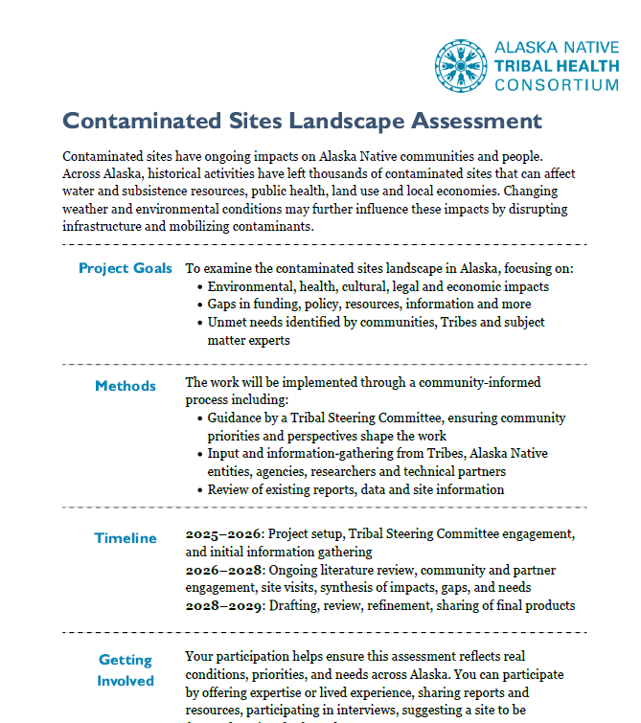
Notes:
Before we wrap up, I also wanted to briefly mention a couple other projects our program has been working on that connect to contaminated sites work in Alaska.
One is an ANCSA-focused podcast project we’ve been developing in partnership with Tribal TAB and Rosebay Audio. The goal of the podcast is to help make some of these complicated issues around ANCSA-conveyed contaminated lands more accessible and understandable — especially through Tribal stories, community experiences, and conversations with people directly involved in that work. A lot of the legal and policy dynamics I touched on today can feel extremely abstract until you hear how they actually affect communities and real projects on the ground. It’s going to be a six-episode limited series and we’re planning for it to release this fall, so keep an eye out for that.
We’re also working on a statewide Landscape Assessment of the impacts of contaminated sites on Tribes in Alaska.
That project is looking more broadly at contaminated site trends, community needs, environmental risks, and infrastructure pressures across Alaska.
Part of the goal is to better understand where barriers exist to contaminated site work, where resources are lacking, and how those constraints are intersecting for Alaska Tribal communities. Basically this presentation, but more thorough. This has never been documented before in a single, comprehensive resource. This will be a longer-term project over the next four years or so – we’re just starting to kick off the community outreach and data collection phase this year.
So if anyone is interested in either of those projects afterward, I’d be happy to talk more.

Slide 38
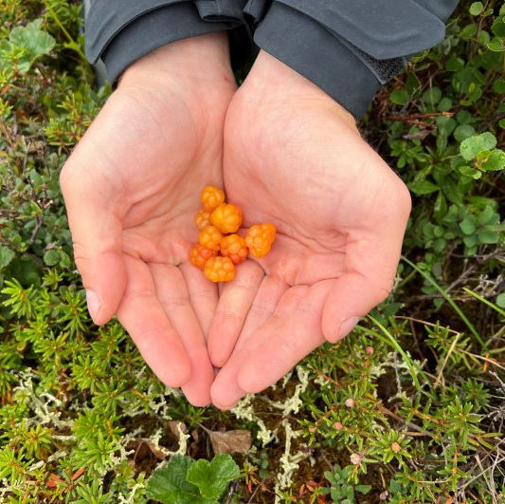
Thank you!
ANTHC Contaminated Sites Program
contaminatedsites@anthc.org
907-729-4008
Notes:
And with that, thank you all so much. I’m happy to open it up for questions and discussion, and other Alaska folks, please feel free to chime in with your own thoughts.

