Slide 1





Updated Quality Assurance Project Plan Standard (2023)
What you need to know for your Brownfields Projects

Slide 2


Quality Assurance Project Plan (QAPP) = Project Blueprint
QAPPs describe the plan for site investigation and sampling and are required before any site investigation can begin.
QAPP layout determines how environmental site investigations are:
  planned
  implemented
  documented
  assessed during the life cycle of a project

Slide 3
Updated QAPP Standard requirements will apply to all EPA contracts issued on or after July 18, 2023, and new and supplemental grant awards issued on or after August 31, 2023
Rescinded Standard - EPA Requirements for Quality Assurance Project Plans EPA QA/R-5 March 2001
Updated Standard - Directive No: CIO 2105-S-02.1 - Reissued as the Agency’s Environmental Information Quality Assurance Project Plan (QAPP) Standard. The directive was signed by the EPA Chief Information Officer and Deputy Assistant Administrator for Environmental Information on July 18, 2023.

Slide 4

Updated QAPP Standard
Group A: Project Management and Information/Data Quality Objectives
A1 Title Page
A2 Approval Page
A3 Table of Contents, Document Control, and Document Format
A4 Project Purpose, Problem Definition, and Background
A5 Project Task Description
A6 Information/Data Quality Objectives and Performance/Acceptance Criteria
A7 Distribution List
A8 Project Organization
A9 Project QAM Independence
A10 Project Organizational Chart and Communications
A11 Personnel Training/Certification
A12 Documents and Records

Slide 5
Updated QAPP Standard
Group B: Implementing Environmental Information Operations
B1 Identification of Project Environmental Information Operations
B2 Methods for Environmental Information Acquisition
B3 Integrity of Environmental Information
B4 Quality Control
B5 Instruments/Equipment Calibration, Testing, Inspection, and Maintenance
B6 Inspection/Acceptance of Supplies and Services
B7 Environmental Information Management

Slide 6
Updated QAPP Standard
Group C and D
Group C: Assessment, Response Actions and Oversight
C1 Assessments and Response Actions
C2 Oversight and Reports to Management
Group D: Environmental Information Review and Usability
D1 Environmental Information Review
D2 Useability Determination

Slide 7
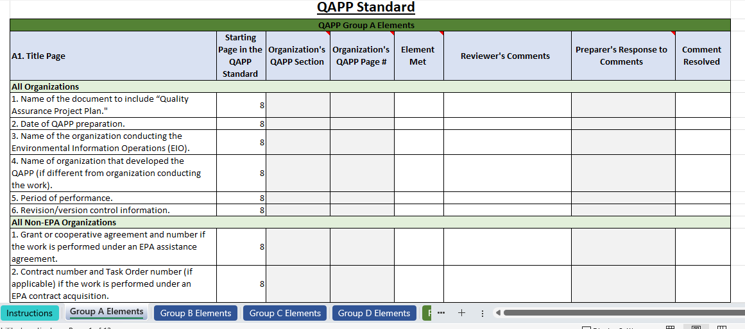
Checklist for Updated QAPP

Slide 8
Link for EPA QAPP Standards and Training:
https://www.epa.gov/quality/quality-program-directives EPA QA Website - has the updated QAPP standard
https://www.epa.gov/quality/r9-qa-project-planning#examples EPA Region 9 Website - has QAPP CHECKLIST for the new standard
https://www.epa.gov/quality/quality-assurance-project-plan-qapp-guidance QAPP Guidance document
Always check your Grant’s Terms and Conditions for any requirements for the Quality Assurance process!

Slide 9

EPA Region 6 Brownfields Contacts
Contact Information:
Althea Foster (foster.althea@epa.gov)
Brownfields R6 Section Supervisor Contact - 214-665-2268
Marsha Lay (lay.marsha@epa.gov)
Brownfields R6 128(a) Program for States and Tribes Coordinator| R6 MARC Coordinator Contact - 214-665-7562
Adrian Goettemoeller (goettemoeller.adrian@epa.gov)
Brownfields R6 128(a) Project Officer Contact - 816-689-7909

