Slide 1

Storytelling
in the Modern Age
TribalTAB.org
Hayley Veilleux

Slide 2
STORYTELLING TODAY
  Writing and oral storytelling are more interlinked than ever
  (I’m using these terms interchangeably)
  When I think about storytelling as it pertains to the work being done in this room, I think of the following:
    Scripts (for videos or social media reels)
    Speeches (for presentations or advocacy work)
    Graphic design copy
    Social media copy
    Project articles or profiles for community success stories
    Webpages highlighting redevelopment work
    Interviews
    So much more (ask someone who’s chronically online or who reads often)
1 of 2

Slide 3
STORYTELLING TODAY
  How to compete with the seemingly endless quantity of information available and shortened shortened attention spans
  My hot take: None of the above matters
  It is meaningful, informative, and impactful storytelling that captures a person’s attention
  Storytellers still need to have something compelling or interesting to share with the world
    We need to communicate insight we have to offer in fresh, novel ways
  There are pillars of effective storytelling
2 of 2

Slide 4
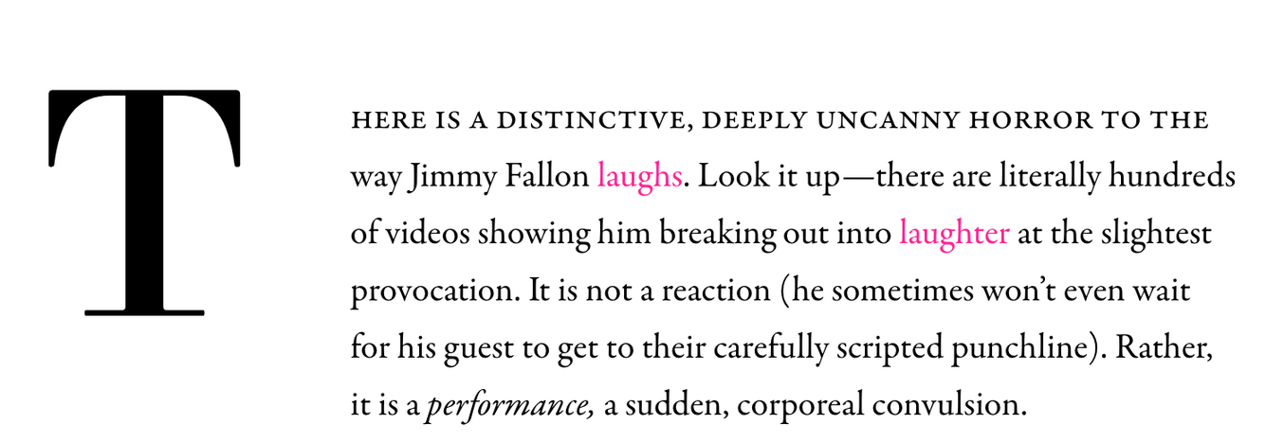
COMPELLING HOOKS
  The hook is one of the most important features of a good story
  We see evidence of compelling hooks in short form media all of the time
For example:
  “There was no possibility of taking a walk that day.” ― Jane Eyre by Charlotte Brontë

Slide 5
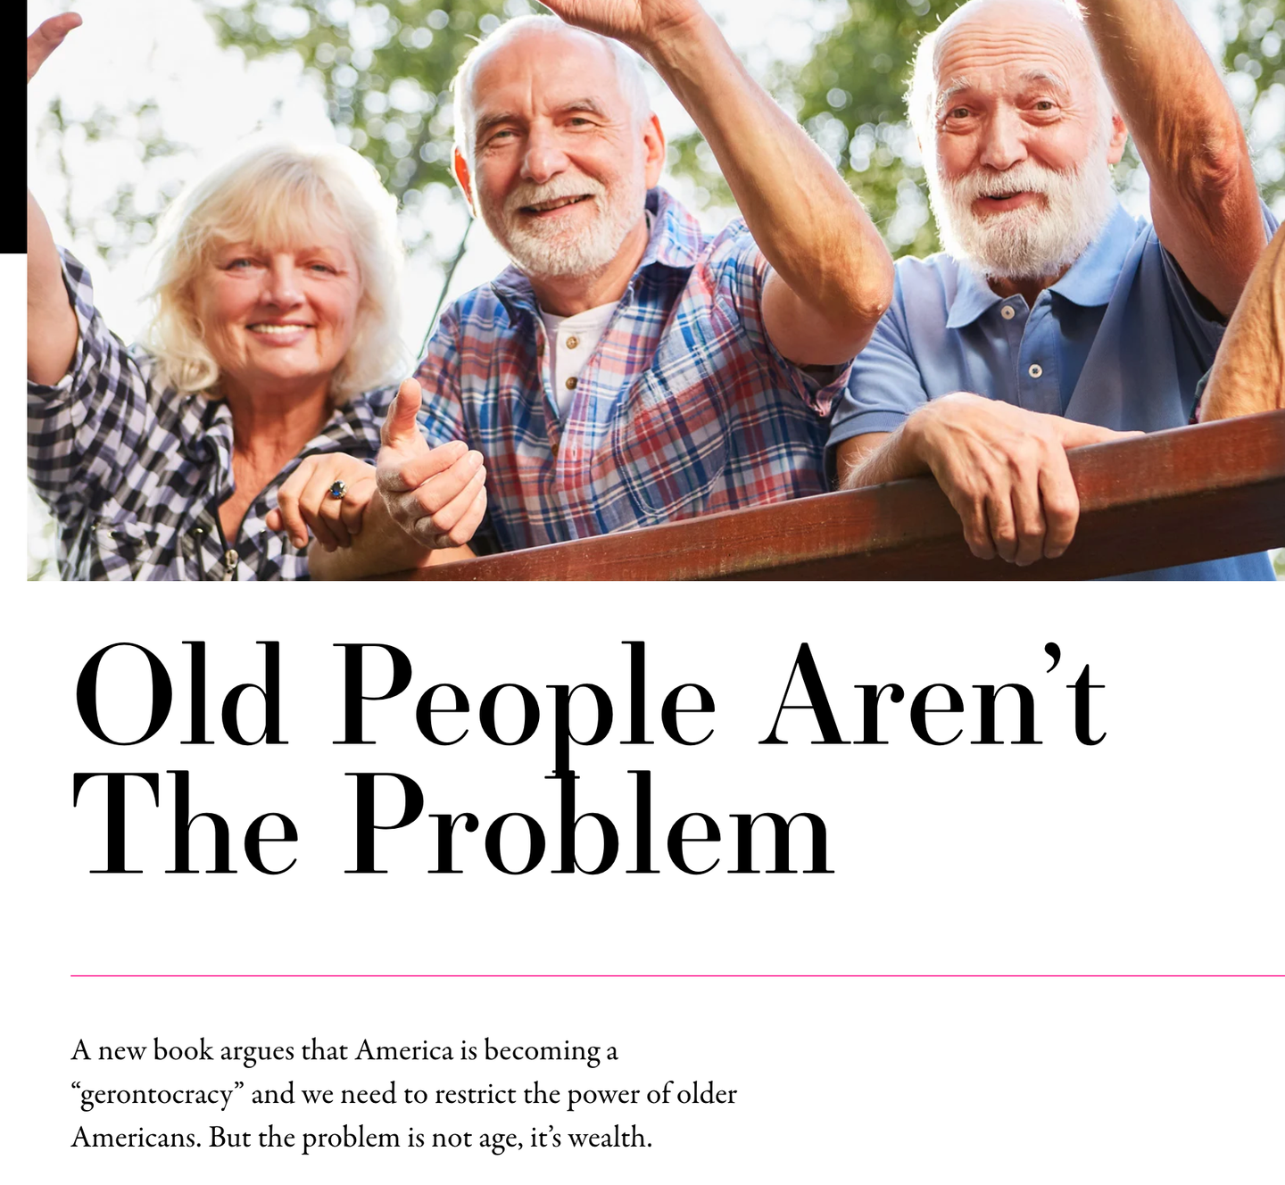

Slide 6
WRITING COMPELLING HOOKS
  Begin with a quote or incorporate it early on if it’s worthwhile
  Raise a question—one that can only be answered if they continue reading.
  In medias res (Begin the story in the middle of a crucial action rather than the obvious beginning.
    Ex: a habitat restoration story might begin by describing the moment a team of scientists reintroduced a dozen beavers into Scotland’s rivers to study their impact on biodiversity after a 400-year absence. Then we could go back in time and tackle the events that led up to this moment, and finally, the results, which were beneficial beyond what any scientist on the team anticipated.)
  Say something interesting or divisive. For ex: “There is a distinctive, deeply uncanny horror to the way Jimmy Fallon laughs.”

Slide 7
APPEAL TO EMOTION
  Write for humans; don’t rely on repetitive abstractions.
  Write for emotions
  Terms like brownfields, revitalization, land reclamation, economic development, or redevelopment, may point toward incredibly important work in theory, they lack meaning to people hungry for stories.
HOW DO WE DO THIS?
  Include ample imagery and specificity in the stories we share.
  “Show” rather than “tell” readers what to think and feel.

Slide 8
SHOW, DON’T TELL
Telling:
Hazardous materials on the abandoned site negatively impacted the town for years, resulting in the 1998 closure of Thomas Elementary School and high rates of lung cancer and a fractured community.
Showing:
After its closure in late 1998, the playground behind Thomas Elementary sat empty, its portrait displaying a swing-set stiff with rust, a graffiti-covered jungle gym, and a gravel lot marked off by a sagging chain-link fence.
This image was taken a decade after Mr. Hayes, the school’s music teacher, began pausing mid-lesson, one hand pressed against his chest while he struggled to catch his breath. Other times, Mr. Hayes was overtaken by coughing fits and had to excuse himself from the classroom, and by the following spring, the widely known alto singer had retired early from a lung cancer diagnosis.

Slide 9
Visual and design elements are essential.
  When it comes to copy for graphics, less is always more.
  Two minutes of editing a photo to use online can make a huge impact.

Slide 10
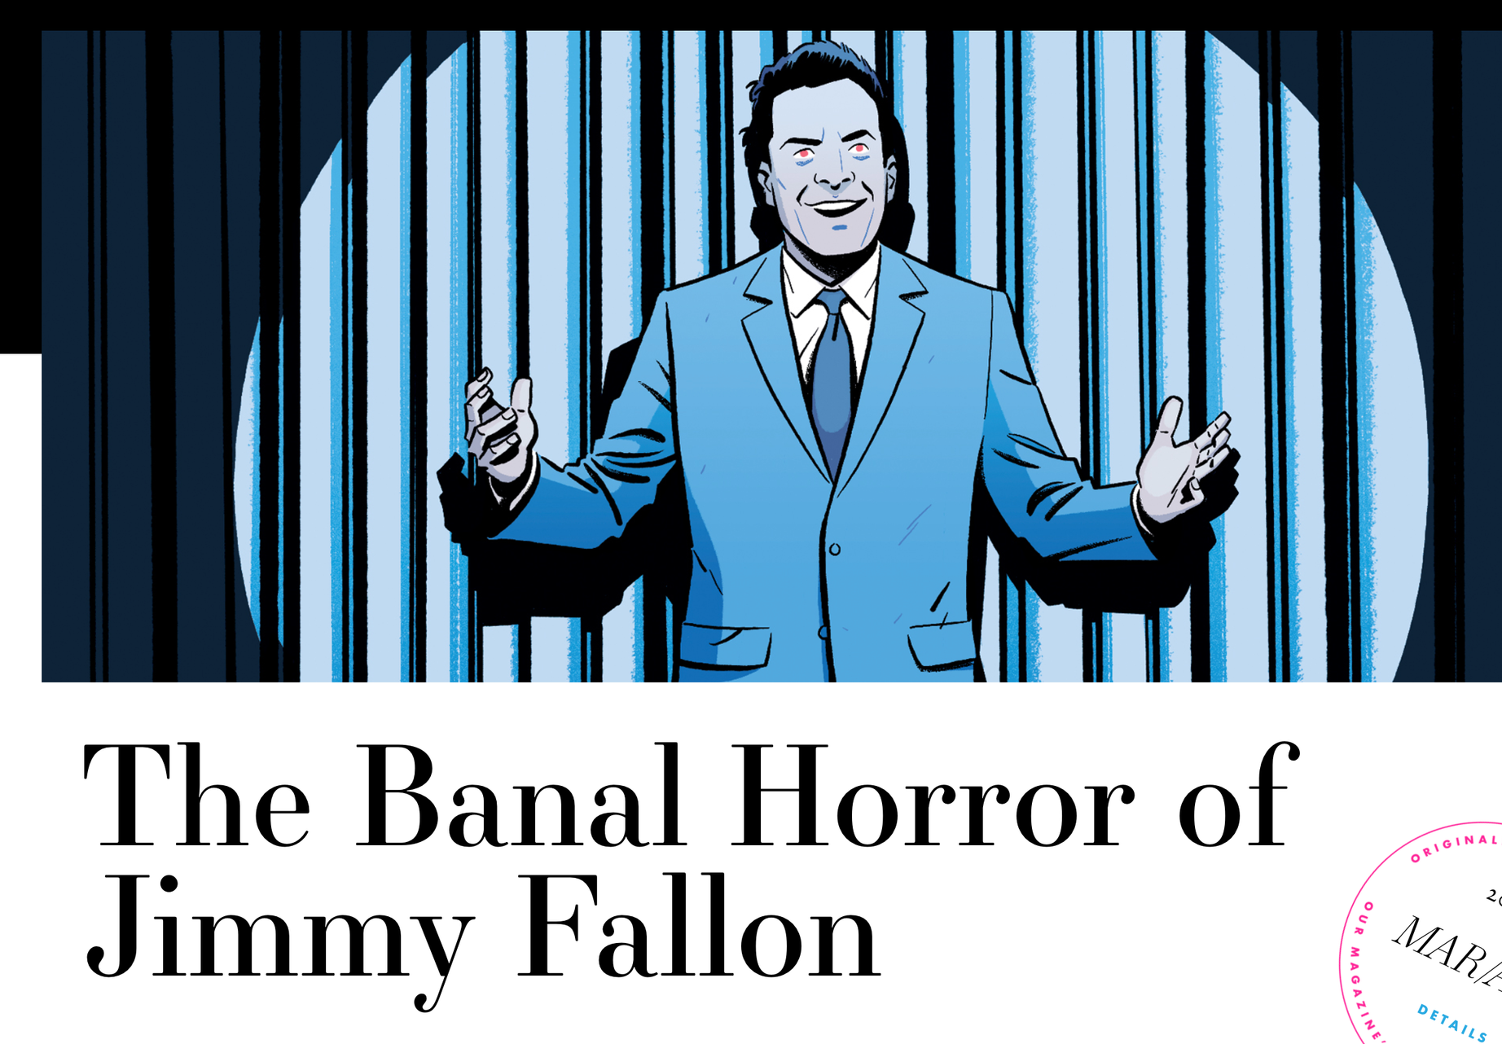

Slide 11
STORYTELLING IS FOR EVERYONE
  Steal from other storytellers, journalists, and “content creators”
  Read social justice, environmental, or advocacy articles to understand how journalism and narrative work together
  Spend some time creating a strong hook for titles or opening paragraphs
  Incorporate vivid imagery and specificity
  When possible, Show, don’t tell.
  If a story doesn’t interest you, inspire you to take action, expand your worldview in a meaningful way, or make you angry, it’s not working. Emotions are central to effective writing.
  Include visual elements
  Prioritize people, places, and consequences.

Slide 12
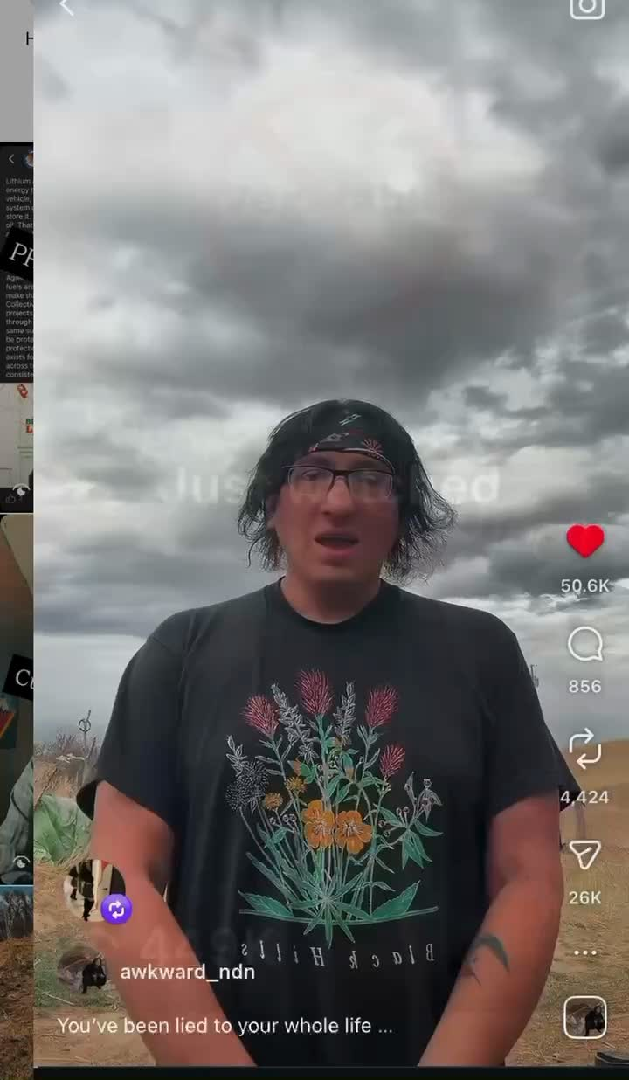
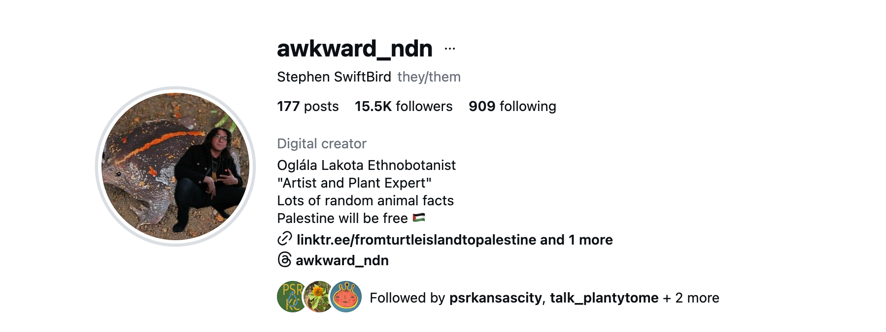
MEET STEPHEN SWIFTBIRD

