Slide 1

Multipurpose
Adrian Goettemoeller

Slide 2
Agenda
Eligible Sites
Eligible Entities
Multipurpose Grant Uses and Nuances
Upcoming Competition Timeline
Questions

Slide 3
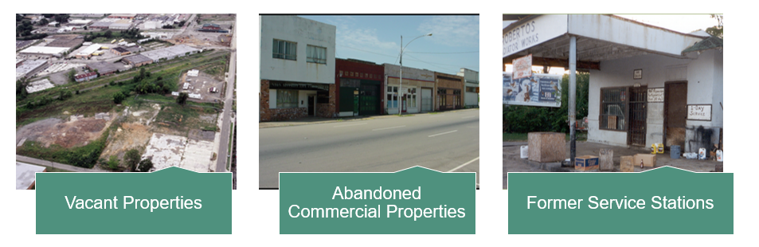
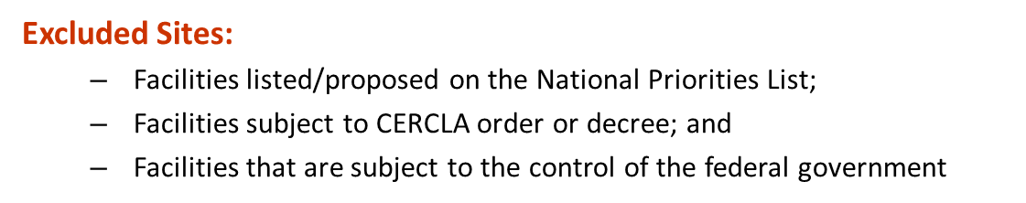
Eligible Sites

Slide 4
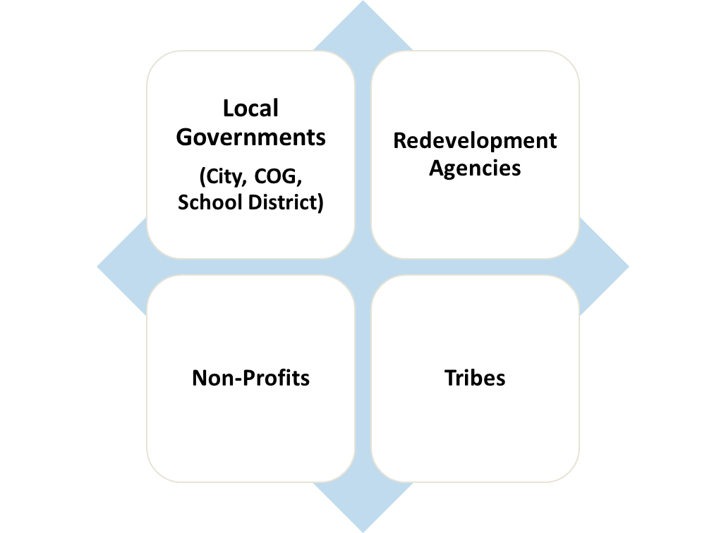


Eligible Entities
Not Eligible for Brownfields Funding:
Potentially
Liable
Parties
4

Slide 5
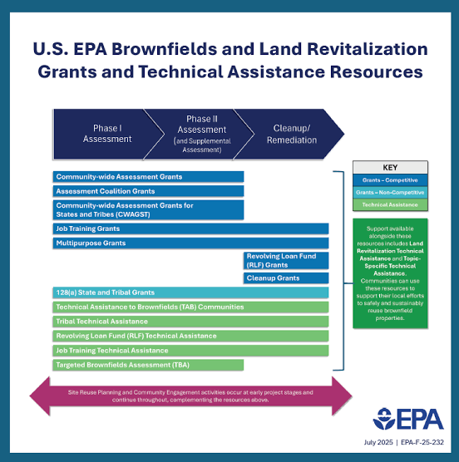
Multipurpose Grant Uses and Nuances
Appropriate for communities that have identified through community engagement efforts, a discrete area with one or more brownfields site for focus
Flexibility with sites
Specific outputs
  At least one Phase II
  Cleanup of site
  Site-specific or area-wide reuse plan
Cross-cutting requirements included
  NHPA
  Davis-Bacon
5

Slide 6
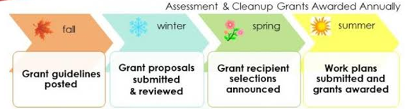
Anticipated Upcoming Timeline

Slide 7
Join us in Dallas!
August 25-27, 2026
Thank you!
Adrian Goettemoeller
Goettemoeller.Adrian@epa.gov

