Slide 1
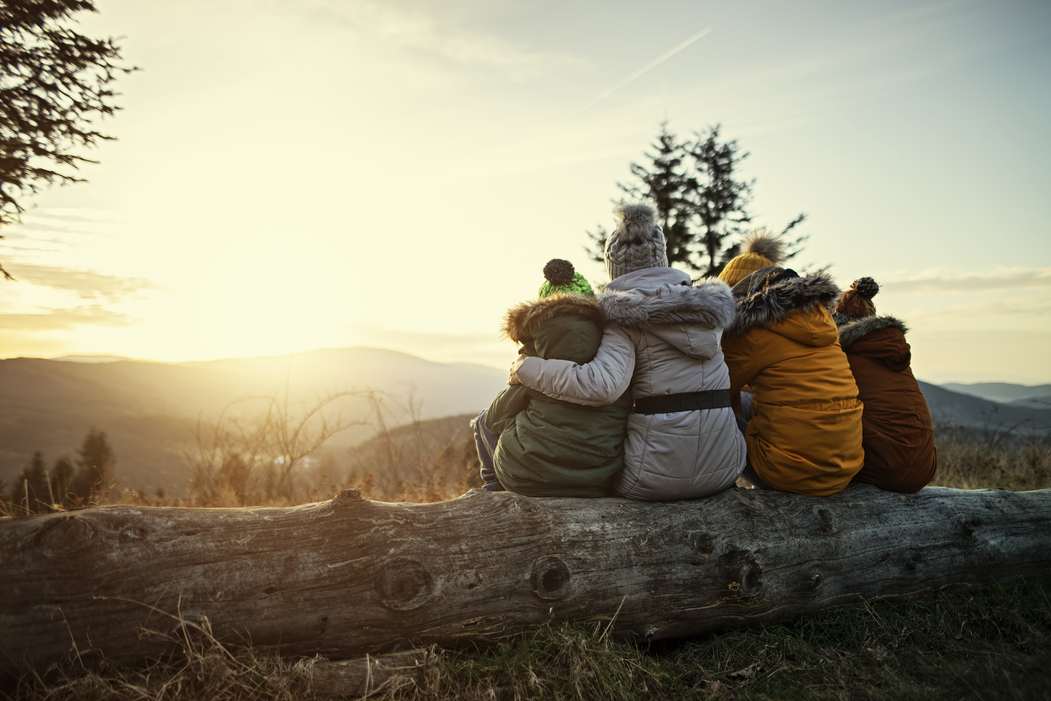
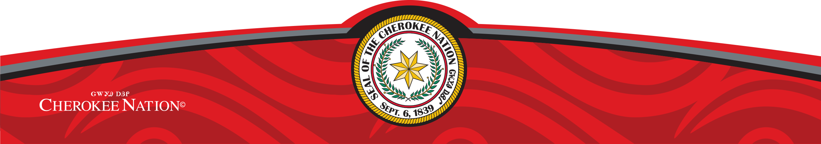
Community Wide Grant
Case Studies from Cherokee Nation

Slide 2

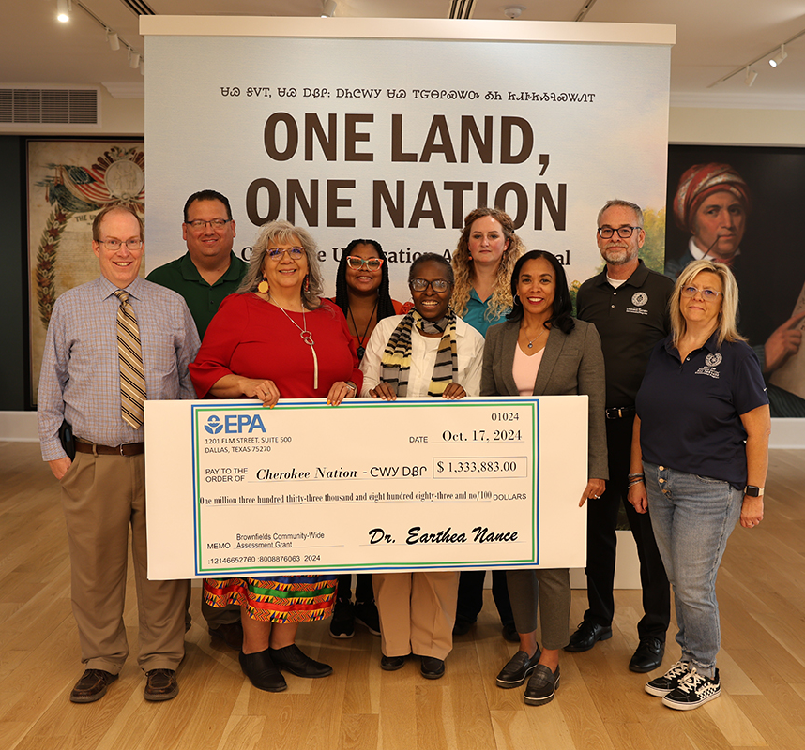

Slide 3
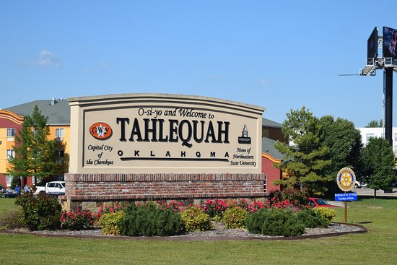
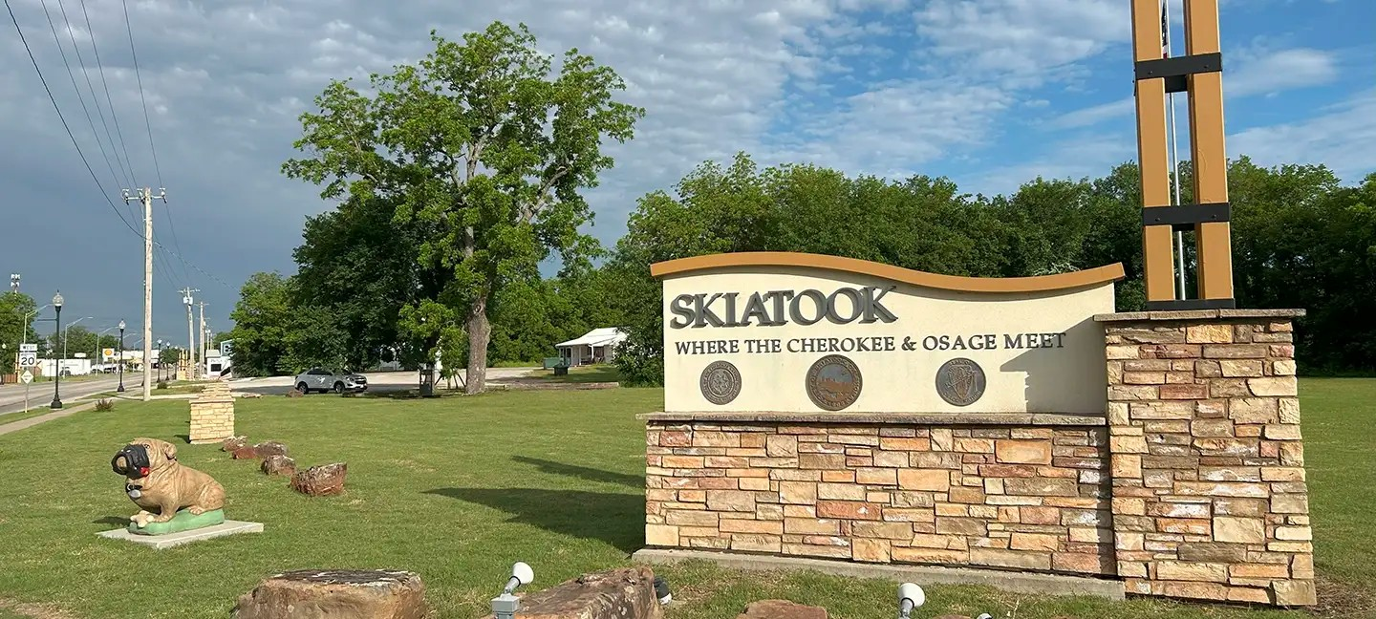
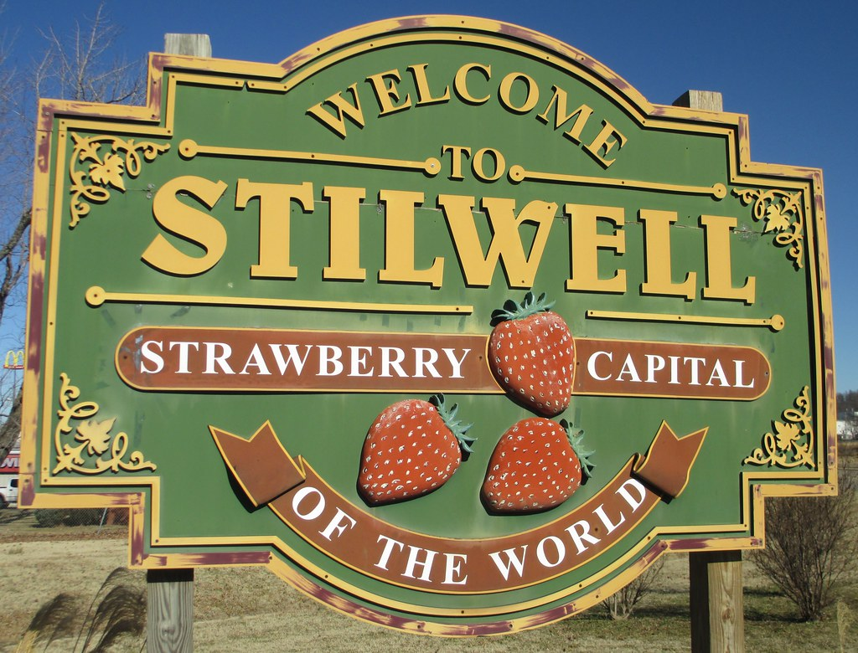
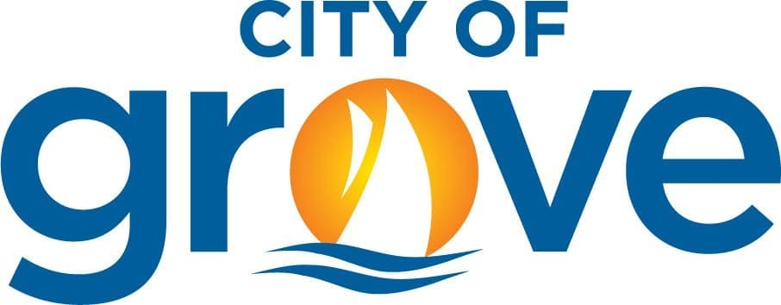
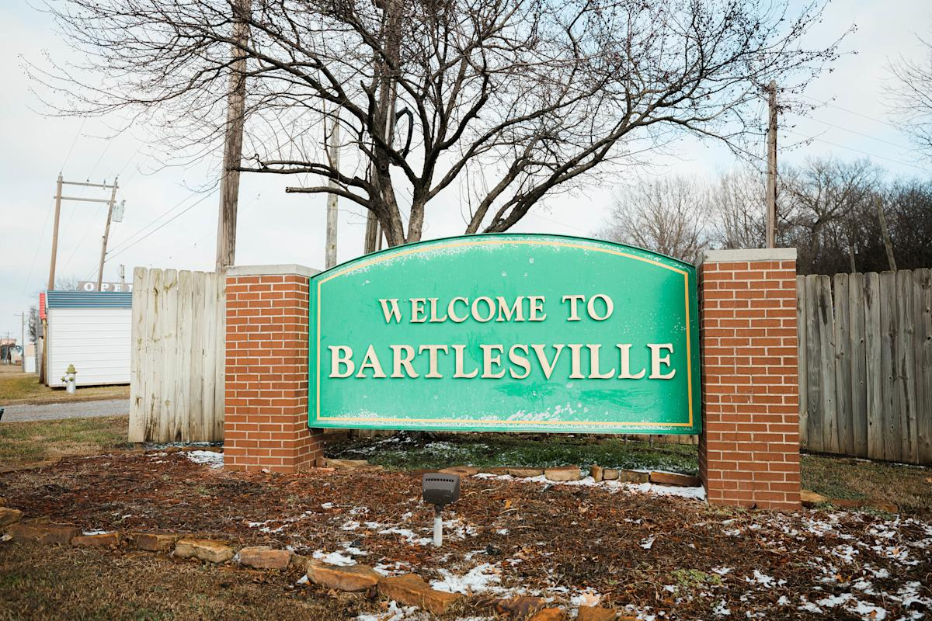
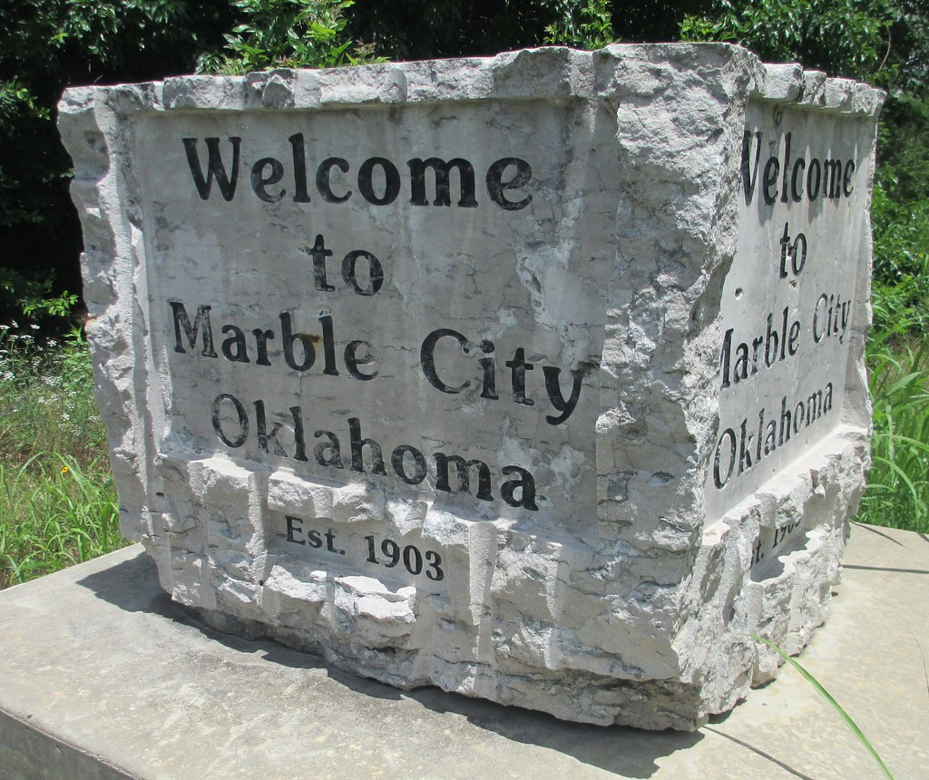
Cherokee Nation Community Wide Assessment Grant
We are providing Phase I and Phase II Environmental Site Assessments, Community Meetings, and Cleanup and Reuse Planning assistance to communities within the Cherokee Nation Reservation.
The first year, we worked with the communities of Bartlesville, Marble City, Skiatook, Stilwell and Tahlequah.
We are in year two, continuing to work with the original communities and are adding additional cities like the City of Grove.

Slide 4
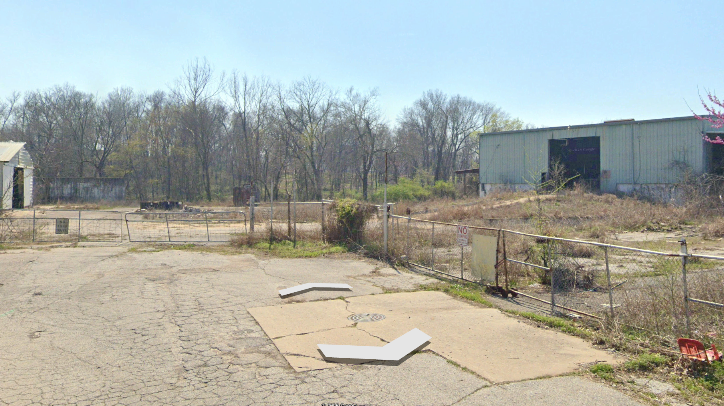
Tahlequah- Basin Street

Slide 5
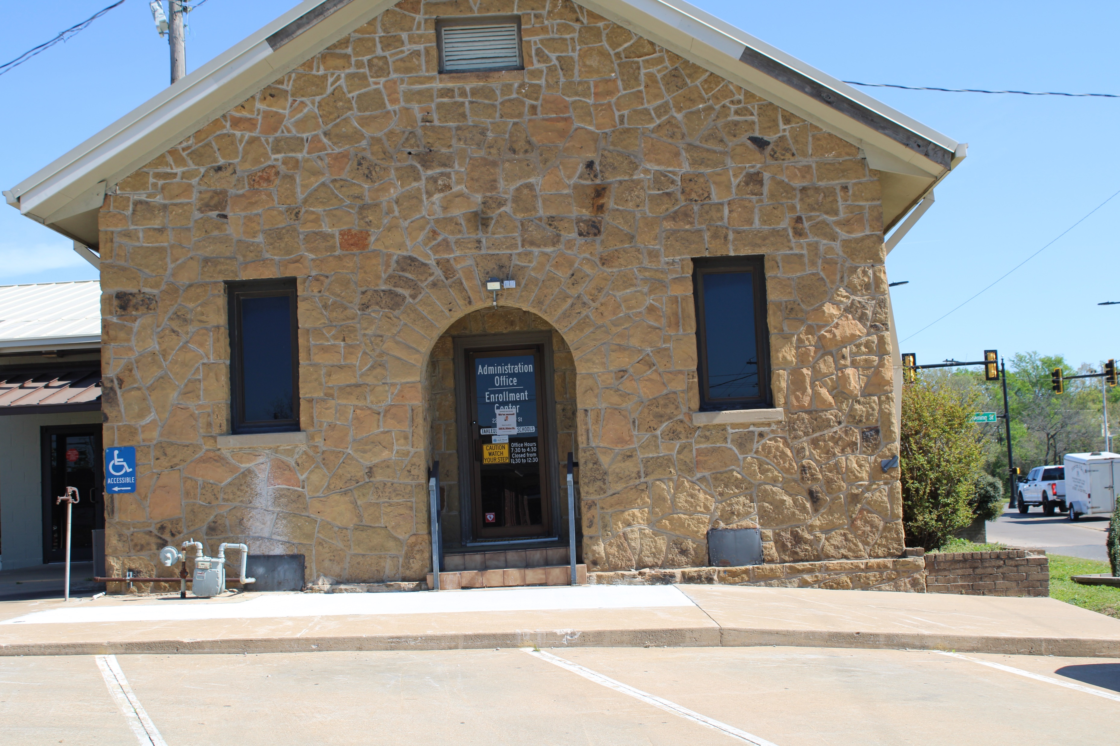
Tahlequah-
225 N. Water Avenue

Slide 6
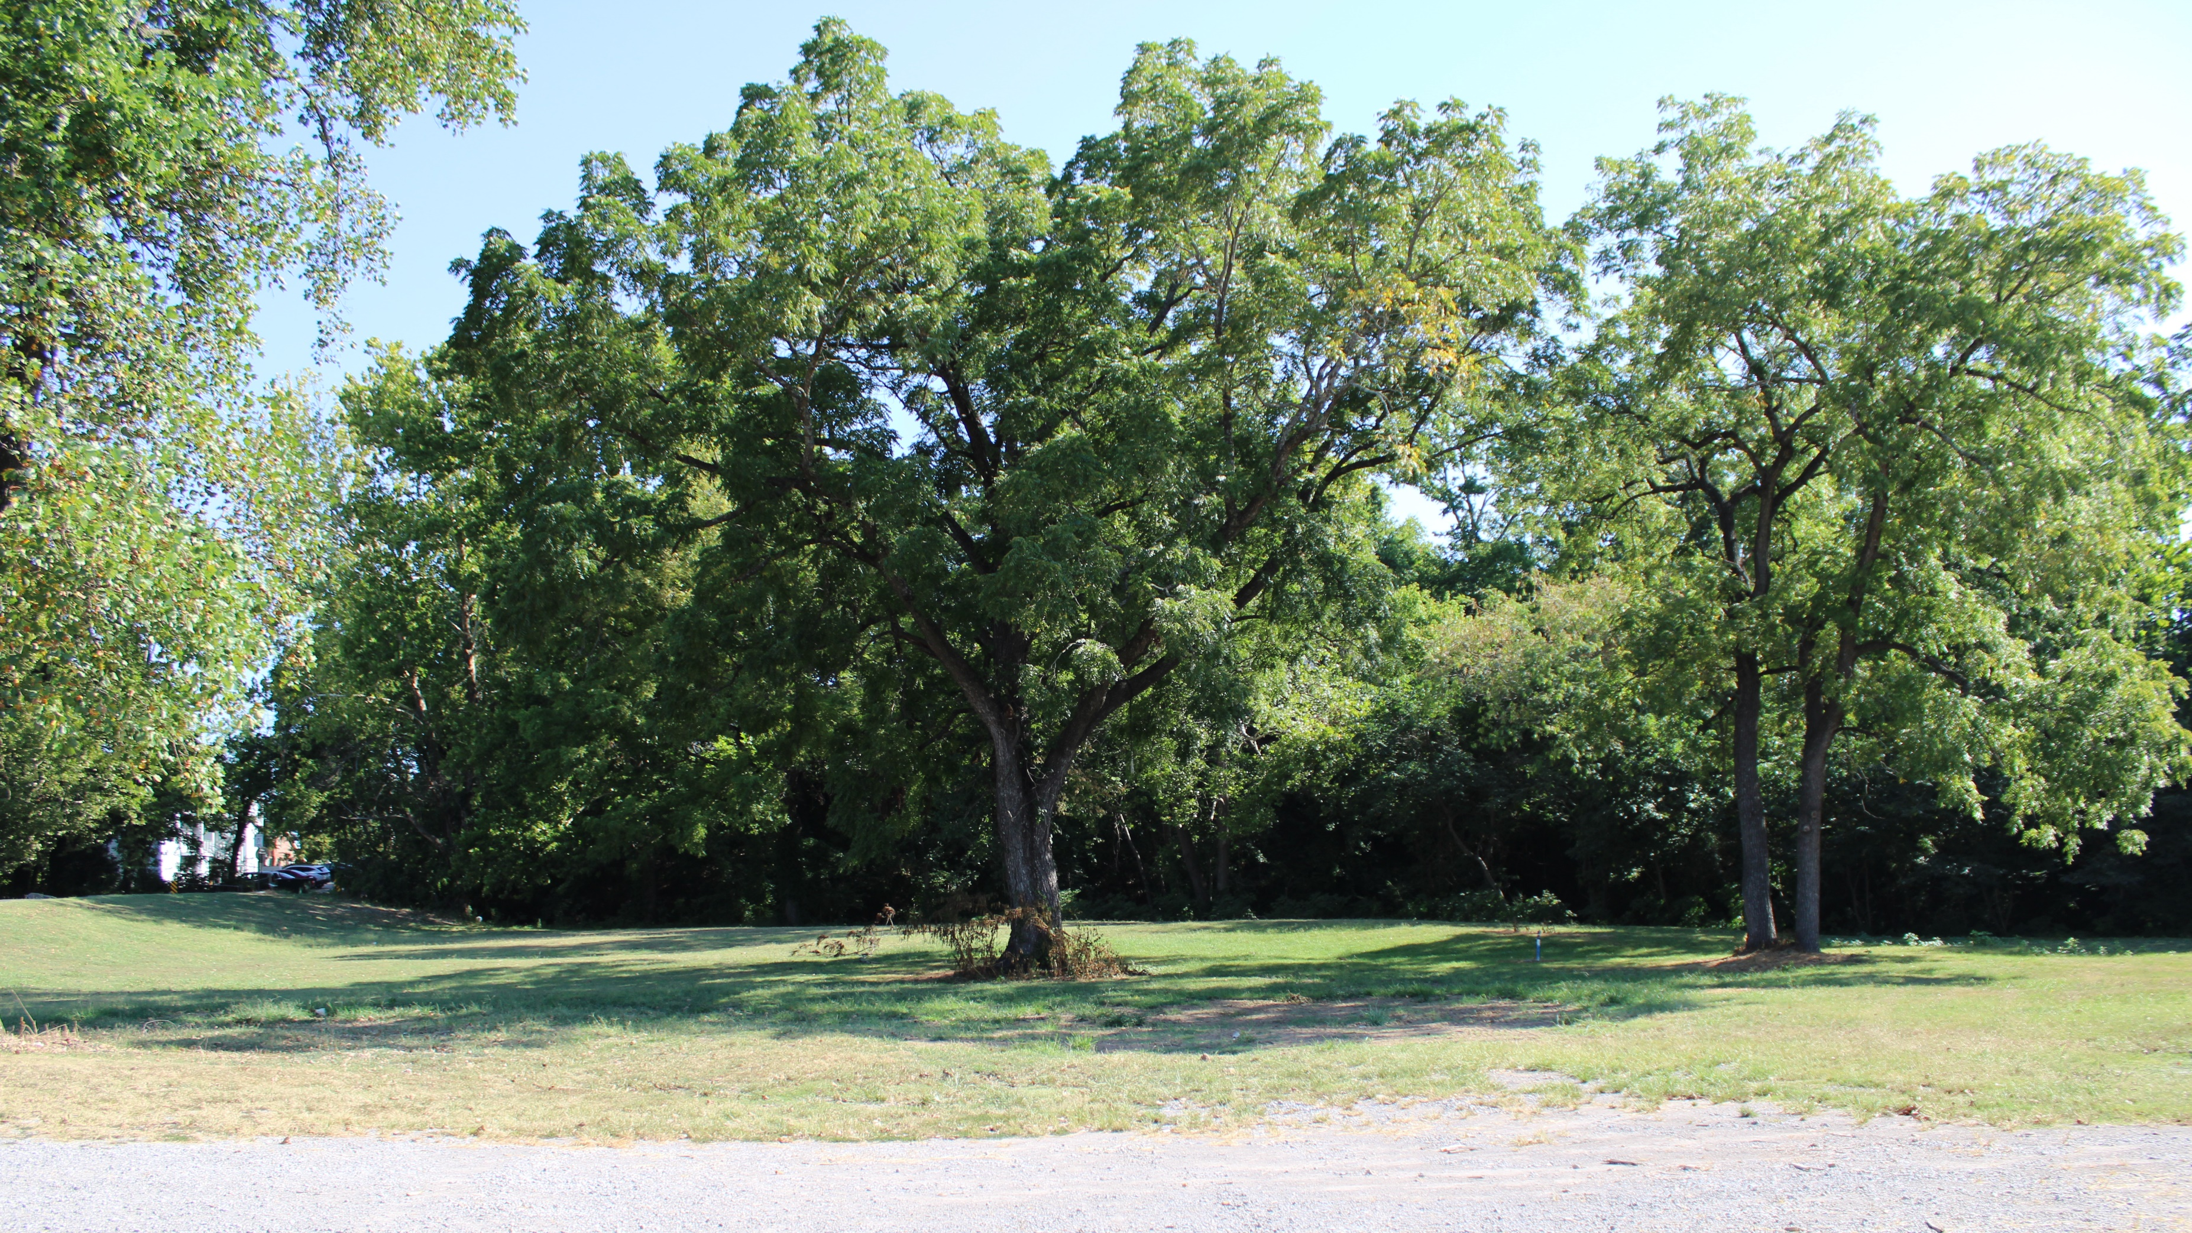
Tahlequah- 201 E. Morgan Street

Slide 7
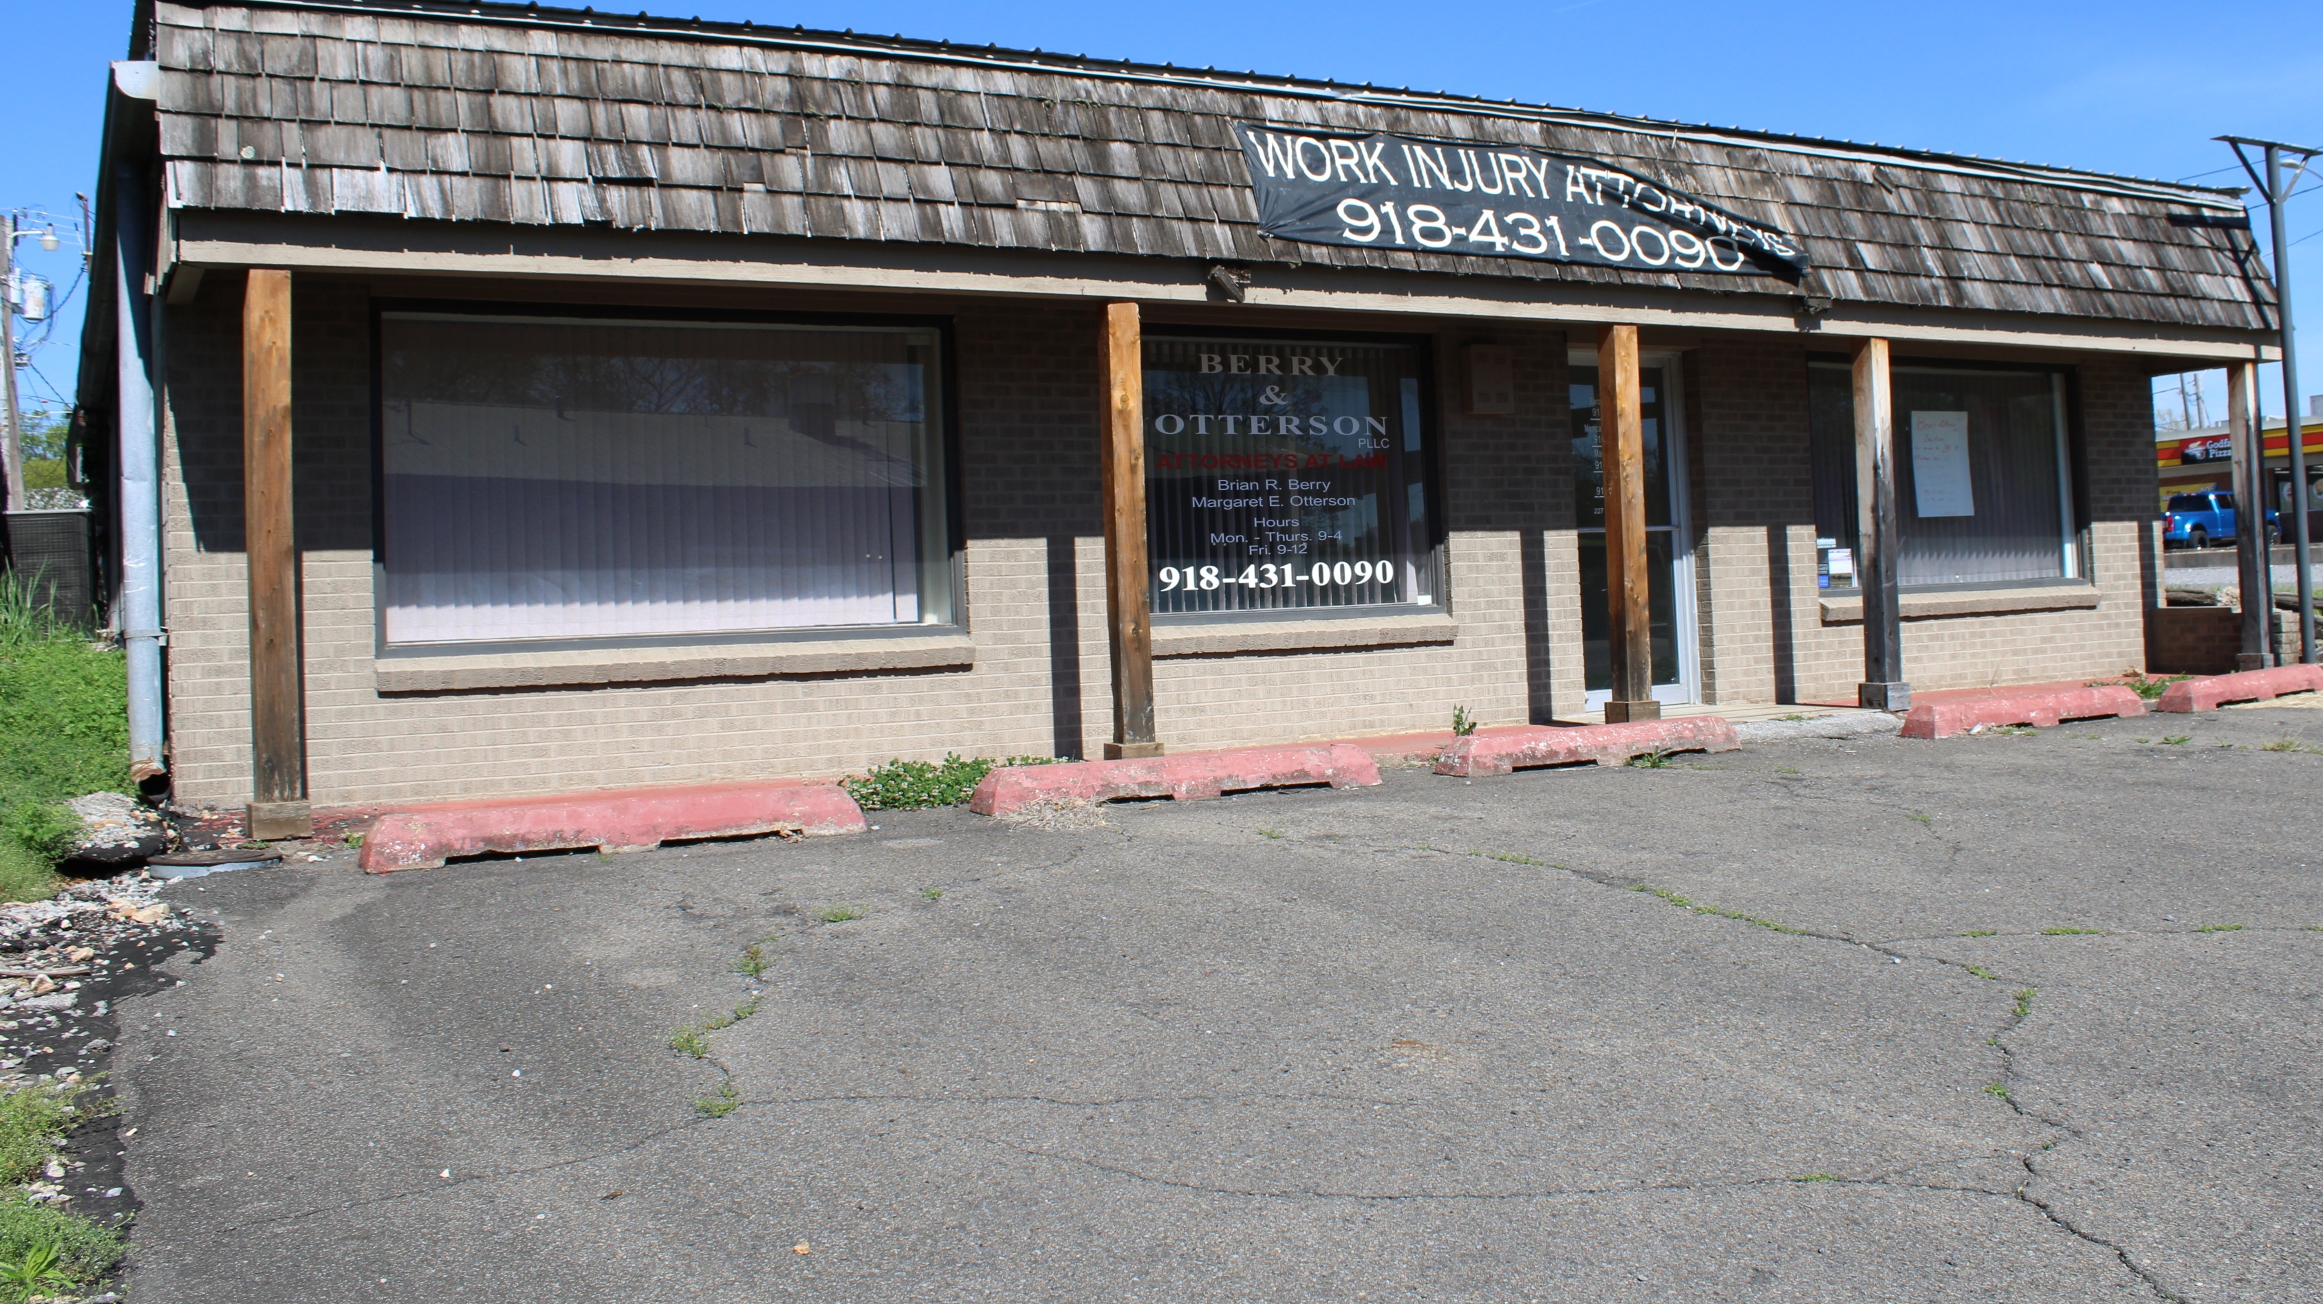
Tahlequah- 227 N. Water Avenue

Slide 8
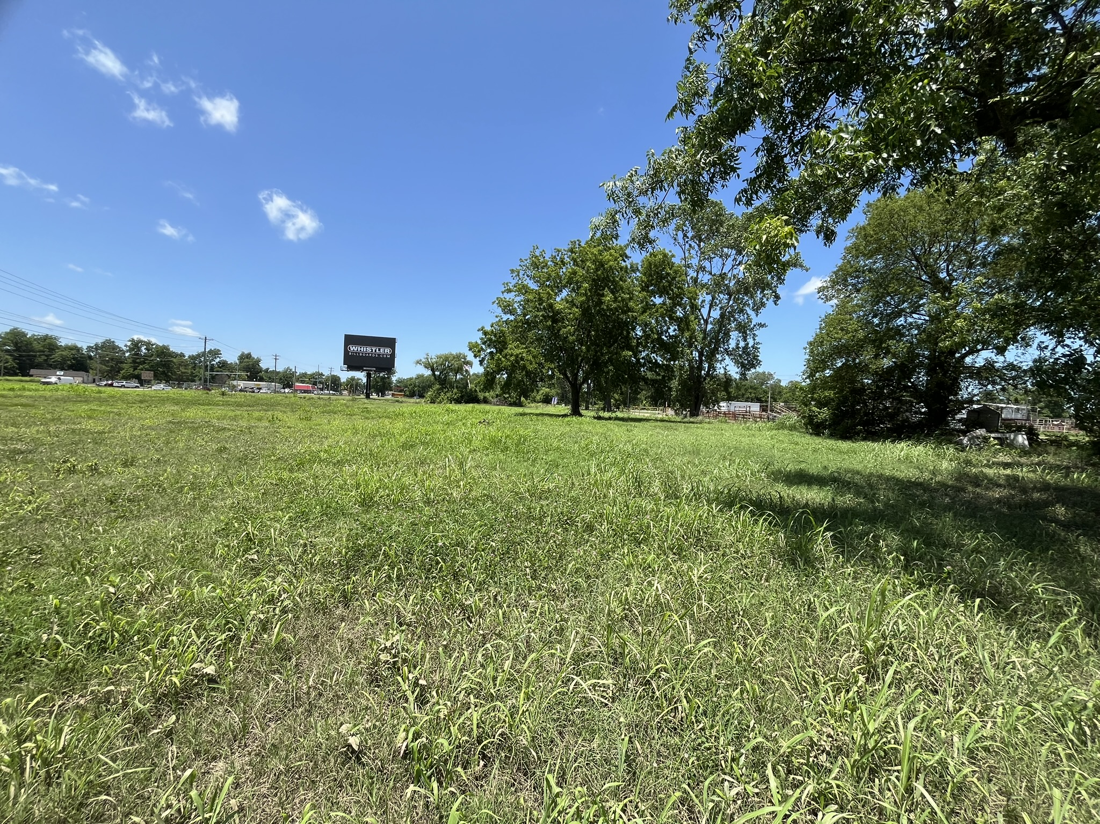
Skiatook-
Farmer’s Market

Slide 9
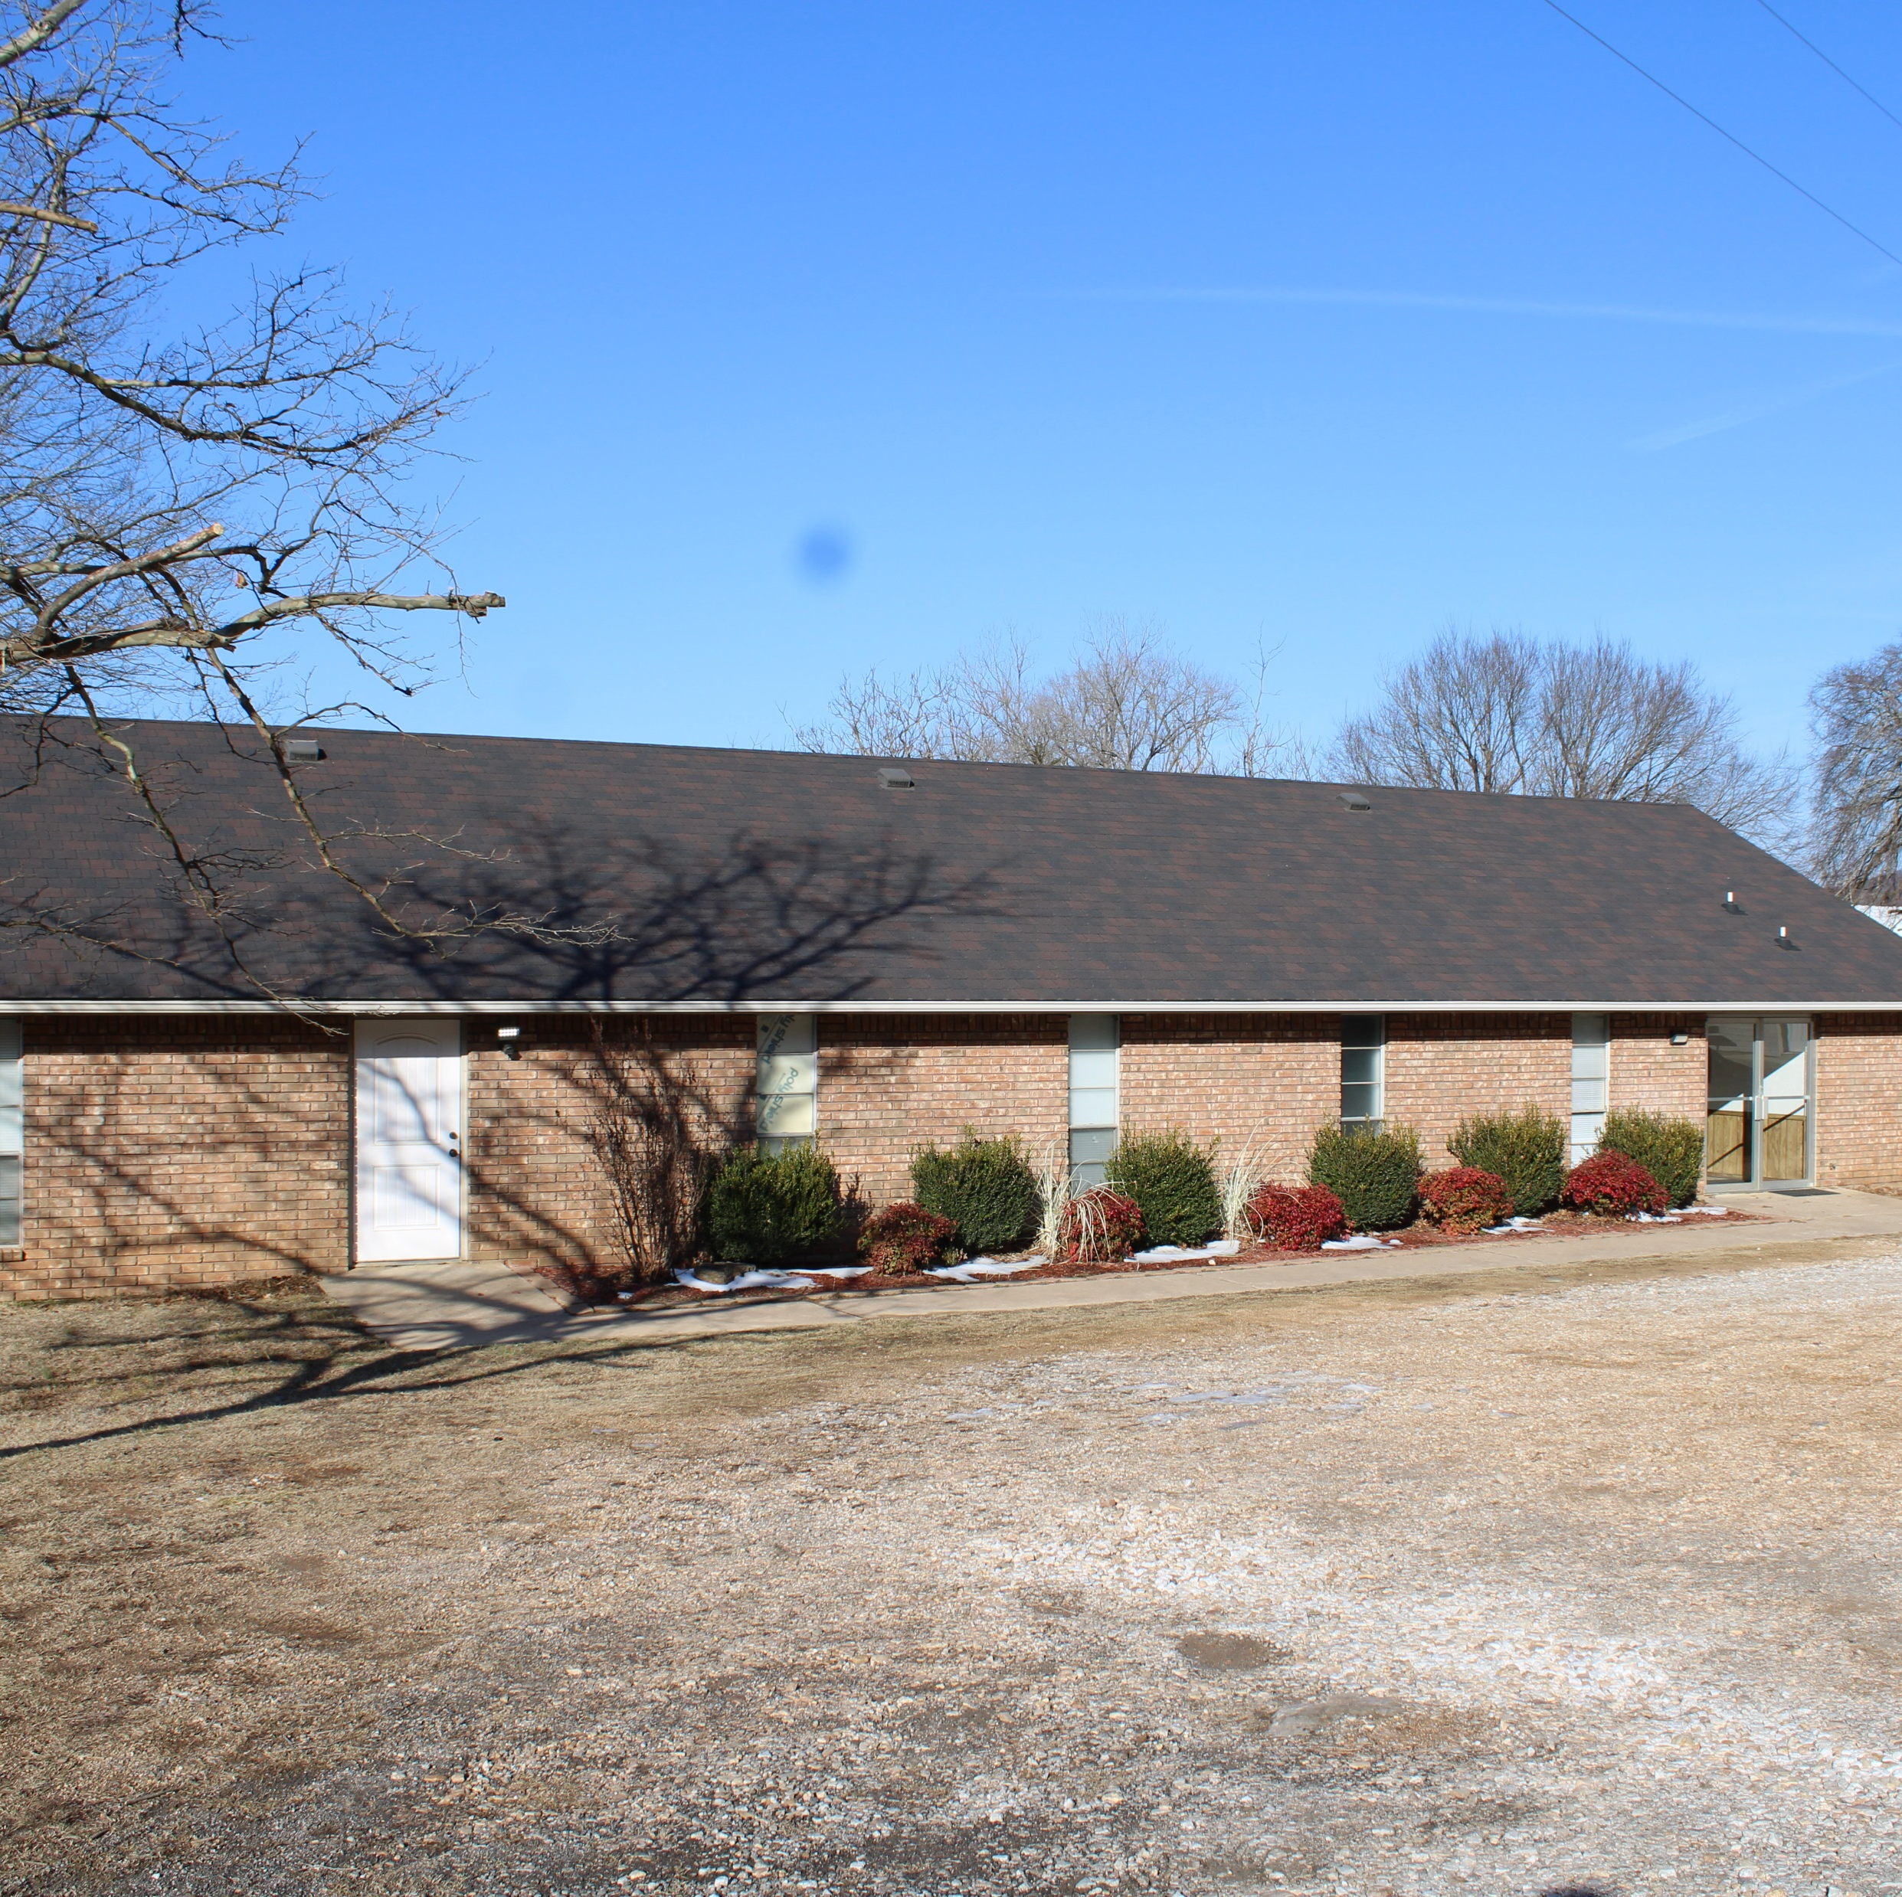
Marble City-
Free Holiness Church

Slide 10
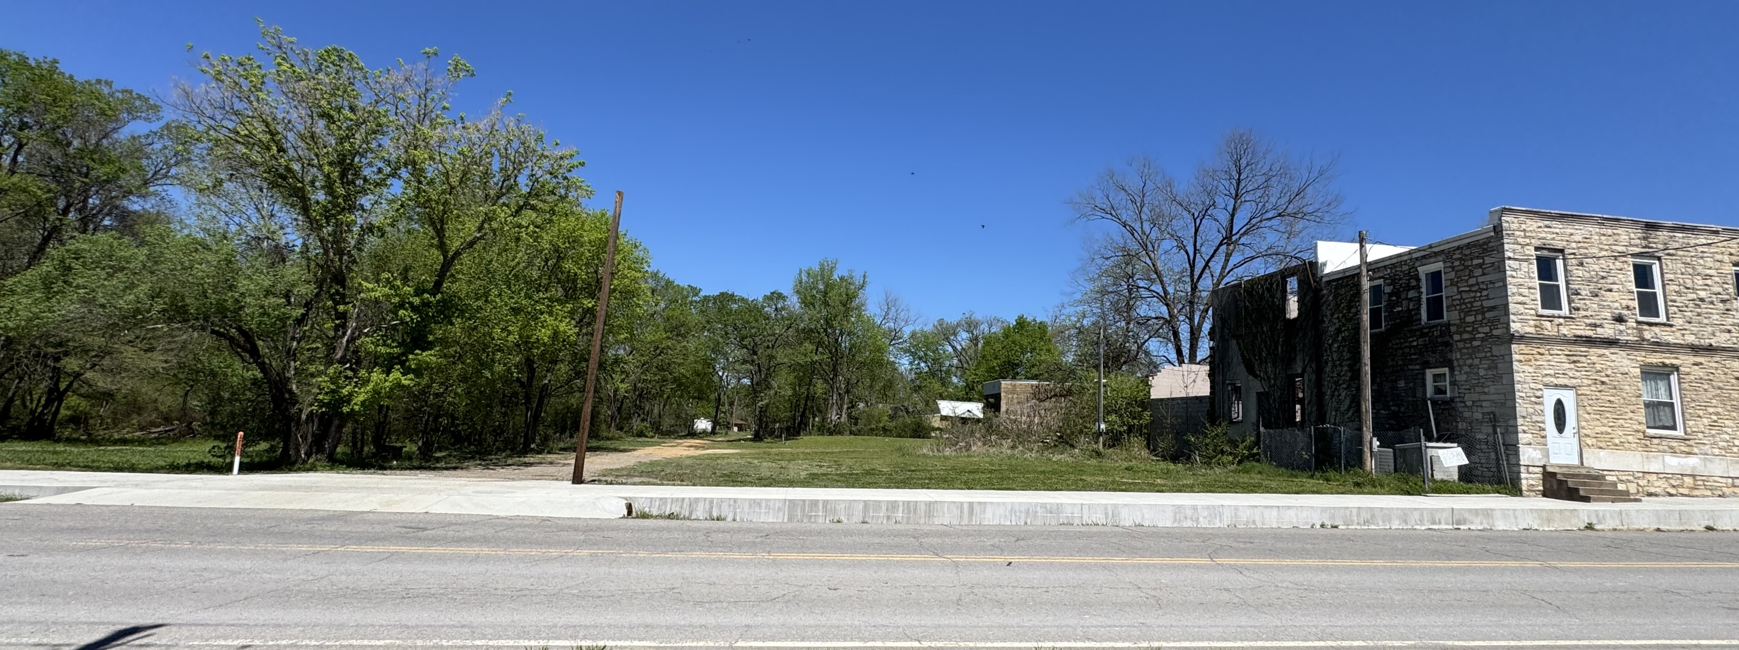
Marble City- Recreation Property

Slide 11
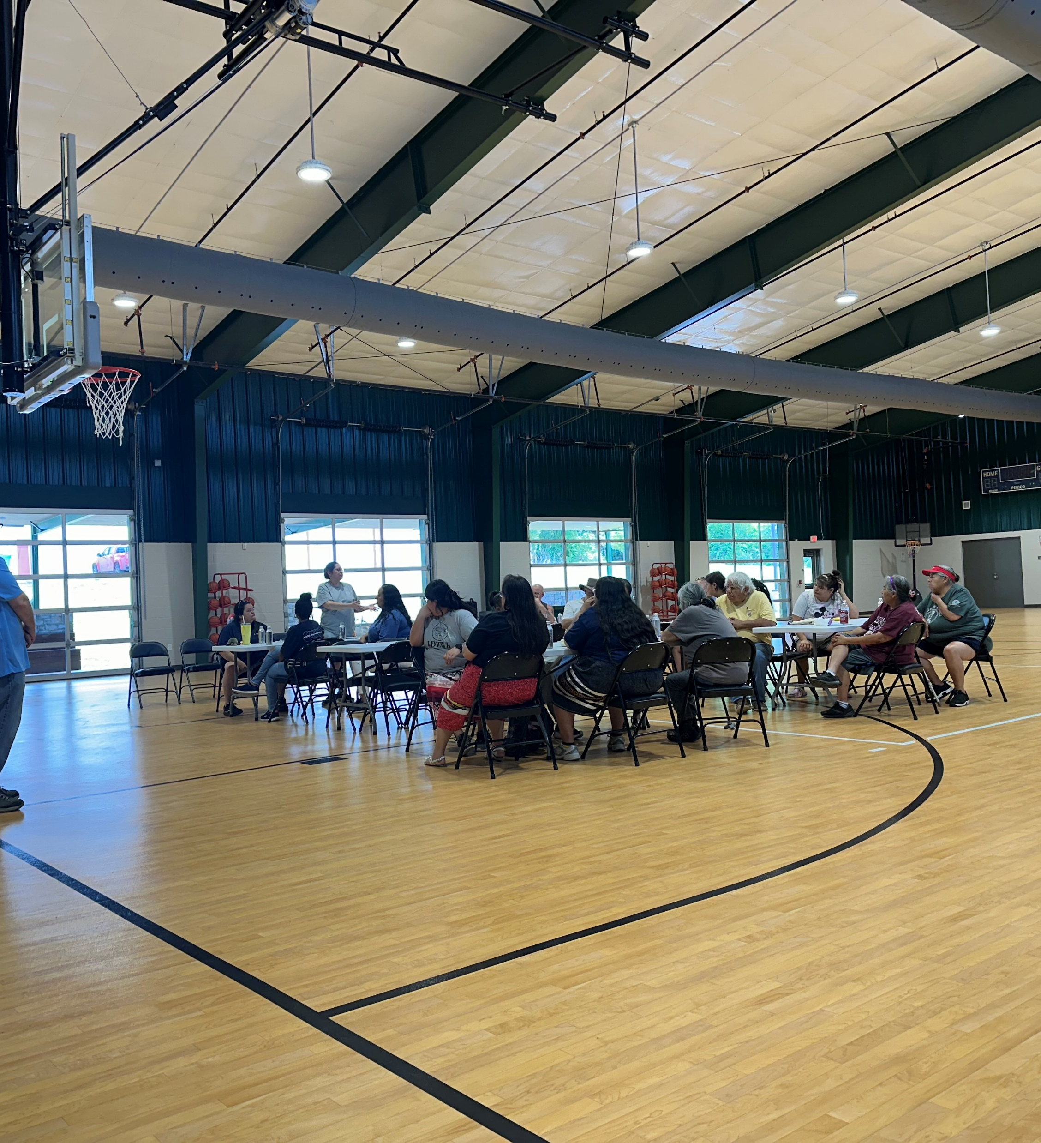

Community Engagement
Marble City- Community Meeting

Slide 12
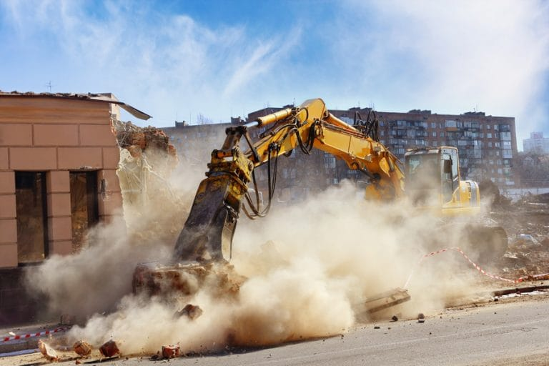
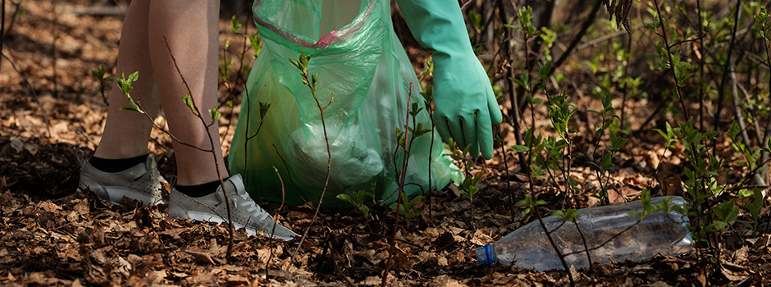
Development of Reuse Plans and Clean Up Plans
Currently two reuse plans have been developed for the city of Tahlequah. ​
  Tahlequah Morgan Street Property​
  Tahlequah Basin Street Property
Cherokee Nation has obtained a contractor to help conduct this service.
The grant does have funding budgeted to assist with the development of Cleanup Plans. However, no communities have requested this yet.

Slide 13
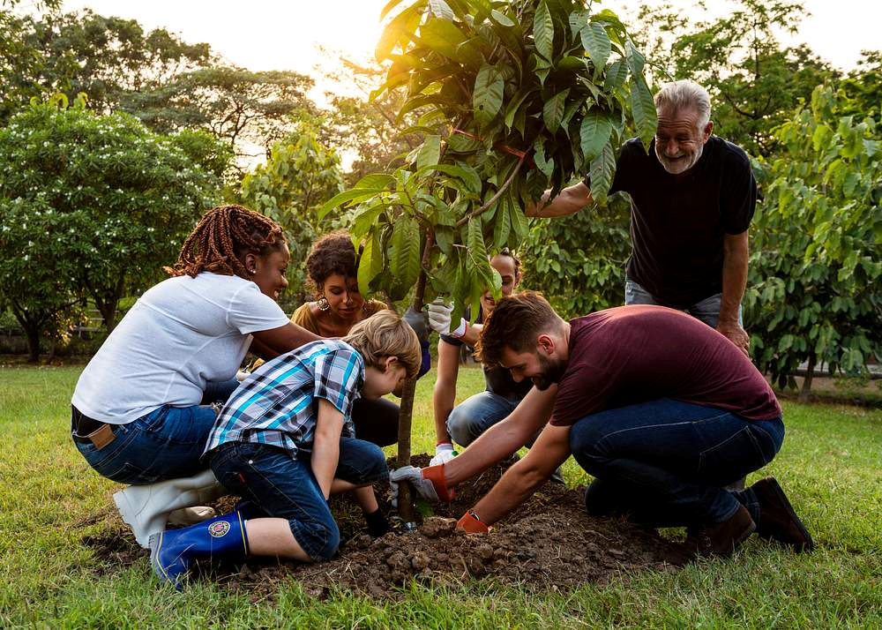
GaDuGi: "working together"
Special thanks to:
EPA
State Partners
(ODEQ and OCC)
Communities
Our Tribe

