Slide 1
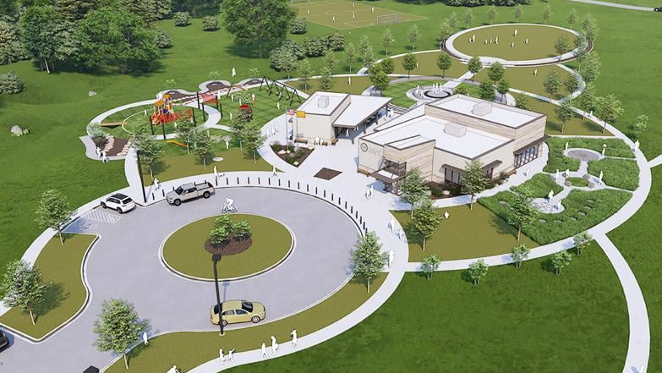
Wilma P. Mankiller
Cherokee Capitol Park

Slide 2
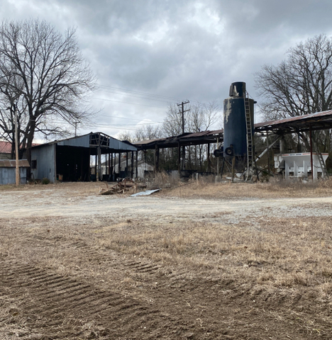
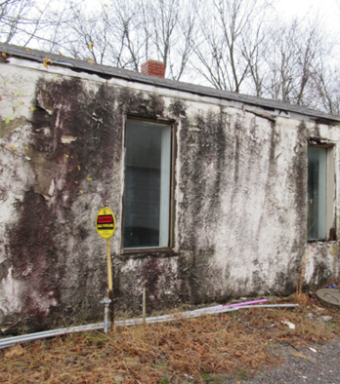

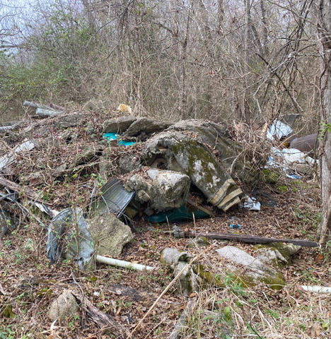
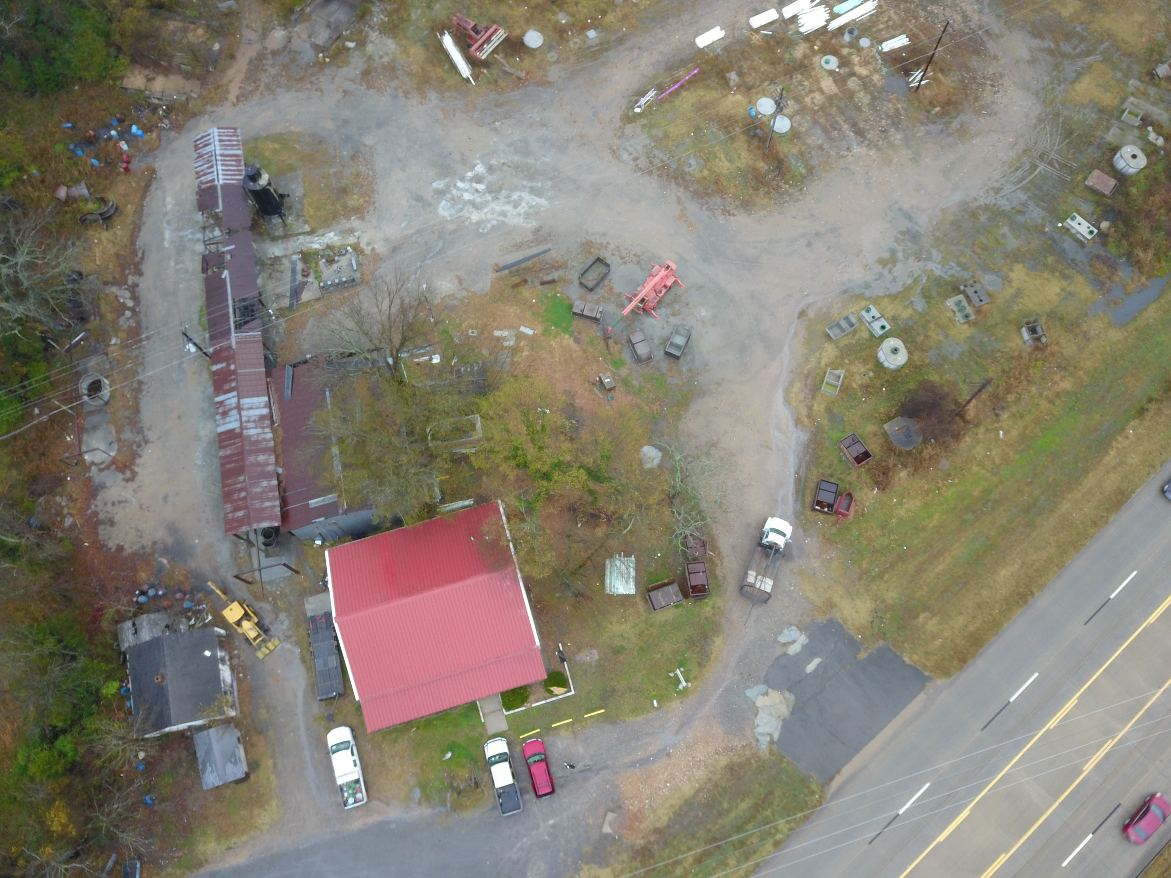
The Prewitt’s Smith Septic Tank, Inc. site was a hazard to our community.

Slide 3
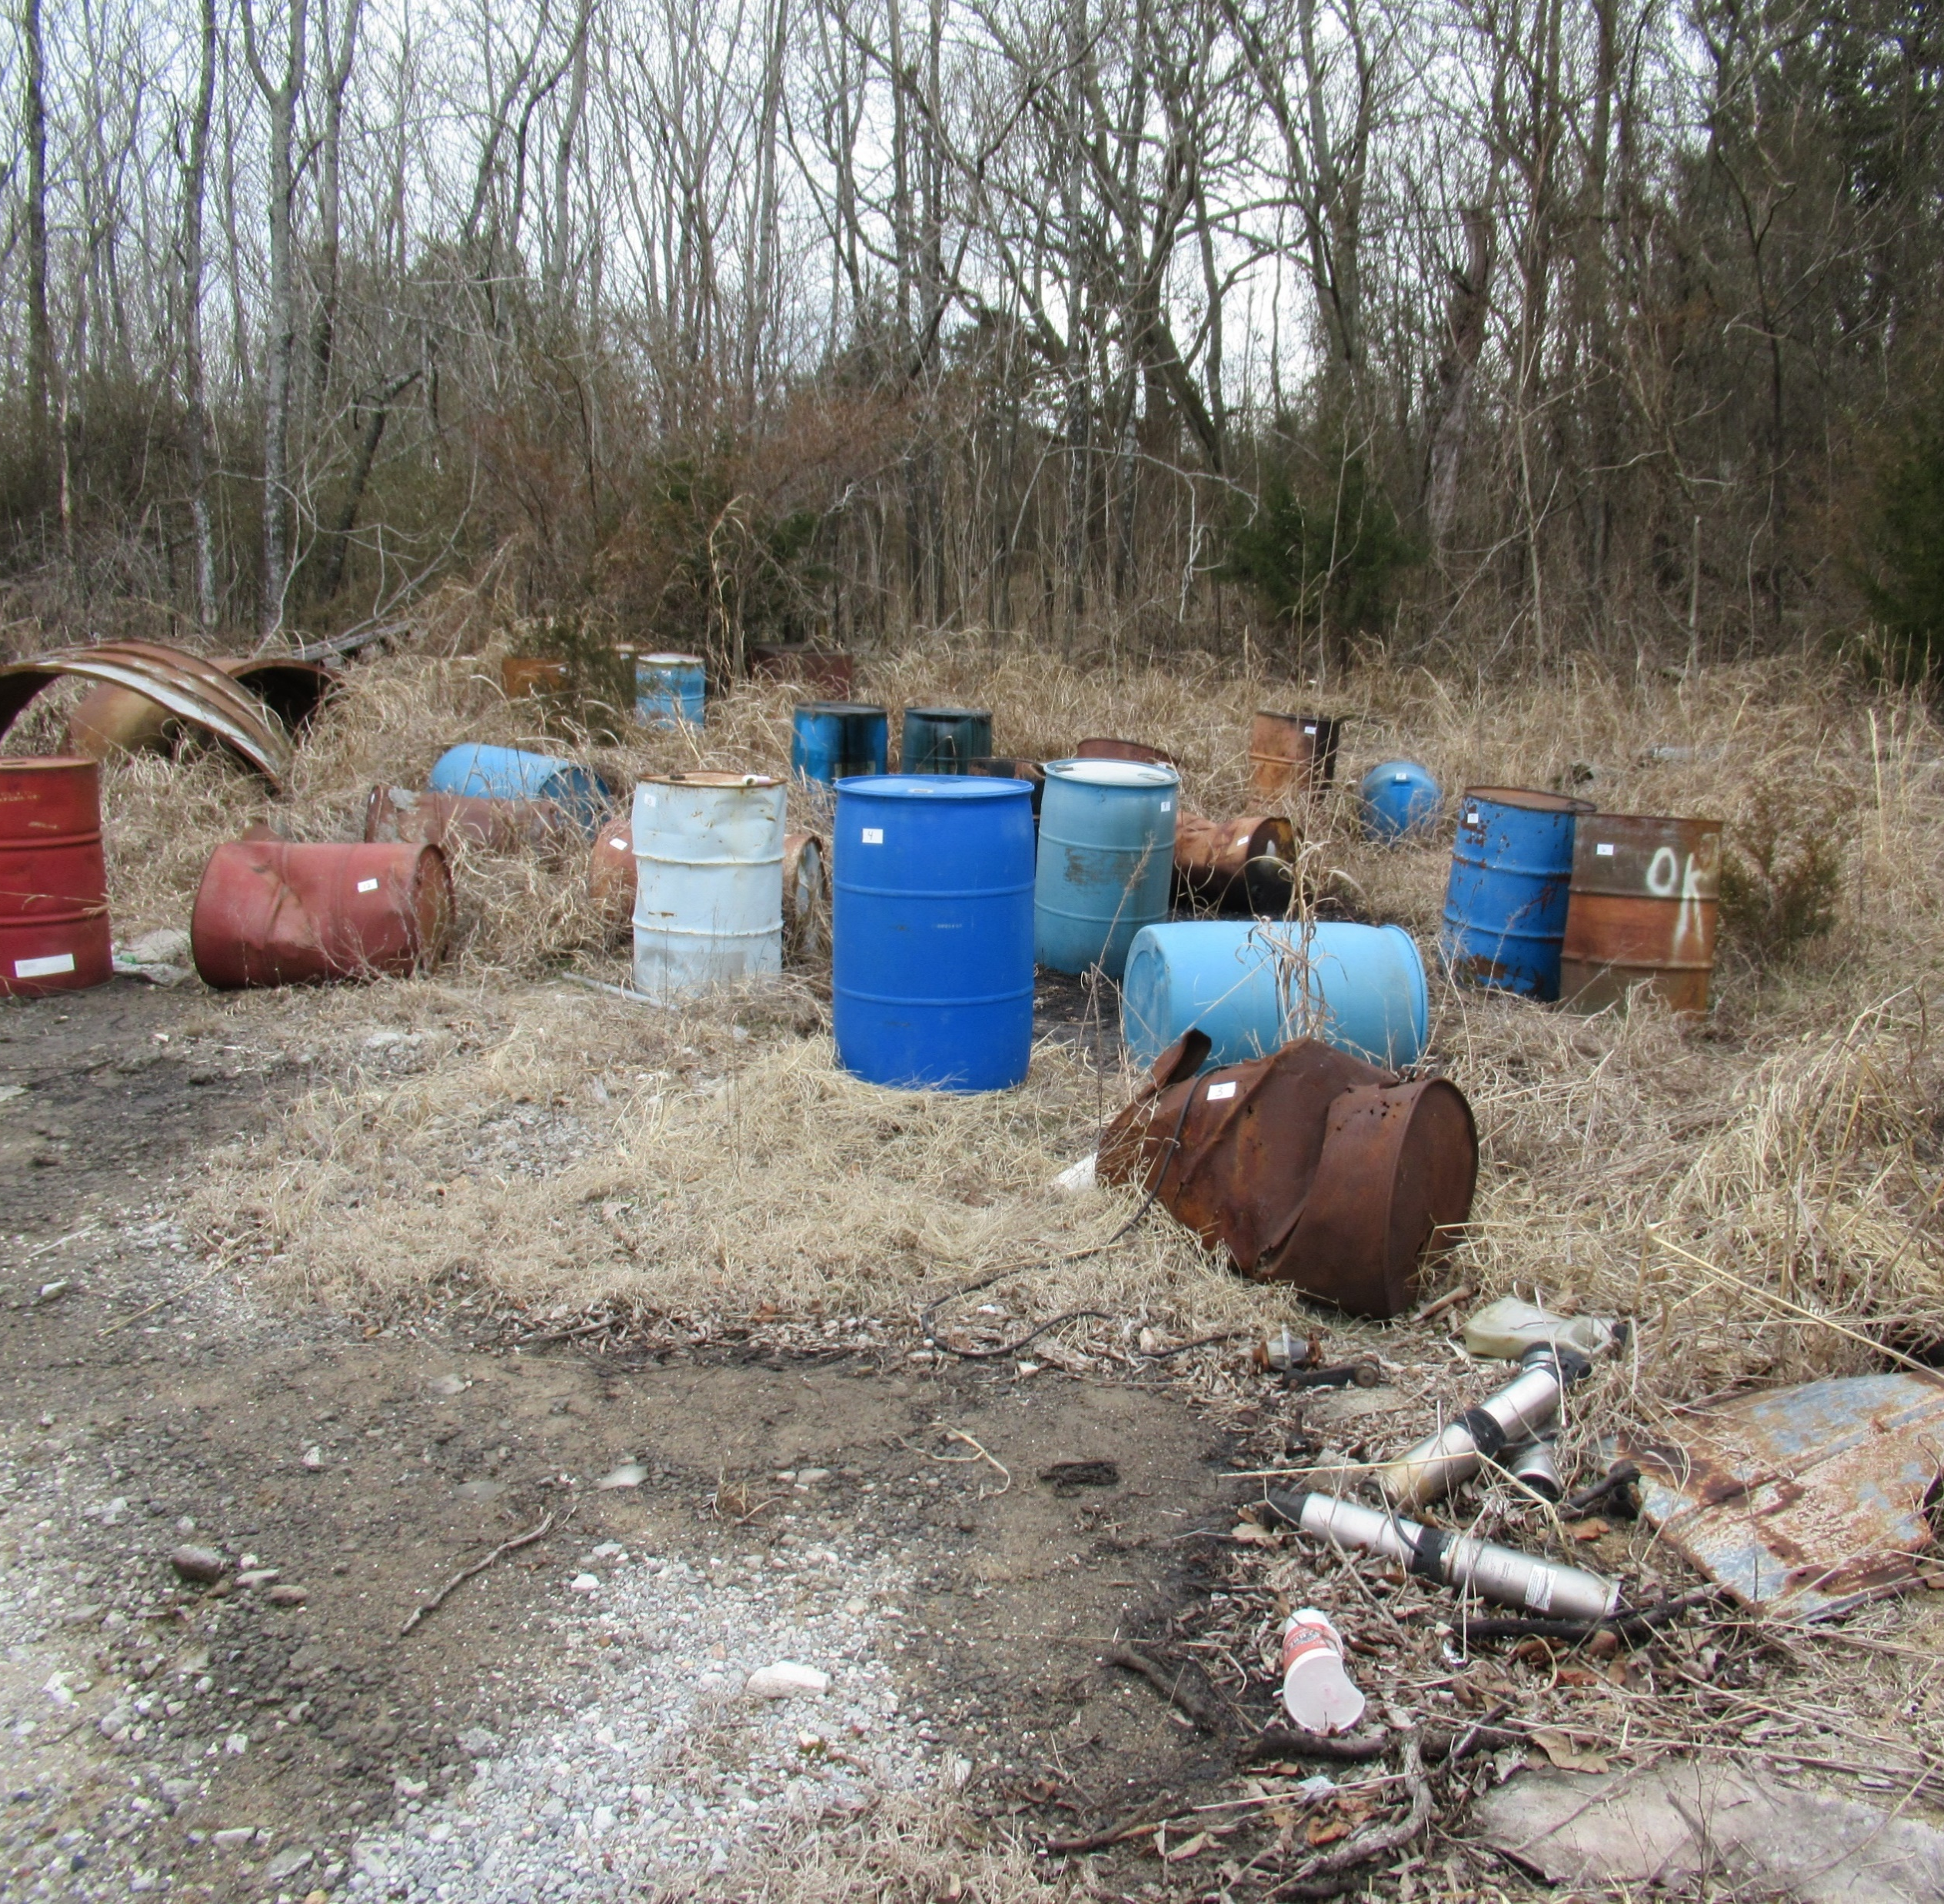
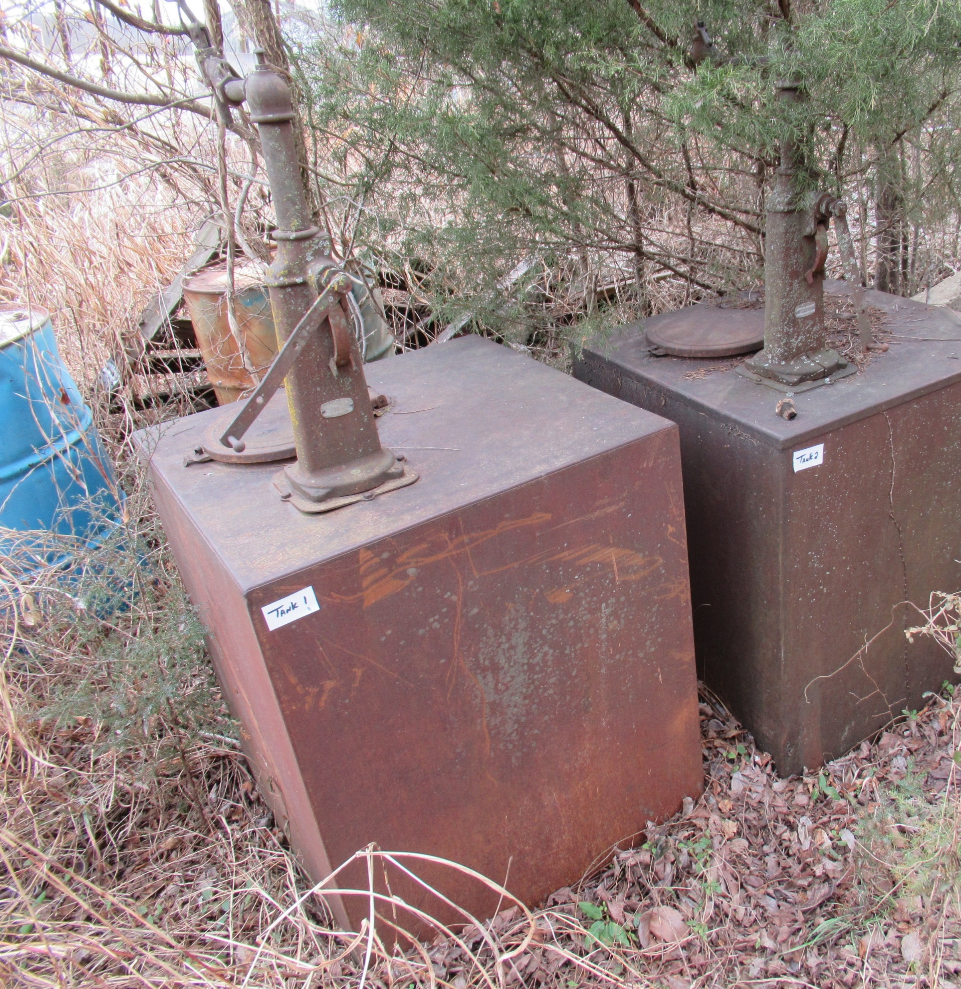
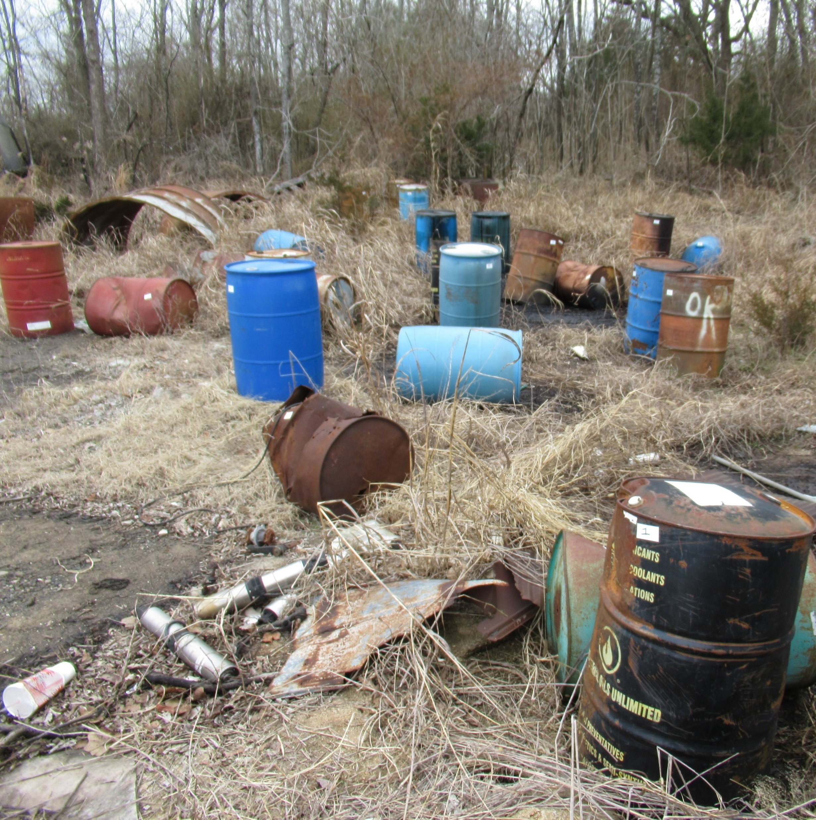
The dangers went deeper than the surface contamination.
Cherokee Nation Environmental Programs was contacted to conduct a
Phase I site assessment.

Slide 4
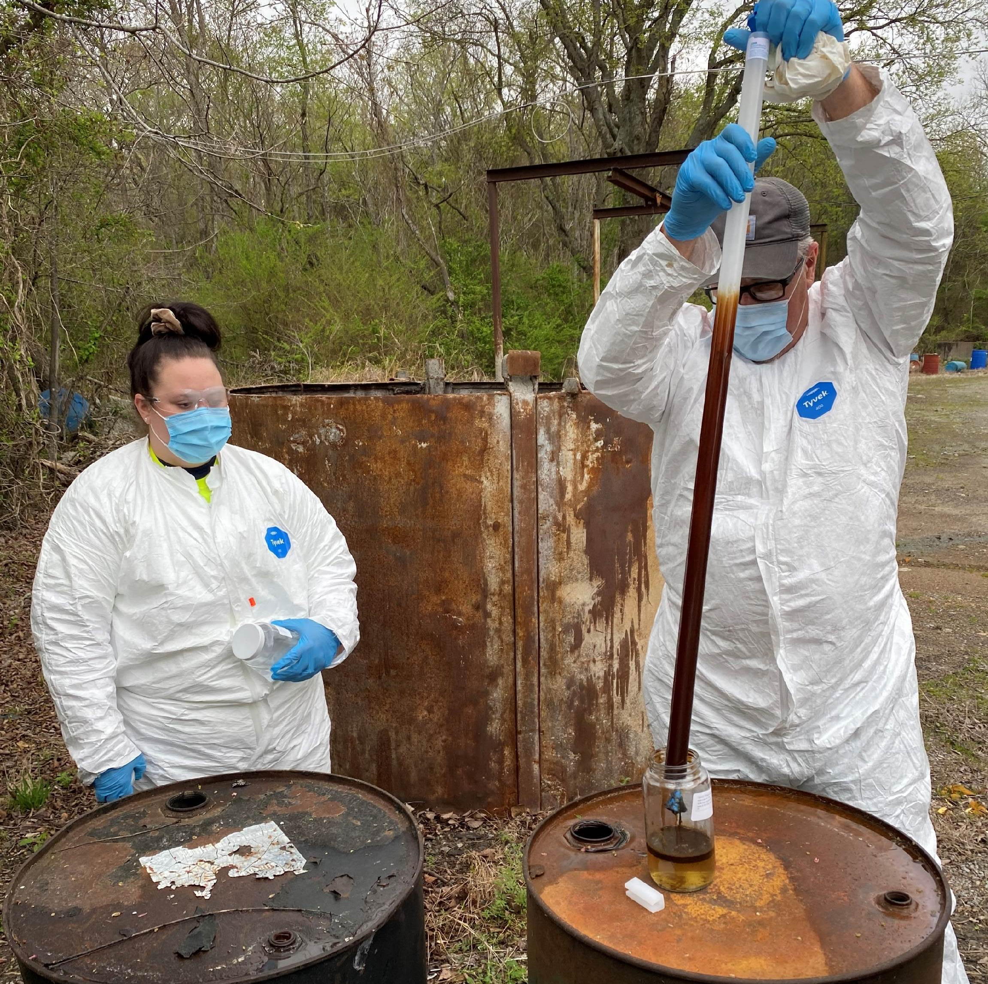
CNEP staff conducted
testing on the barrel contents to
determine the best
steps forward.
Cherokee Nation paid for the clean up of the site.
CNEP paid for the testing and removal of all the barrels.

Slide 5
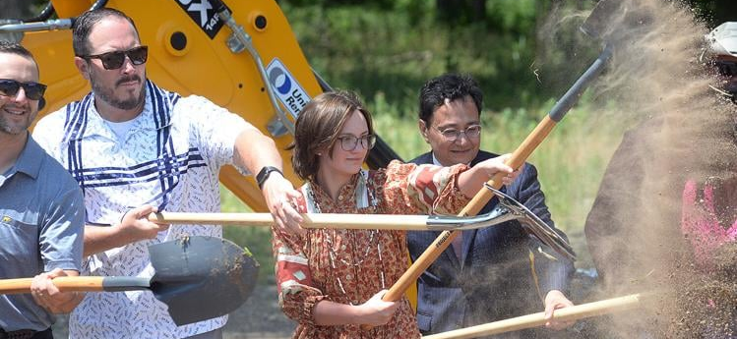
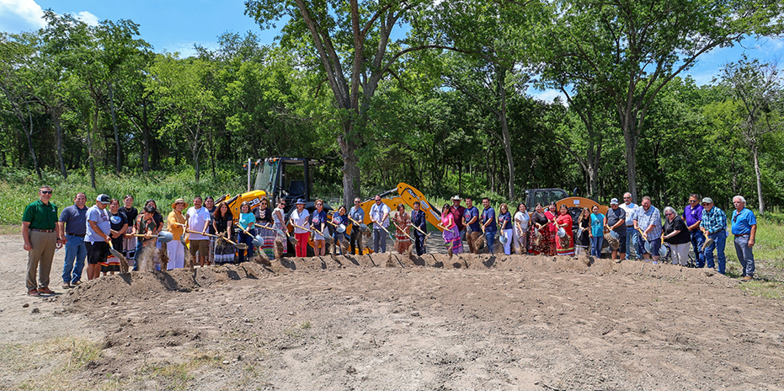
By 2024, four years after the first inspection, groundbreaking began on what would become the
Wilma P. Mankiller Cherokee Capitol Park.

Slide 6
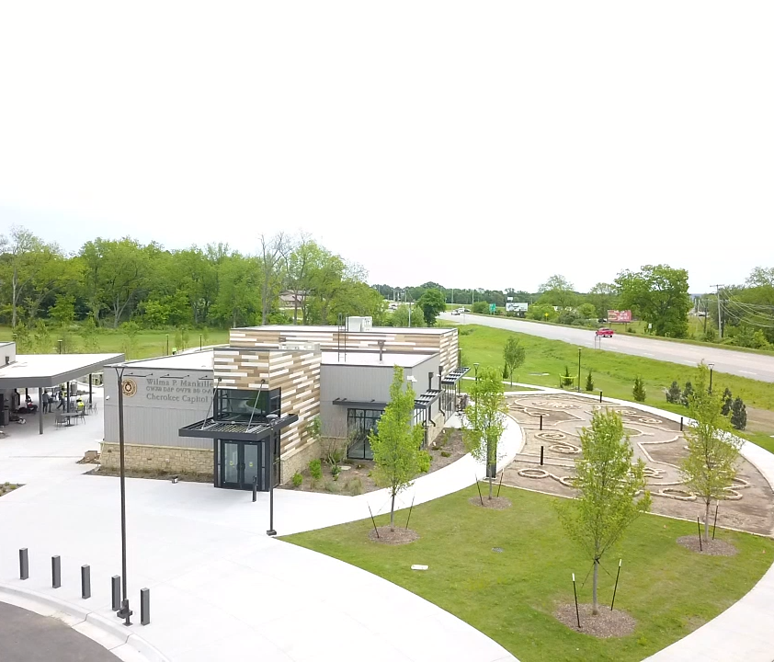
It has taken many hours across many departments...

Slide 7
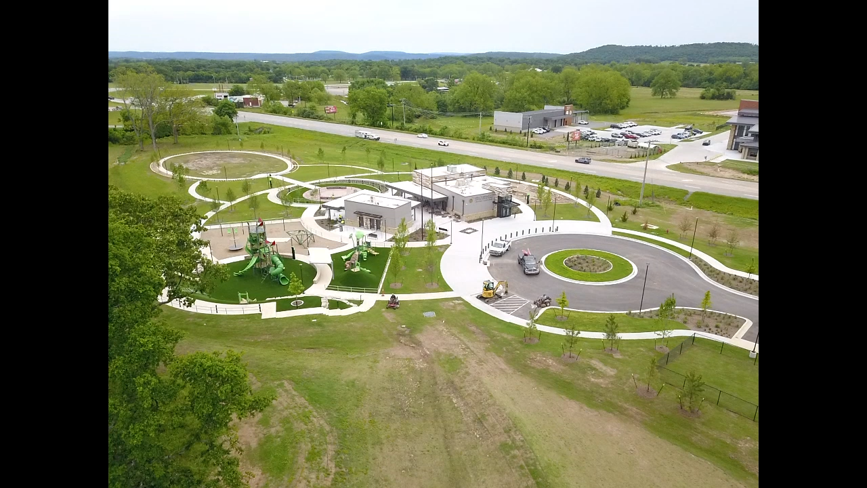
...but we’re almost there!

Slide 8
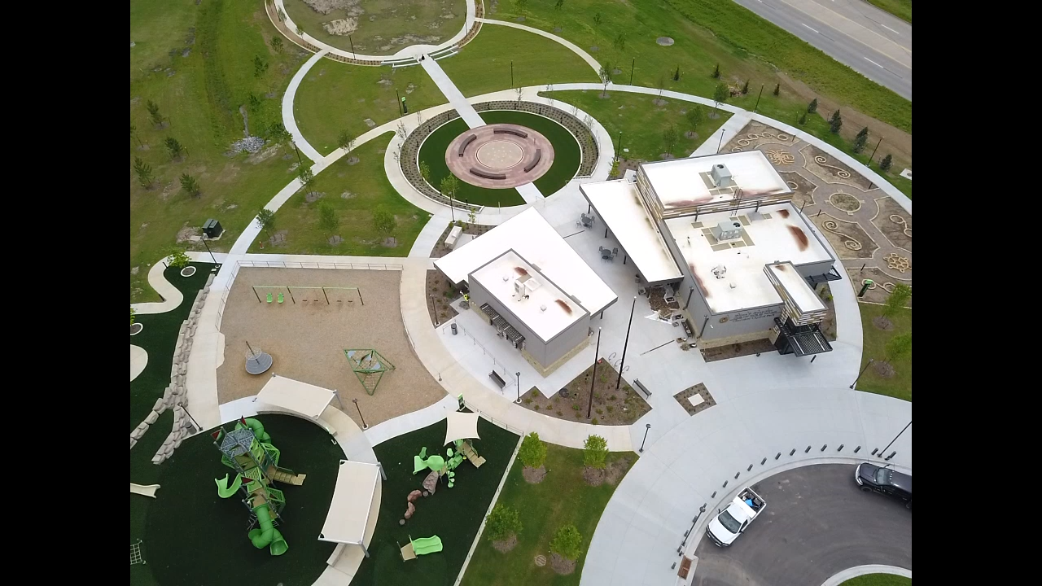
The Dream becomes Reality, May 2026

