Slide 1

ASSESSMENT
Marsha Lay

Slide 2
Agenda
Eligible Sites
Eligible Entities
Assessment Grant Types
Upcoming Competition Timeline
Questions

Slide 3
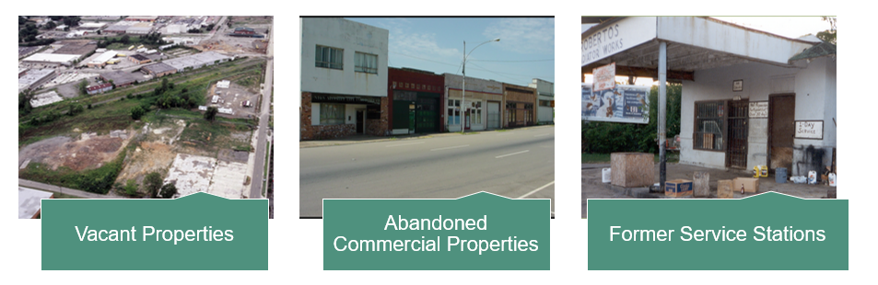
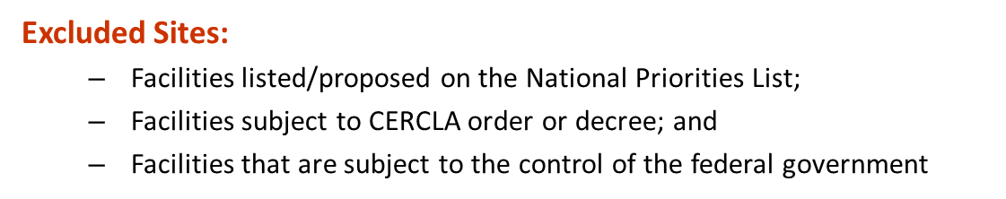
Eligible Sites

Slide 4
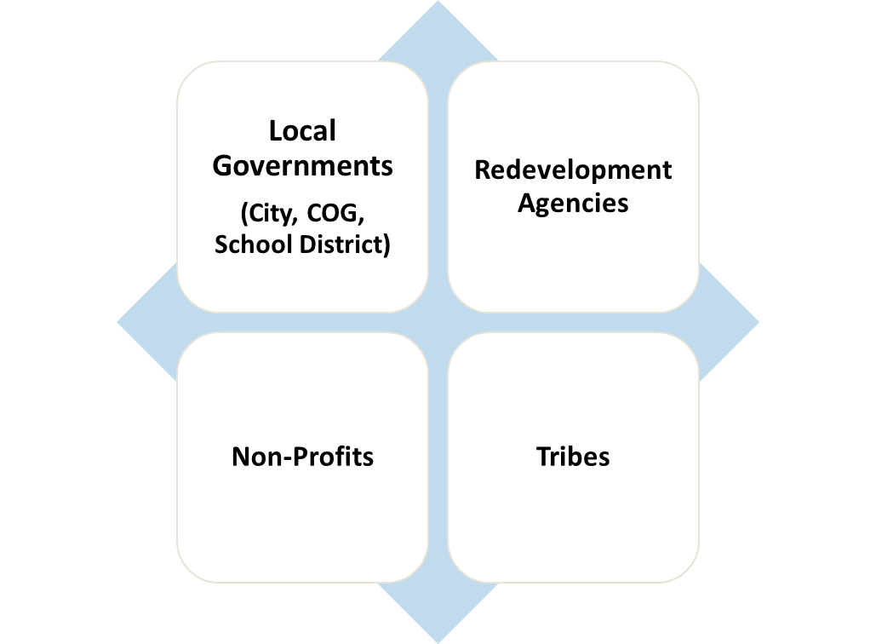


Eligible Entities
Not Eligible for Brownfields Funding:
Potentially
Liable
Parties
4

Slide 5
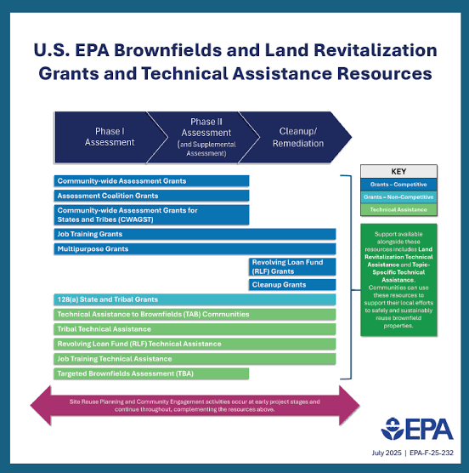
Assessment Grant Types
Community-Wide Assessment (CWA)
Assessment Coalition
Community-Wide Assessment Grant for States and Tribes (CWAGST)
5

Slide 6
What’s the same?
All competitive
Appropriate for communities beginning to address their brownfields challenges and/or have ongoing efforts to bring sites into productive use.
Conduct planning activities
Inventory
Characterize
Assess
Develop site-specific cleanup plans
Conduct community engagement
6

Slide 7
What’s different?
Assessment Coalition:
  Requires:
    2-4 eligible entities
    2 site assessments completed in each coalition members geographic boundary
  Higher award amount than CWA
CWAGST
  Only available to State and Tribal entities
  Less competition

Slide 8
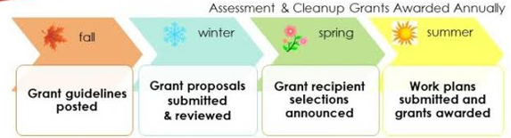
Anticipated Upcoming Timeline

Slide 9
Join us in Dallas!
August 25-27, 2026
Thank you!
Marsha Lay
Lay.Marsha@epa.gov

