Slide 1
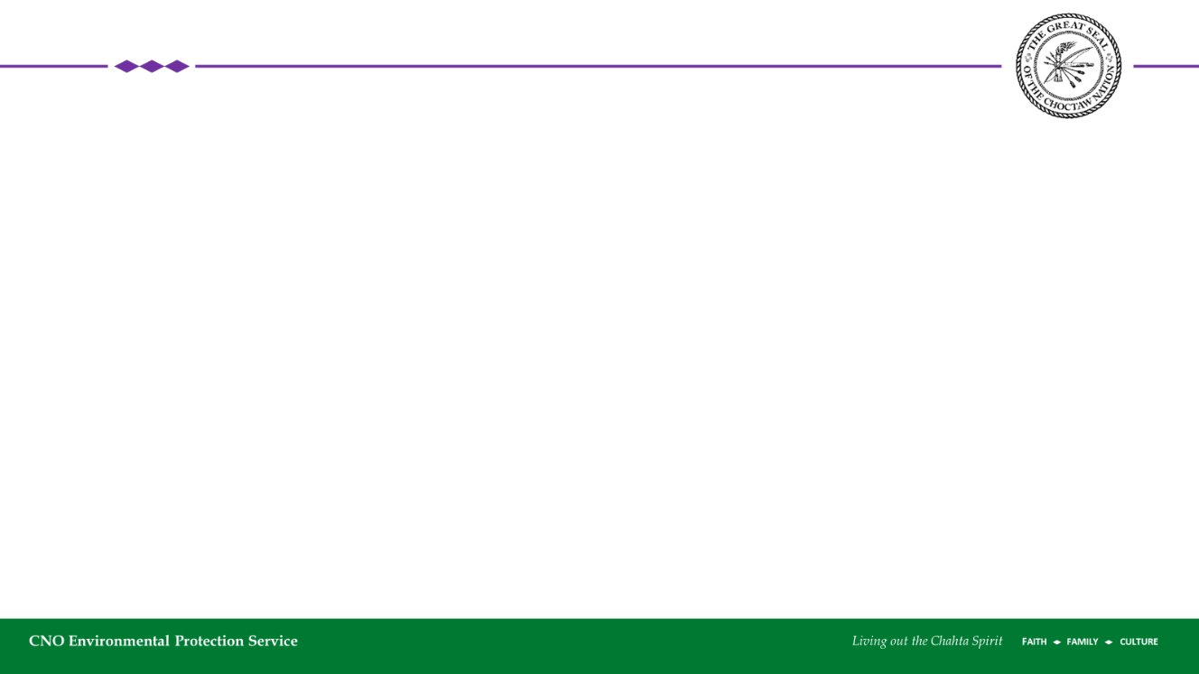
Collaborating with Other Departments & Programs for Greater Success
Stories from Choctaw Nation Brownfields Program

Slide 2
Important Questions...
What's the goal of your 128(a) program?
What is your tribal governing structure?
Who makes decisions that could affect reuse of sites?
Is there a pre-existing framework for you to work with?
What type of sites do you think you will have to address?
  Are there certain contaminants you are looking to address more than others?

Slide 3
Departments @ CNO that we partner with...
Historic Preservation
Cultural Services
Economic Development
Natural Resources
Strategic Development
Business Development
Construction
Geographic Information Systems
Tribal Research
CNO Wildlife Division
Facilities Maintenance
Safety
Land and Title

Slide 4
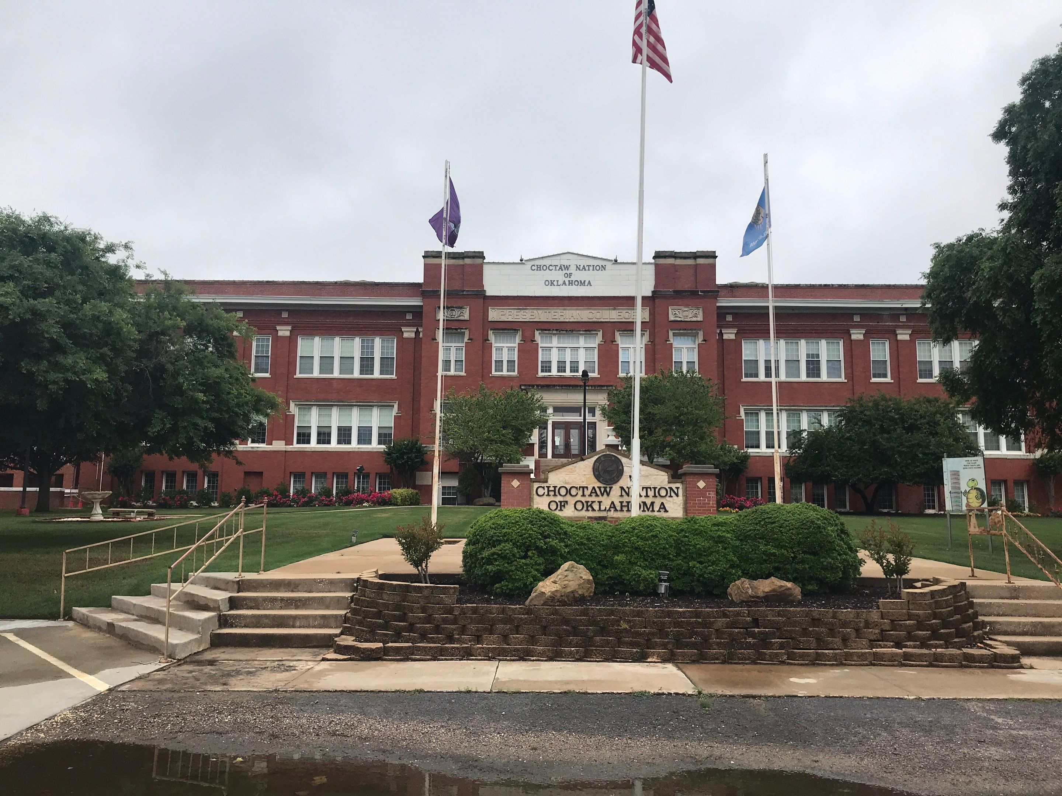
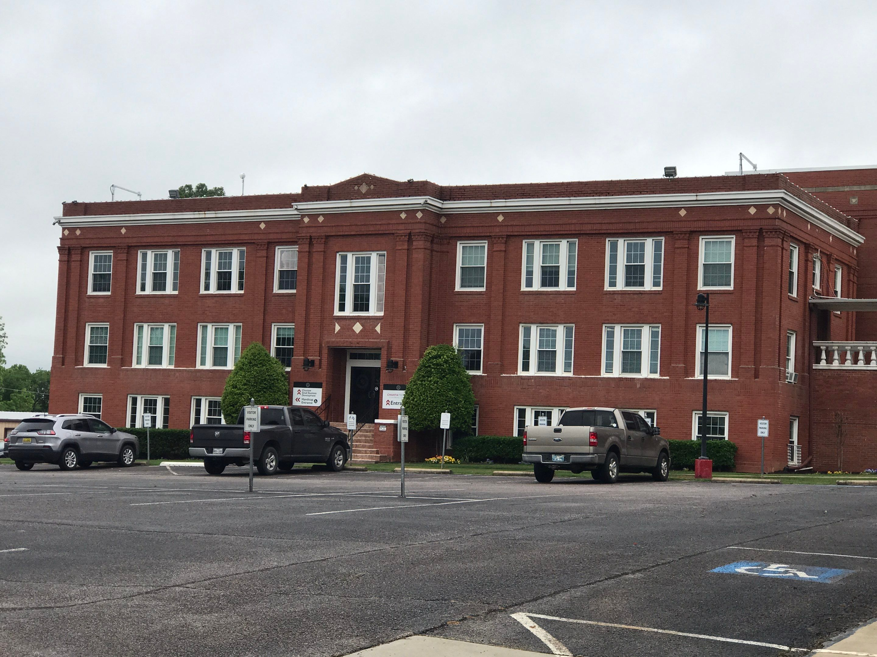
Examples: Old Headquarters
Collaborations: Business Development, Safety, Facilities Maintenance, and Historic Preservation
Justification: Historic Building constructed prior to 1978.

Slide 5
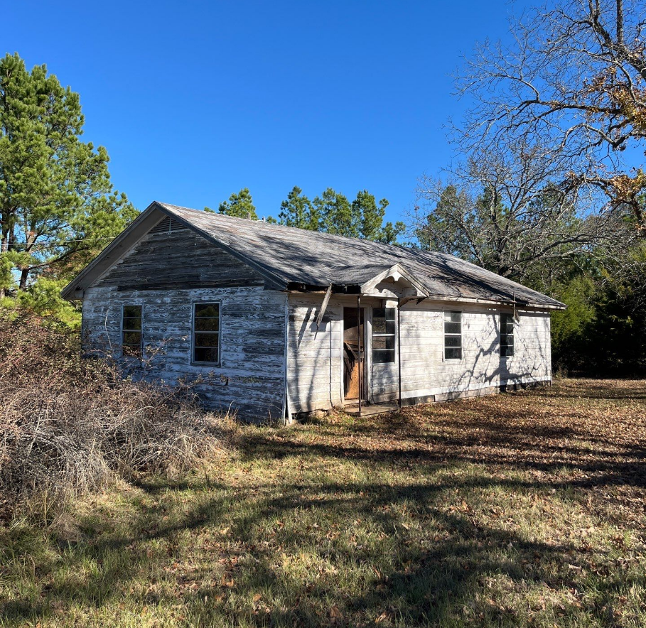
Examples: Homer's Chapel
Collaborations: Historic Preservation, Land and Title, Facilities Maintenance, GIS
Justification: Construction prior to 1978
Culturally significant site

Slide 6
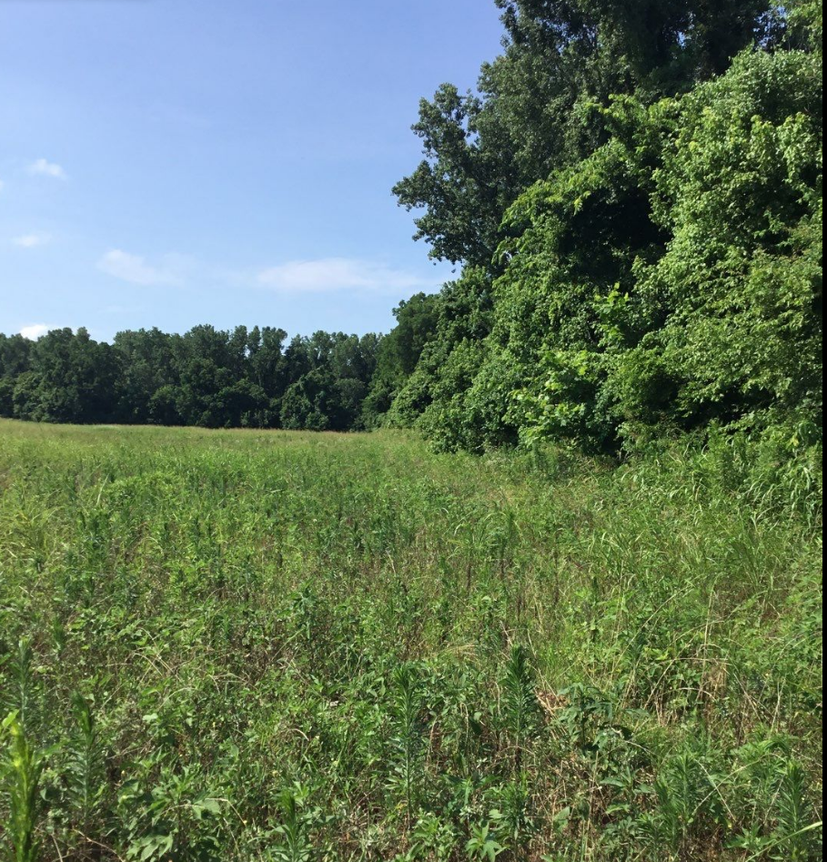
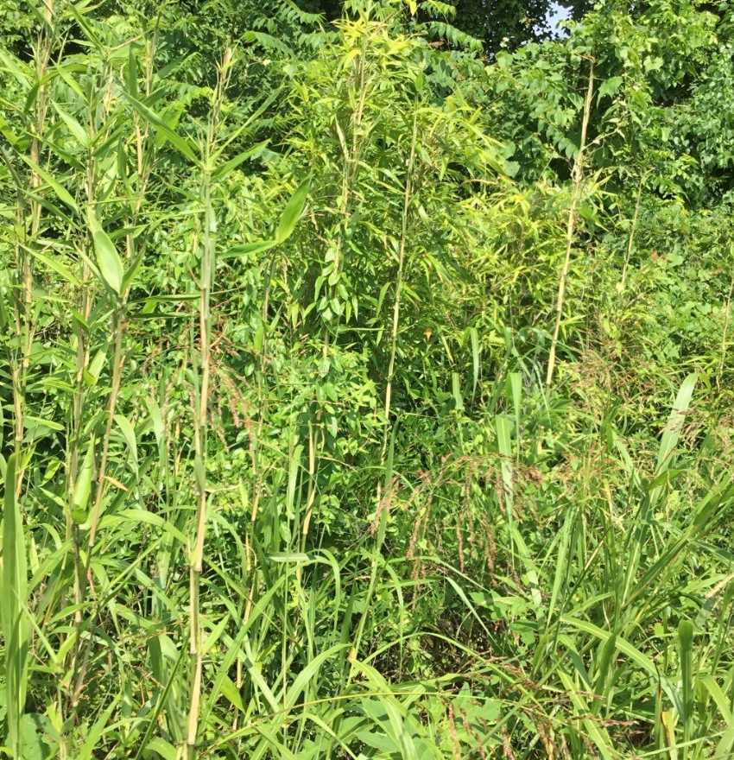
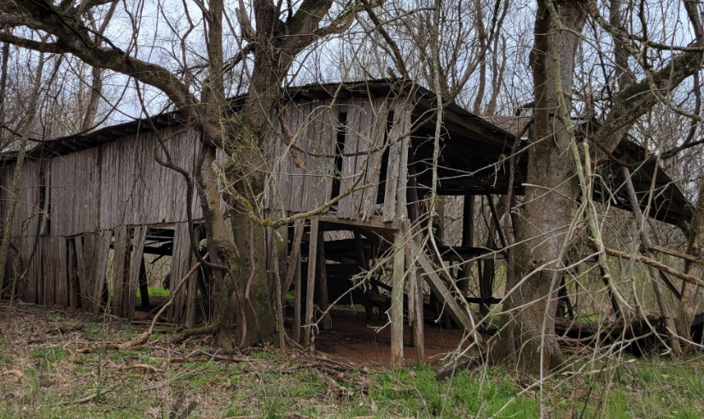
Examples: Tom Marshall
Collaborations: Natural Resources, Historic Preservation, Land and Title
Justification: Culturally Significant Plants, flood zone along Red River, ceased by US Marshall's prior to trust process.

Slide 7
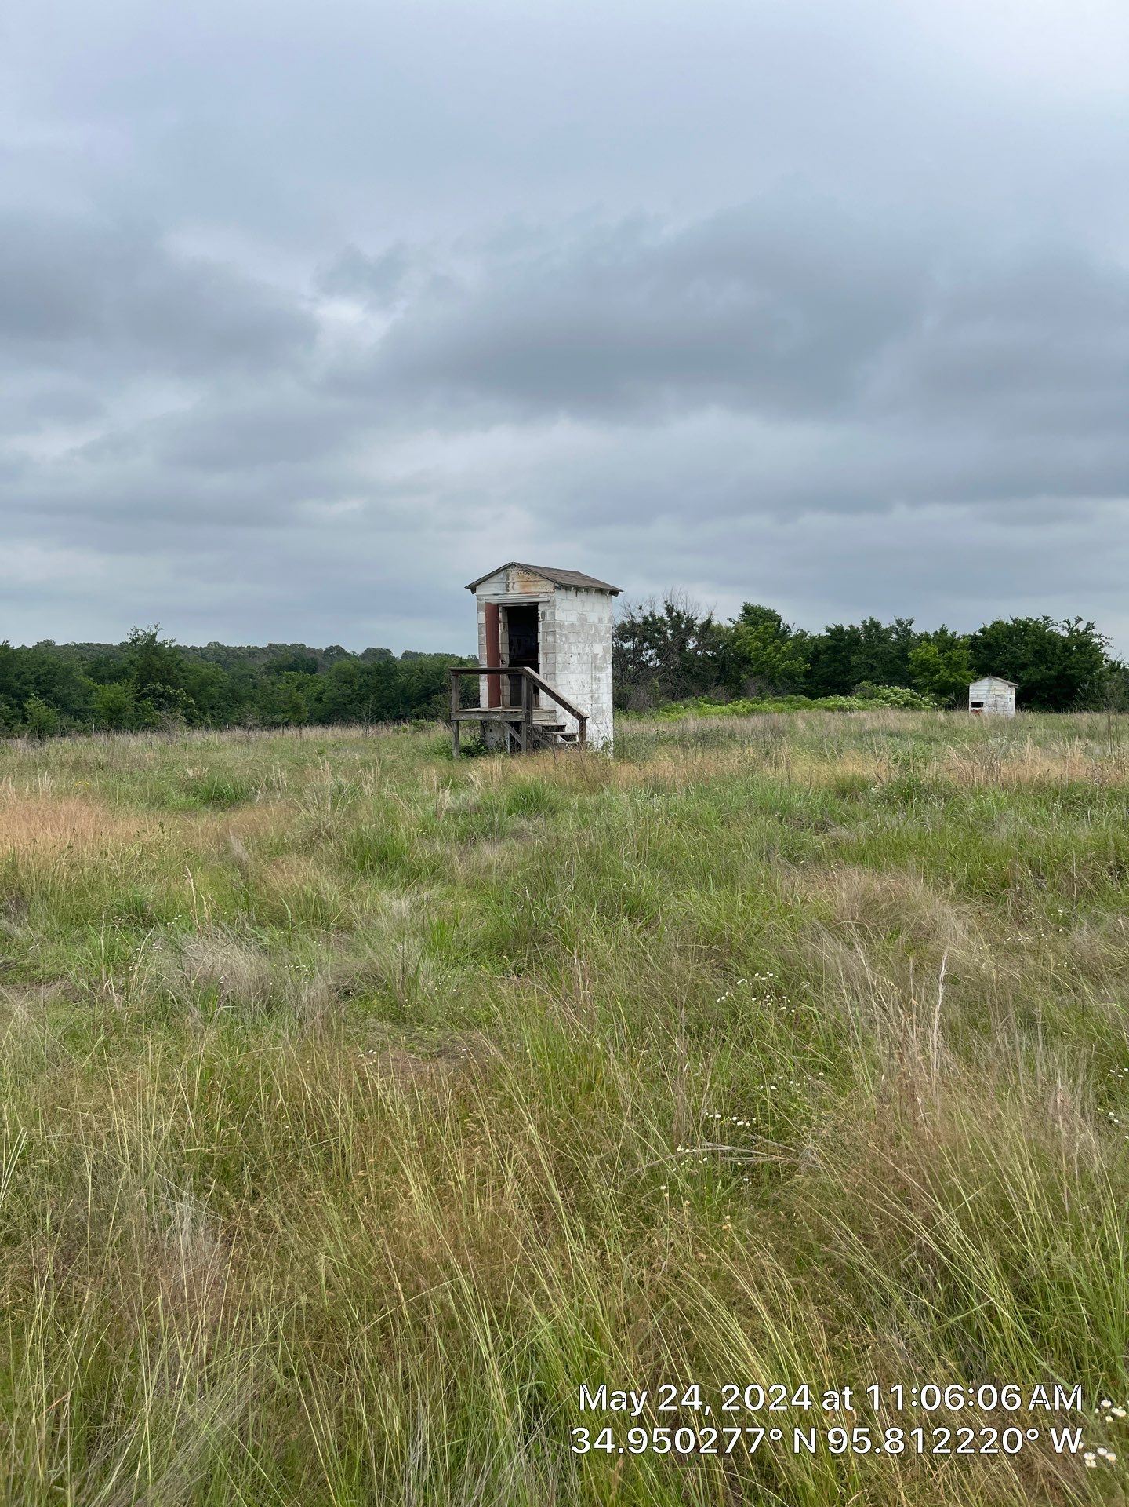
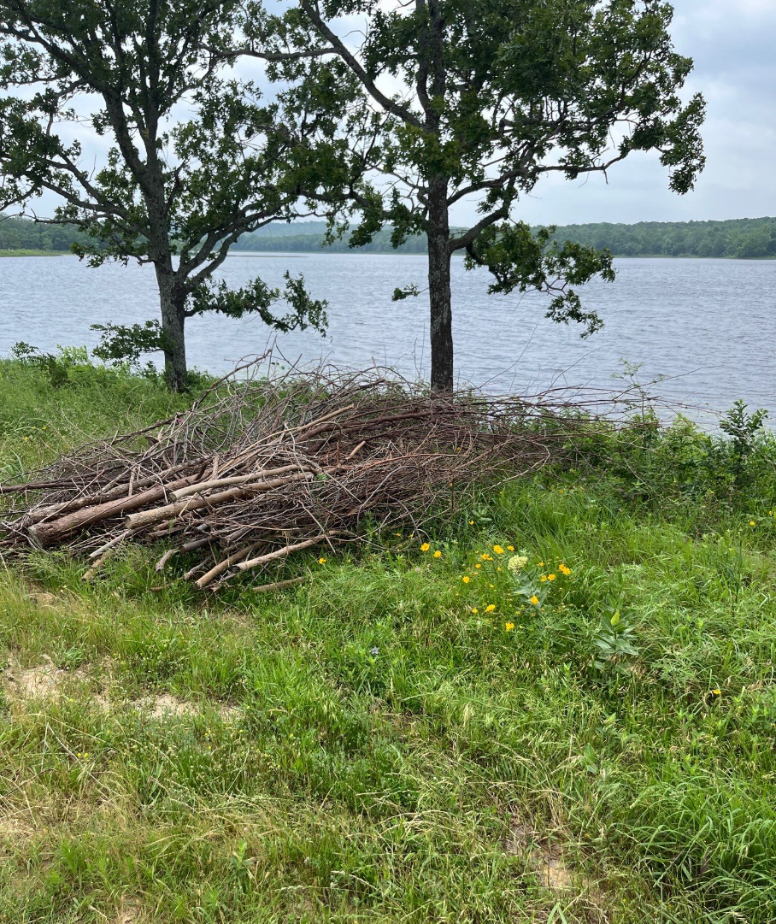
Examples: Talawanda
Collaborations: Natural Resources, Historic Preservation, Cultural Services, Wildlife
Justification: Old shotgun range, screenings showed potential lead issues.

Slide 8
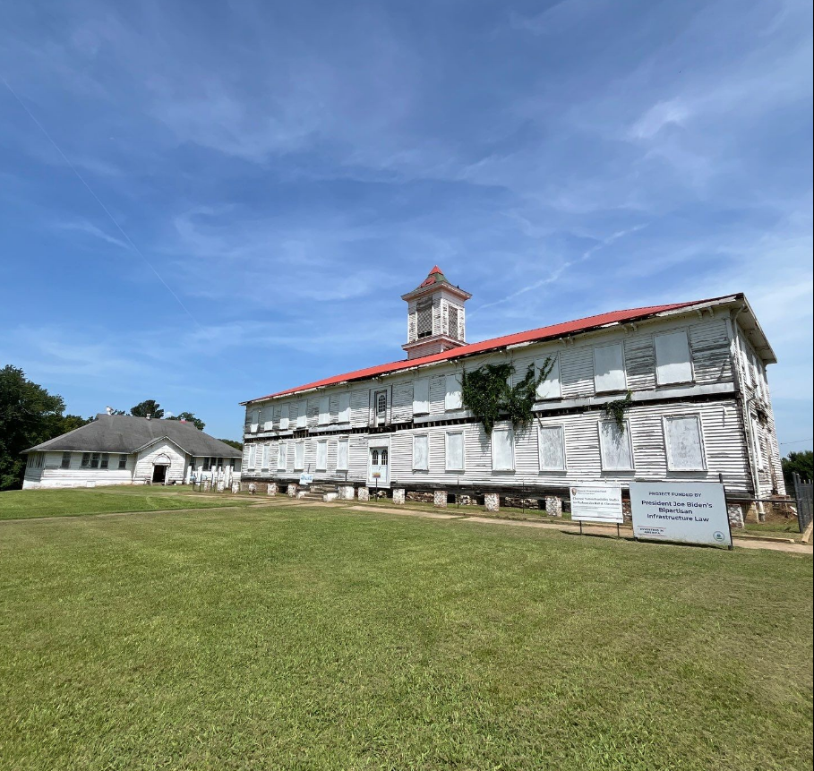
Examples: Wheelock
Collaborations: Historic Preservation, Cultural Services, Safety, Facilities Maintenance, Wheelock Reformation Committee
Justification: Buildings constructed prior to 1978
Culturally significant site

Slide 9
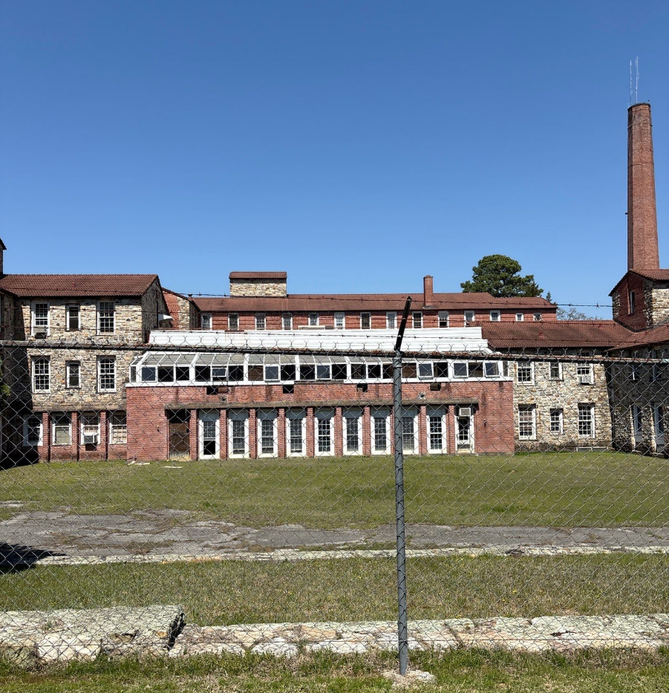
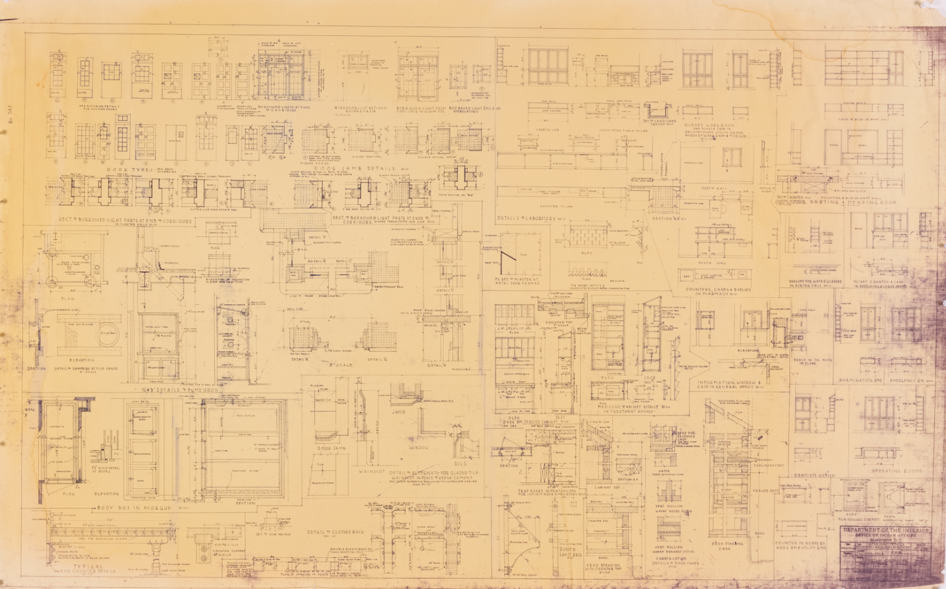
Examples: Old Talihina Indian Hospital
Collaborations: Historic Preservation, Land and Title, Facilities Maintenance
Justification: Constructed prior to 1978, previous reports of ACM and LBP

Slide 10
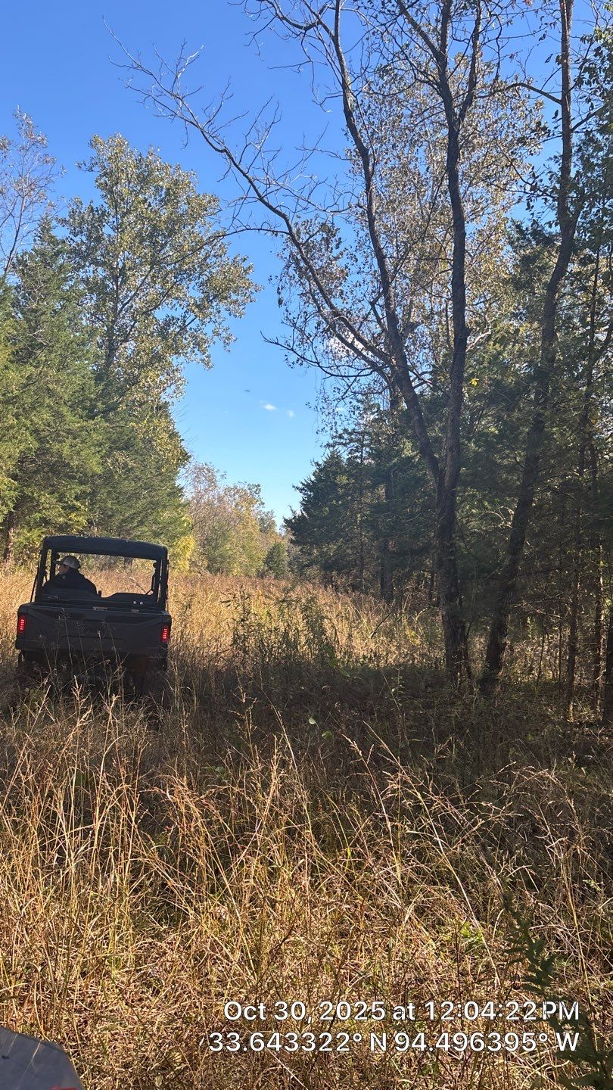
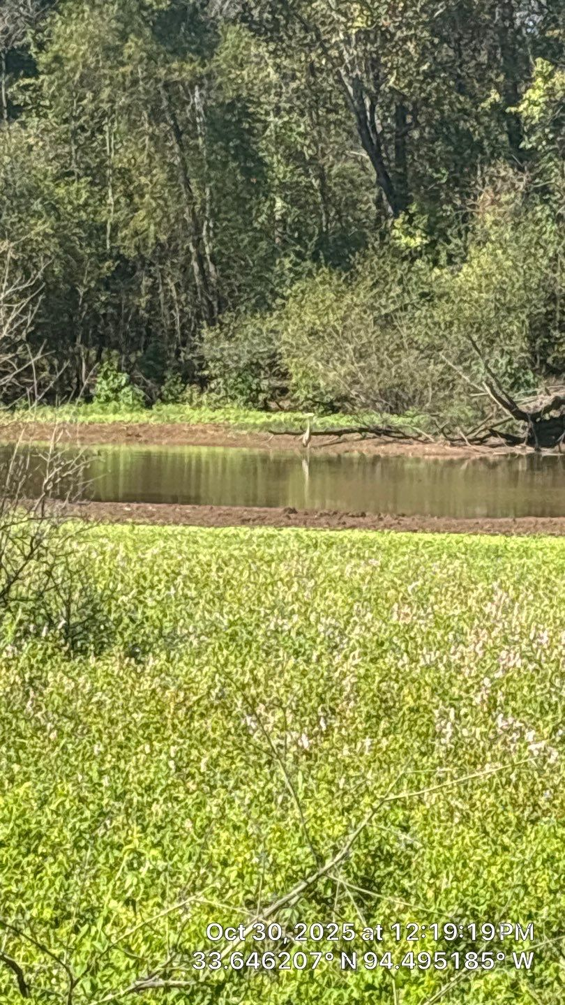
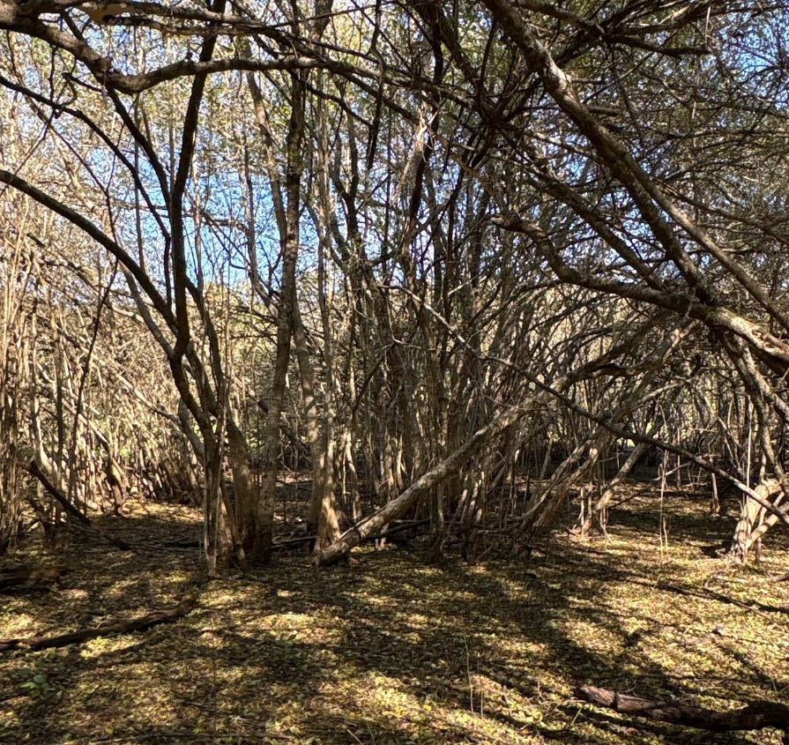
Examples: Border Property
Collaborations: Land and Title, Wildlife Division, Natural Resources
Justification: Flood zone w/ documented releases upstream, land was unleasable as it was. Culturally significant plants present.

Slide 11
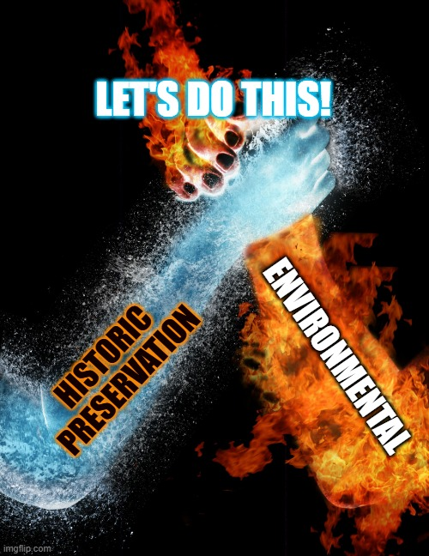
Common Threads
Historic Preservation
  Partnership started in 2020
  Looking for projects
  Site visits to historic properties that could qualify
  Created movement for projects that hadn't been previously prioritized.
    Historic properties like: Wheelock, OTIH, Homer's Chapel
    Culturally significant plants and properties that had them present.
  Led to partnerships with Natural Resources

Slide 12
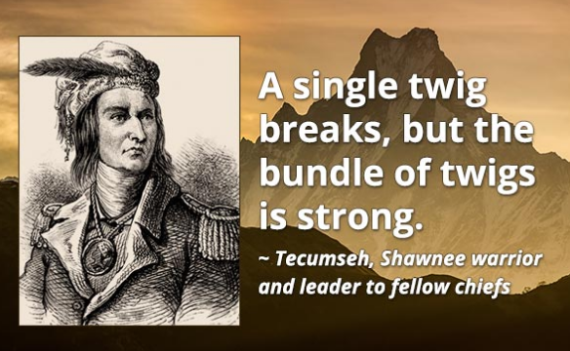
What if my Tribe is small?
See important questions!
Use our experiences and apply to your tribal structure
  Example: If you are looking at combating asbestos in building materials, then maybe you want to partner with construction and economic development?
Could you make a Brownfields Committee?
  Risks:
    Time limits, schedules
    Getting everyone on the same page

Slide 13

Questions?

Slide 14
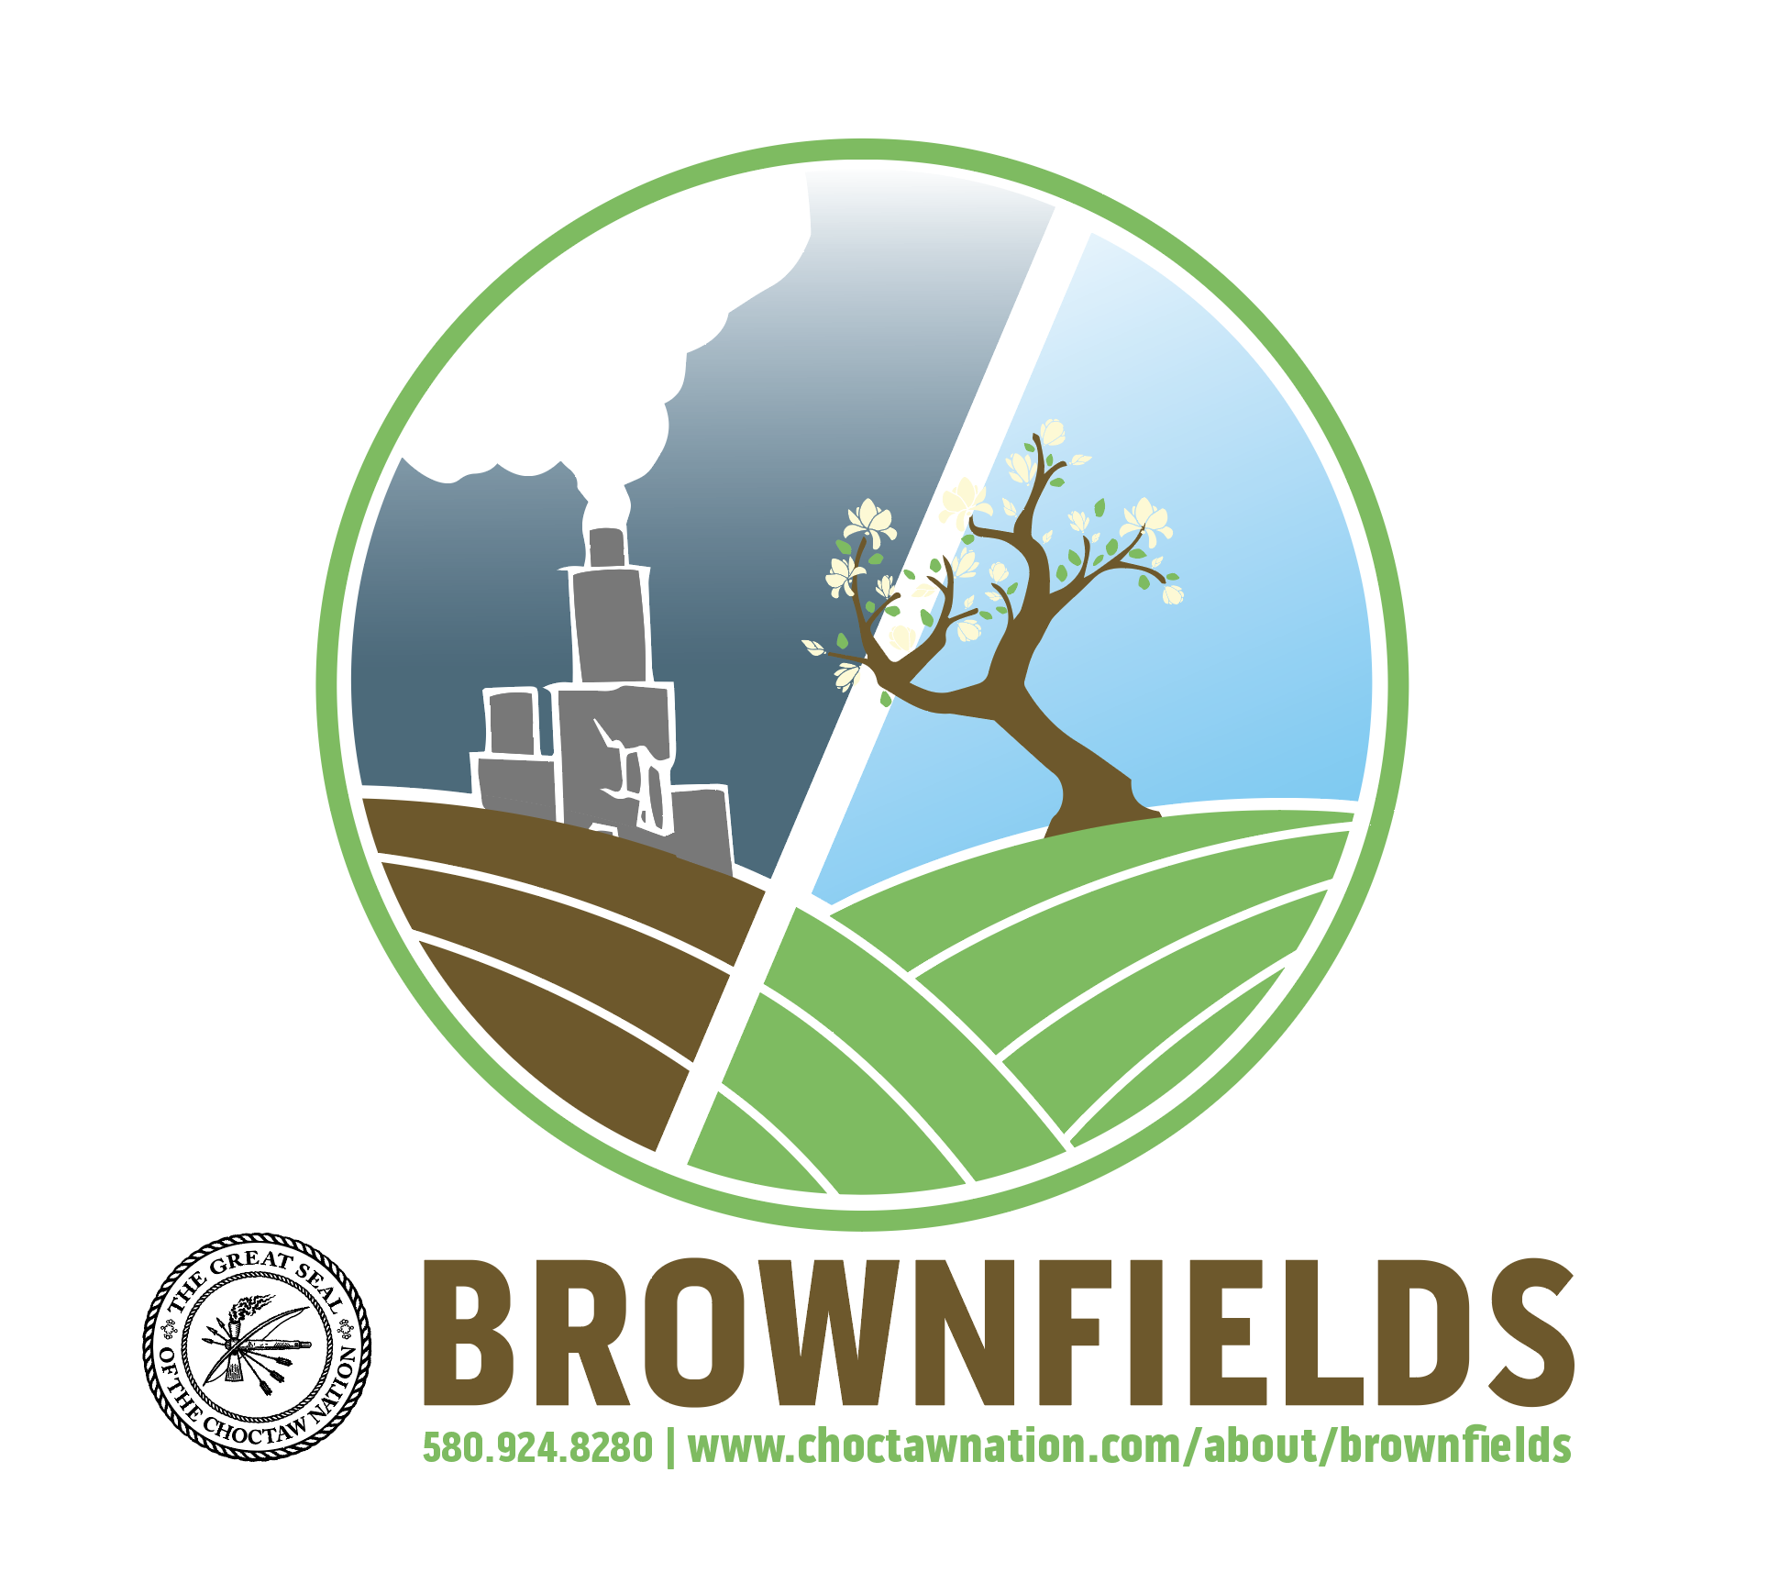
Hvchim Yakokali

